Slide 1
Feature Poster Task
Pick one of the features you have learned about – waterfall, V shape valley, meander, oxbow lake.
Make a poster that explains how that feature is formed – include diagrams and an explanation (highlight any key words/phrases).
These posters will be used for revision and put up on the walls.
20 mins left on this!!!

Slide 2
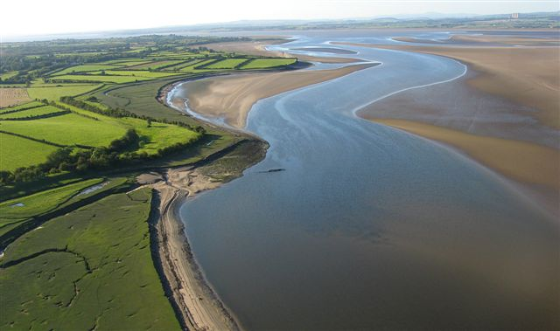
The Lower Course - Levee Formation

Slide 3
Lower Course of a River – What are the key points?

Slide 4
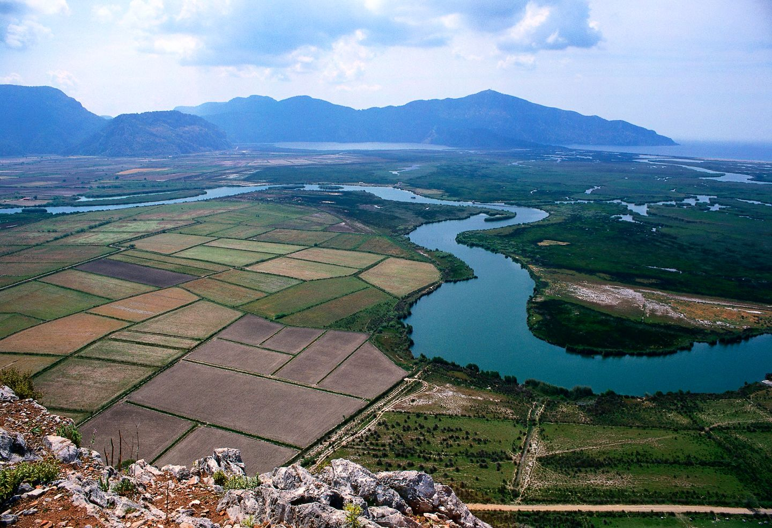
What is a floodplain?

Slide 5
Floodplain
The floodplain is the flat land at either side of the river that gets flooded when the river is in flood.
They are found in the middle and lower stages.
When rivers flood they carry their sediment with them which is deposited on the flood plain. This sediment is called alluvium or silt and is very fertile. This makes the land on floodplains very good for farming (but not for much else!)

Slide 6
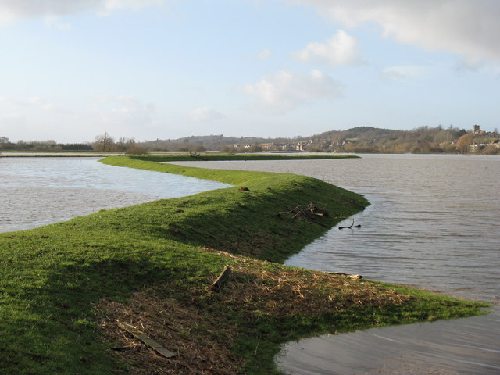
Levee

Slide 7
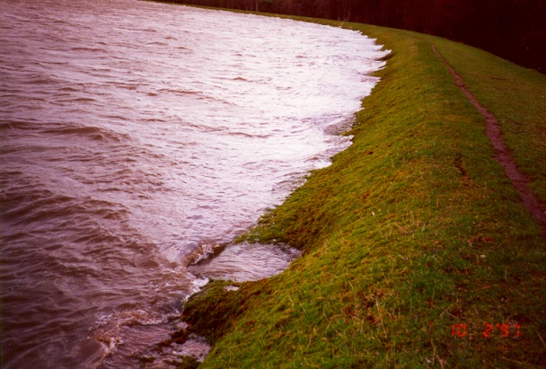
A LEVEE is the name given to the bank of a river that has built up by the river depositing at its sides

Slide 8
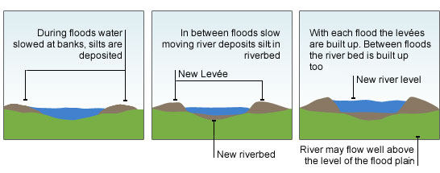
Levees

Slide 9
Explanation
Levees are natural embankments along the side of rivers and are found in the lower course of the river.
Levees are built up during times of flooding.
In times of low flood, any deposition (caused by slow currents) takes place on the bed of the river and this raises the height of the river bed.
In times of flood, the river leaves the channel and due to a lack of energy, heavy material is deposited near the sides of the river to form levees. With each flood the levees are built up.
Finer silt is carried further onto the floodplain, making the floodplain more fertile.

Slide 10
Formations you have learnt
Upper Course:
V Shape Valley
Waterfall
Middle Course:
Meander
Oxbow Lake
Lower Course:
Levee

Slide 11
What formation? Write a sentence for each one.
Shortest Course
Vertical Erosion
River Bed
Soft Rock
Slower Current

