Slide 1
Homework Due: Tuesday 24th October (first day back)
Describe and explain possible changes within the death rate between Stages 1 and 2 of the Demographic Transition Model. (4)
A) Explain possible impacts if a country was to enter Stage 5 of the Demographic Transition Model. (4)
B) Explain possible ways in which these impacts may be controlled. (4)

Slide 2
Homework Due: Tuesday 24th October (first day back)
Describe and explain possible changes within the death rate between Stages 1 and 2 of the Demographic Transition Model. (4)
A) Explain possible impacts if a country was to enter Stage 5 of the Demographic Transition Model. (4)
B) Explain possible ways in which these impacts may be controlled. (4)

Slide 3
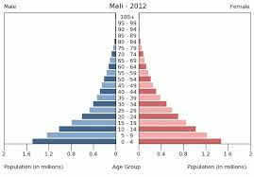
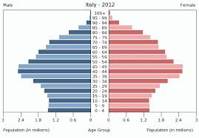
Homework Due: Tuesday 24th October (first day back)
Outcome 1.2 - Describe the differences between the population pyramids of Mali and Italy (3)

Slide 4
Outcome 2.2 (c) – Explain in detail, reasons for a change in birth rates for a developed country (3).
Outcome 2.2 (c) – Explain in detail, reasons why death rates for a developed country may have changed over time (3).
Outcome 2.2 (d) – Explain in detail, reasons for a change in birth rates for a developing country (3).

Slide 5
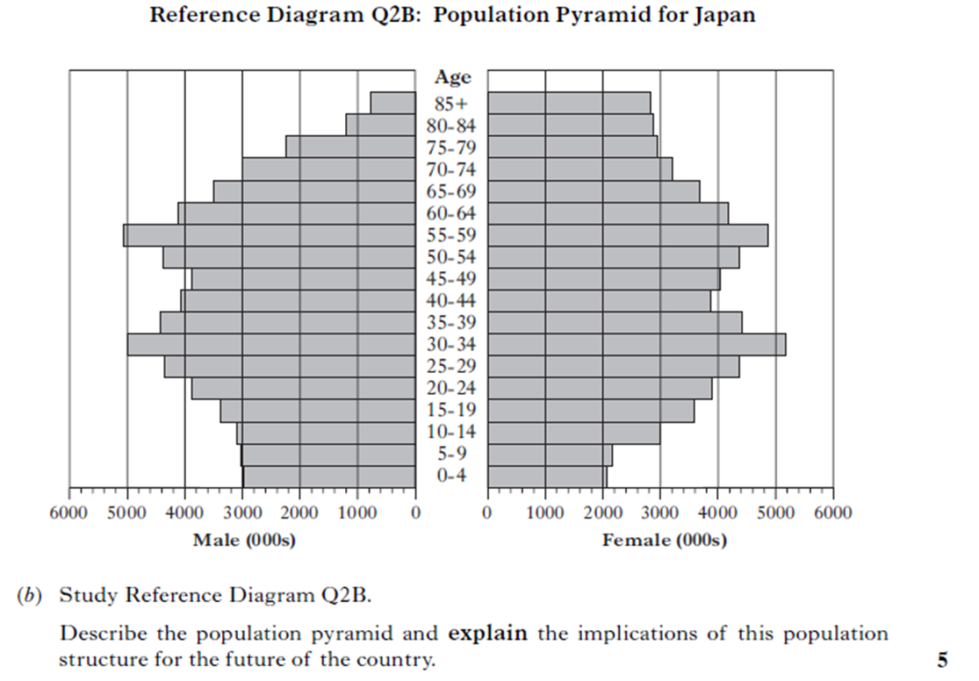

Slide 6
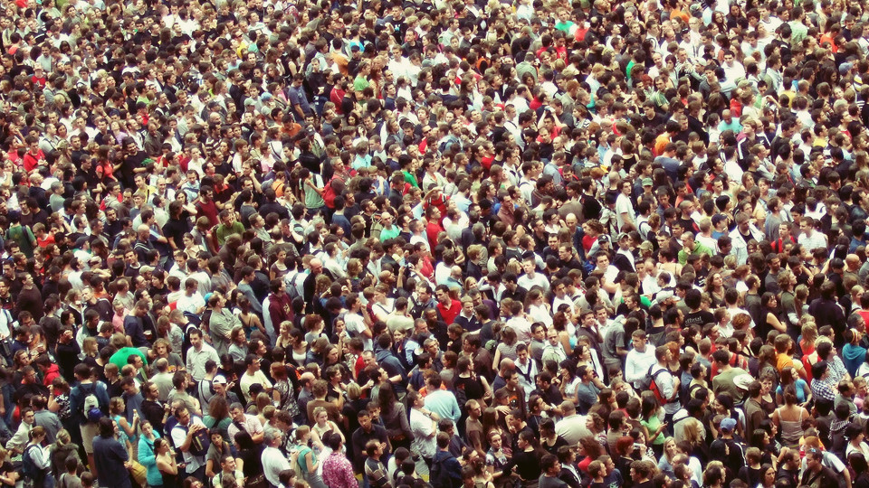

Controlling under/over population

Slide 7
Learning Intentions
I will be able to explain ways in which under/over population can be controlled.
I will be able to explain how the One Child Policy has controlled over population.

Slide 8
How do you think under population could be controlled?
How do you think over population could be controlled?

Slide 9
Find all the reasons…
Everyone in the class has been given a different solution to either under or over population.
You need to actually get up and speak to people to try find all the solutions and put them in correct side – under or over population.

Slide 10
Over Population
Laws limiting family size – One Child Policy in China.
More information given out on how to reduce births – more family planning clinics.
Greater education of females – evidence shows a link between higher female education rates and lower birth rates.
More opportunities for abortion and sterilisation.
Incentives given to limit family size – free health care and better housing opportunities.
Increase the legal marriage age - A UN report has suggested that there would be a significant decline in world population if the legal for marriage is made 20 years.
Work on making ELDCs more developed – example - greater healthcare would mean less infant mortality so less needs for bigger families

Slide 11
Under Population
More paternity to leave to encourage parents to have more children – UK fathers get two weeks paid leave.
More maternity benefits – France offer parents who have three children a year off work and the government pay them 900 euros a month.
Raise retirement age so more taxes paid and less pensions – UK raised retirement age for women to 65 in 2010.
Encourage more women to work so more taxes paid – provision of creches in workplaces.
Allow more immigrants in so more taxes and workers.
Encourage private pension schemes to take strain off providing public pensions.

Slide 12
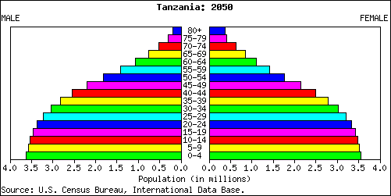
Practice Question
Explain ways in which Tanzania may be able to control future population impacts (4).

Slide 13

Case Study: One Child Policy

Slide 14
Research Task
Create a fact file which answers the following:
When/Why was it introduced?
Any exceptions to the rule?
Explain how they enforce it?
What has the impact been on China’s population?
What is the current story – is it still the One Child Policy?

Slide 15
Why was One Child Policy introduced?
In the 1970s, China’s population was growing rapidly and the problems of over population were becoming apparent.
Previous Chinese governments had encouraged people to have a lot of children to increase the country's workforce.
1950 growth rate of country = 1.9% each year (3% per year causes country population to double in less than 24 years).

Slide 16
Exceptions
Multiple births – twins etc.
Handicapped children.
Child born outwith the country.
Rural families – second chance if first was a female.
Bribes?

Slide 17
What is the One Child policy?
To slow the birth rate/growth of the countries population down, the One Child Policy was introduced in 1979.
The one child policy limited families to having only one child.

Slide 18
How was it enforced?
Benefits for abiding to this included access to education for all, plus childcare and healthcare + priority housing offered to families who followed the rule.
Fined for violations, and the local and national governments created commissions to raise awareness and carry out registration and inspection work – if you didn’t follow rules you could lose job, social shame.
Massive contraception campaigns waged.
Early marriages were discouraged
Food and clothing rations withheld if not following rules.
Abortion is legal and is widely used.

Slide 19
The Granny Police!
The Granny Police are a group of elderly men and women in China whose task is to help enforce China's policies.
They are placed in local communities and are instructed to report all suspicious activities (women looking pregnant).
Give out information regarding family planning, contraception etc – make sure families are using it.

Slide 20
Radical Enforcement
Forced abortions for women who became pregnant another time.
Forced sterilisation policies for persistent offenders.
Female infanticide – deliberate killing of female children.

Slide 21
Impact?
In 2007, 36% of China's population was subject to a strict one-child restriction, with an additional 53% being allowed to have a second child if the first child was a girl.
According to the Chinese government, 400 million births were prevented
1975 = 31 per 1,000 of population birthrate.
2005 = 12 per 1,000 of population birthrate.

Slide 22
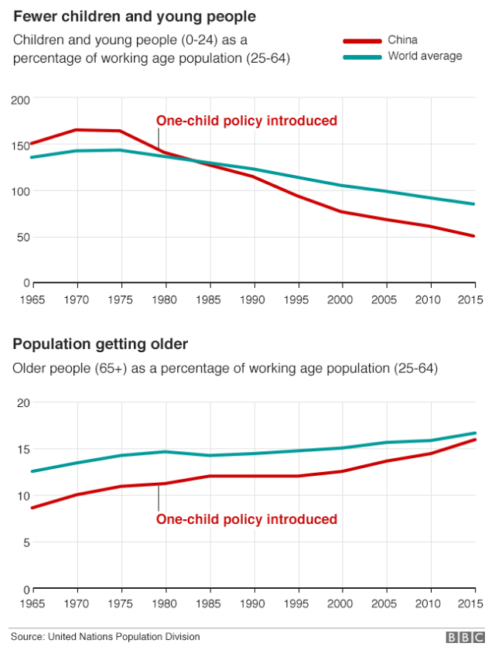

Slide 23
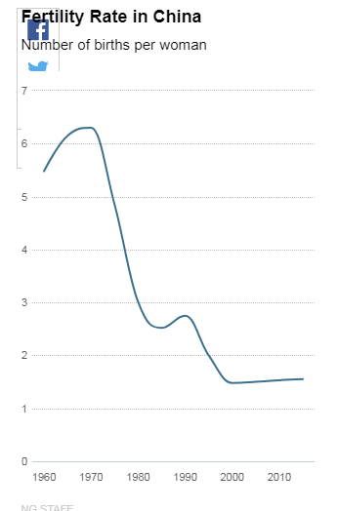

Slide 24
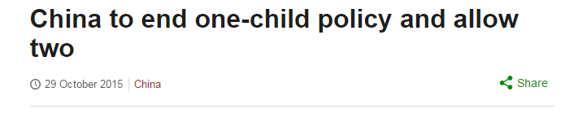
What’s the current story?
Now, with China’s population set to peak in a little more than 10 years, the nation is facing a worker shortage.
Last year the rules were changed to allow all couples to have two children. Trouble is, not many are taking the government up on the offer.

Slide 25
Why don’t people want 2 children?
High living costs, long work hours and surging child-care expenses mean that many couples can only afford to have one child — or none.

Slide 26
Why not remove all limits?
In smaller cities, where couples have been more willing to have second children after the policy change, hospitals and pediatricians have been overwhelmed by the baby boom.
Before allowing even bigger families, officials might need to build up medical and education facilities and work out new tax breaks for families.

Slide 27
What happens without more births?
China’s population will peak at roughly 1.45 billion around 2030. It should then hover at around 1.4 billion until the middle of the century.
Aging Population = China’s National Bureau of Statistics projects that about a quarter of China’s population will be 60 or older by 2030. That’s up from 13.3 percent of the population in 2010. According to United Nations figures, those 60 and older will be nearly one third of the population by 2050.

Slide 28
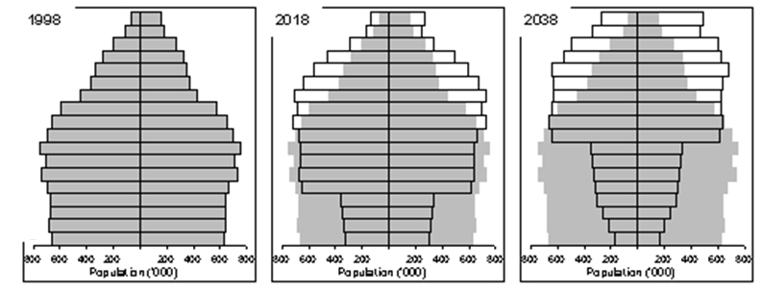
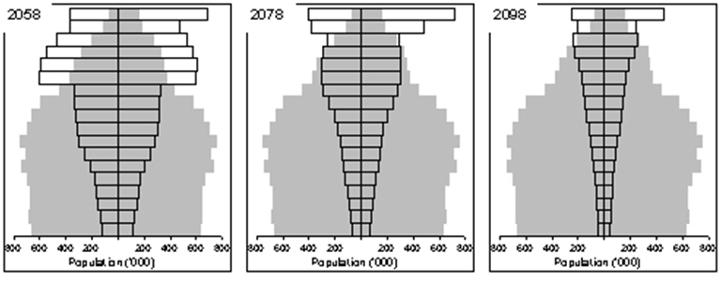
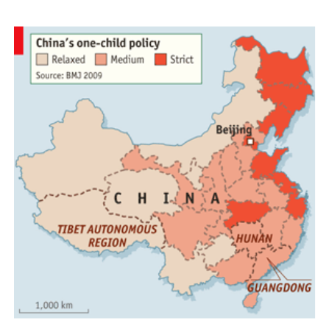
China’s One Child Policy

Slide 29
Advantages and Disadvantages
Colour code the advantages and disadvantages of the One Child policy.

Slide 30
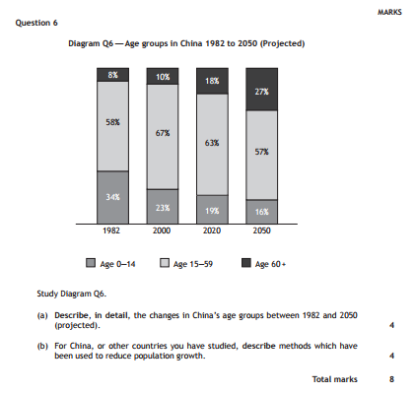

Slide 31
