Slide 1
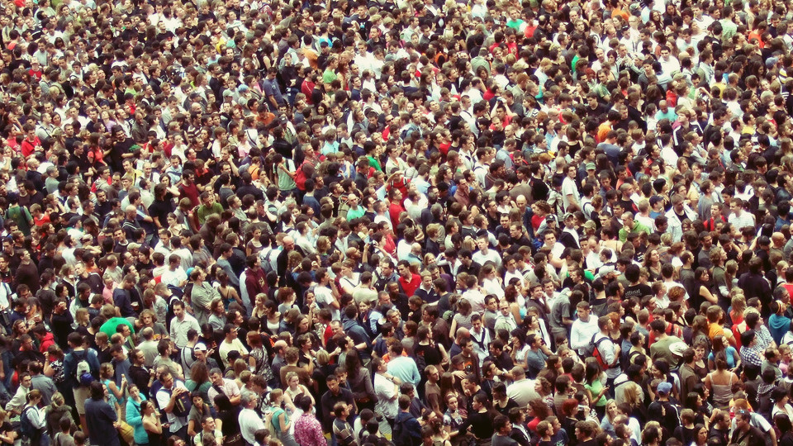

Population Structure Problems

Slide 2
Learning Intentions
I will be able to explain the impact of population structure issues within a country.

Slide 3
What happens if the birth rate falls below the death rate (natural decrease)?
This caused the proposal of the fifth stage of the demographic transition model.
Loss to the overall population as the death rate is becoming higher than the birth rate (natural decrease) – elderly population.
Examples – Germany, Greece, Japan, Portugal, The UK?

Slide 4
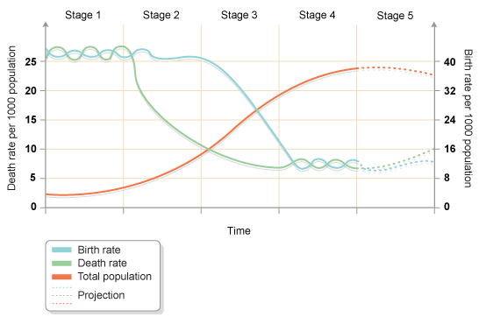
Stage 5 of the DTM
5.Total population is high but going into decline due to an ageing population.
There is a continued desire for smaller families, with people opting to have children later in life.
Natural Decrease

Slide 5
The Two Main Population Structure Problems
Underpopulation = birth rates lower than death rates (life expectancy increasing) = elderly population
Over population = rising birth rate = lots of young people.

Slide 6
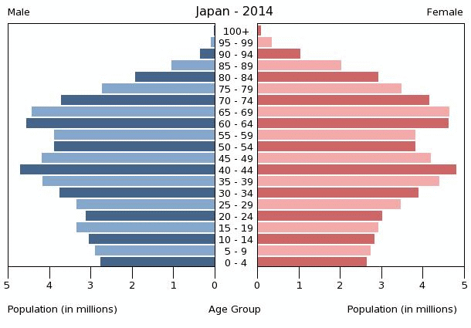

Slide 7
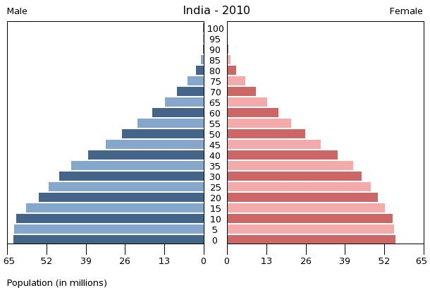

Slide 8
IMPACTS = CAN BE POSITIVE OR NEGATIVE.

Slide 9
Video
Overpopulation –
https://www.youtube.com/watch?v=fNxctzyNxC0&t=408s
Underpopulation -https://www.youtube.com/watch?v=qn9DDsxfpCA&t=171s

Slide 10
What are the impacts of overpopulation/lots of young people?

Slide 11
What are the impacts of underpopulation/lots of elderly?

Slide 12
Task
Using your worksheet – color in whether you think it is an impact of under population (elderly) or over population (youthful).

Slide 13
Answers - Overpopulation
Negative
Not enough food for population → leads to food shortages/famine = inflation of prices, decline in productivity and health and wellbeing due to less energy/more disease.
Not enough accommodation for the population → leads to poor living standards as more people sharing same sized area (slums, over crowding etc).

Slide 14
Answers - Overpopulation
Negative
Urbanisation brings people to the city in search of better life = growth of slums.
Overcrowding in urban areas = disease spreads quickly, poverty and crime increases.
Public services = pressure to meet the demand – health (life expectancy rates decrease), education (literacy rates decrease).

Slide 15
Answers – Under population (STAGE 5 DTM)
Lots of elderly people = expensive care → health, social, accommodation.
Smaller workforce
Less productive
Deters industry from coming as not lots of workers
Less armed forces
Small tax pot → taxes increase
Increasing demand to support elderly

Slide 16
Policy therefore put in to deal with these issues.
Increase retirement age so people work for longer, pay taxes for longer and productivity lasts longer.
Increase in taxation to increase fund to pay for public services needed.
Funding diverted to areas needing it most – Education switched to health (for elderly)
Defence switched to health
Means loss of jobs and number of service.

Slide 17
Policy therefore put in to deal with these issues.
Migration encouraged into the country – more people to fill labour shortages.

Slide 18
Possible Consequences
Protest due to civil unrest as people are angry about cut in services, increase in taxes etc.
Emigration – due to high taxes, cut in services – people leave the country – leading to a brain drain.
Closure of services such as schools could impact on future education of children → future shortage of people qualified to do jobs.

Slide 19
Random Reason!
You will all pick a random word/phrase from me.
Think about how that may be either an impact of underpopulation/overpopulation.
Construct an explain sentence for it.

Slide 20
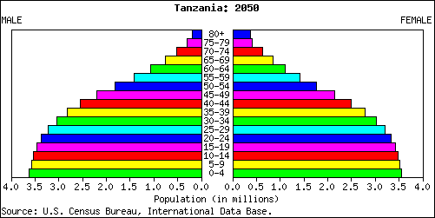
Practice Question
Explain the long term problems which may be caused by Tanzania’s population structure (5).

