Slide 1
What do you need to know?
Formations: limestone pavement, potholes/swallow holes, caverns, stalactites and stalagmites, intermittent drainage.
Mapwork
Case Study of Yorkshire Dales
Land use in a limestone landscape.
Conflicts and solutions within this landscape – forestry, industry etc.

Slide 2

Wheel of Fortune!
Without jotters, explain the formation of…..
https://www.classtools.net/random-name-picker/70_3E2M72

Slide 3
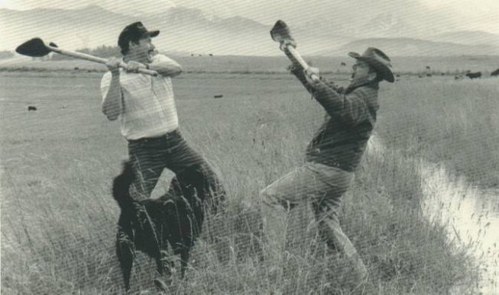
Land Use Conflicts – Who falls out?
Due to the area having so many different land users, there are many conflicts between such land users

Slide 4


Family Fortunes
X
Mr Smith surveyed 100 people and asked them to give someone who may be involved in a conflict in the YDNP.
X
Position | Word | Score
1
2
3
4
5
Tourists
43
Quarries
27
Farmers
14
X
Locals
11
A yob
5
1
2
3
4
5
X
X
X

Slide 5
Management of the Yorkshire Dales
The National Park Authority – an official body
Dales became an NP in 1954
Its planning board can refuse planning permission for new quarries but can not close them down once they are open!
They can however buy the land of them to stop them spoiling anymore of the landscape. An example is Ribblesdale where land was bought to protect the limestone pavement.
The board can insist that quarries screen their sites with fast growing trees to reduce visual, air and noise pollution.
Quarries MUST restore the quarry once finished with it – grow trees, turn it into a lake, infill quarry to allow the land to be enjoyed.

Slide 6
The role of voluntary
bodies – the Yorkshire Dales Society
Society that promotes the conservation of the Dales landscape and the people who live in it
It brings the problems to peoples attention through its magazine, lectures and walks it organises.
They suggest recommendations to problems – eg sending the rocks away by rail rather than by road.
It promotes sustainable development – it encourages alternative jobs in new industries which are not environmentally damaging (quarrying)

Slide 7
The role of voluntary
bodies – the National Trust
Can buy land and buildings
Helps maintain drystone walls and footpaths
Does work to educate and protect important wildlife habitats
Involved in planning to make sure land is used for the greatest long term benefits.

Slide 8
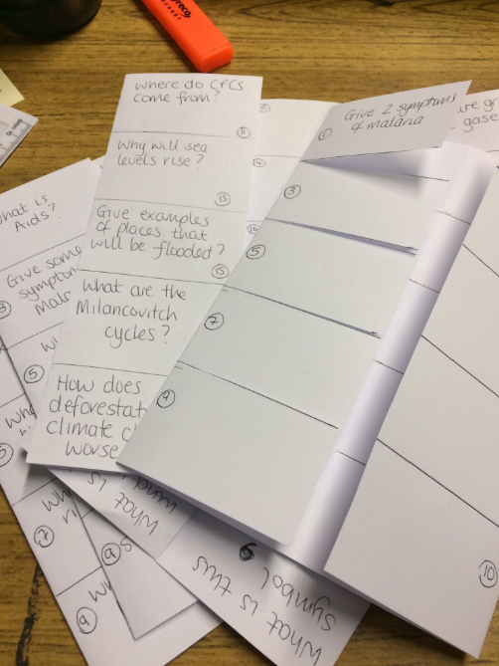
Conflict and Solutions -Foldables
Write a conflict question or solution question on one side.
Answer on other.
Examples
“Farmers v Tourist Conflict”
“Farmers v Tourists Solution”
“Quarries v Locals Conflicts”
OR Problem on one side → Solution on other (“Litter” → what they are doing?”)

Slide 9
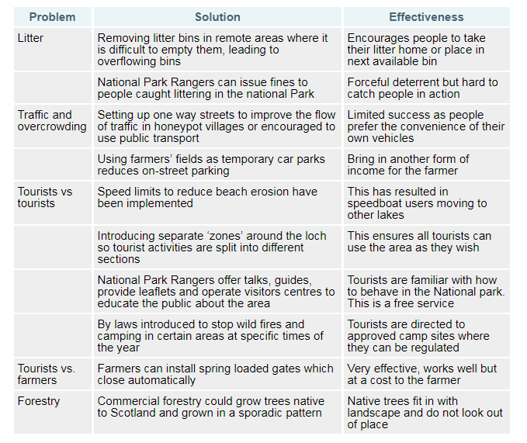

Slide 10
For a named area you have studied, explain in detail, ways in which two different land uses (from the list) may be in conflict with each other (4):
Industry
Recreation and Tourism
Farming
Forestry
Water Storage and Supply
Renewable Energy

