Slide 1
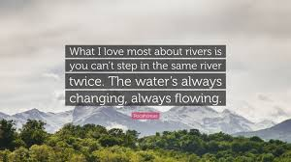
Welcome Back!

Slide 2
Give me three....
Name three features of the upper course. | Name three ways the river erodes. | Explain these three ways (give definitions).
Name three features of the middle course. | Name three ways the river transports. | Explain these three ways (give definitions).
Name three features of the lower course. | Name three reasons why the river deposits. | Name what processes you would expect to find at each stage (upper, middle, lower).
1 point for each | 2 points for each | 3 points for each

Slide 3
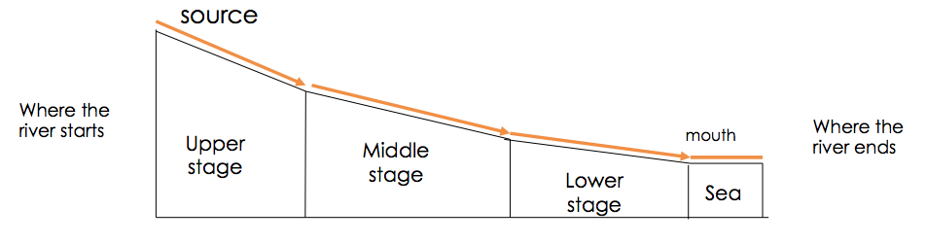
The Long Profile of a River

Slide 4
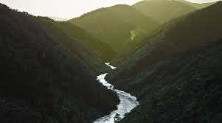
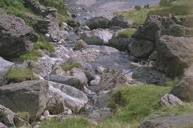
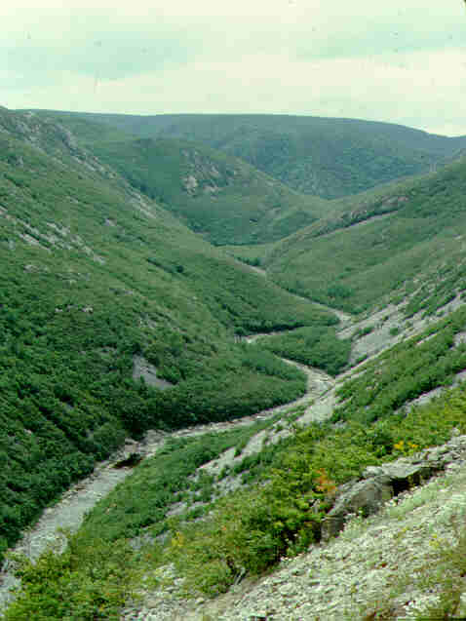
Upper Course

Slide 5
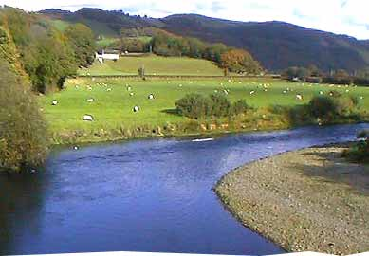
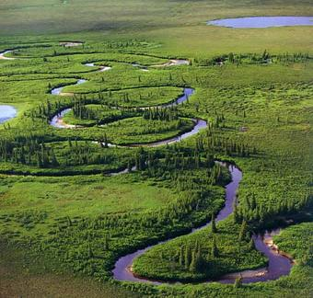
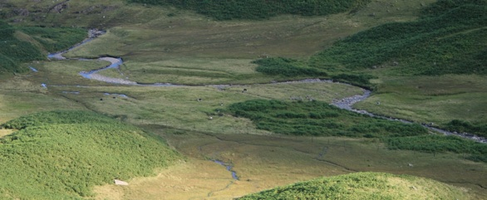
Middle Course

Slide 6
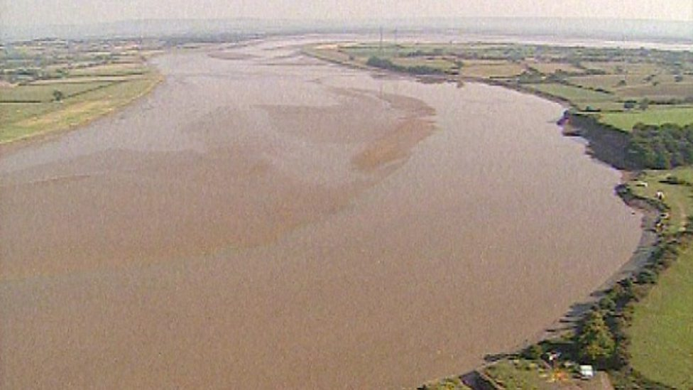
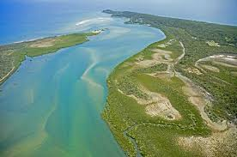
Lower Course

Slide 7
Different Features
V Shape Valley
Waterfall
Meander
Ox Bow Lake
River Beach/River Cliff
Floodplain

Slide 8
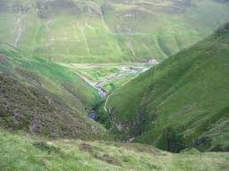

Slide 9
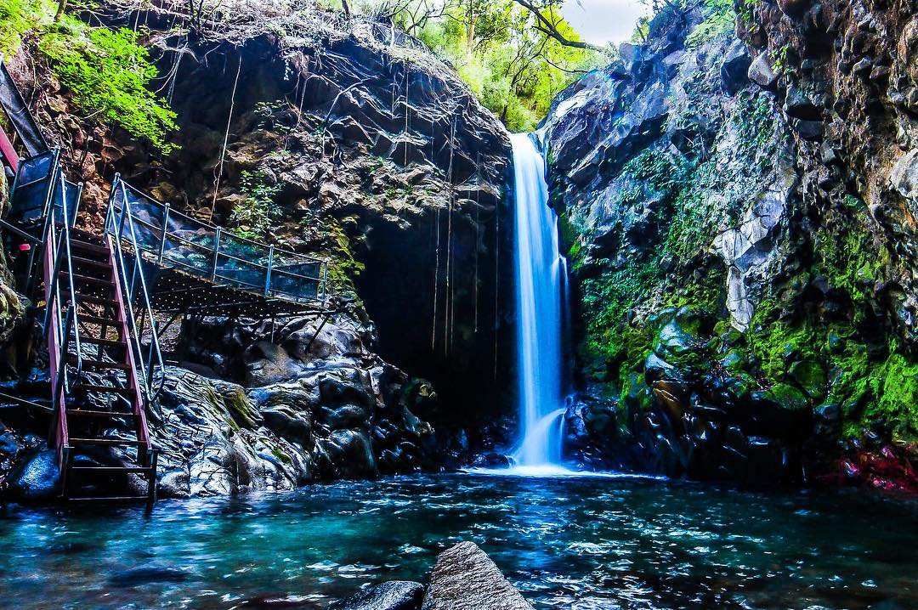

Slide 10
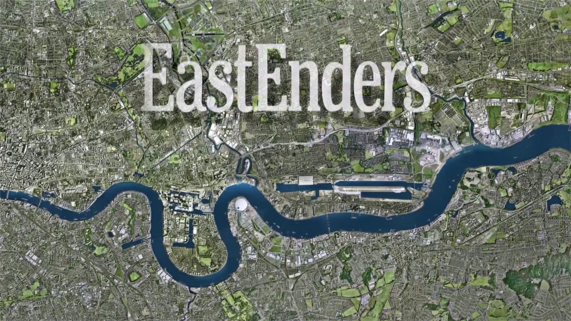

Slide 11
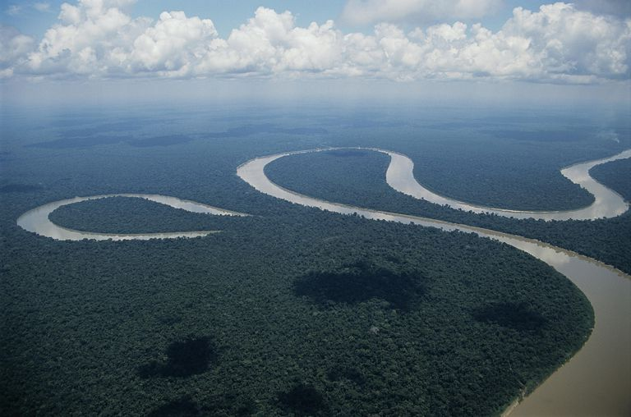

Slide 12
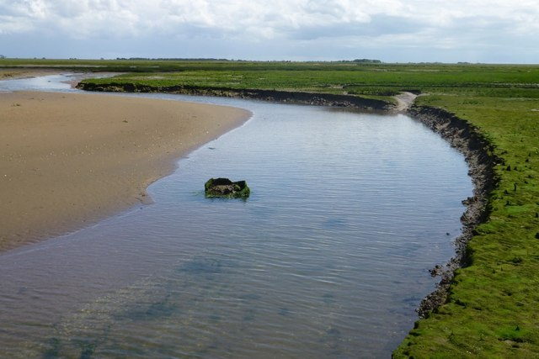

Slide 13
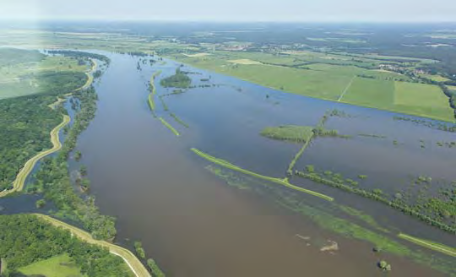

Slide 14
Characteristics | Upper Course | Middle Course | Lower Course
Slope | Steep | Getting flatter | Flat
Width | Narrow | Getting wider | Widest
Depth | Shallow | Getting deeper | Deepest
Load | Sharp angular pebbles | More rounded pebbles | Small pebbles, sand and silt
Features | Waterfall, V Shape Valley | Oxbow, Meander,Floodplain, River Cliff/Beach | SAME AS BEFORE + Levees, deltas
Main work/processes | Vertical Erosion and Transportation | Lateral Erosion, Transportation and some deposition | Mainly deposit, transportation.

Slide 15
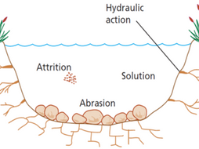
River Processes

Slide 16
What does erosion mean?

Slide 17
What does erosion involve?
Erosion take place in four different ways:
1. Hydraulic action is the force of just the water in the river wearing away
the land.
2. Abrasion is the force of the water plus the load (rocks etc) that the river is
carrying, wearing away the land.
3. Attrition is the material that the river is carrying, breaking each other down in
the river
4. Solution is the acid in the river water, dissolving the rock and wearing it down.

Slide 18
How does a river transport materials?

Slide 19
Transportation
Transportation take place in three different ways:
1. Traction is the bigger load rolling along the bottom of the river.
2. Saltation is the smaller material bouncing along the bottom of the river.
3. Suspension is fine material, floating inside the river, being carried by the water.
4.Solution is when some minerals dissolve in the water and are always present.

Slide 20
Why might a river deposit its load?

Slide 21
What does deposition involve?
A river choses to deposit its load for the following three reasons:
The material that it is carrying is too heavy.
The river has lost power/speed/energy and no longer can move the
material (heaviest material deposited first)
3. The river doesn’t have enough water to move the material

Slide 22
River Formations
What you need to know?
To draw diagrams and explain the formation of river features:
Upper Course: Waterfall and V Shape Valley.
Middle Course: Meander and Oxbow Lake.
Lower Course: Levee

Slide 23
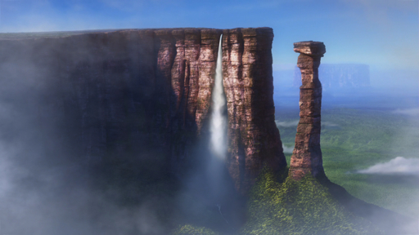
Upper Course – Waterfall Formation

Slide 24
The Upper Course Formations
For the upper course you are expected to be able to describe its characteristics, identify on a map and explain formations:
Waterfalls
V Shape Valley

Slide 25
A Nice Waterfall Video!
https://www.youtube.com/watch?v=PTgil3lympU

Slide 26
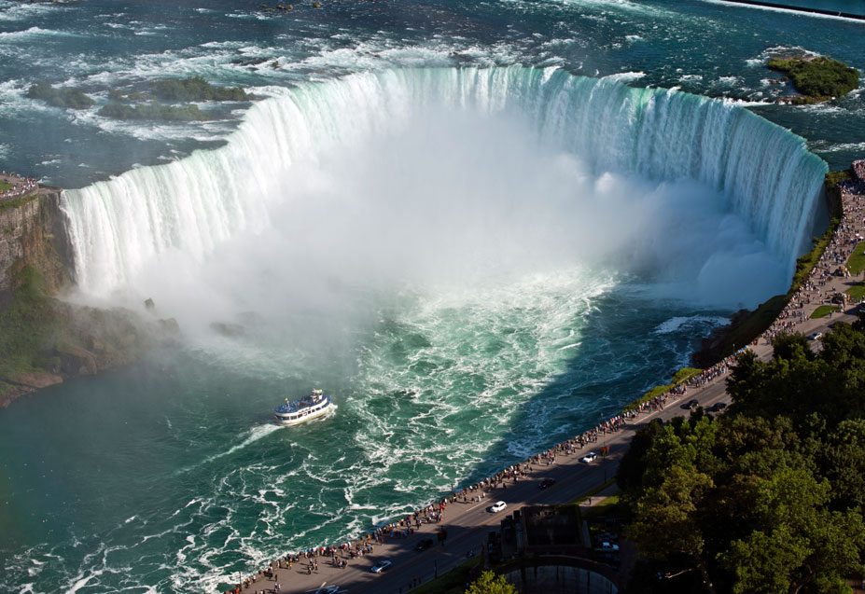
Niagara Falls

Slide 27
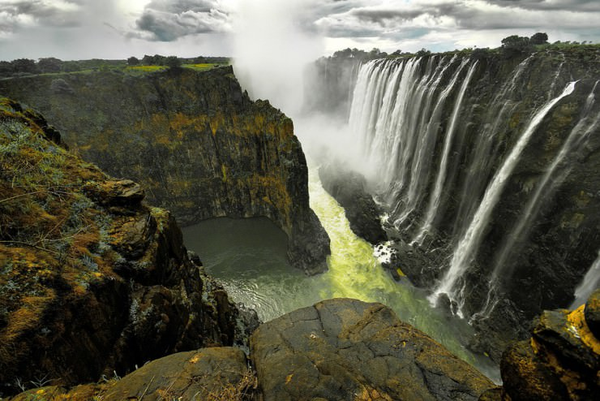
Victoria Falls, Zimbabwe

Slide 28
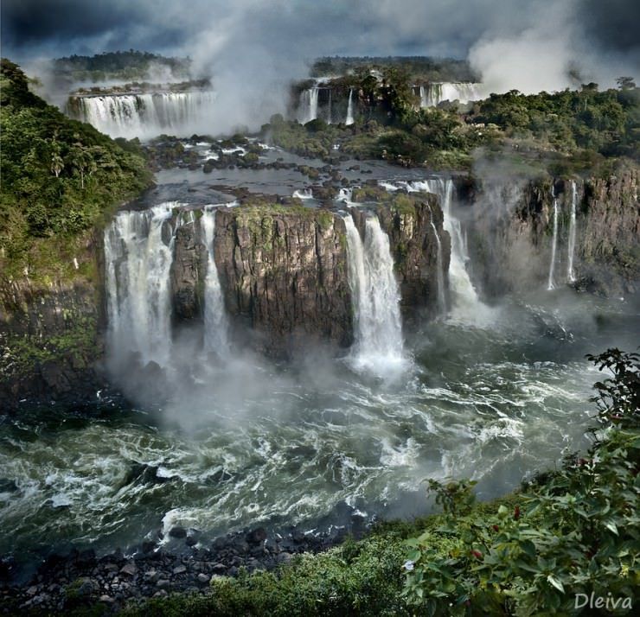
Iguazu Falls, Argentina

Slide 29
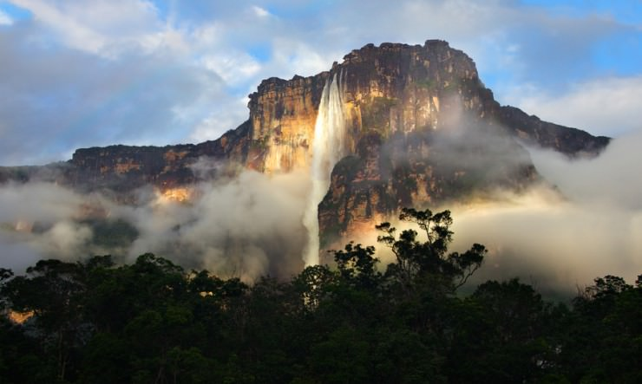
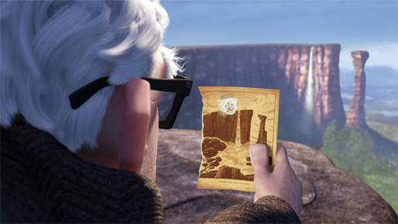
Angel Falls, Venezuela

Slide 30
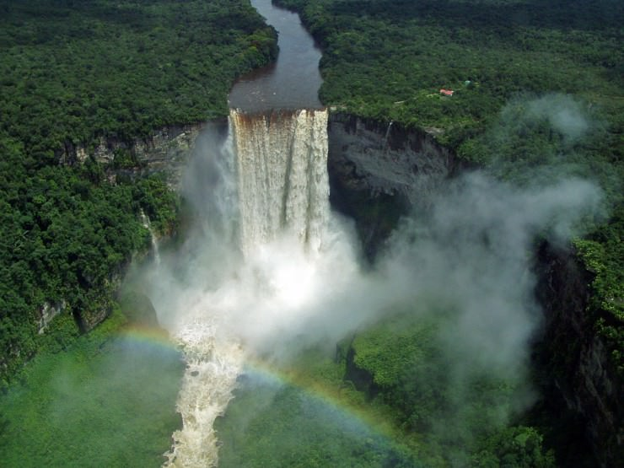
Kaieteur Falls, Guyana

Slide 31
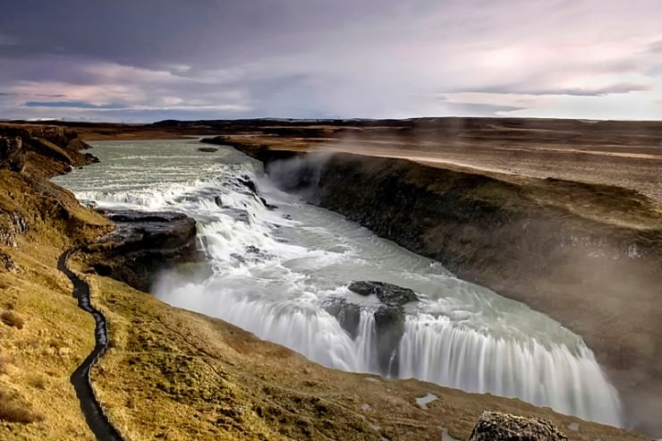
Gullfoss, Iceland

Slide 32
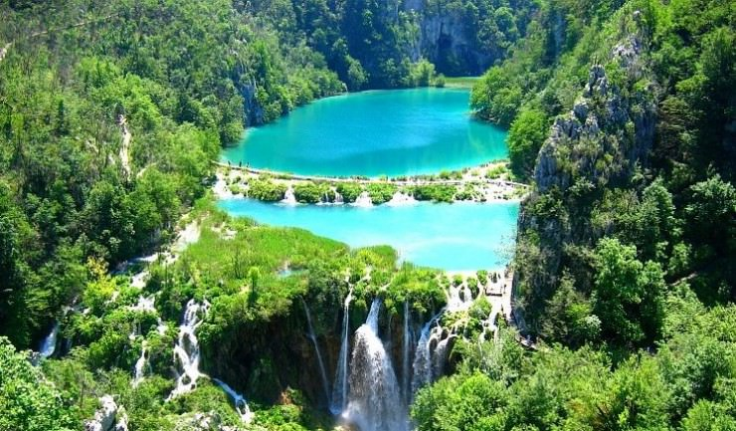
Plitvice Falls, Croatia

Slide 33
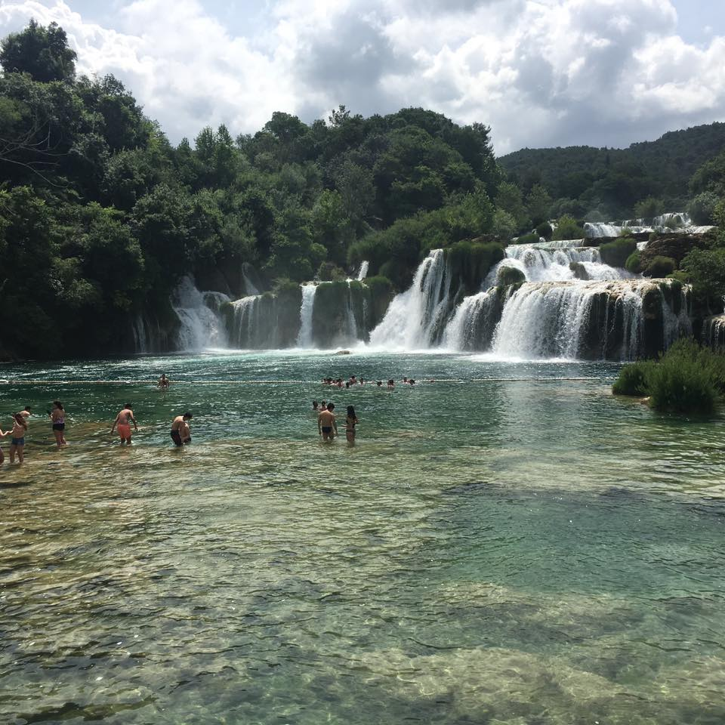
Krka Falls, Croatia

Slide 34
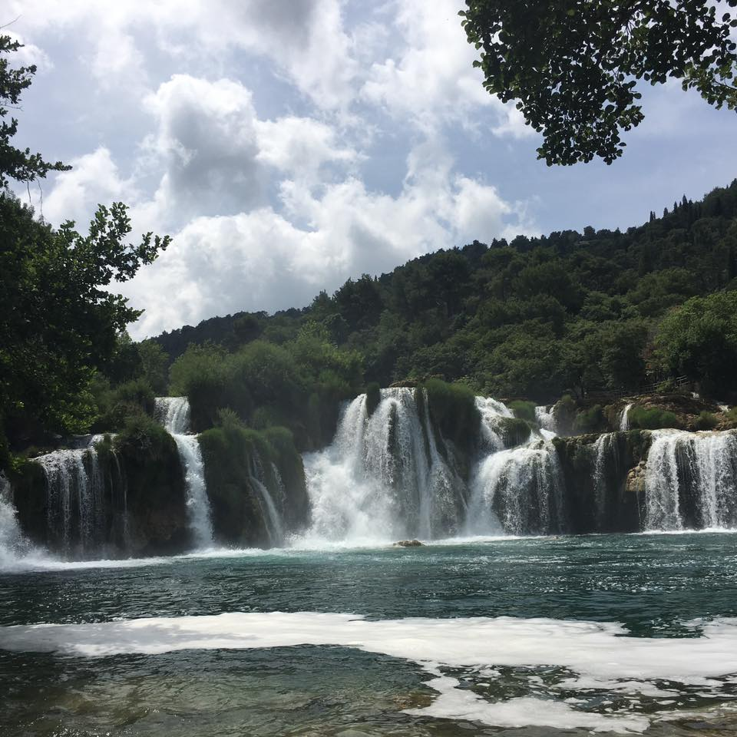

Slide 35
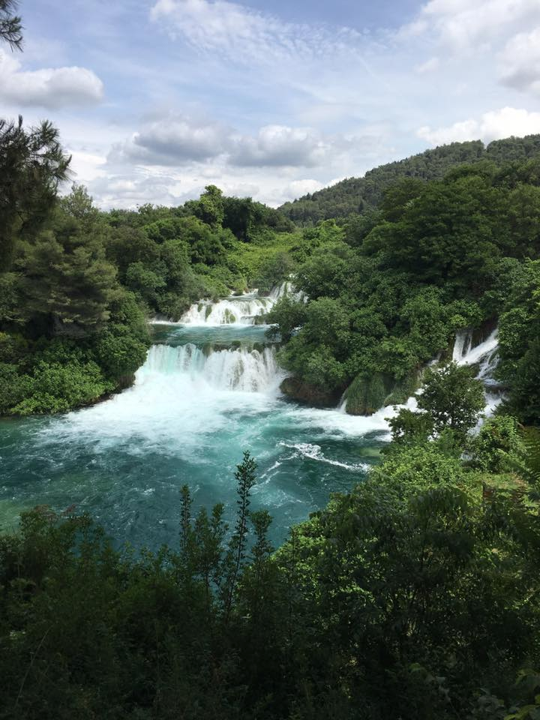

Slide 36
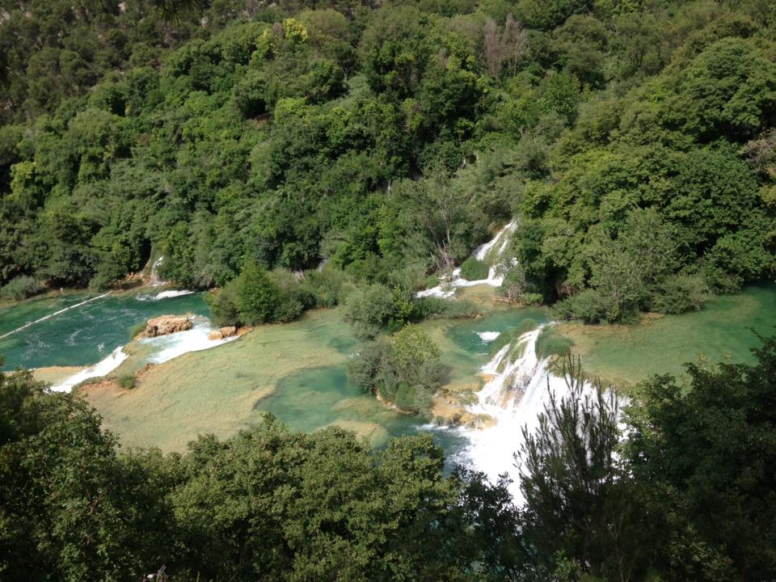

Slide 37
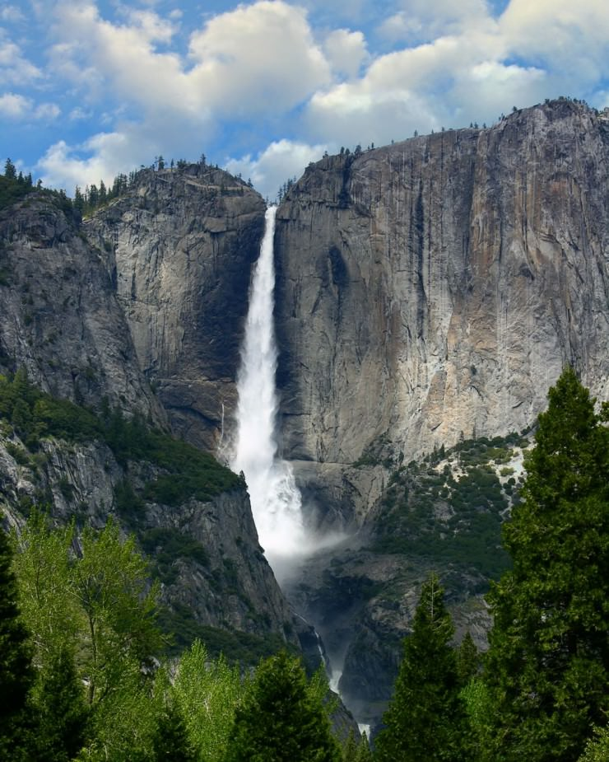
Yosemite Falls, USA

Slide 38
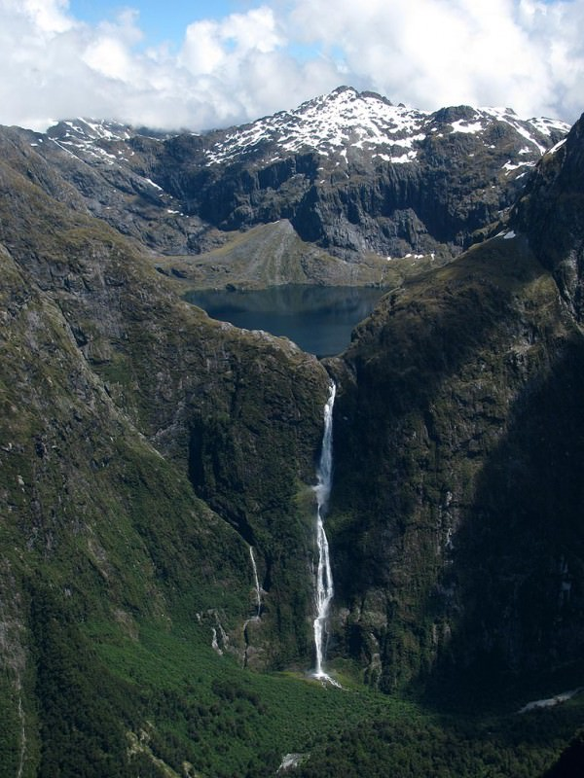
Sutherland Falls, New Zealand

Slide 39
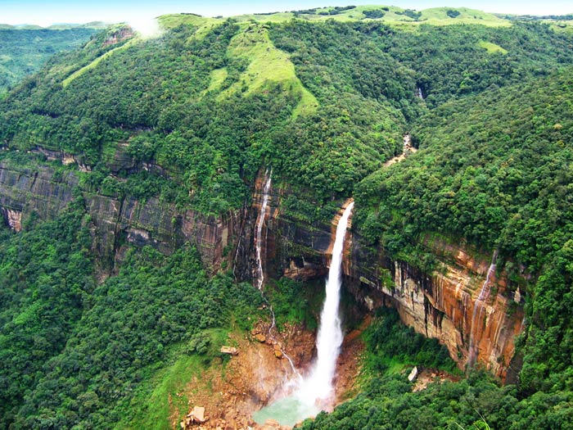
Nohkalikai Falls, India

Slide 40
What are waterfalls?
Waterfalls are perhaps the most spectacular erosional feature of a river.
Occur in upper course of the river.
A waterfall is an area of a river or stream where the water flows over a steep vertical drop, often landing in a plunge pool below. They occur in the upper course of a river/stream.

Slide 41

But how are they formed?

Slide 42
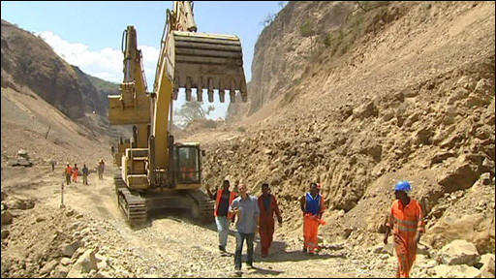

Slide 43
How are they formed?
Often a waterfall will form when a band of harder rock lies over a softer rock.
As the river flows over the edge of the harder, more resistant rock, the softer rock below is eroded away – creating an overhang.
When the overhang is big enough, it collapses – due to its weight and gravity.
The whole processes occurs again, this means over time, the waterfall will move backwards up the valley, leaving a steep sided gorge in front of them.

Slide 44
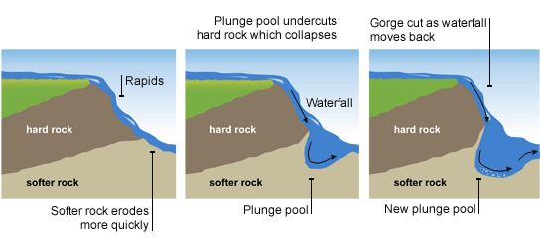

Slide 45
Key Processes
Hydraulic action – force of water.
Abrasion – rocks wearing away the ground as they move over it.

Slide 46
WHITEBOARD TIME!

Slide 47
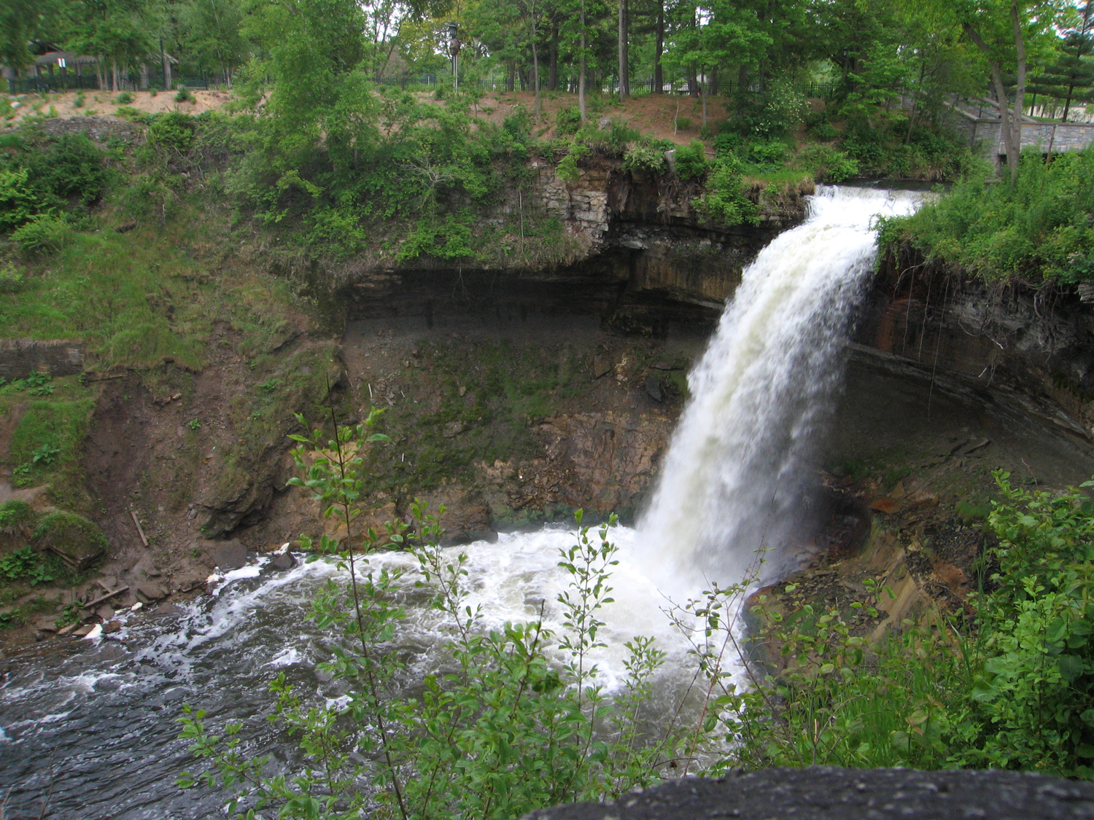
Steep sided gorge
Hard Rock
Undercutting
Soft rock
Plunge pool

Slide 48
Formation of a waterfall
Waterfalls usually occur where a band of hard rock lies next to soft rock. The water flows over these different bands of rocks and this creates rapids.
Hydraulic action (the force of the water) and abrasion (rock carried by the water eroding rock it moves over – like sand paper) erode the softer rock more quickly than the hard rock as it is less resistant.
The power of the water creates a deep plunge pool below the waterfall. This plunge pool undercuts the harder rock until an overhang is developed.
Overtime this overhang of hard rock will become unsupported and will eventually collapse. This causes the waterfall to move back upstream, leaving a steep sided gorge behind. The plunge pool is made deeper as the hard rock which has fallen in erodes the pool through abrasion.

Slide 49
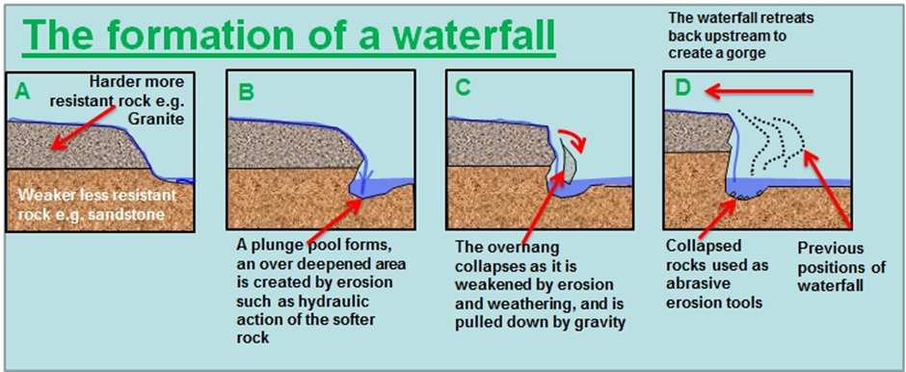

Slide 50
MINI WHITEBOARD MEMORY TEST!

