Slide 1
Limestone Map Work
Starter
Explain the ways in which two different land uses may be in conflict within a upland limestone area. (4).

Slide 2
Learning Intentions
To learn how to spot limestone features on an OS Map.

Slide 3
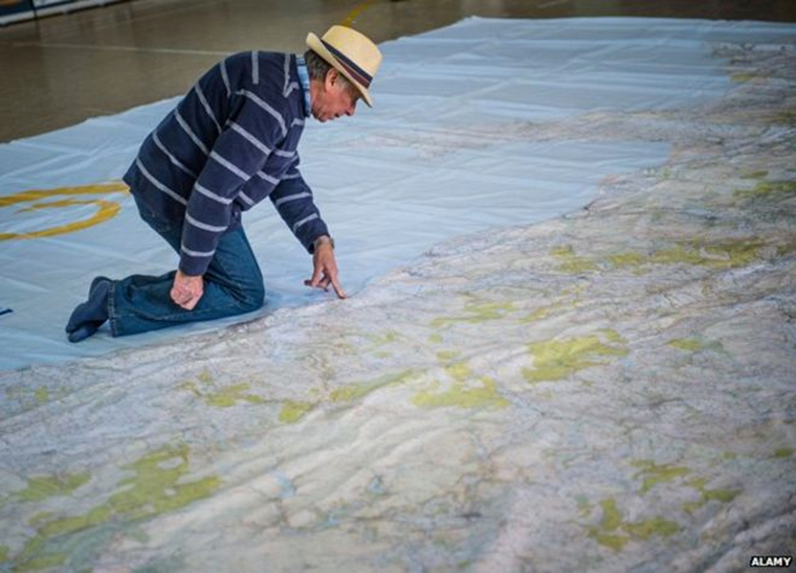
6 Figure Grid Reference Recap

Slide 4
ALONG THE CORRIDOR AND UP THE STAIRS!!!

Slide 5
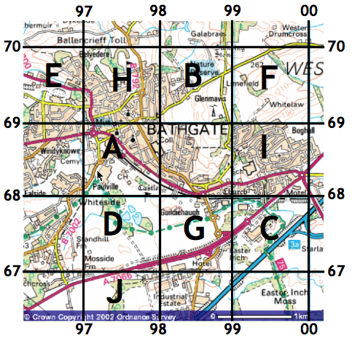
What are the 4 figure grid references for A-J?

Slide 6
6 Figure Grid References
6 figure grid references are more accurate. They are used to identify exact points on a map for example a church, tourist information centre or car park.
We apply the same rules as 4 figure grid references – along the corridor and up the stairs.
You need to think about it as dividing each grid into tens – both up and down.

Slide 7
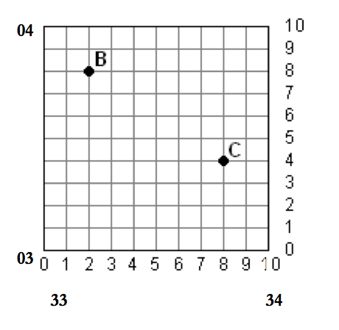

Slide 8
654725
4 FIGURE GRID REFERENCE = 6572
654 = 4 along in the 65 square.
725 = 5 along in the 72 square.

Slide 9
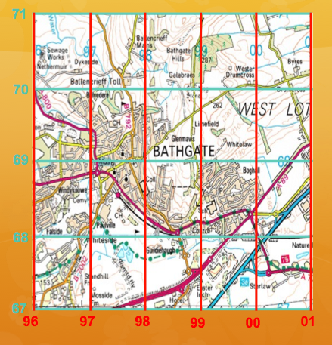
Practice
Give the 6 figure grid references for:

Slide 10
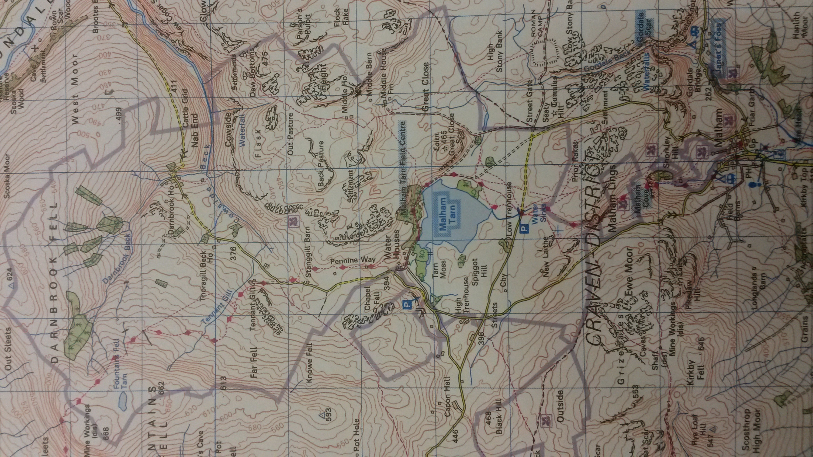
Consider
What features?

Slide 11
Introduction
It is fairly easy to identify limestone features on an OS map as the names of features are often shown on the map, eg Raven Scar or White Scar Caves.

Slide 12
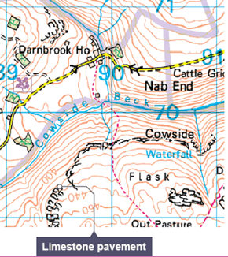
Limestone Pavement

Slide 13
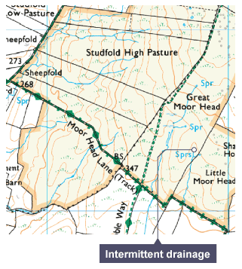
Intermittent Drainage
Rivers/streams appear to start and stop randomly.
Will reappear as Springs (Spr).

Slide 14
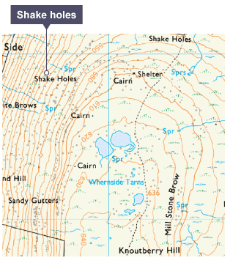
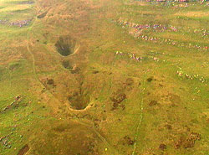
Shake Holes
Shake holes are formed when boulder clay is washed down through cracks or gaps in the underlying limestone.

Slide 15
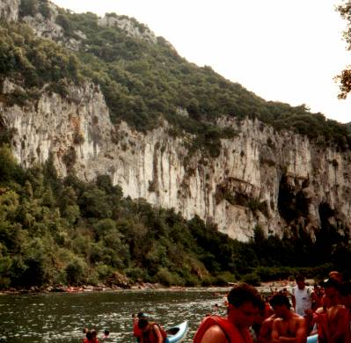
A scar or scree slope is the name for a mini-cliff at the edge of the limestone plateau.
Scar

Slide 16
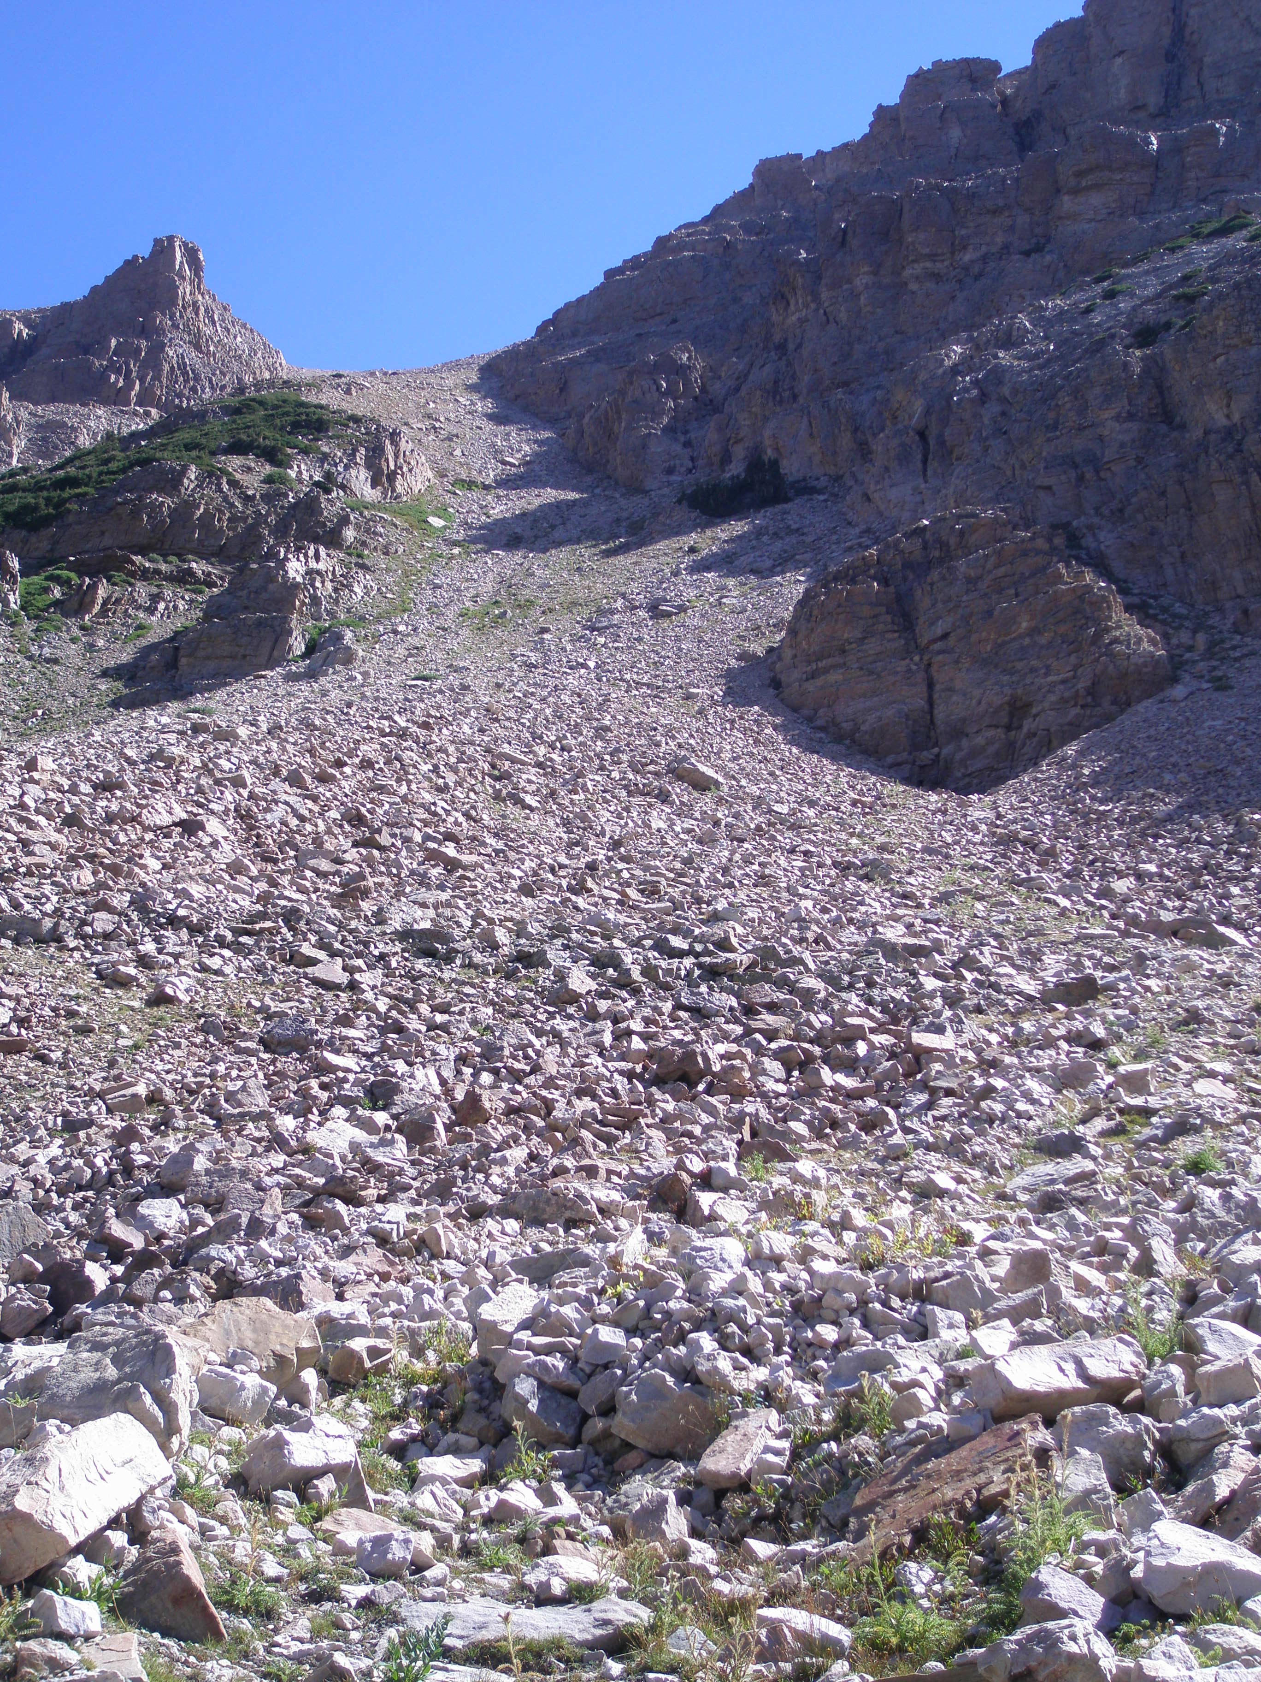

Slide 17
Scree slopes are tiny bits of rock that form steep cliffs on the limestone.
Formed by freeze thaw action (frost shattering) This is where water collects in the rock fractures, freezes and expands exerting great pressure on rock – breaking rock into tiny pieces.
These break off and are moved downhill by gravity and accumulate at the base of slopes as a scree slope

Slide 18
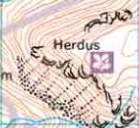
Scree

Slide 19
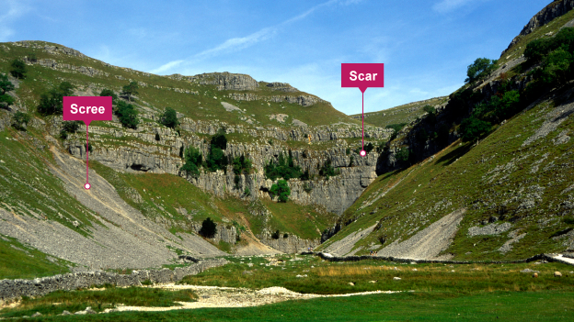
Scar

Slide 20
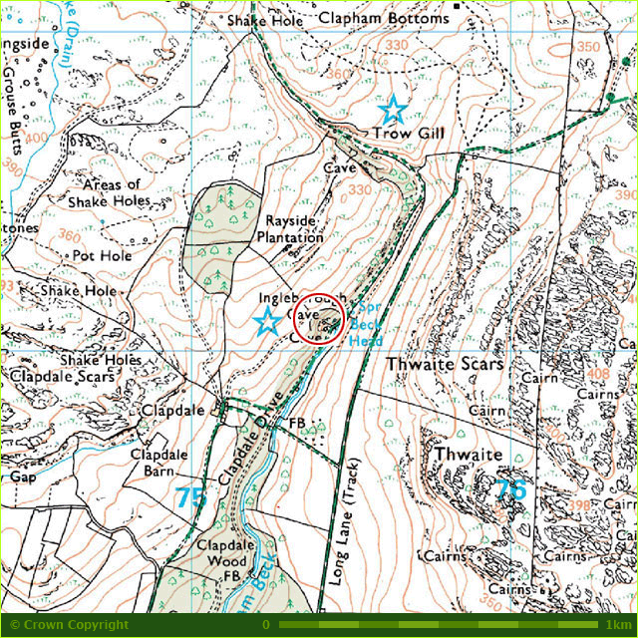
Scar

Slide 21
Cave/Caverns

Slide 22
Pot Hole/Swallow Hole

Slide 23
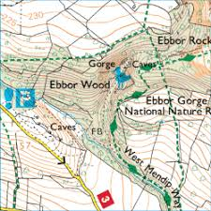
Gorge

Slide 24
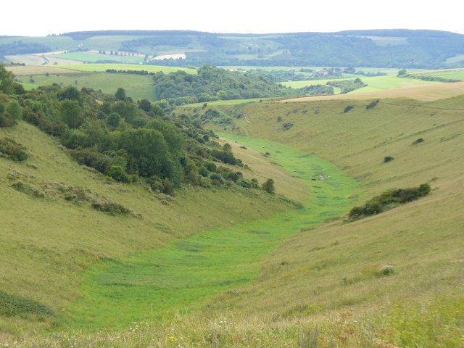
Dry Valley
A dry valley may develop on permeable rock, such as limestone. Such valleys do not hold surface water because it sinks into the permeable bedrock.

Slide 25
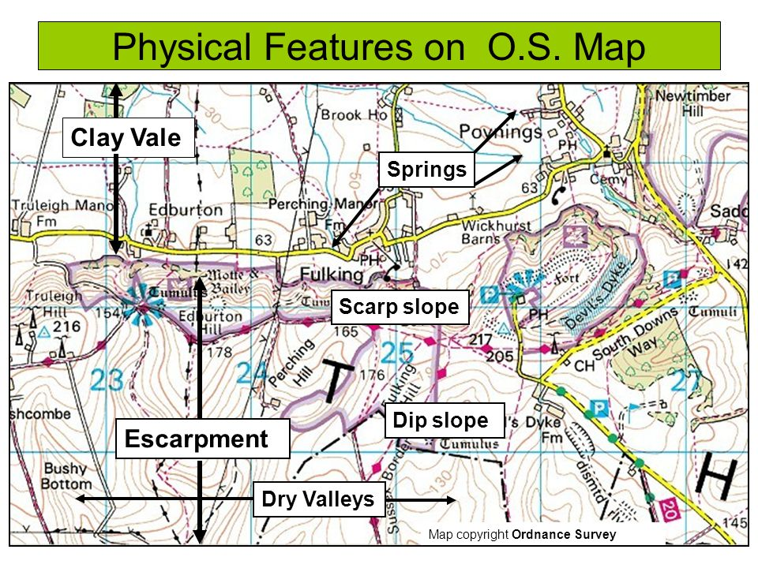
Dry Valley

Slide 26
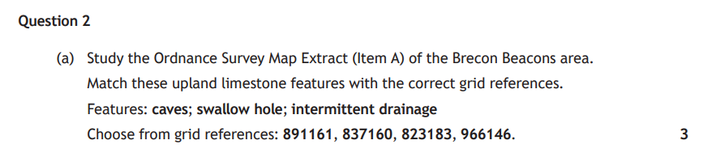

Slide 27


Slide 28
Questions
a) For an area that you have studied, and give detailed explanations of a landscape management issue and how public bodies and voluntary organisations are solving these issue (6).

