Slide 1
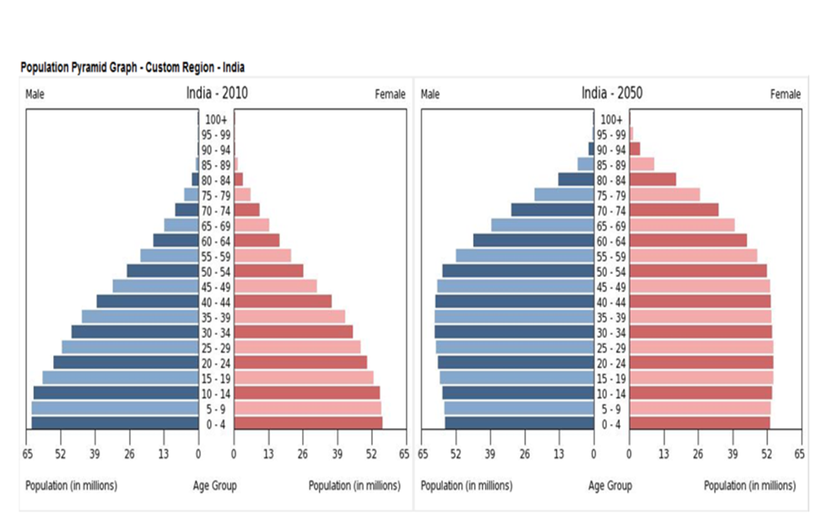
Describe and explain the changes in India’s population structure (6).

Slide 2
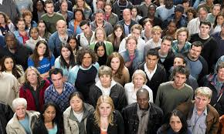
Demographic Transition Model

Slide 3
Learning Intentions
I will understand what the Demographic Transition Model is
I will be able to understand why birth and death rates change throughout each stage

Slide 4
Blind Drawing
Pair up.
One person will face the board and the other wont.
The one facing the board must describe to partner what they see and they must draw it on whiteboard.
See who gets closest!

Slide 5
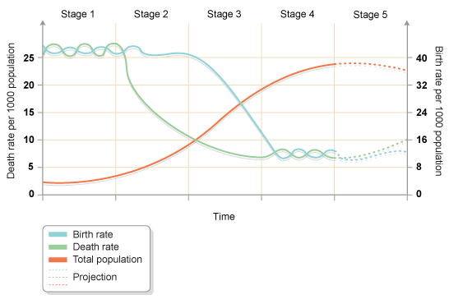

Slide 6
What is the demographic transition model?
The demographic transition model shows population change over a period of time. It explores how birth and death rates (natural change) affect the total population of a country – doesn’t include migration.
Originally 4 stages but fifth stage has been proposed

Slide 7
Natural Increase
Natural Increase = when birth rate is higher than death rate.

Slide 8
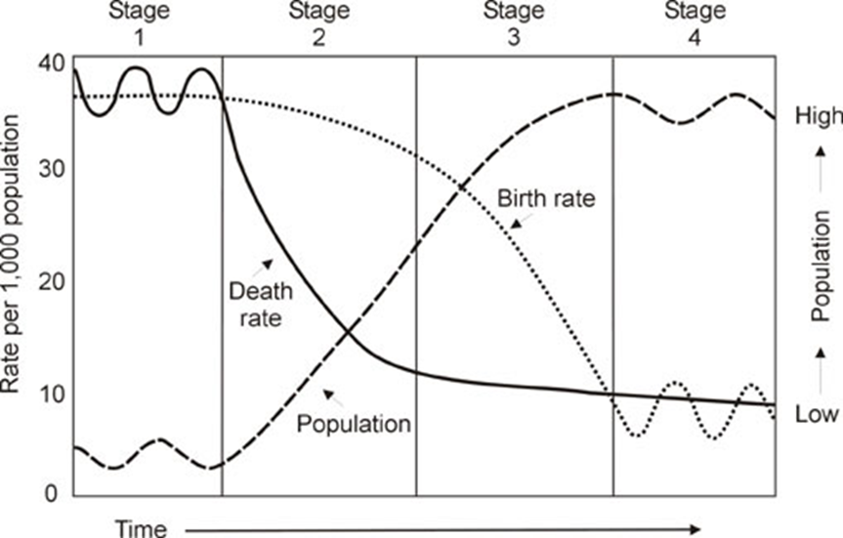

Slide 9
A3 Paper Task/Jotter
In the top half of your paper draw the demographic transition model.
Underneath create the following table:

Slide 10
 | Stage 1:High Fluctuating | Stage 2: Early Expanding | Stage 3:Late Expanding | Stage 4:Low Fluctuating
Present World Examples?
UK?
Describe
Explain
Wider world textbook page 6-7.

Slide 11

Stage 1
Britain before 1750
What are the reasons for a high birth and death rates at this time?

Slide 12
High Birth Rates
High Infant Mortality Rates so more children had to over come this
Children needed to work – economic asset
No contraception or family planning
Status of men – more children more social standing
Lack of political freedom for women and so could not have careers or go to university
Children viewed as an insurance policy- would look after the elderly later on in life
Religious beliefs encourage large families
High Death Rates
  lack of food – death by famine
  poor sanitation = water bourne diseases.
  Lack of clean water = water bourne diseases (cholera)
  poverty
  lack of medical care/supplies to fight disease
  Diseases = Bubonic Plague which killed 1/3 Britain's population in 14th Century
  War

Slide 13
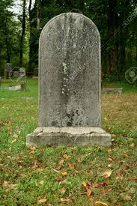
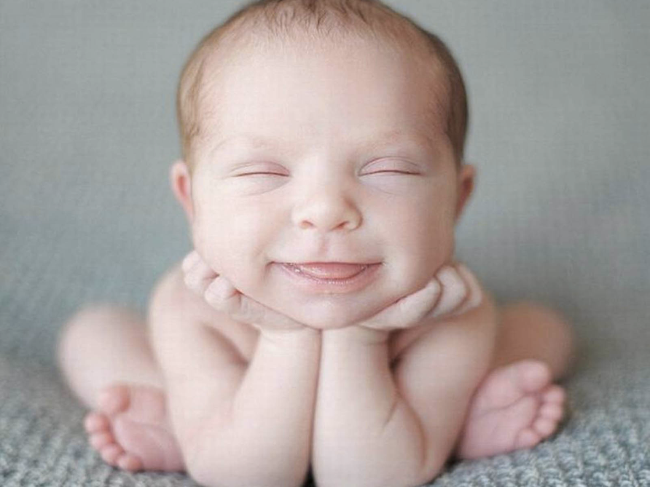
Natural Increase
Low natural increase 0.5 % due to high birth and death rates

Slide 14
Stage 2
Britain 1750-1900
What are the reasons for a falling death rate at this time?
Disease
declined
Medical
advances
Sanitation
improved
Better
food supply
Improved
living standards

Slide 15
Natural Increase
High Natural Increase 2-3 %
Due to lower death rates

Slide 16
Stage 3
Late Expanding
Britain 1900-1960
What are the reasons for a declining birth rate at this time?
Higher female employment
First family planning
Centre opened in 1921
Contraceptive pill
introduced in 1961
New laws of employment.
Over 11 yrs old
Abortion legalised in 1967

Slide 17
Increased mechanisation

Slide 18
Natural Increase
Lowering Natural Increase 1-2 %
Due to falling birth rates and deaths rates

Slide 19
Stage 4
Low Stationary
What are the reasons for low birth and death rates?
Better food supply
Kids = more expensive
work and money
Before kids
Improving status of women
in education and workplace
Medical Advances:
Screening programmes
Surgical procedures
vaccinations
Women can chose if they
Want children

Slide 20
Natural Increase
Natural Increase is low 0.1%

Slide 21
Amazon tribes, rural communities in developing countries
Costa Rica, Indonesia, South Africa
USA, Australia, Britain,China
Yemen, Afghanistan, Bhutan

Slide 22
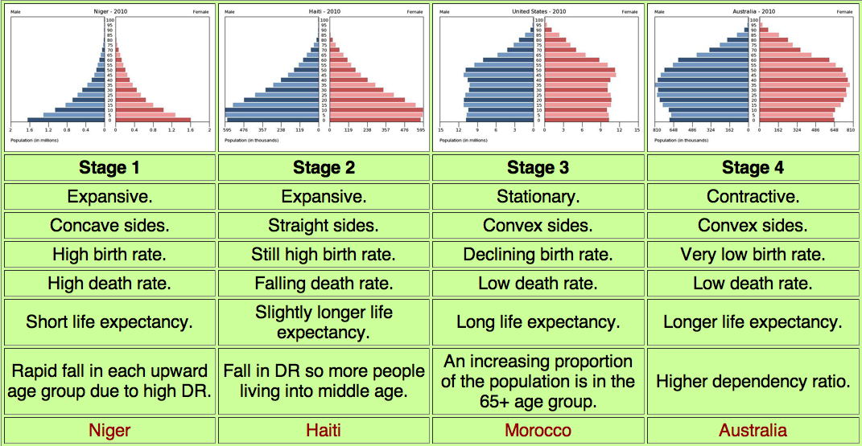
Population Pyramids

Slide 23
Describe the changes which have taken place in the birth rate and death rate line through stages 1-4. State what you see, use figures from the graph, how many births and deaths per thousand are there at each stage? Overtime are birth or death rates increasing or decreasing??
For either the birth rate or the death rate explain why the changes (from stages 1-4) have taken place. Give reasons for the patterns shown, remember include either the birth rate or death rate NOT BOTH!!!!!!

Slide 24
MODEL ANSWER
Describe the changes which have taken place in the birth rate and death rate line through stages 1-4.
The birth rate starts off at 35 births per 1000 people in stage 1 although it is fluctuating. It remains high in stage 2 but starts to fall rapidly in stage 3 from 34 births per 1000 at the beginning to 15 births per 1000 at the end of stage 3. In stage 4 the birth rate is low and fluctuating at around 10 births per 1000 people per year.

Slide 25
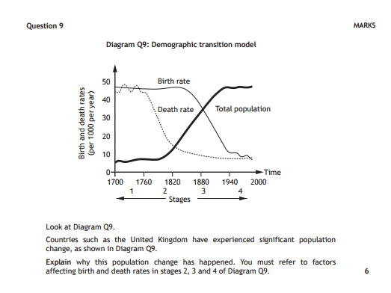

Slide 26
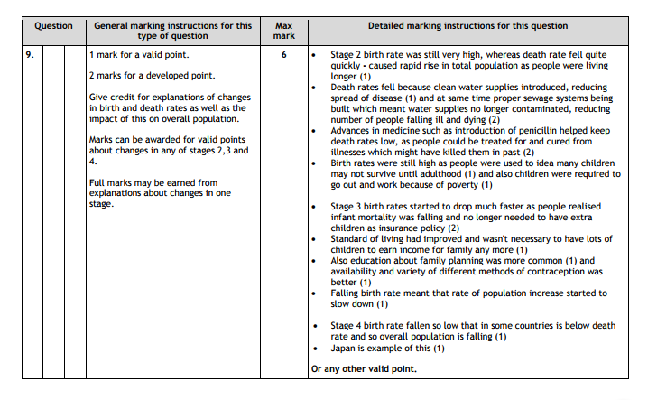

Slide 28
The Song...
https://www.youtube.com/watch?v=pzxREH08EkI

