Slide 2

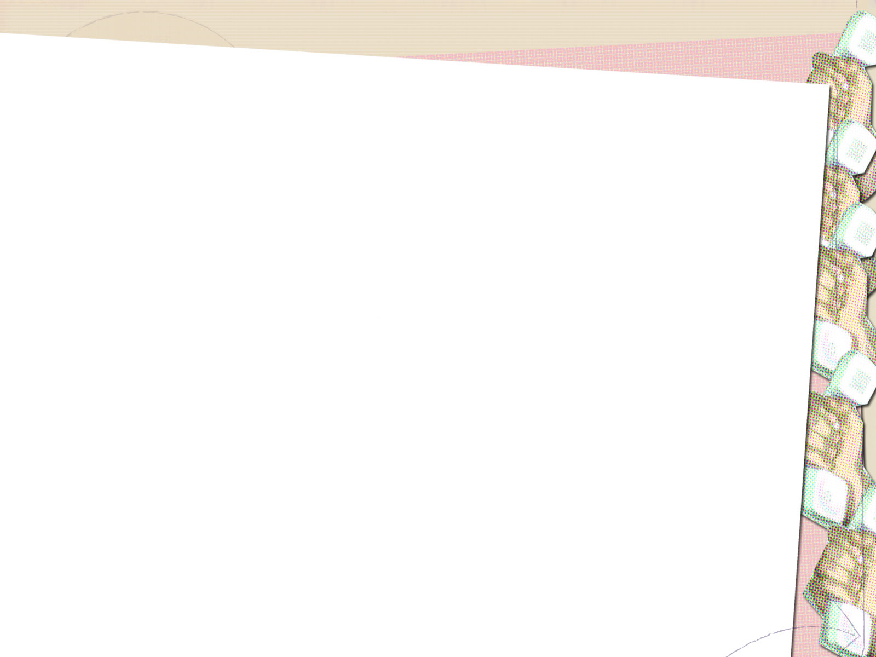
Family Fortunes
X
Mr Smith surveyed 100 people and asked them to give something you would associate with the upper course of a river.
X
Position | Word | Score
1
2
3
4
5
Steep land
43
Narrow River
27
Shallow Water
14
X
Waterfall
11
Sharp Rocks
5
1
2
3
4
5
X
X
X

Slide 3
Family Fortunes
X
Mr Smith surveyed 100 people and asked them to give something you would associate with the lower course of a river.
X
Position | Word | Score
1
2
3
4
5
Wide
43
The mouth
27
Meanders
14
X
Slow moving
11
Levees
5
1
2
3
4
5
X
X
X

Slide 4
Better or worse…
https://www.youtube.com/watch?v=RDh6vQQax5E

Slide 5
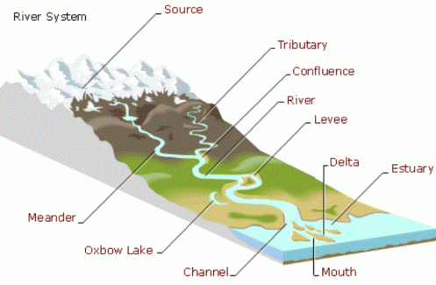
The Profile of a River

Slide 6
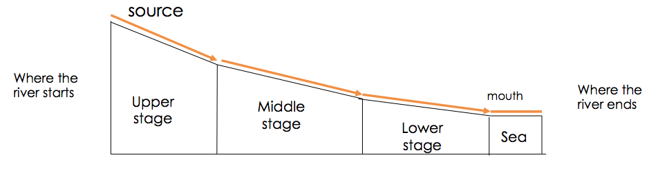
The Long Profile of a River

Slide 7
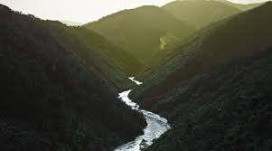
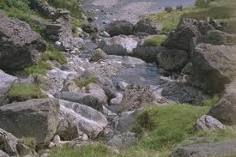
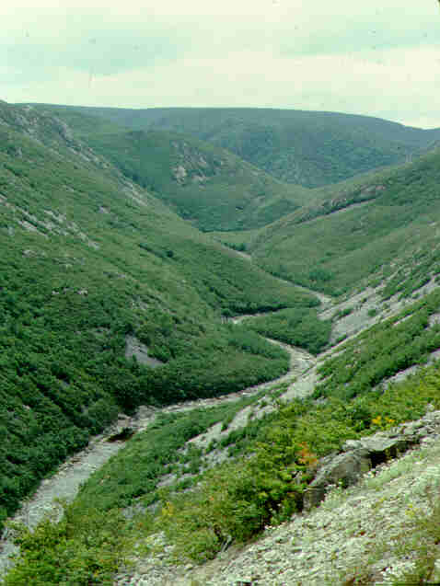
Upper Course

Slide 8
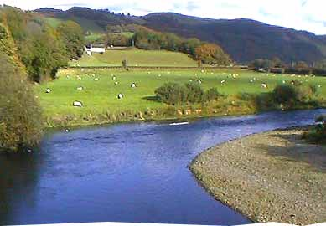
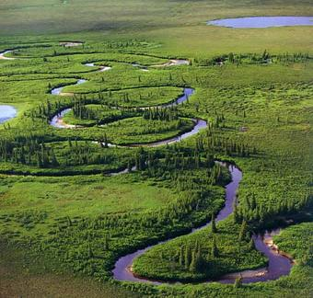
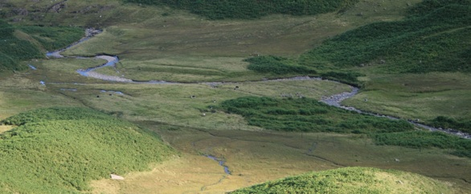
Middle Course

Slide 9
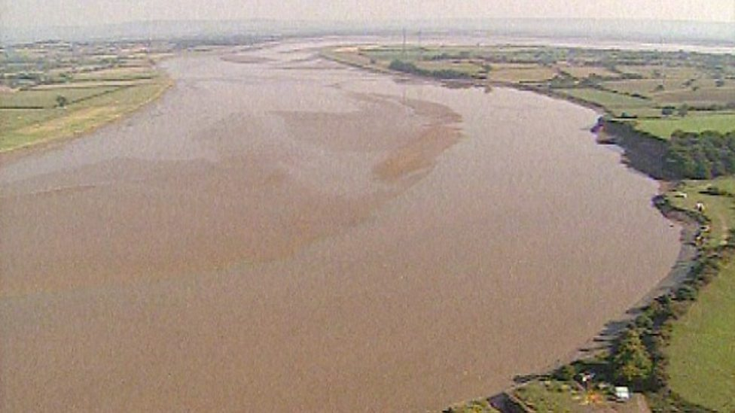
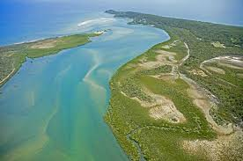
Lower Course

Slide 10
Different Features
V Shape Valley
Waterfall
Meander
Ox Bow Lake
River Beach/River Cliff
Floodplain

Slide 11
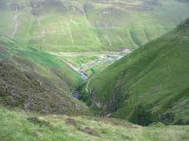

Slide 12
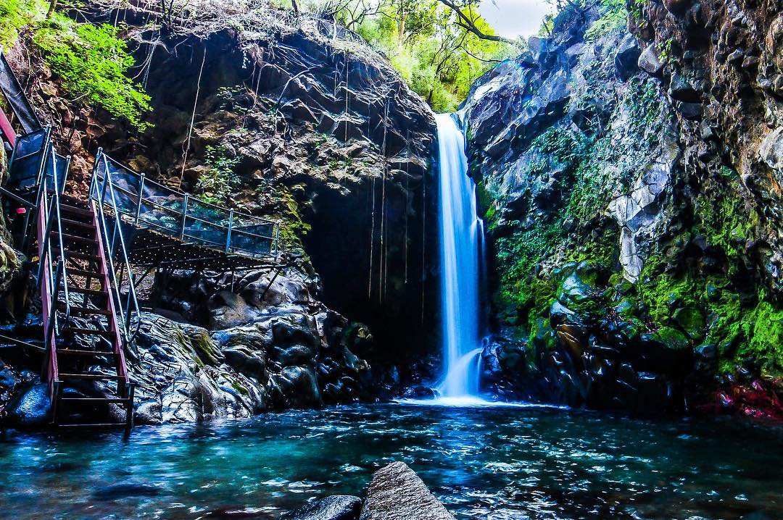

Slide 13
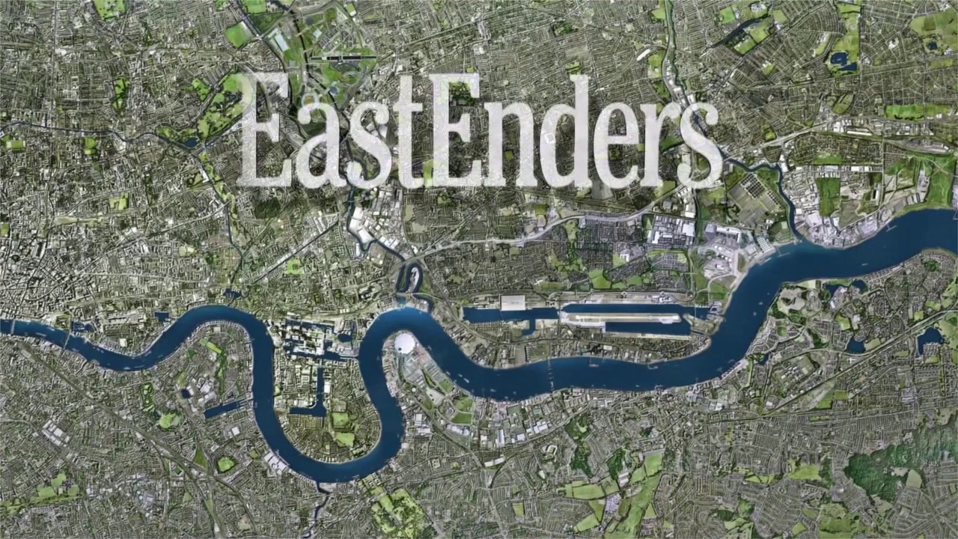

Slide 14
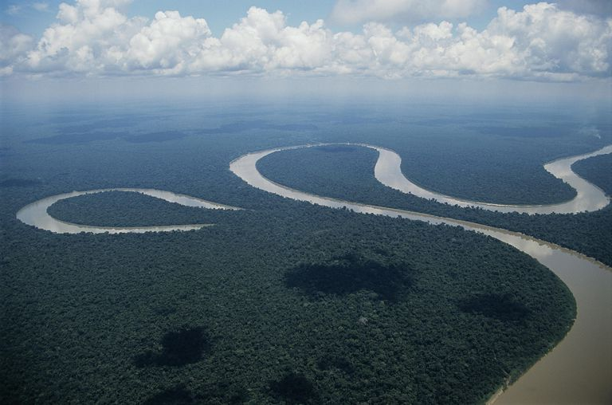

Slide 15
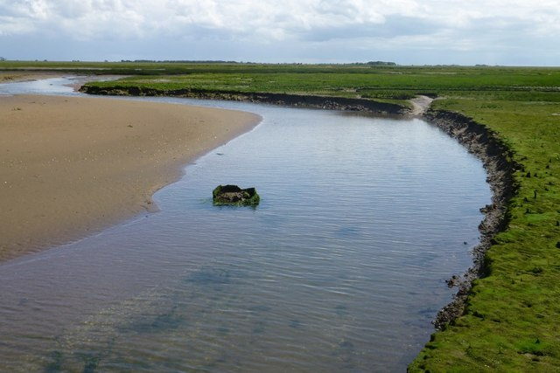

Slide 16
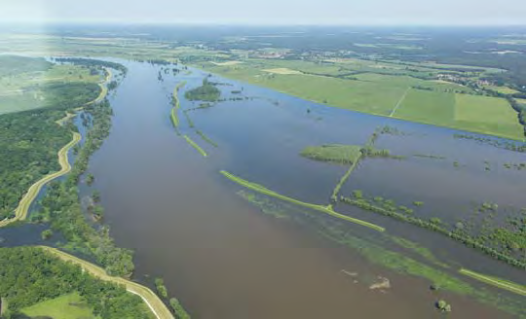

Slide 17
Characteristics | Upper Course | Middle Course | Lower Course
Slope | Steep | Getting flatter | Flat
Width | Narrow | Getting wider | Widest
Depth | Shallow | Getting deeper | Deepest
Load | Sharp angular pebbles | More rounded pebbles | Small pebbles, sand and silt
Features | Waterfall, V Shape Valley | Oxbow, Meander,Floodplain, River Cliff/Beach | SAME AS BEFORE + Levees, deltas
Main work/processes | Vertical Erosion and Transportation | Lateral Erosion, Transportation and some deposition | Mainly deposit, transportation.

Slide 18
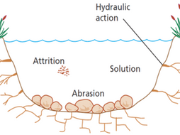
River Processes

Slide 19
What does erosion mean?

Slide 20
What does erosion involve?
Erosion take place in four different ways:
1. Hydraulic action is the force of just the water in the river wearing away
the land.
2. Abrasion is the force of the water plus the load (rocks etc) that the river is
carrying, wearing away the land.
3. Attrition is the material that the river is carrying, breaking each other down in
the river
4. Solution is the acid in the river water, dissolving the rock and wearing it down.

Slide 21
How does a river transport materials?

Slide 22
Transportation
Transportation take place in three different ways:
1. Traction is the bigger load rolling along the bottom of the river.
2. Saltation is the smaller material bouncing along the bottom of the river.
3. Suspension is fine material, floating inside the river, being carried by the water.
4.Solution is when some minerals dissolve in the water and are always present.

Slide 23
Why might a river deposit its load?

Slide 24
What does deposition involve?
A river choses to deposit its load for the following three reasons:
The material that it is carrying is too heavy.
The river has lost power/speed/energy and no longer can move the
material (heaviest material deposited first)
3. The river doesn’t have enough water to move the material

Slide 25
Task: Definition and Picture
Write out the definitions for the key processes for erosion, transportation and deposition.
Beside each one draw a picture/diagram to show the process – can be imaginative if you wish! This will help you remember them!
Can also make as a foldable?

Slide 26


How well have you remembered?

