Slide 1

Starter Question
Explain possible reasons behind the rapid growth of New Delhi (3).

Slide 2
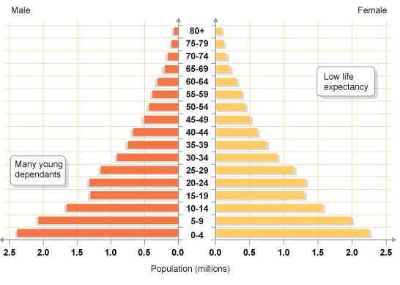
Population Structure (Population Pyramids)

Slide 3
Learning Intentions
To be able to describe the population structure of a country
To explain the reasons behind this population strucutre.

Slide 4
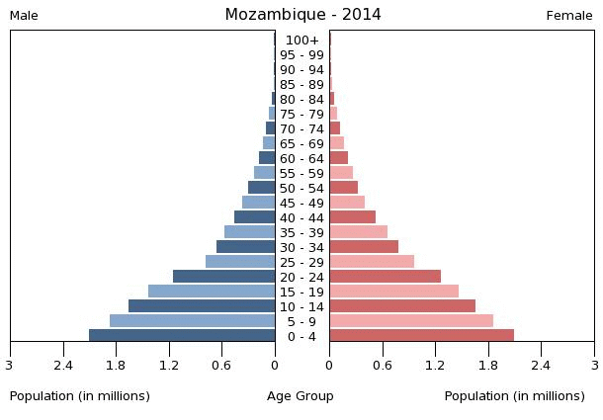
What can you remember?

Slide 5
What are population pyramids?
Population structure of a place is usually shown using a population pyramid. A population pyramid can be drawn up for any area, from a whole continent or country to an individual town, city or village.
DEFINITION – A population pyramid is a graphical illustration which shows the amount of the two genders and various age groups within a population (normally a country or region).

Slide 6
Describing population pyramids
“Describe” = say what you see.
When describing population pyramids, its is important to note at a number of things:
The three distinct age groups – young dependents (0-15 years old), economically active (16-64), elderly dependents (65+)
How these groups can tell us about the following: birth rates, death rates, infant mortality rates and life expectancy – USE HIGH OR LOW.

Slide 7
Key Terms
Birth rate = number of births per 1000 of population
Narrow base = low BR.
Wide base = high BR.
Infant mortality rate = number of infant deaths per 1000 live births.
Big reduction between 0-4 and 5-9 = high infant mortality rate.

Slide 8
Death rate = number of deaths per 1000 of population.
Bars getting narrower = high DR.
Bars remain fat = low DR.
Life expectancy = average age people live to.
High amount of people in elderly dependents = high life expectancy.

Slide 10
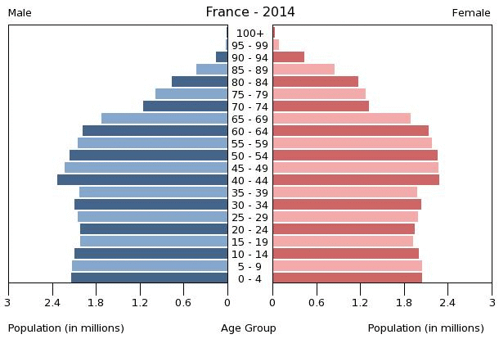

Slide 11
Differences between developing and developed countries population pyramids - Diagrams

Slide 12
 | Developed | Developing
Examples
Birth Rate
Death Rate
Infant Mortality
Life Expectancy

Slide 13
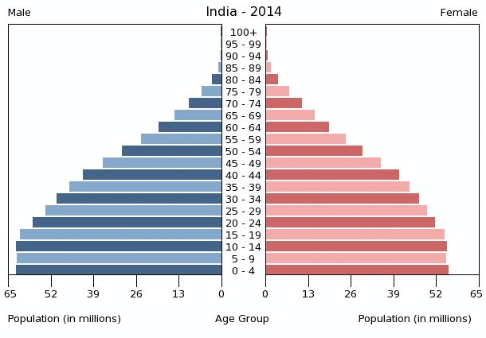
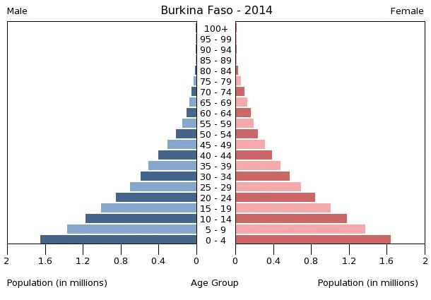
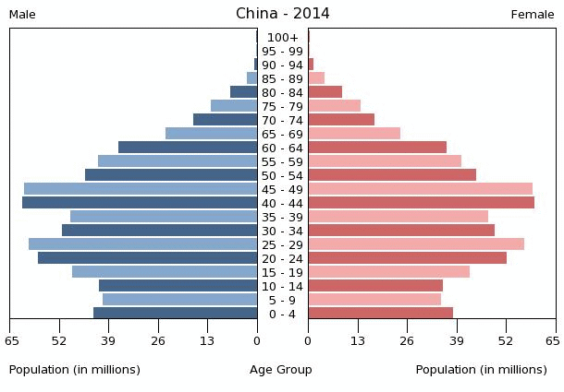

Describe each of the following (4 marks each).

Slide 14
“Explain the reasons for the population structure”

Slide 15
What we need to know?
Reasons for high death rates in developing countries
Reason for low death rates in developed countries
Reasons for a higher birth rate in developing countries
Reasons for a lower birth rate in developed countries.

Slide 16
Split Jotter into Four Sections
High Death Rates/Low Life Expectancy
Low Death Rates/High Life Expectancy
High Birth Rate
Low Birth Rate

Slide 17
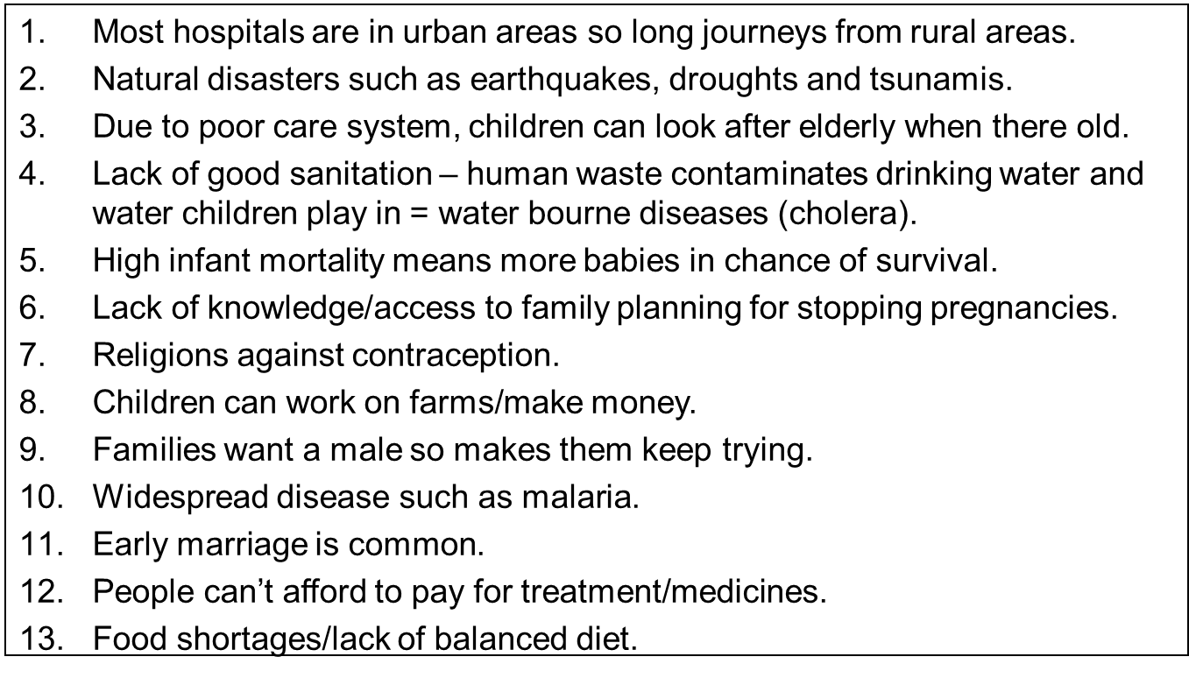

Slide 18
Why Infant Mortality rates are lower in EMDC?
Developed countries have better healthcare in particular better anti and post natal care.
There are less diseases in developed countries which could attack the immune system of babies
Women are healthier during pregnancy
Women are less likely to give birth prematurely
Women are educated as to how to care for the child, how to provide the right nutrients for the child.
The birth rate in developed countries is also considerably lower reducing the infant mortality figures by less children are being born overall.

Slide 19
Create and Describe
Find a population pyramid for a country of your choice on Google.
Make it out of lego or draw it.
Use it to answer these two questions:
“Describe the population structure of your country” (4).
“Explain the population structure of your country” (4).

Slide 20
How do we answer an explain question?

Slide 21
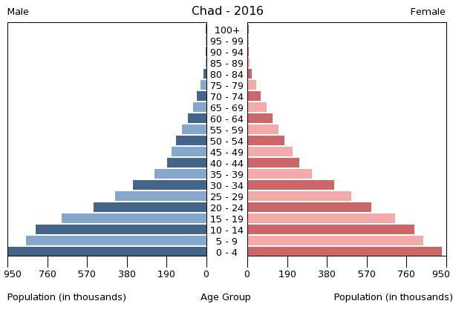
Explain the reasons for the population structure of Chad (5).

Slide 22
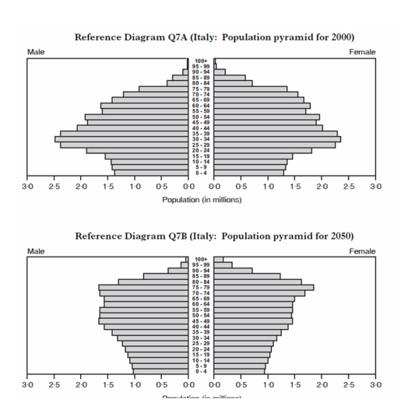
Describe the differences and similarities between Italy’s population in 2000 and 2050 (3).
Explain possible reasons behind this. (4)

Slide 23
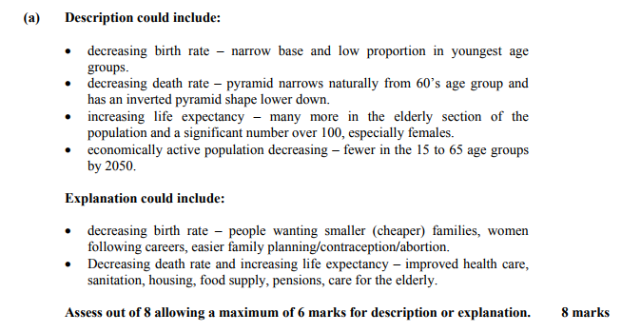

Slide 24
Rules
Phones/Headphones when I say so.
Respect for classroom = mess.
Work ethic = needs to improve.
Extension = more opportunities will be available to avoid sitting doing nothing if done.
Do not talk while I am talking/mucking about.
No eating/drinking in class.

Slide 25
Class Feedback/Reflection
Write down anything you think is working well in the class.
Write down anything I could do better/change about the class.
Please be honest.

