Slide 1
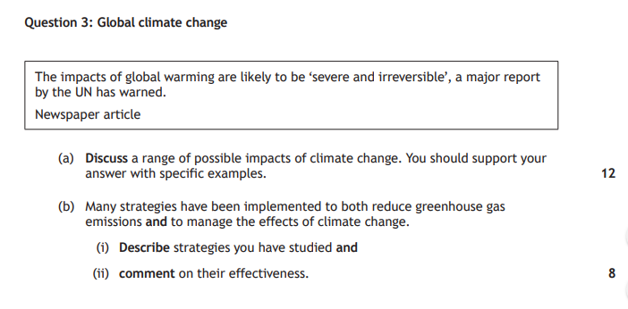
Specimen Paper

Slide 2
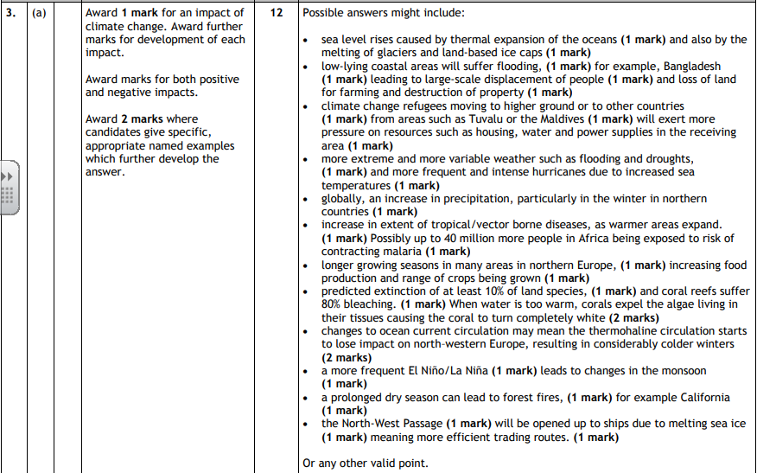

Slide 3
Prelim Reminder – Thursday 28th March.
Atmosphere
Hydrosphere
Biosphere
Development and Health
Climate Change

Slide 4
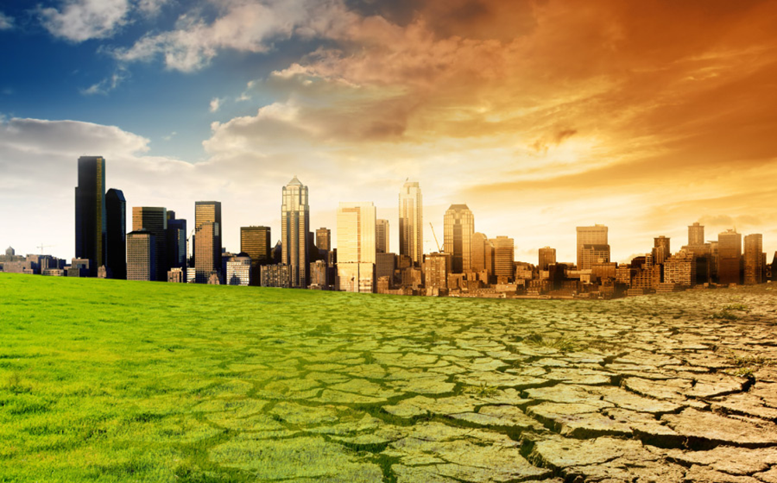
Controlling Climate Change

Slide 5
Younger Generations Need to Care!!
https://www.youtube.com/watch?v=eRLJscAlk1M
https://www.youtube.com/watch?v=_FpihogHAQM

Slide 6
Different Levels
We can begin to deal with climate change at different levels:
Local (ourselves, local towns)
National (UK)
International (The World, EU).

Slide 7
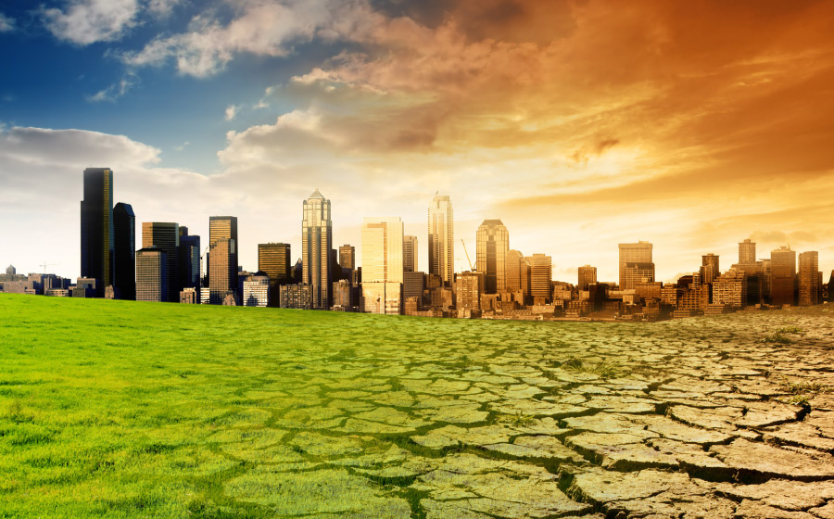
Local Level

Slide 8
“Act Locally and Think Globally”

Slide 9
Reducing our Carbon Footprint
Recently, there has been a call for people to reduce the amount of carbon they produce.
The volume of carbon that you are responsible for producing is known as your carbon footprint.

Slide 10
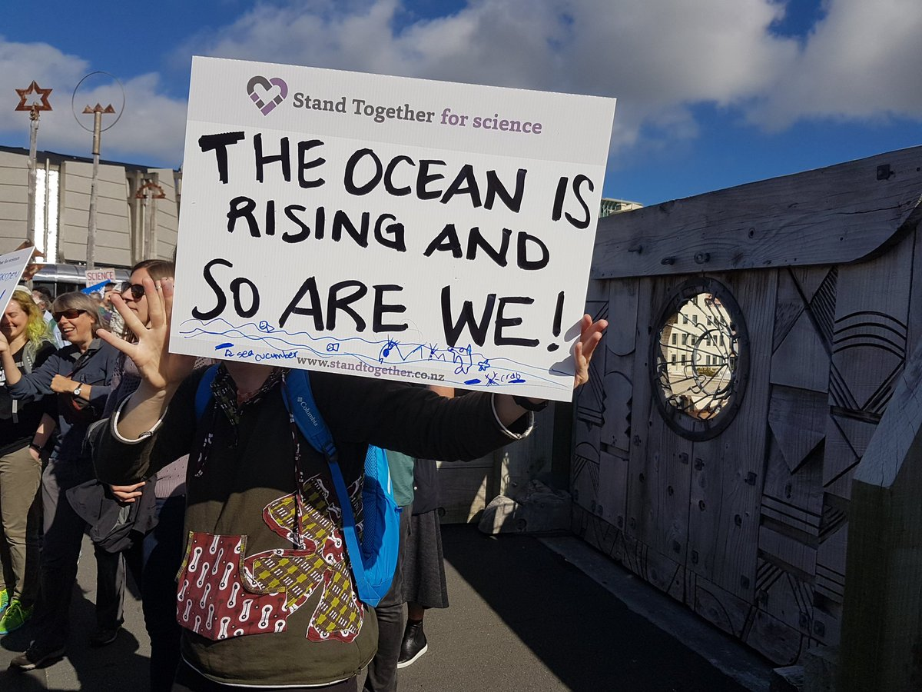
Climate Change Pledge
Get your diary out that we did last week.
Come up with 5 things that you think you could change in your life that would help reduce your carbon footprint.

Slide 11
What methods of control do you already know?
What are the human causes of climate change?
What solutions do you know to reduce these greenhouse gases?
Watch this to help….
https://www.youtube.com/watch?v=fg2SHJNiQ80

Slide 12
How can you reduce it?
Ride a bike or walk instead of going by car.
Turn the lights off when you leave the room
Don’t leave the TV on standby – turn it off at the wall.
Recycle and compost as much as possible
Eat less meat and dairy products. Animals produce methane which is one of the most damaging greenhouse gases.
Plant trees - Planting trees is a great way to reduce greenhouse gases. Trees absorb carbon dioxide from the air.
Buy recycled products which don’t use ‘new’ resources and don’t require so much energy to make. Buy energy efficient electrical goods.
Buy local produce and products

Slide 13

Starter- How Could You Have Changed?
Write down 5 things you could have done differently in the last week which would have lowered your carbon footprint.

Slide 14

“Reuse, Reduce and Recycle”

Slide 15
Edinburgh City Council – Ways to Reduce and Reuse Waste
ITEM
Food Waste
Carrier Bags
Household Items
Nappies
RECOMMENDATION
Compost unused fruit and vegetables
Re-use carrier bags, carry a bag for life.
Donate re-usable household items to charity shops
Use real nappies instead of disposable ones

Slide 16

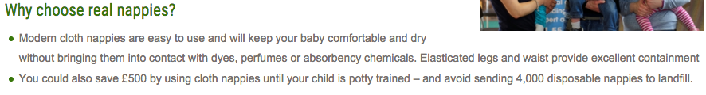
Edinburgh and Lothian's Real Nappy Project

Slide 17
90% of countrys waste going to landfill in 2009.
50% in 2015 – forecast to be 10% by 2020.

Slide 18
Energy Saving Lightbulbs
We have been encouraged to replace our lightbulbs with energy saving ones – will save you around £55 per year
The energy saving lightbulbs generate less heat, use much less energy and last 10-50 times longer.

Slide 19
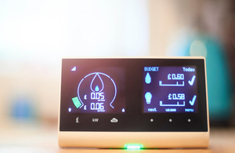
Reducing Electricity

Slide 20
Could you live Carbon Neutral?
Bhutan is the worlds only carbon negative country.
https://www.youtube.com/watch?v=fJspiF5WQlM

Slide 21
Research Task – National and International
National
What is the 2050 Challenge? How does it aim to help?
Explain 2 more intiatives that the UK have brought in to help combat climate change.
International – Kyoto Protocol
Key info – where? When? Who was there?
What did it decide the aims were to help with climate change?
What was the USA stance on it?Who pulled out the Kyoto Protocol and why?
Any issues with this protocol?
International – Paris Agreement
Key info – where? When? Who was there?
What did it decide the aims were to help with climate change?
What was the USA stance on it?
Any issues with this agreement? Anyone unhappy?

Slide 22
National Level

Slide 23



UK Government policies

Slide 24
The 2050 challenge
The UK is committed to reducing GHG emissions by 80% by 2050

Slide 25
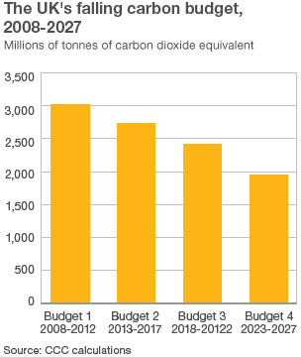
Carbon Budgets
This is a restriction on the total amount of GHG the UK can produce over a five year period – every year it will get lower
This is to help work toward the 2050 challenge – break it down into manageable/achievable chunks

Slide 26
How effective is it?
UK emissions were 35% below 1990 levels in 2014 and provisional figures show emissions fell a further 3% in 2015.

Slide 27
Renewable Energy
Renewable energy is a sustainable alternative, as it comes from sources which will not run out – such as the wind or sun.
Renewable energy sources are much better for the environment, as they produce close to no greenhouse gases. In the UK in 2014, Carbon dioxide output fell by almost a tenth, as renewable energy generation rose to a new record high, accounting for nearly a fifth of electricity.

Slide 28
The UK Targets
Under European Union targets, the UK must produce 15% of its energy from renewable sources by 2020, and is one of a small number of big member states to be judged on track to meet all of its energy and climate commitments by the European environment agency.
In 2013 - 15% of the UK’s electricity came from renewable sources. This puts the UK about halfway towards its commitments, because the overall energy target includes transport and heating, as well as electricity generation. For the UK to meet its EU goals, electricity generation from renewable sources is likely to have to increase to above 30% by 2020.

Slide 29
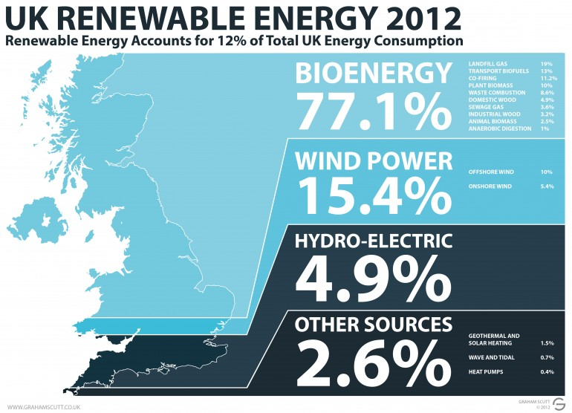

Slide 30
2015 - Evaluate
New data from the Department for Energy Climate Change (DECC) shows energy use fell to its lowest level for at least half a century, while coal use fell to levels not seen since the 19th century and renewable power increased by a fifth.
Along with a record warm year, the combined impact of these changes was a 10% reduction in UK carbon emissions — the largest ever fall to accompany economic growth.

Slide 31
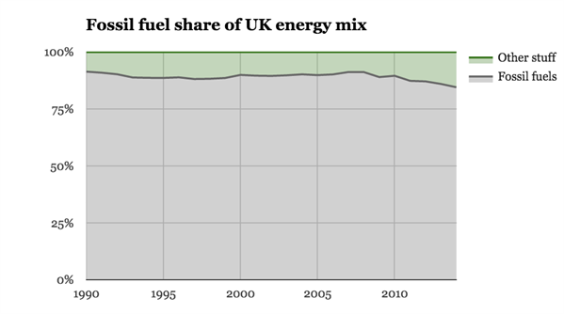

Slide 32
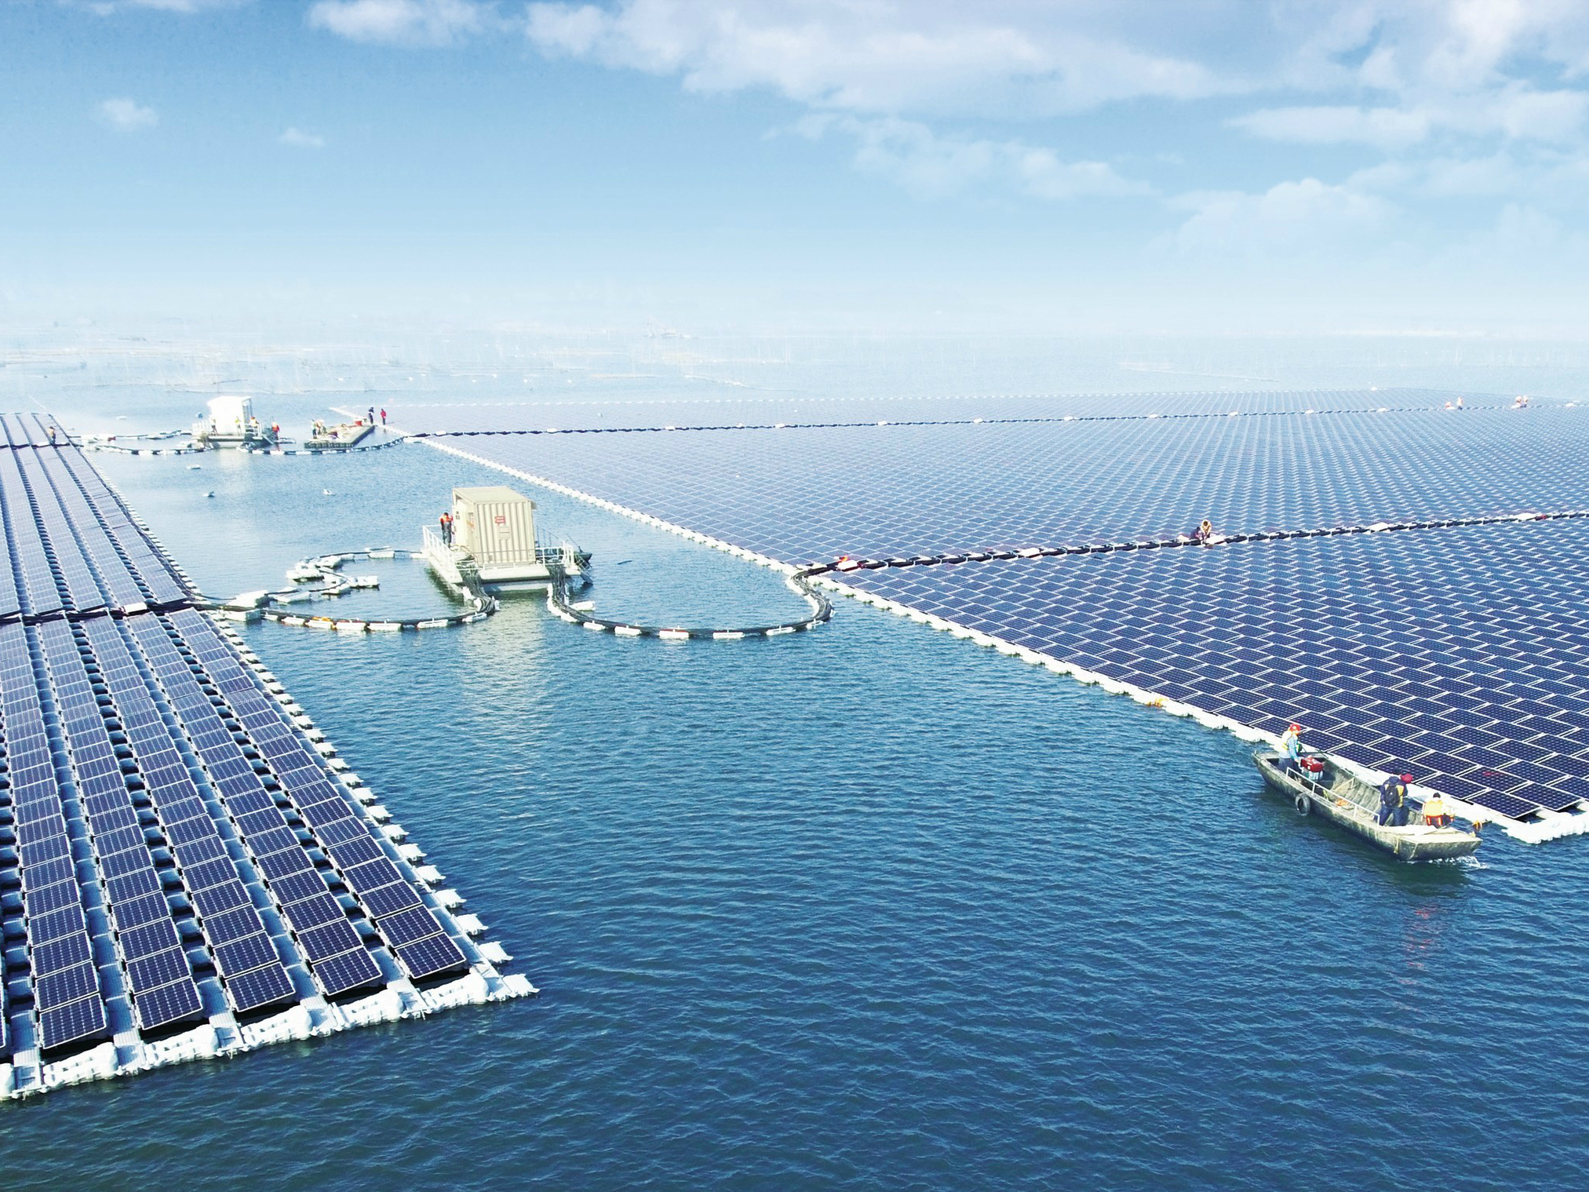
Largest floating solar plant - China

Slide 33
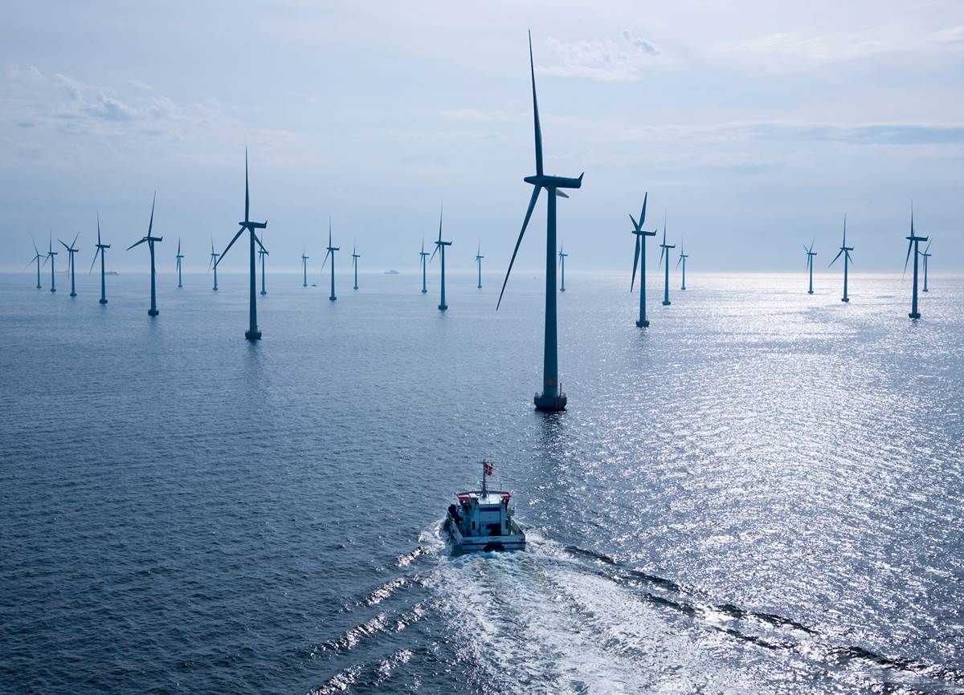
Largest offshore wind farm - North Sea

Slide 34
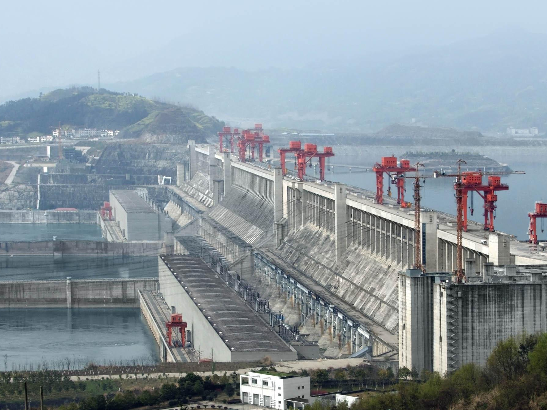
Largest hydroelectric dam-
Three Gorges Dam, China

Slide 35
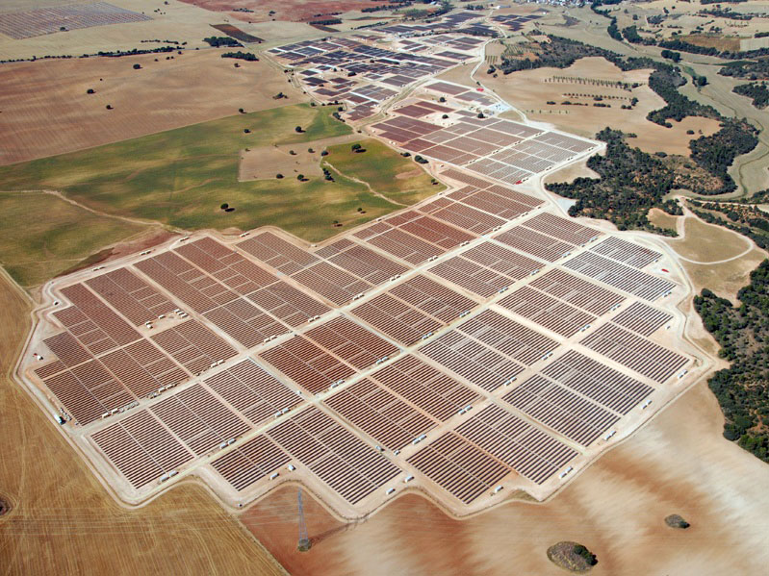
Largest solar plant - Spain

Slide 36

100%?
Do you think it will ever be possible to generate 100% of our energy from renewable resources?
https://www.youtube.com/watch?v=RnvCbquYeIM

Slide 37
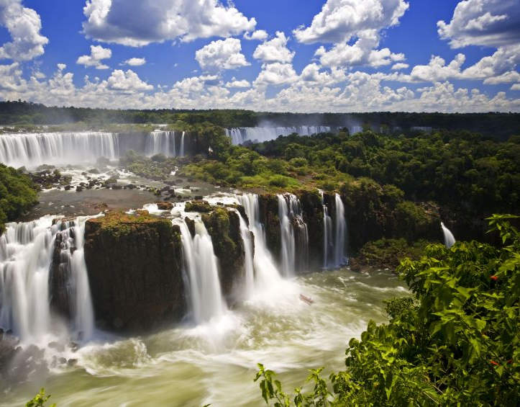
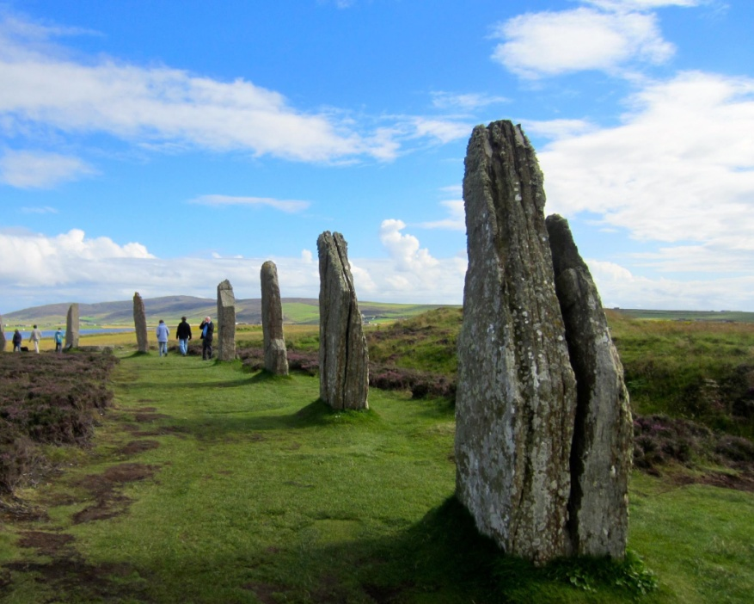
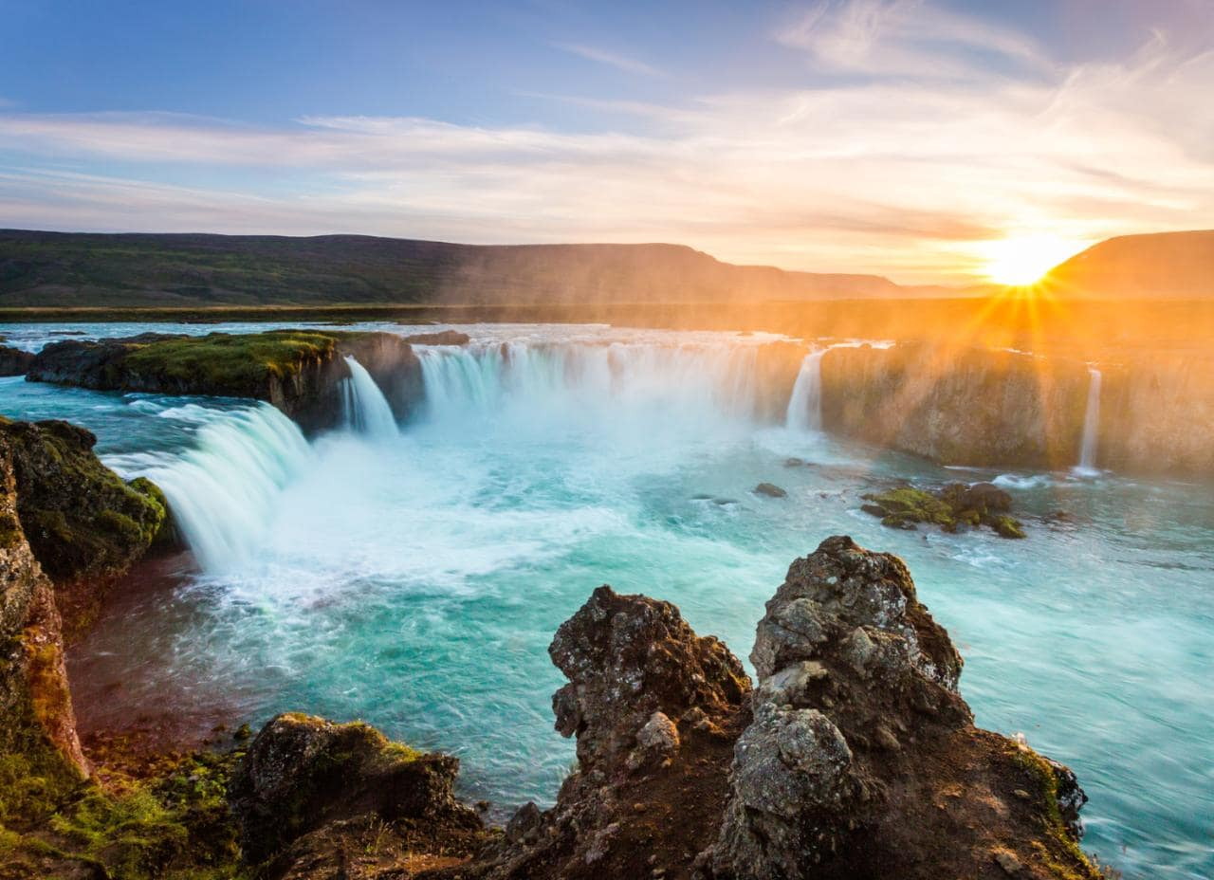
100%?
Some Countries / Cities in the world are already using 100% renewable energy resources!!!
Orkney, Scotland
generates over 100% of its net power from wind and marine power. Connected to the mainland
Paraguay
Electricity sector is 100% hydroelectric. 90% of this is exported with the remaining 10% covering domestic demand.
Iceland
generates 72% of its electricity from hydroelectric and 28% from geothermal, wind .

Slide 38
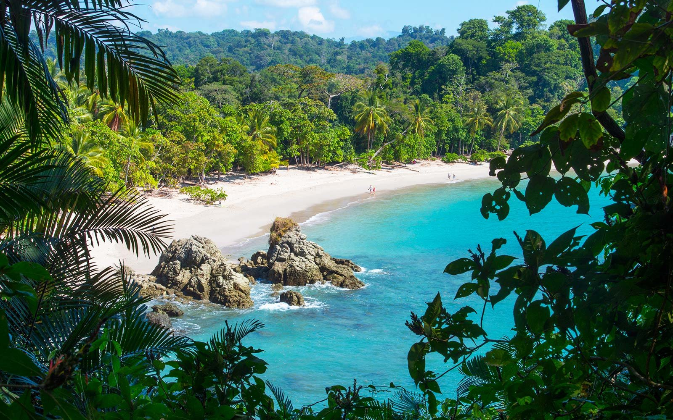


Slide 39
Costa Rica!!!
Population = 5 million.
Constitution = “right to a healthy environment for all citizens”
Doubled Forest Cover in last 30 year to counter deforestation.
Nearly 100% of energy from renewables – went 300 days just using renewable energy.
Recently revealed they now want to become completely carbon –neutral by 2021 = no fossil fuels – transport is big issue!
No army!

Slide 40


Slide 41
Plastic Bag usage down 80% since introduced in 2014.
Recycling of plastic saves on average about 2.5 kg CO2 per kg of plastic.
About 6% of the world-wide oil consumption is used for the production of plastic (with increasing tendency).

Slide 42
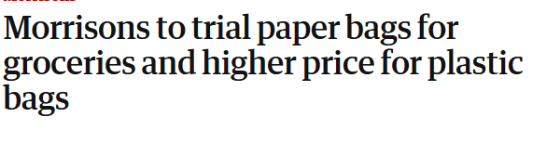



Slide 43

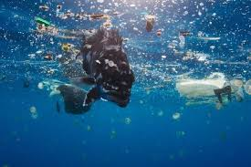
Blue planet 2 – Episode 4: 44 minutes in.
Blue planet 2 – Episode 7: 17 minutes in.
https://www.youtube.com/watch?v=xLx4fVsYdTI
https://www.youtube.com/watch?v=5nPikmzpVwY

Slide 44
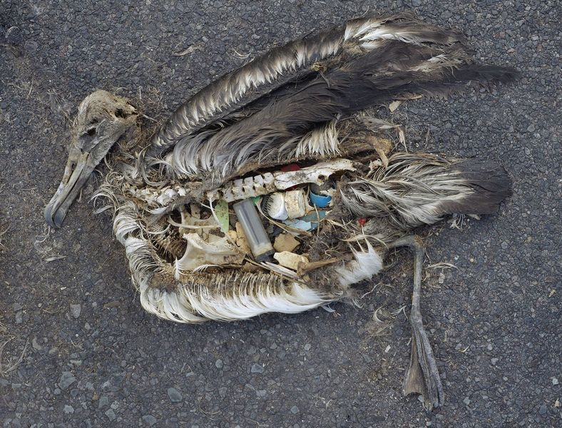
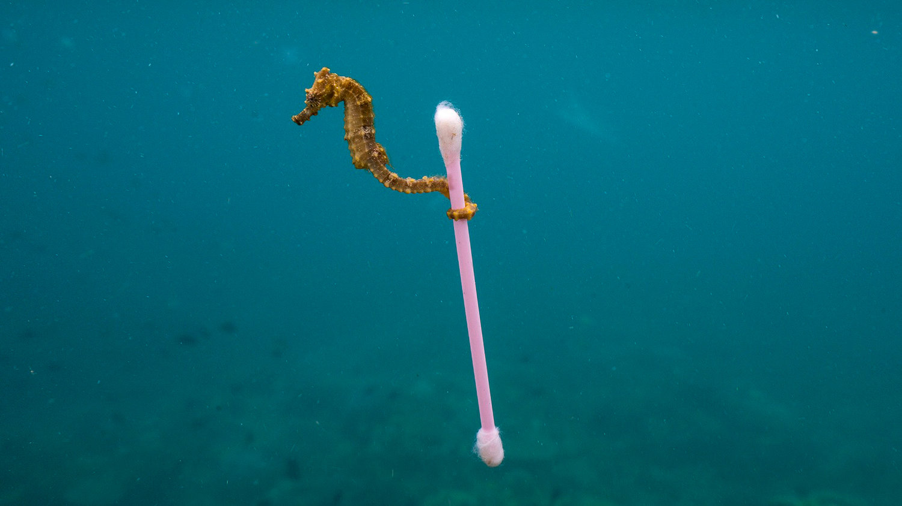

Slide 45
Get rid of cars
Bus Lanes.
Hybrid buses – less greenhouse gases emmited.
Increased number of services and routes.
Cycle lanes introduced.
Car sharing schemes – tripshare.

Slide 46
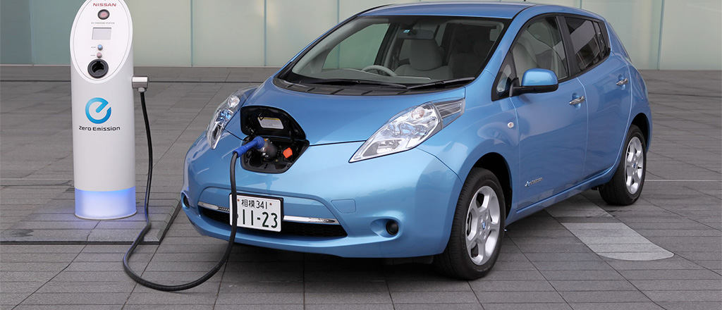

Slide 47
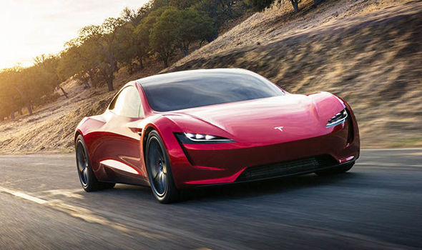

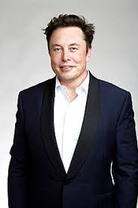

Slide 48
Edinburgh in Top 10 cities that have increased number of people travelling by bus or train.
About 3% increase between 2001 and 2011.
Electric cars registered in UK up by 23% in 2018.

Slide 49
International Level

Slide 50
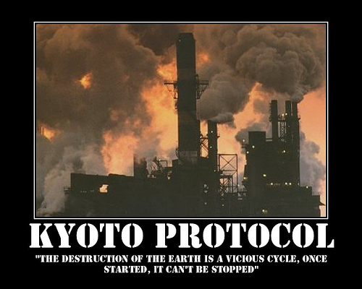

Kyoto Protocol

Slide 51
The Key Facts
An international treaty adopted by world leaders in Kyoto, Japan in 1997 – became effective in 2005.
192 different states part of this.
Agreement calls for participating industrialized countries to reduce their emissions of six greenhouse gases
The overall goal was a reduction of 5.2% below 1990 levels of greenhouse gas emissions between the years 2008 and 2012.
Each country that signed the protocol agreed to its own specific target. EU countries are expected to cut their present emissions by 8% and Japan by 5%
AN INTERNATIONAL APPROACH TO REDUCING GREENHOUSE GAS EMISSIONS!

Slide 52

The USA
In 2001, the USA were the biggest co2 emitters in the world – expected to reduce emissions by 7%.

Slide 53
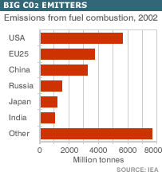
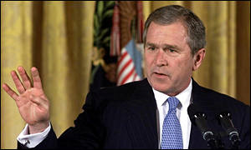
Why the USA didn’t ratify?
US President George W Bush pulled out of the Kyoto Protocol in 2001, saying implementing it would gravely damage the US economy.
At the time, the United States was facing an economic downturn and an energy shortage – he thought the protocol would make that worse - and also make his own position worse.

Slide 54
Bush also opposed the Kyoto protocol, because "it exempts 80% of the world, including major population centers such as China and India, from compliance” – focused on the developed world reducing emissions and not the developing world (China and India were classed

Slide 55

Canada
In 2011, Canada withdrew from the Kyoto Protocol.
Canada had been committed to reducing its production of greenhouse gasses to 6% below 1990 levels by the end of 2012.
However, emissions rose sharply, and were expected to exceed the 2012 target by 30-35 percent.

Slide 56
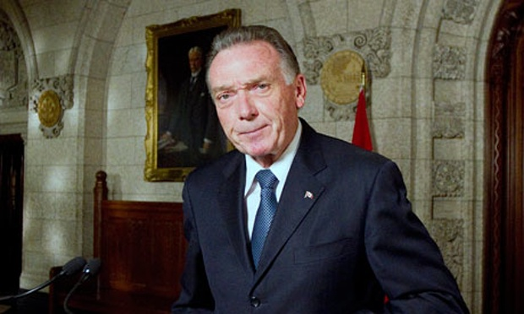
Why Canada pulled out?
Had Canada not withdrawn, its estimated cost of non-compliance would have been in the range of US$13-14 billion – equivalent to $1,600 from every Canadian family
With the U.S. accounting for 75 percent of Canadian exports, Canada was reluctant to put itself at a competitive advantage

Slide 57

An agreement within the United Nations Framework Convention on Climate Change (UNFCCC) dealing with greenhouse gas emissions.

Slide 58
Paris Agreement
https://www.youtube.com/watch?v=3tnDjCA4peY&t=7s
Watch the video and make notes under these two headings
Pledges | Problems

Slide 59
2015 Climate Change Conference Paris
Aimed at reducing global greenhouse gas emissions and thus avoiding the threat of dangerous climate change.
A long-term goal of keeping the increase in global average temperature to well below 2°C above pre-industrial levels;
To aim to limit the increase to 1.5°C, since this would significantly reduce risks and the impacts of climate change;
The EU will cut its emissions by 40%, compared with 1990 levels, by 2030. The US will cut its emissions by 26% to 28%, compared with 2005 levels, by 2025. China will agree that its emissions will peak by 2030.
174 countries signed and began adopting it at National level.

Slide 60
Issues
Poorer countries want the rich world to provide them with financial help that will enable them to invest in clean technology to cut their greenhouse gas emissions, and to adapt their infrastructure to the likely damage from climate change – major obstacle.

Slide 61

Paris Agreement: Who Signed?
195 Countries

Slide 62

United Kingdom
“determined to play our part in the international effort against climate change”

Slide 63

France
“Make our planet great again”

Slide 64

China
“Climate change is a global problem, and requires that the international community cooperate in its response.”

Slide 65

Brazil
“Our government is concerned about the future… everything we do today is not aimed at tomorrow, but rather at a future that preserves the living conditions of Brazilians.”

Slide 66
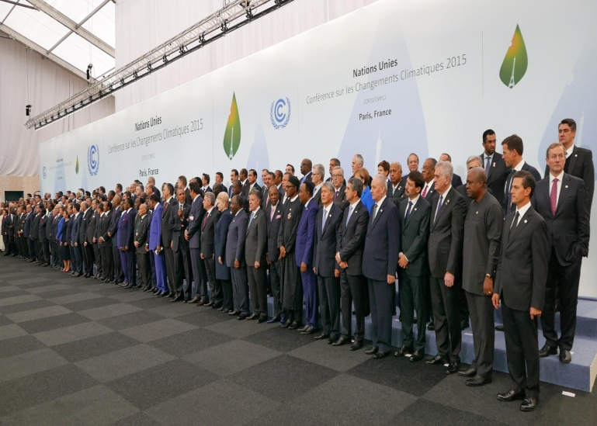
However…
Targets set for each
Country are not legally
binding, with no penalties if not met.
The pledges made are not likely to meet the targets.
A 2017 study found that no major nations are sticking to their pledges.

Slide 67



Paris Agreement: Who Didn’t?
Nicaragua
They didn’t think the agreement went far enough- particularly not punishing those who didn’t follow it. Will continue to counter climate change on their own.
Syria
Was not expected to sign due to the ongoing Syrian Civil War.
USA
President Trump announced that they would withdraw from the deal.
The earliest possible date for this to happen is 4th November 2020.

Slide 68

On June 1, 2017, United States President Donald Trump announced that the U.S. would cease all participation in the 2015 Paris Agreement on climate change. Trump stated that "The Paris accord will undermine (the U.S.) economy," and "puts (the U.S.) at a permanent disadvantage.

Slide 69

Why did the USA pull out of the deal?
Economic concerns
Fossil fuel industry
Climate change denial
Campaign promises
America first

Slide 70
You’re the politician…
If you could write one policy for countries world wide to follow to help with climate change, what would it be? Would there be punishment if they didn’t follow?

Slide 71
Managing Impacts of Climate Change
To manage greater risk of flooding = Thames barrier has protected London from flooding on numerous occasions. But after 2070, predict a second barrier may be needed and greater advanced warning systems to warn households of possible flooding.
To manage extreme heat which causes drought = the UK implemented hose pipe bans (20 million people in 2012) but these are unpopular and difficult to enforce.
Desalination plant built in London for periods of extreme drought only(due to high operation costs).Uses 100% renenwable energy but some feel money should be spent dealing with water wastage.

Slide 72
Managing Impacts of Climate Change
To manage greater risk of flooding = Thames barrier has protected London from flooding on numerous occasions. But after 2070, predict a second barrier may be needed and greater advanced warning systems to warn households of possible flooding.
To manage extreme heat which causes drought = the UK implemented hose pipe bans (20 million people in 2012) but these are unpopular and difficult to enforce.
Desalination plant built in London for periods of extreme drought only(due to high operation costs).Uses 100% renenwable energy but some feel money should be spent dealing with water wastage.

Slide 73
Managing Impacts of Climate Change
To manage greater risk of flooding = Thames barrier has protected London from flooding on numerous occasions. But after 2070, predict a second barrier may be needed and greater advanced warning systems to warn households of possible flooding.
To manage extreme heat which causes drought = the UK implemented hose pipe bans (20 million people in 2012) but these are unpopular and difficult to enforce.
Desalination plant built in London for periods of extreme drought only(due to high operation costs).Uses 100% renenwable energy but some feel money should be spent dealing with water wastage.

Slide 74
Managing Impacts of Climate Change
To manage greater risk of flooding = Thames barrier has protected London from flooding on numerous occasions. But after 2070, predict a second barrier may be needed and greater advanced warning systems to warn households of possible flooding.
To manage extreme heat which causes drought = the UK implemented hose pipe bans (20 million people in 2012) but these are unpopular and difficult to enforce.
Desalination plant built in London for periods of extreme drought only(due to high operation costs).Uses 100% renenwable energy but some feel money should be spent dealing with water wastage.

Slide 75
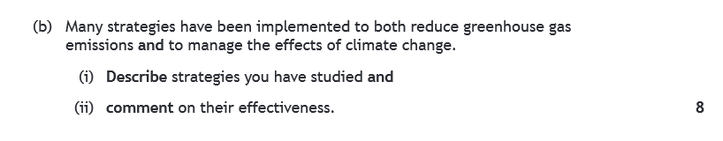
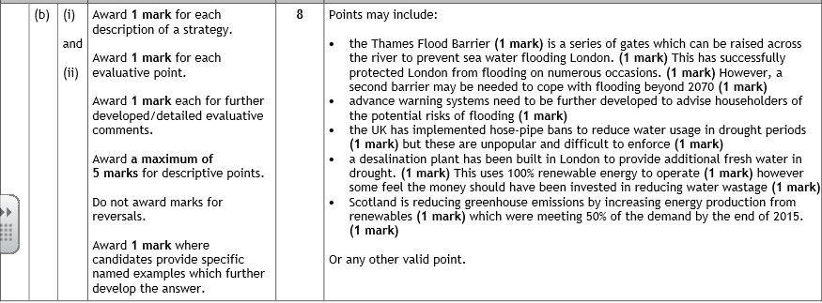
Specimen Paper

Slide 76

Climate Change Pledge!
Your Pledge – After doing this unit, what one (or more!) things to do you pledge to try and change to lower your carbon footprint.

Slide 77
How sustainable are you?
http://www.sustainablestuff.co.uk/quiz-how-green-your-life.html
We are about to do a quiz together as a class.
Write your answers in your jotter to see how green (sustainable) your life is!
NEVER, ALWAYS, SOMETIMES.

Slide 78
Scores
Add Up Your Score
2 points for each Always answer
1 point for each Sometimes answer
0 point for each Never answer

Slide 79
Your Green Score
Less than 12 points
Have you even heard about climate change and the planetary threat? If so, you are not giving it the priority it deserves. As the class teacher would say – Must Do Better!

Slide 80
Between 12-20 points
You are already doing a few basic things – but there is so much more that you could be doing to show your concern for the environment. Note some of the tips in our quiz – and start to implement them

Slide 81
Between 20-34 points
You demonstrate a good environmental conscience – but there’s still room for improvement, so look at the questions where you scored badly and make some changes

Slide 82
Between 35- 40 points
Wow, you certainly know your Greens. If you scored this highly, you can rightly call yourself a Green Champion – well done and keep up the good work!

Slide 83
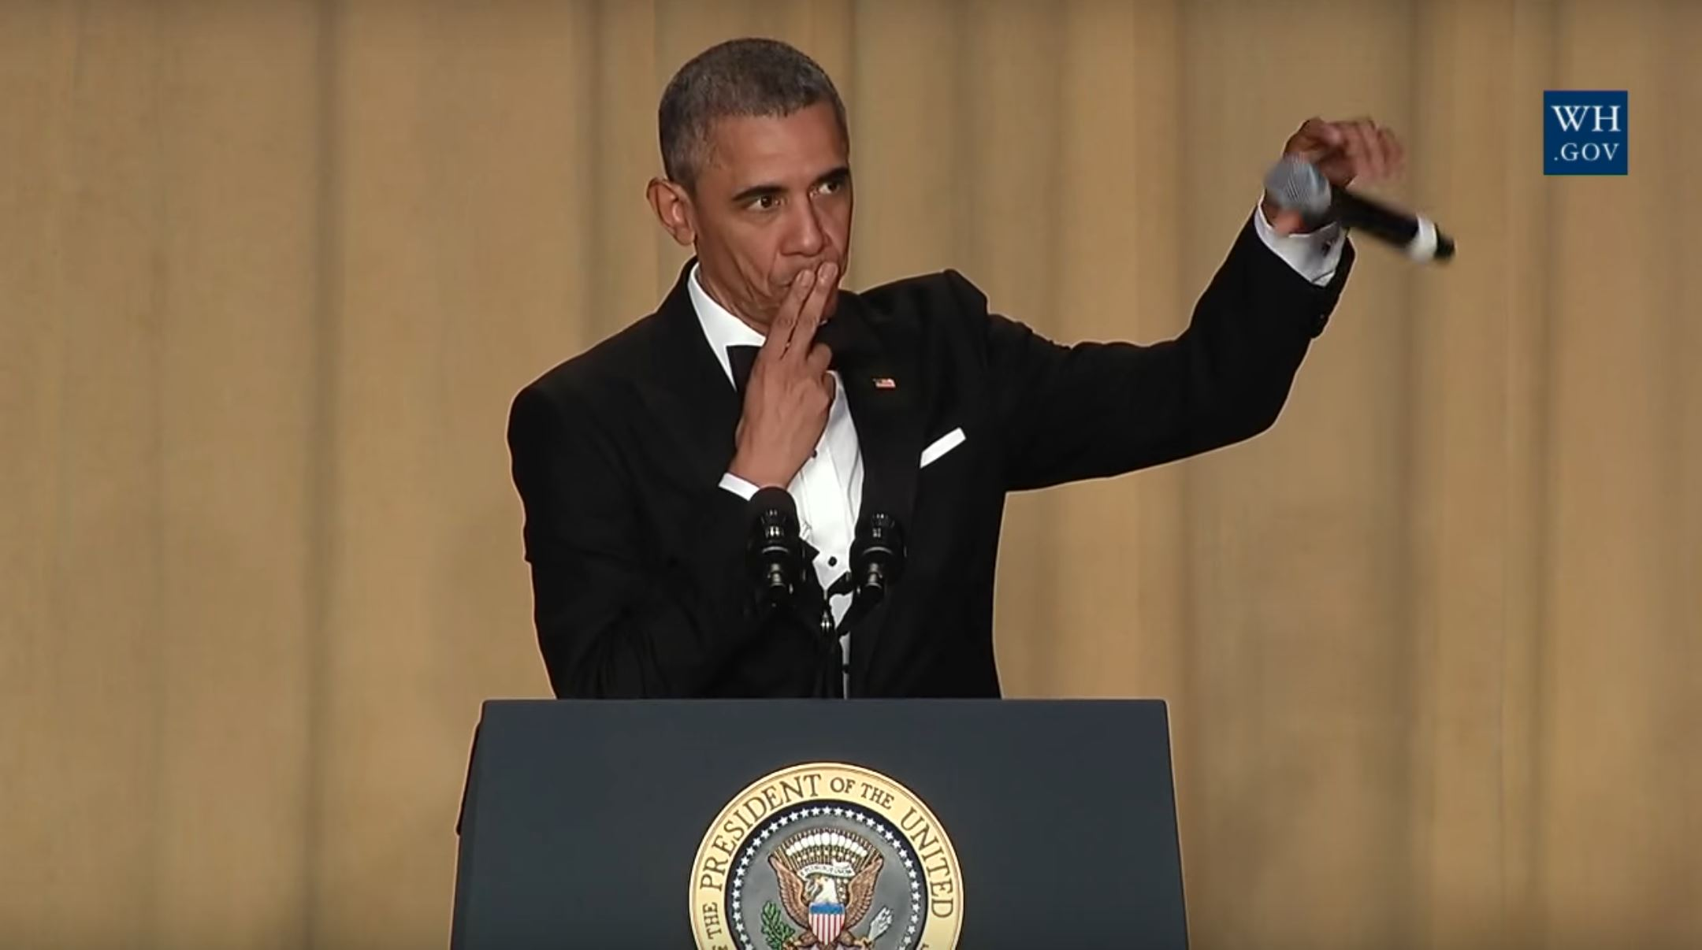
Higher Geography? Completed it!

