Slide 1
Underground Formations
Starter
Jotters away!!!
“Explain the formation of a limestone pavement. You may use a diagram(s) in your answer.” (4)

Slide 2
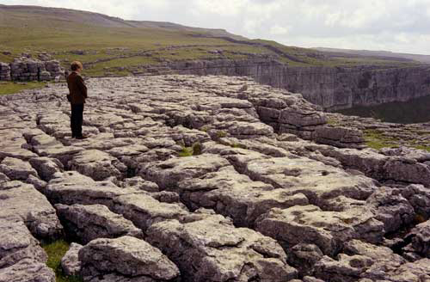
Malham Cove

Slide 3
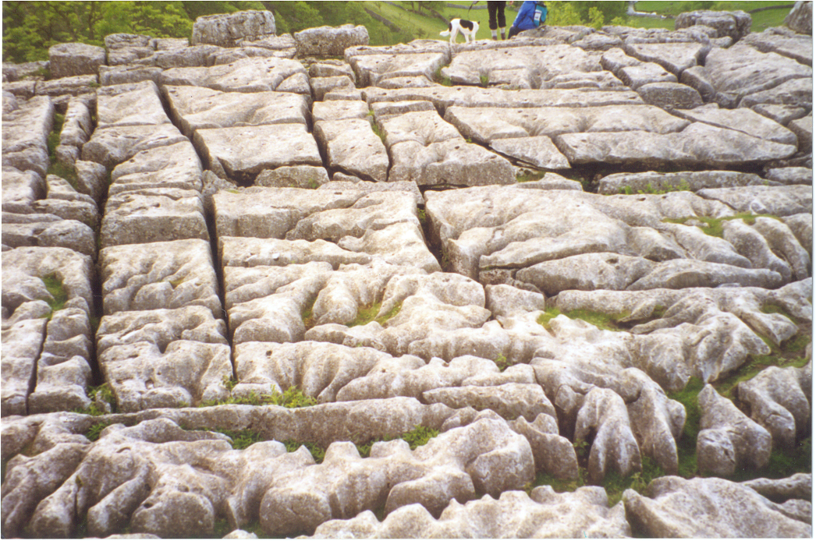
CLINT
CLINT
GRIKE
GRIKE
Limestone pavement, showing its characteristic clints (blocks) and grikes (cracks).

Slide 4
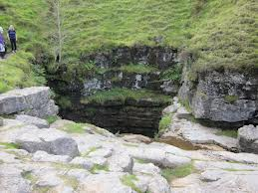
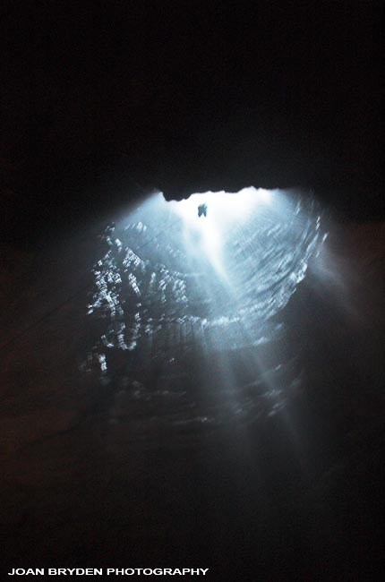
Gaping Gill - Britain’s second
deepest swallow hole
http://www.bbc.co.uk/learningzone/clips/upland-limestone-drainage-features/4706.html

Slide 5
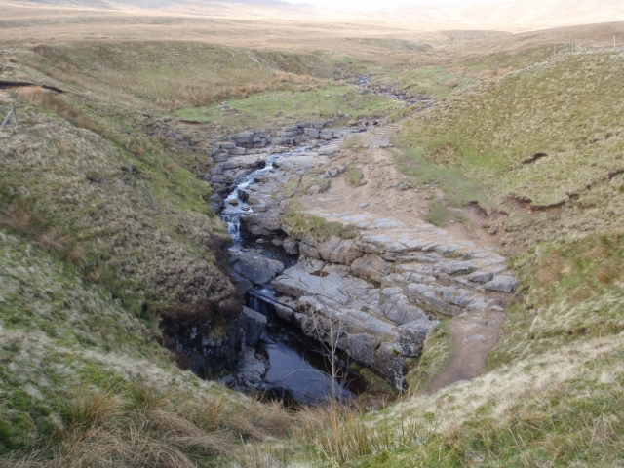

Slide 6
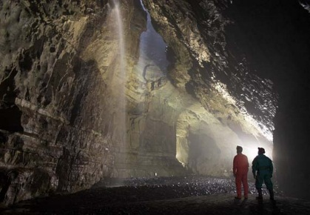

Slide 7
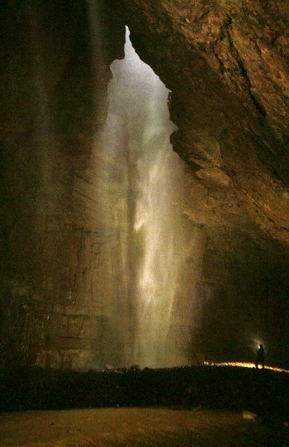
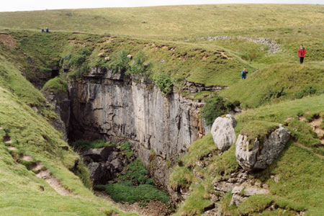
potholes = swallowholes
Fell Beck flows into Gaping Gill pothole -
it falls as a 110m waterfall into Britain’s
largest cave room.
It flows 11km through a series of
underground passages before emerging
at Clapham Beck Head.
Gaping gill

Slide 8
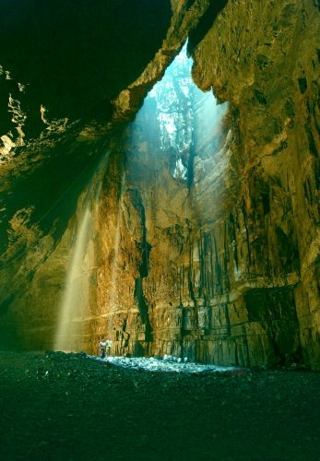
Gaping Gill has been formed over millions of years - the result of chemical weathering enlarging a vertical joint in the limestone. It is over 110 metres deep.

Slide 9
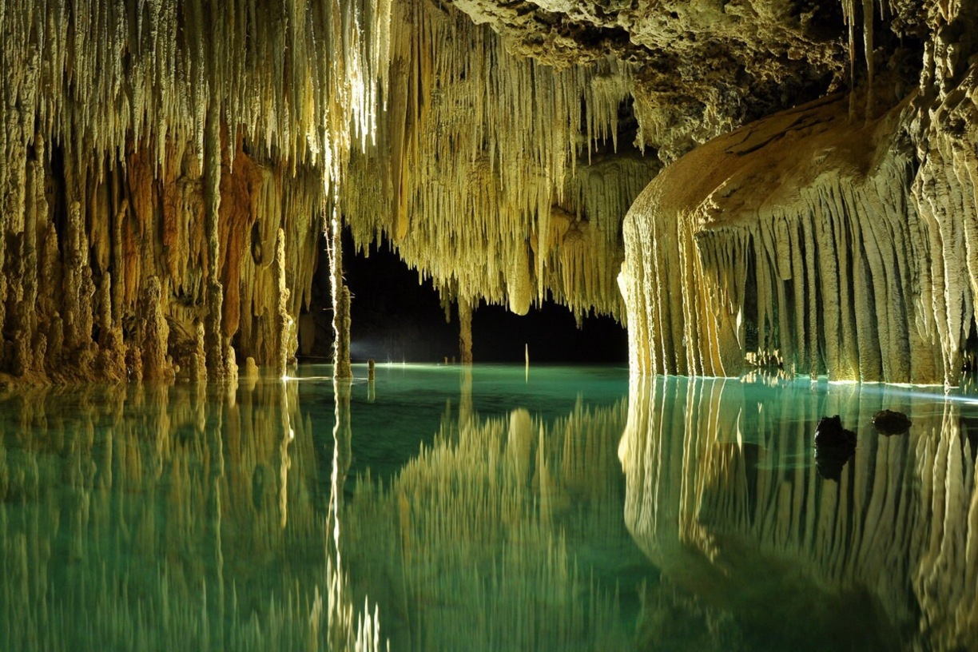
Underground Limestone Features

Slide 10
Learning Intentions
To describe and explain the formation of underground limestone features: cave/cavern, stalactites, stalagmites, pillar, intermittent drainage.

Slide 11
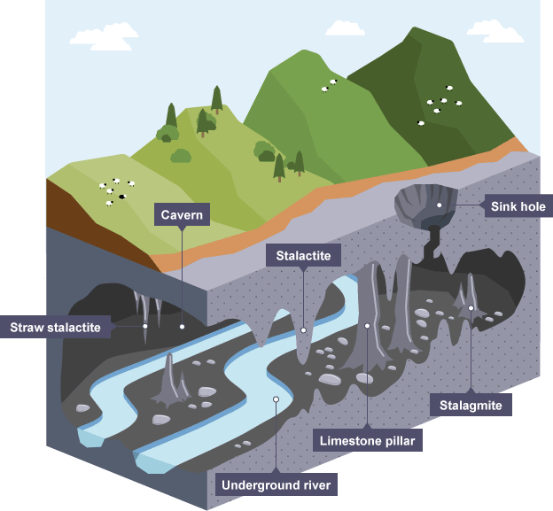
Swallow Hole
Intermittent Drainage

Slide 12
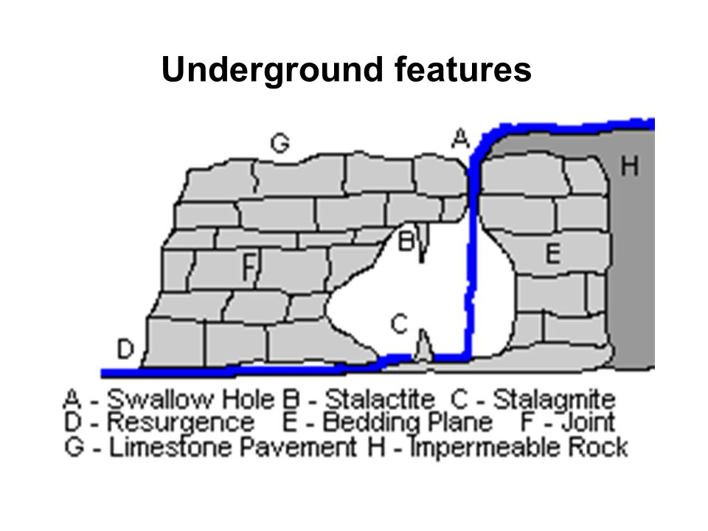

Slide 13
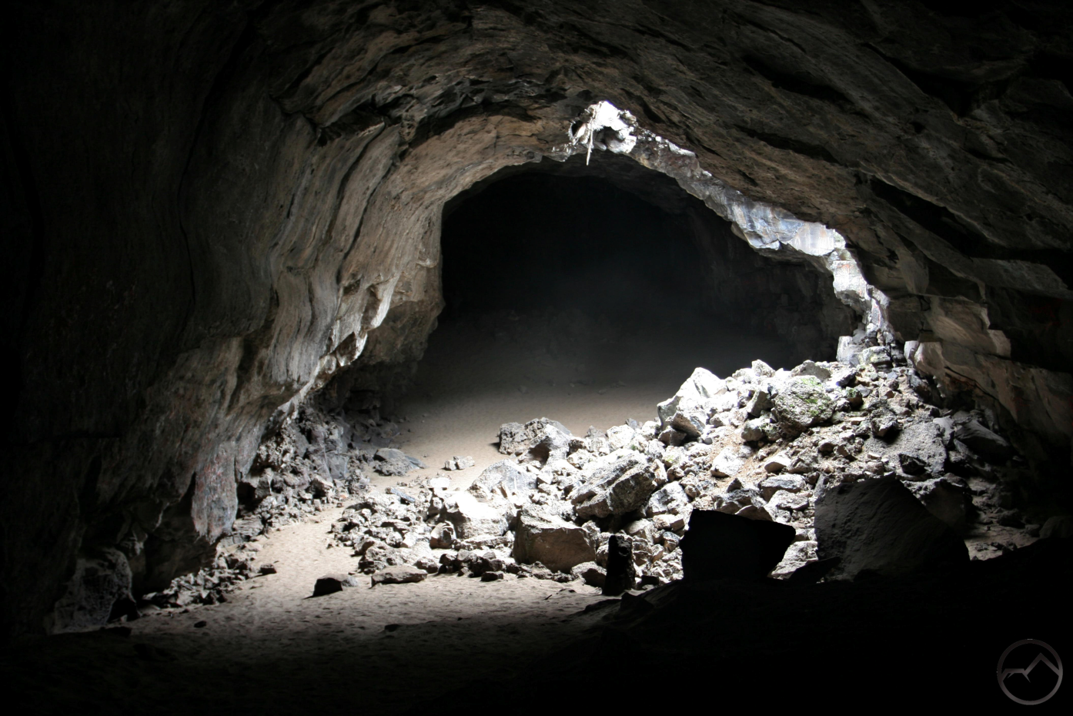
Cave/Cavern Formation

Slide 14
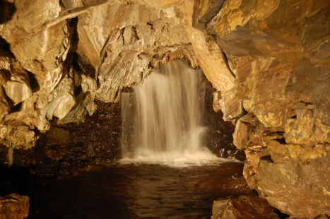
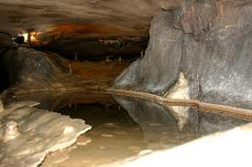

Slide 15
Bit of David Attenborough…
https://www.youtube.com/watch?v=IKZ9EHewjZg
Cave Hotels = https://www.youtube.com/watch?v=5Al7dqnkGhA

Slide 16
Formation of Caverns
As limestone is permeable, water seeps in and begins to flow through the rock through its joints and bedding planes.
Caverns are formed when the water that enters the limestone through a swallow hole makes its way down through the rock.
It flows along the many joints and bedding planes dissolving the limestone as it flows (through carbonation – when the carbonic acid in the rain water dissolves the alkali limestone (calcium carbonate) (a type of chemical weathering).
When some of the underground limestone is dissolved more quickly than the rock around it, a cavern is formed.

Slide 17
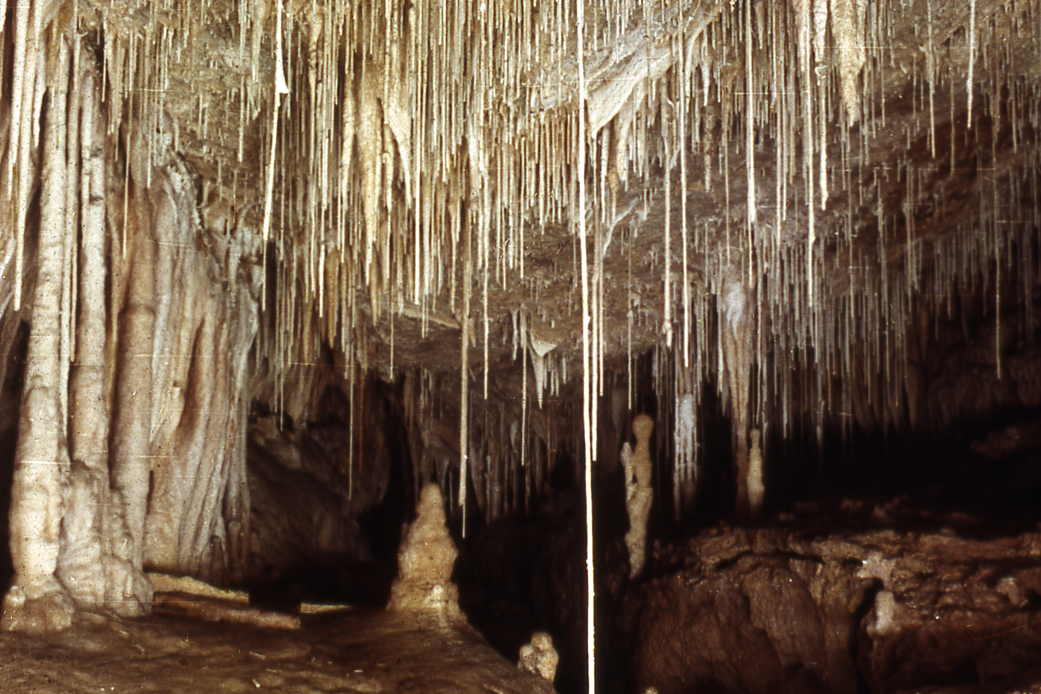
Formation of
stalactites
and
stalagmites

Slide 18
Underground features
stalactite
pillar
cave
stalagmite

Slide 19
Stalactites
The water that drips down into the cavern is laced with calcium carbonate (produced from carbonation).
The water drips from the roof extremely slowly, allowing for evaporation to occur - leaves behind the calcium carbonate, which is deposited on the roof as dripstone.
The deposits build up and the dripstone grows downwards to form stalactites.
Stalactites grow very slowly due to the caverns being very cold allowing little evaporation to occur.

Slide 20
The water continues to drip and evaporate.
The deposits build up to stalactites that grow downwards into the cavern.

Slide 21
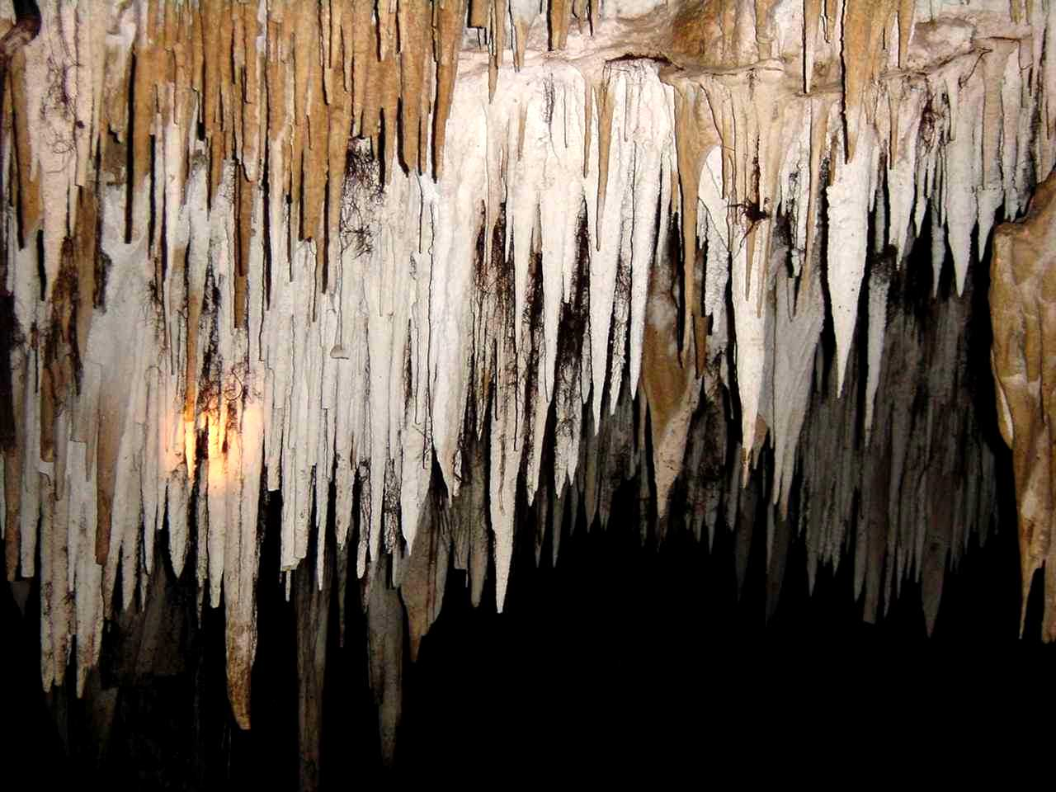
Stalactites grow down from the cave roof…on average about one inch every 500 years.

Slide 22
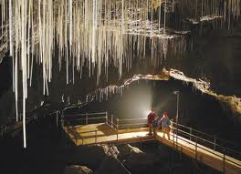
Straw stalactites - slender, hollow and faster growing, grow about one inch every 100 years.

Slide 23
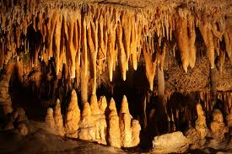

Slide 24
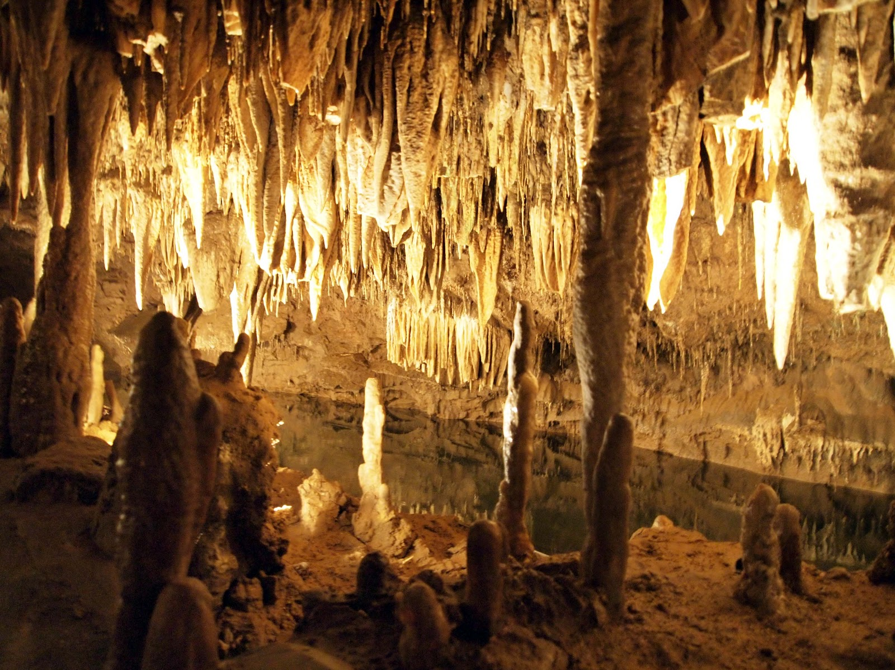
...stalagmites grow up from the cave floor

Slide 25

Stalagmites
Some of the water drips onto the cavern floor, where it evaporates, leaving behind calcium carbonate as dripstone.
As more water drips down, more is deposited.
This results in the dripstone building up and growing upwards from the cavern floor.
This forms STALAGMITES.
Stalagmites grow just as slowly as stalactites.
Eventually over thousands of years, the two can join to form a pillar.

Slide 26
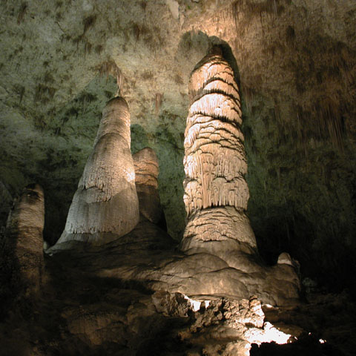
Limestone pillars formed when stalactites grow upwards and the stalagmites grow downwards until they meet.
When they meet they form a pillar.

Slide 27
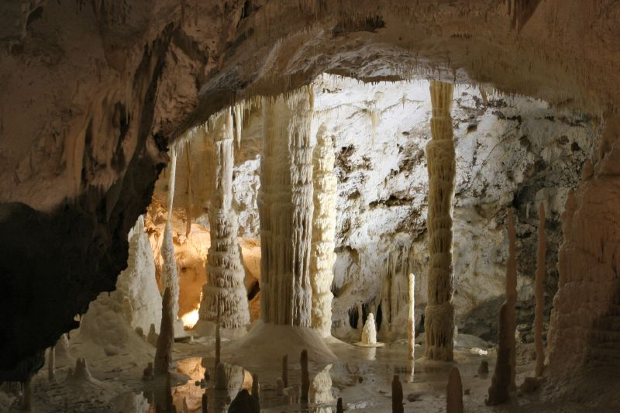
Columns or pillars

Slide 28
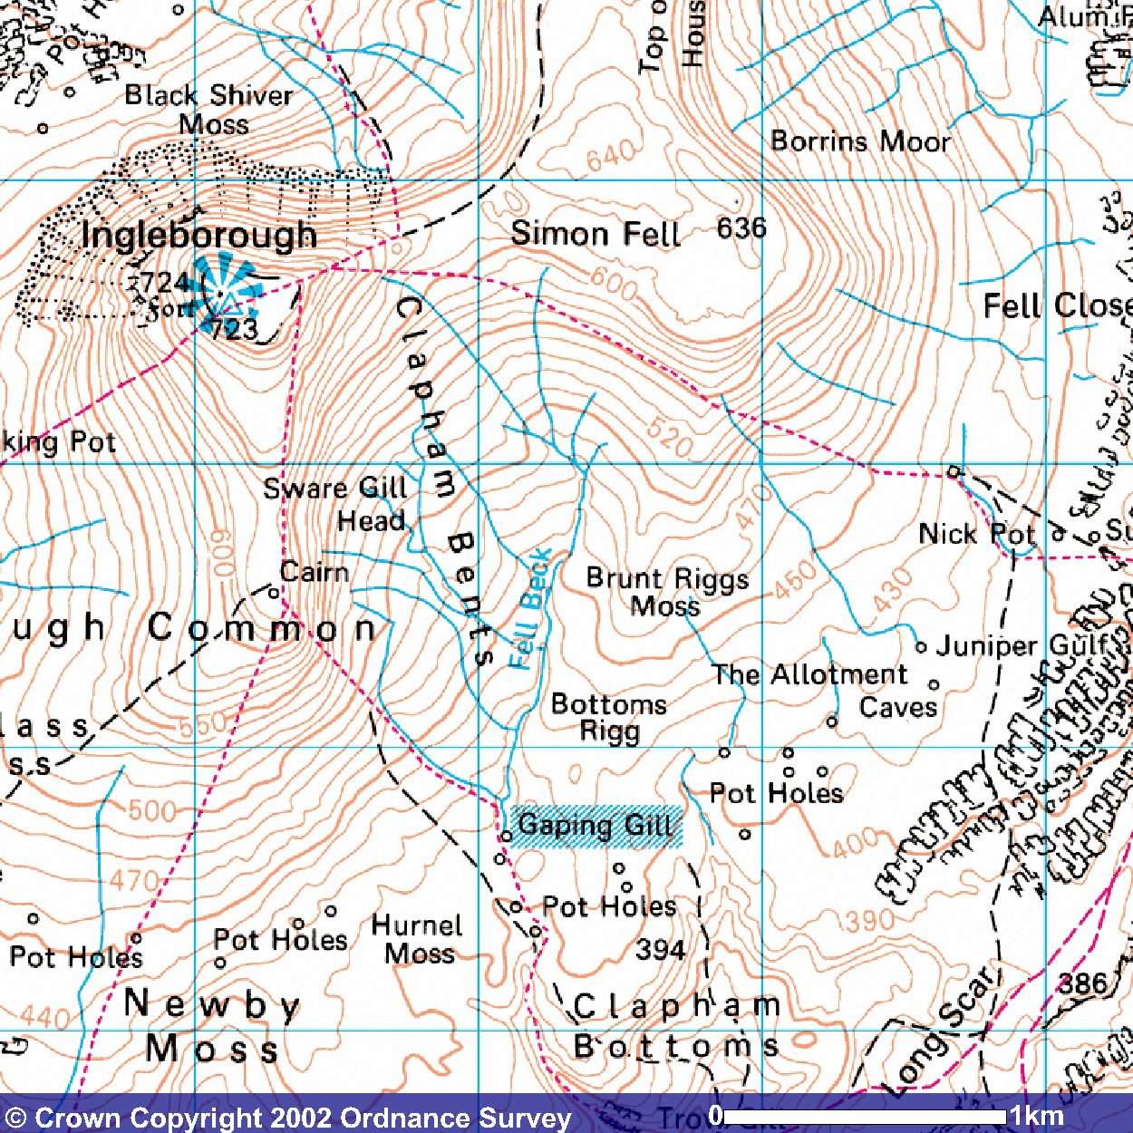
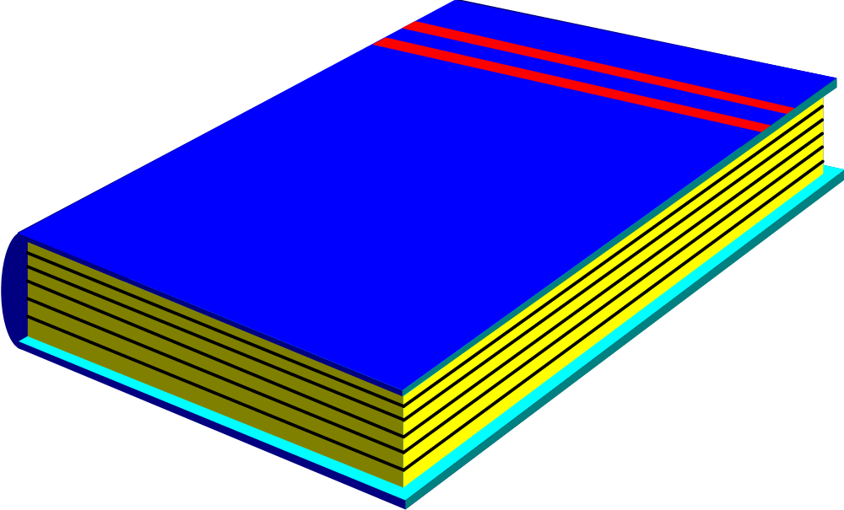
Core Higher
GEOGRAPHY
page 118
Caves/caverns

Slide 29
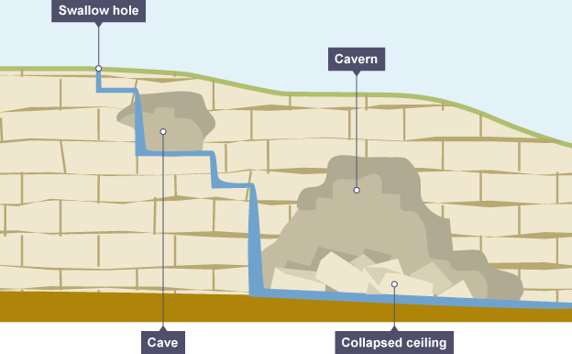
Intermittent Drainage

Slide 30
What is intermittent drainage?
When water flows over ground on impermeable rock and then disappears underground when it flows onto permeable rock.

Slide 31
Intermittent Drainage
Streams flowing over limestone rock disappear down swallow holes and flow down the joints and bedding planes until the water reaches the impermeable water table.
The water/stream flows along the water table until it reaches the surface and appears as a spring.
After heavy rainfall the water table can rise.
At these times the underground streams come to the surface.
As these streams do not flow over the surface all the time they are called intermittent streams.
The area is said to have an intermittent drainage.

Slide 32
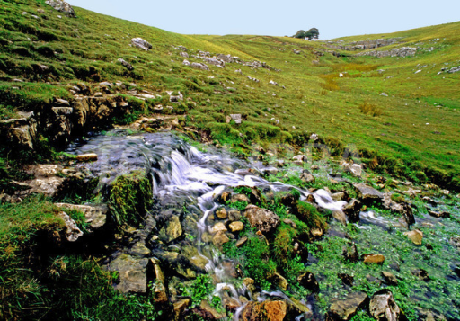
Resurgence/Spring
When a stream disappears it travels underground through a complex series of caves and eventually works its way down to a level of impermeable rock or until it reaches the top of the water table.
The stream travels along the surface of the impermeable rock until it reaches the surface as a spring.

Slide 33

Wheel of Fortune!
Without jotters, explain the formation of…..
https://www.classtools.net/random-name-picker/70_3E2M72

Slide 34
Assignment Write Up - Monday
Must bring PI sheets – make sure all labelled with figure numbers (Figure 1,2,3 etc.) – 2 single sides of A4.
Over weekend learn key points (mainly your explanations – worth 11 marks).
Remember to try and say why each method is good/bad and be clear about what exactly you did.

Slide 35
Last Minute Explanation Revision

Slide 36
Formation Posters
My walls are looking very bare!
In pairs, create a poster to explain the formation of one of the features we have learnt – can make it 3D:
Limestone Pavement (including clints and grykes), Swallow Hole, Cave, Stalactite, Stalagmite, Pillar,, Intermittent Drainage.
Include nice coloured diagrams and highlight key points in the explanation

Slide 37
Limestone Pop Up Model!
Create a pop up model to sum up some of the above ground and underground features that we have learnt.
Create a key to show what features you have labelled.

Slide 38
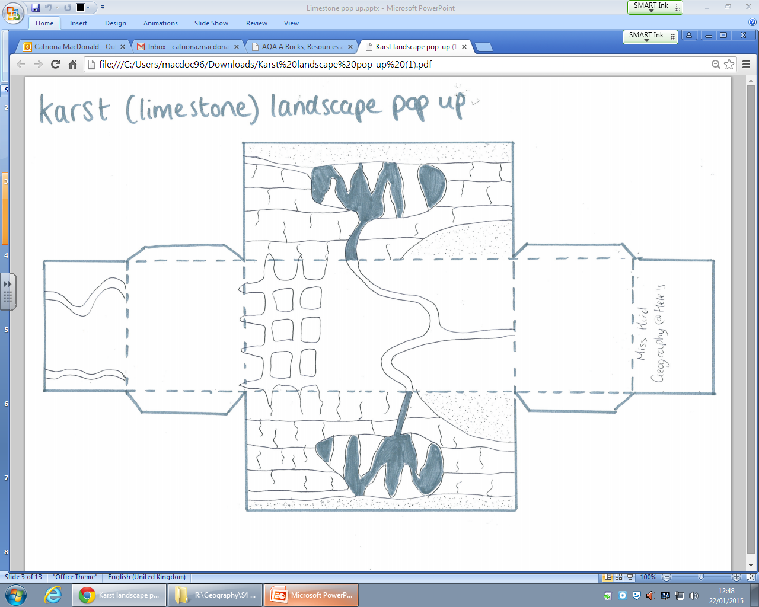
Back
Base

Slide 39
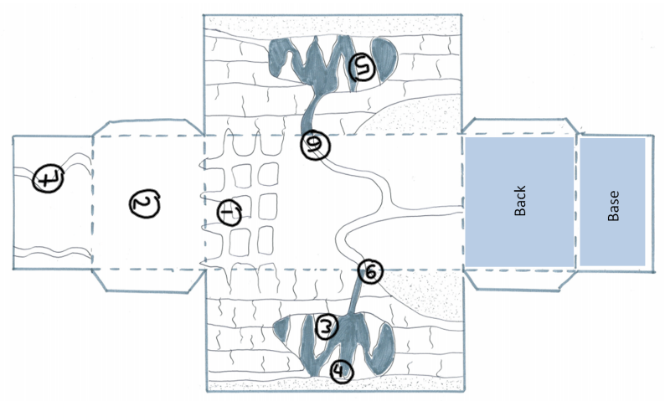
Limestone Feature Pop up model
Cut around this template
Fold the dashed lines
Stick the tabs
Create a key for the 7 features
Features Box
Pillar
Stalactite
Stalagmite
Scar/ Cliff
Limestone pavement
Swallow Hole
Spring

Slide 40
Planet Earth - Caves
https://www.bbc.co.uk/iplayer/episode/b0074sh2/planet-earth-4-caves

