Slide 1
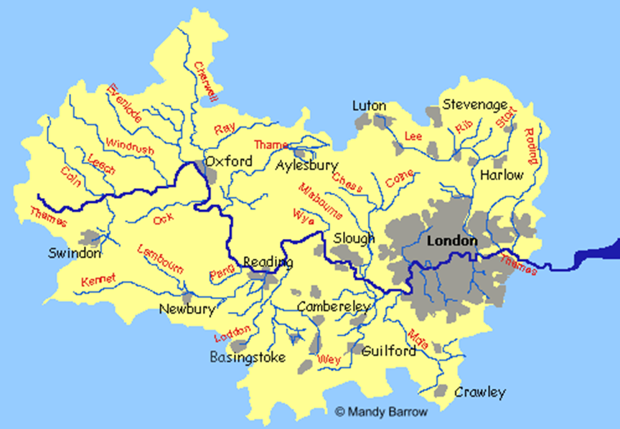
1
4
2
5
3

Slide 2
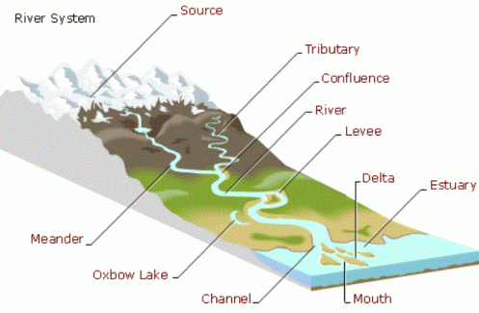
The Profile of a River

Slide 3
Background Info
A river changes in many different ways on its journey from the source to the mouth.
The river can be split into three different courses: Upper Course, Middle Course, Lower Course.
It is important that you know the different characteristics of each course.

Slide 4
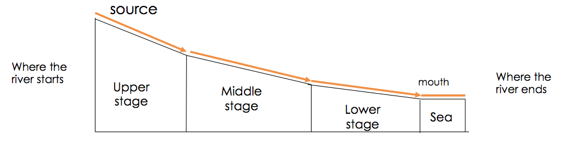
The Long Profile of a River

Slide 5
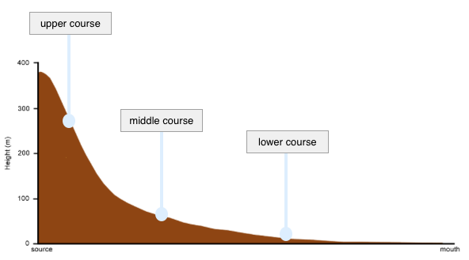
In Graph Form

Slide 6
River Severn Video
Split your page into three: upper, middle, lower.
Watch the video about the journey of the River Severn.
Write down any observations at all you make about each section (what does it look like? Any features etc?)
https://www.youtube.com/watch?v=_M48ANM3hAQ

Slide 7
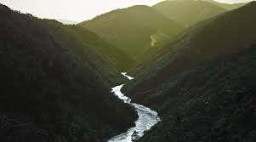
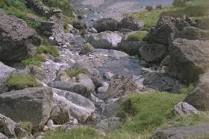
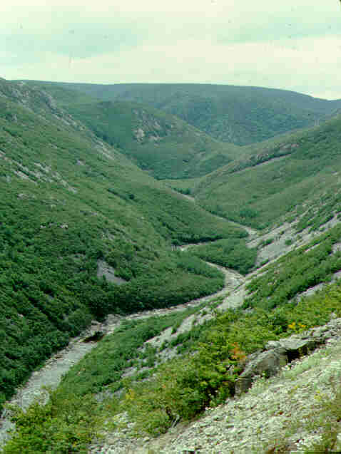
Upper Course

Slide 8
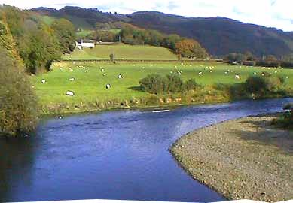
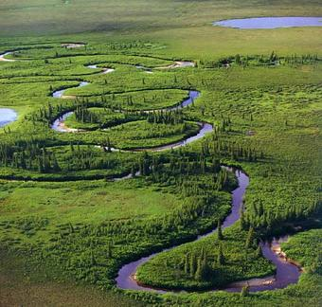
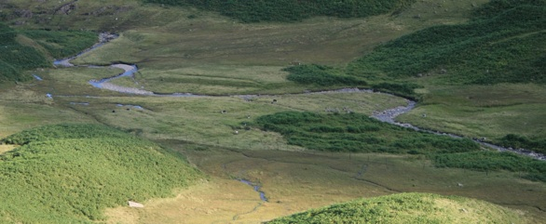
Middle Course

Slide 9
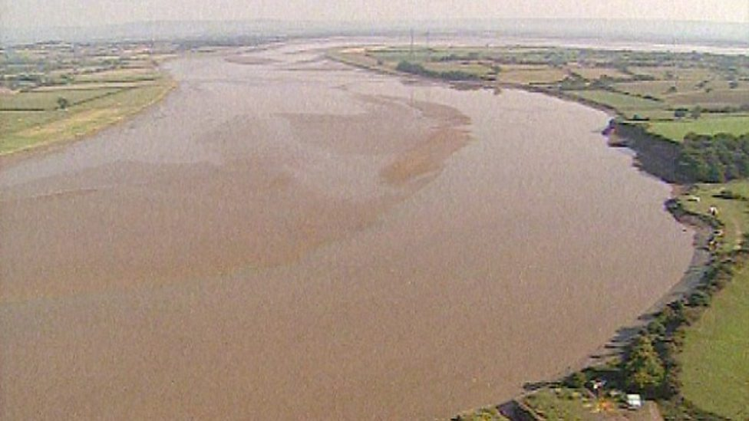
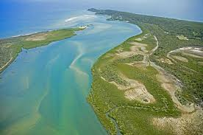
Lower Course

Slide 10
Different Features
V Shape Valley
Waterfall
Meander
Ox Bow Lake
River Beach/River Cliff
Floodplain

Slide 11
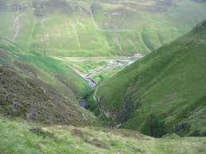

Slide 12
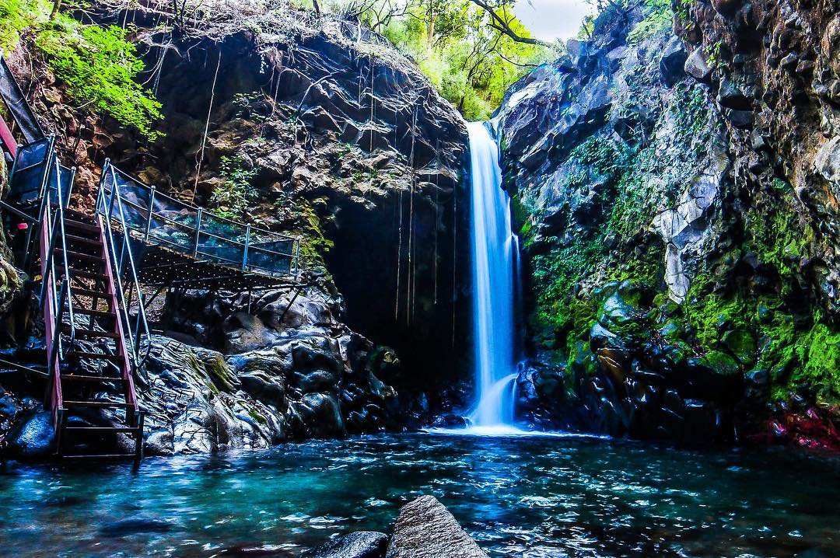

Slide 13
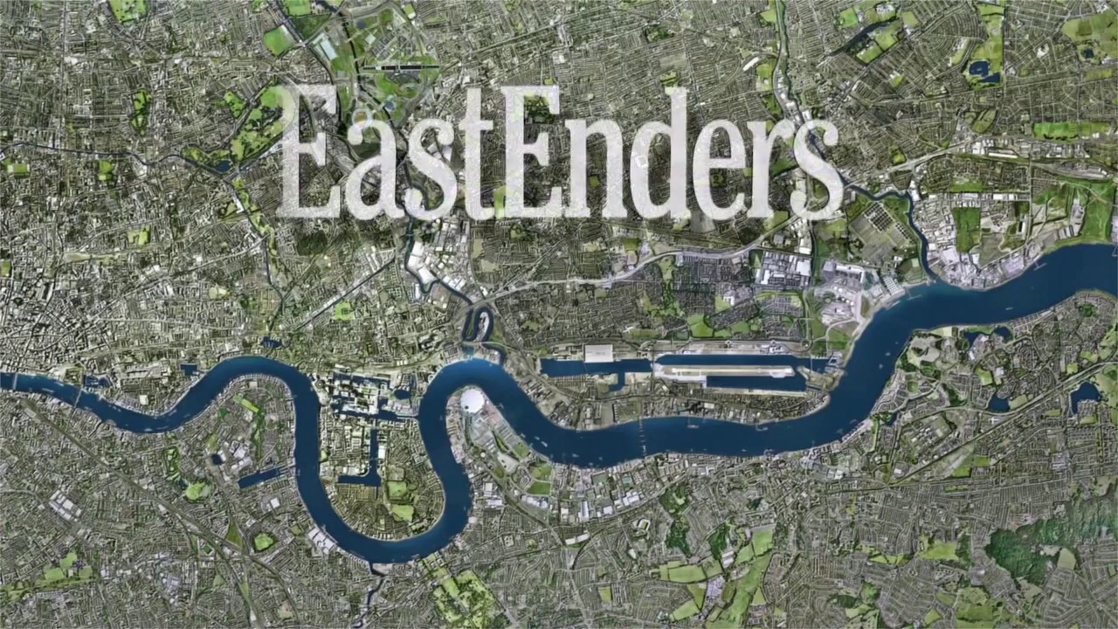

Slide 14
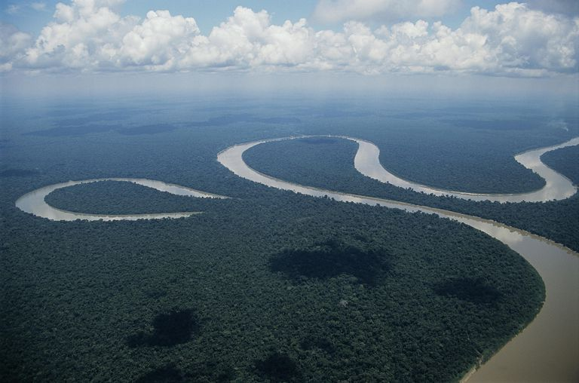

Slide 15
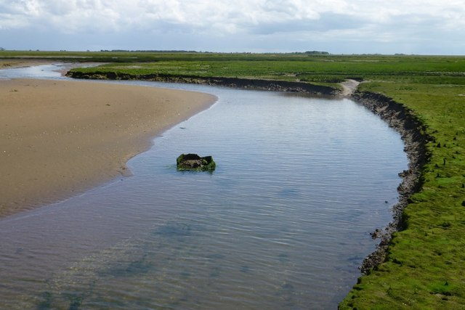

Slide 16
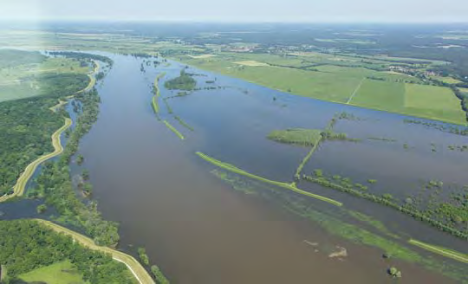

Slide 17
Characteristics | Upper Course | Middle Course | Lower Course
Slope | Steep | Getting flatter | Flat
Width | Narrow | Getting wider | Widest
Depth | Shallow | Getting deeper | Deepest
Load | Sharp angular pebbles | More rounded pebbles | Small pebbles, sand and silt
Features | Waterfall, V Shape Valley | Oxbow, Meander,Floodplain, River Cliff/Beach | SAME AS BEFORE + Levees, deltas
Main work/processes | Vertical Erosion and Transportation | Lateral Erosion, Transportation and some deposition | Mainly deposit, transportation.

Slide 18
Feature Sort
Split your table into three columns – Upper Course, Middle Course, Lower Course – or draw a river system!
Sort the cards into what area you think they apply to – use what you have learnt from the video.
When I say you have guessed it correct –complete the table into your jotter.

Slide 19
Characteristics | Upper Course | Middle Course | Lower Course
Slope
Width
Depth
Load
Features
Main work/processes
Steep gradient
Gentle sloping
More gentle sloping
River is narrow
River starting to widen
River at its widest
Very shallow
River becomes deeper
River at its deepest
Heavy and angular
Smaller and rounder
Very fine silt and sand
Floodplain, bigger meanders, ox-bow lakes, levees, deltas
V-shaped valleys and waterfalls
Floodplain, meanders, river beaches/cliffs, ox-bow lakes, levees,
Vertical erosion and transportation
Mainly deposition, transportation and some erosion
Lateral erosion, transportation and some deposition

Slide 20
What does erosion mean?

Slide 21
What does erosion involve?
Erosion take place in four different ways:
1. Hydraulic action is the force of just the water in the river wearing away
the land.
2. Abrasion is the force of the water plus the load (rocks etc) that the river is
carrying, wearing away the land.
3. Attrition is the material that the river is carrying, breaking each other down in
the river
4. Solution is the acid in the river water, dissolving the rock and wearing it down.

Slide 22
Why might a river deposit its load?

Slide 23
What does deposition involve?
A river choses to deposit its load for the following three reasons:
The material that it is carrying is too heavy.
The river has lost power/speed/energy and no longer can move the
material (heaviest material deposited first)
3. The river doesn’t have enough water to move the material

Slide 24
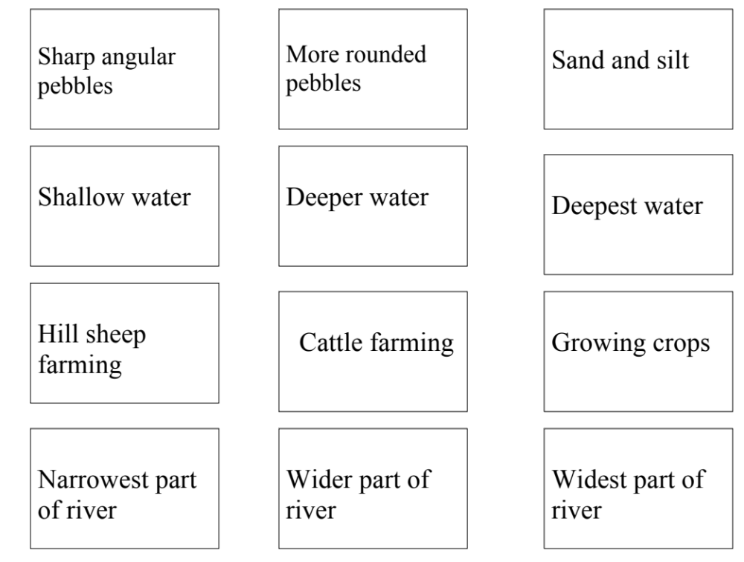
Steep Land
Floodplain
Lots of tributaries

Slide 25
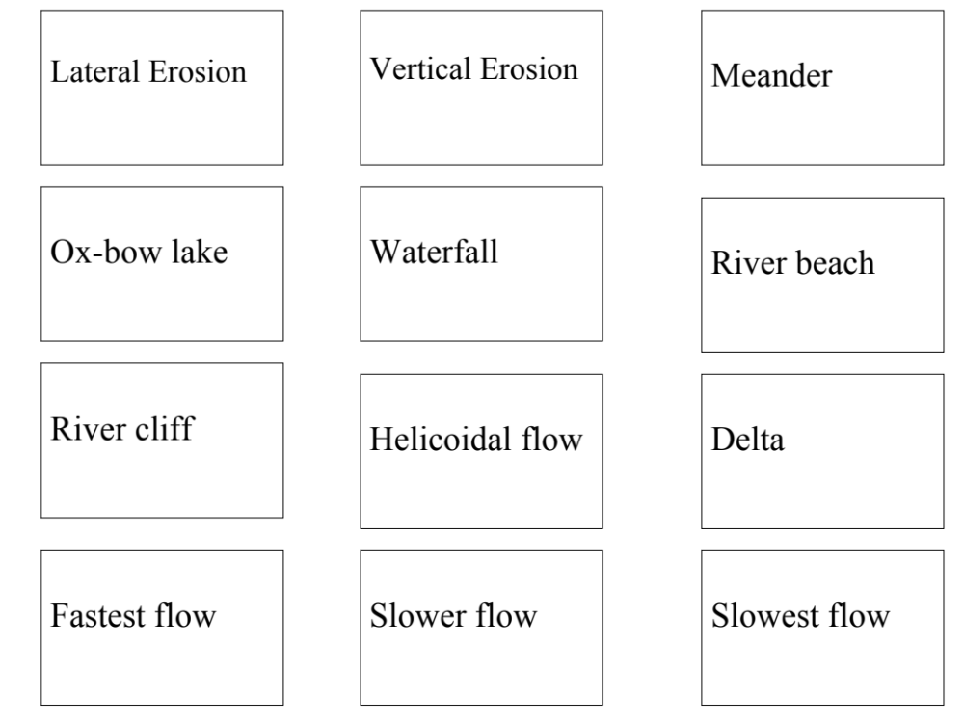
Source
Mouth

Slide 26

How well have you remembered?

Slide 27
The Journey of a River – from Source to Mouth
Pick a river – River Forth is my suggestion but feel free to challenge yourself.
Using Google Maps/Google Earth to make a virtual river profile on powerpoint.
Include a slide for each river courses:
Screenshot of any features you find (source, mouth, meander etc) Descriptions on labels - what is width?depth? Slope?What does the river look like? – straight,narrow etc. Describe features (meander – fast on outside but slow on inside means…)
Try say where that course starts (Stirling, Ben Nevis etc).
Send these to me when you are done.

