Slide 1

Population Density and Distribution

Slide 2
Learning Intentions
To be able to describe world population patterns (distribution) and density.
To explain why people live where they do.

Slide 3
What do they mean?
Population Distribution:The way in which people are spread across a given area. Geographers study population distribution patterns at different scales: local, regional, national, and global.
Population Density: the average number of people per square kilometre. It is a way of measuring population distribution and shows whether an area is sparsely or densely populated

Slide 4
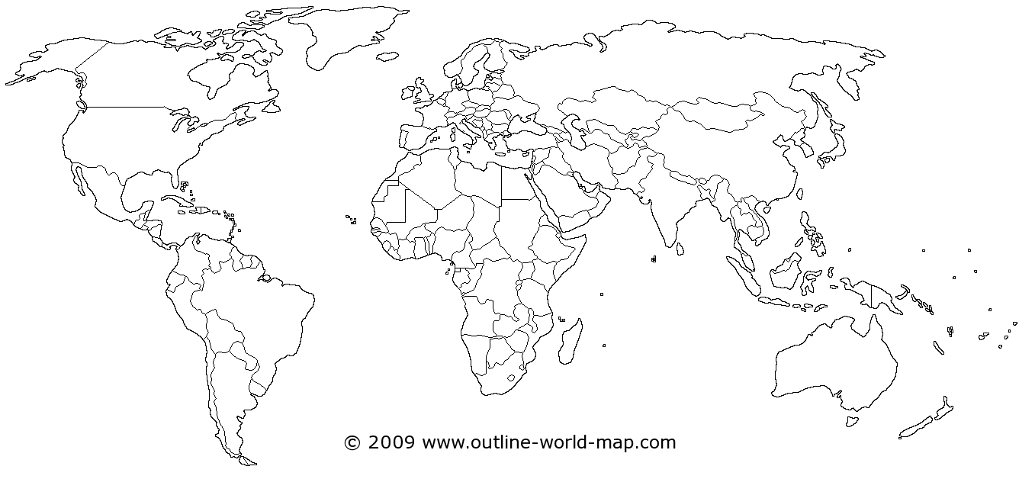

Slide 5
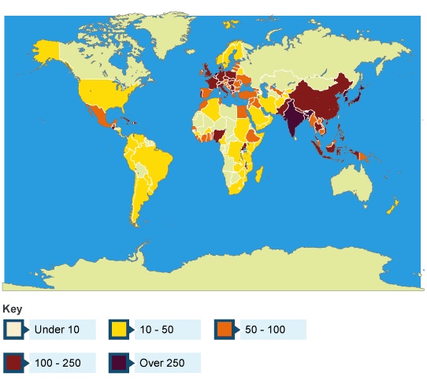
Describe the distribution of the world’s population (3).

Slide 6
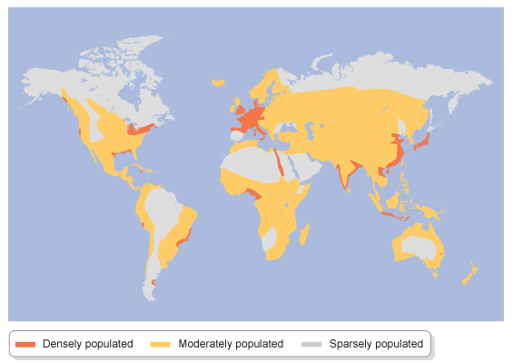
Population Density

Slide 7
Density – Densely populated v sparsely populated
Densely Populated:A lot of people in that one area.
Sparsely populated: Little amount of people in that one area.

Slide 8
What affects population density (where people live)?

Slide 9
Reasons
There are a number of reasons which affect population density (where people live). These can be split into physical and human.
Physical = Climate, soil, relief, natural resources
Human = Communications, technology, economic activities (industry and jobs).

Slide 10
Physical Factors – what do you think?
Physical Factor | High Density | Low Density
Relief (shape and height of land)
Resources
Climate

Slide 11
Physical Factors – Answers
Physical Factor | High Density | Low Density
Relief (shape and height of land) | Low land which is flat – Ganges Valley in India | High land which is mountainous - Himalayas
Resources | Areas rich in resources (eg coal, wood, oil, fishing etc) tend to be densely populated = Western Europe | Areas with little resources tend to be sparsely populated = The Sahel
Climate | Temperate climates tend to be densely populated due to enough rain and heat to grow crops = UK | Areas with extreme hot and cold tend to be sparsely populated = Sahara desert.

Slide 12
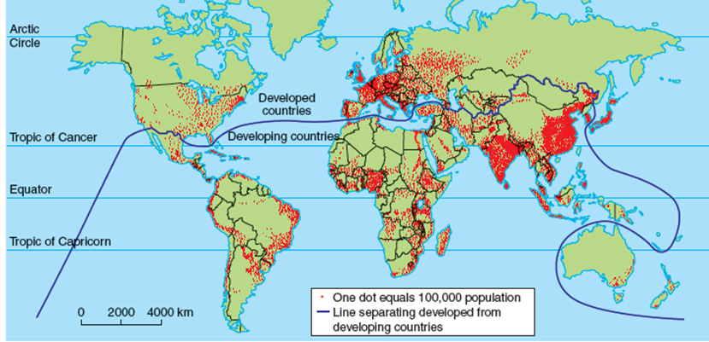

Slide 13
Textbook Task – Page 59
Stick in the world map I have given you.
Read and make “explain” sentences on how the seven different reasons affect population distribution and density. You must include examples and talk about both sparsely and densley populated.
Example = “Cold places are sparsely populated because the ground is frozen so you cannot grow crops to live on.”

Slide 14
Next Stage
Colour code = Physical and Human.

Slide 15
“Explain…” (Give Reasons)
Deep fertile soils.
Unreliable water supplies.
High, rugged mountains.
Ports.
Education, health facilities, entertainment.
Lack of industrial development.

Slide 16
Starter Questions
Explain a physical factor that may influence population density.
Explain a human factor that may influence population density.

Slide 17
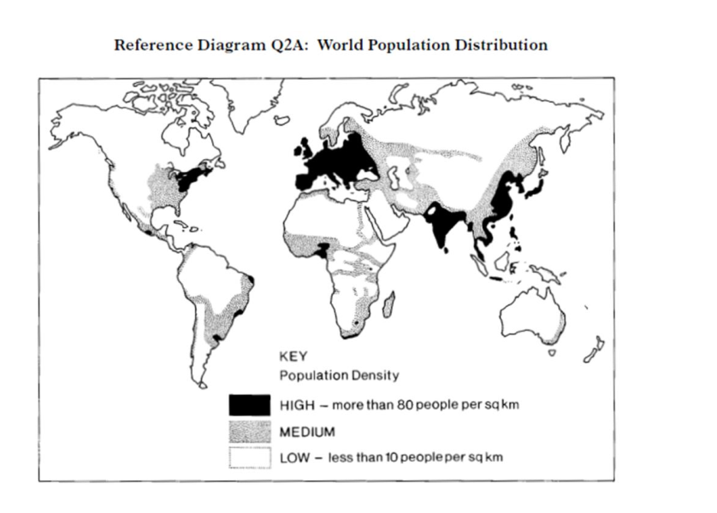
Describe and explain the population density patterns around the world (6).

