Slide 1
Water Cycle from Memory
Condenstaion
Precipitation
Surface Run Off
Infiltration
Transpiration
Evaporation

Slide 2
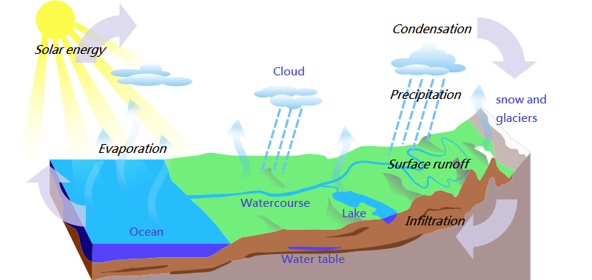

Slide 3
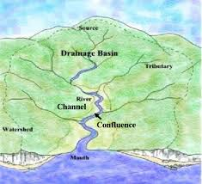
Drainage Basin

Slide 4
What is a drainage basin?
A drainage basin is an area of land that a river starts and ends (where the river collects it water from).
There are many features to the drainage basin which lead the river from its start to its end.

Slide 5
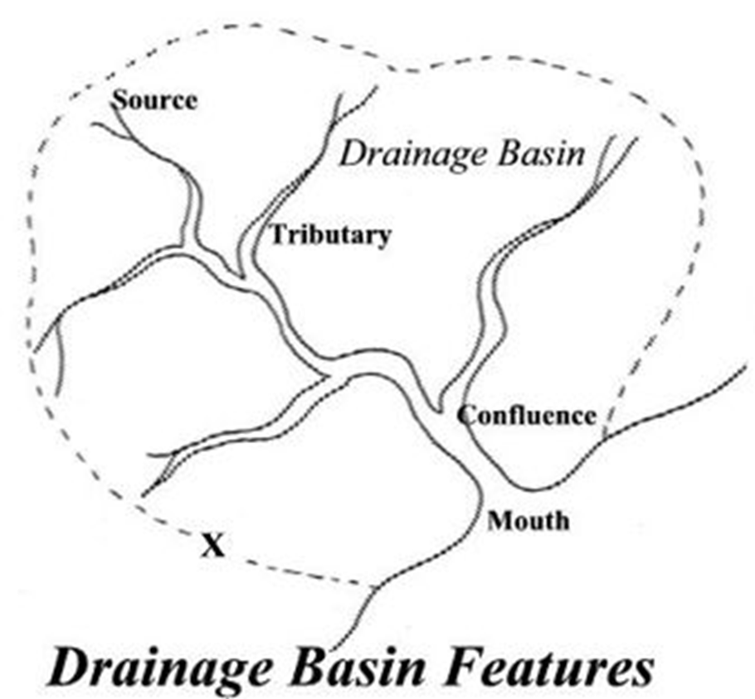

Slide 6
River Basin Vocab
Source – where a river starts (in hills/mountains)
Drainage basin – area a river collects its water from
Watershed – the dividing line between drainage basins
Tributary river – smaller rivers joining onto main river
Confluence – where a smaller river joins a bigger one
Channel – the route river takes to the sea
Load – the material rivers carry (rocks, stones, gravel)
Mouth – the end of the river

Slide 7
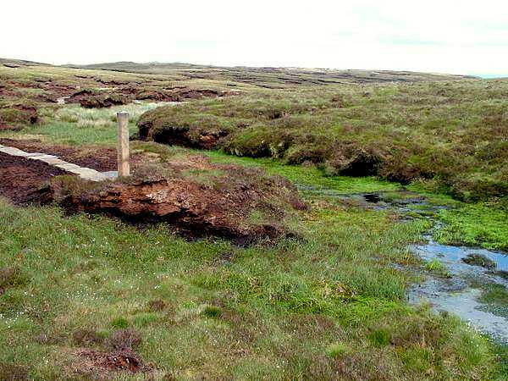
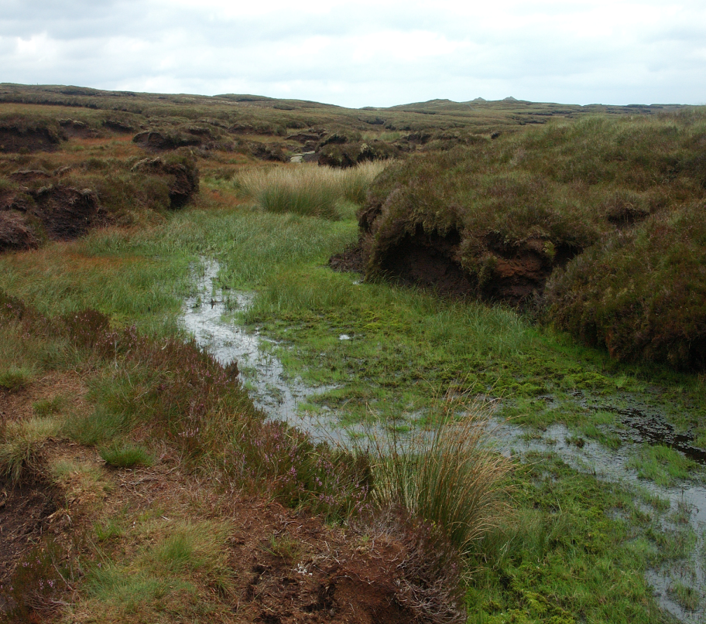
Source
Rivers start at the tops of hills, usually as boggy marsh land

Slide 8
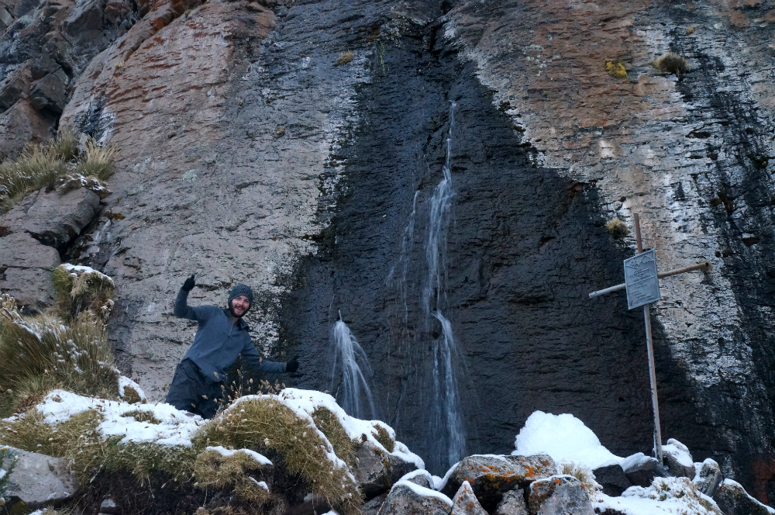

Slide 9
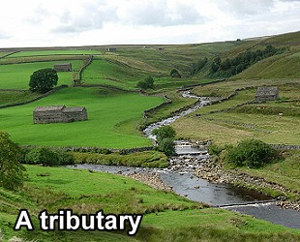
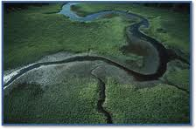
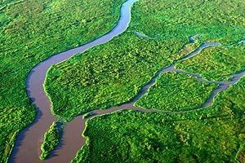
Tributary
A smaller river that leads onto a larger river

Slide 10
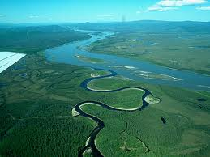
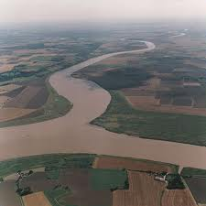
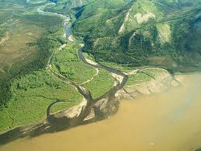
Confluence point
Where a tributary joins the main river

Slide 11
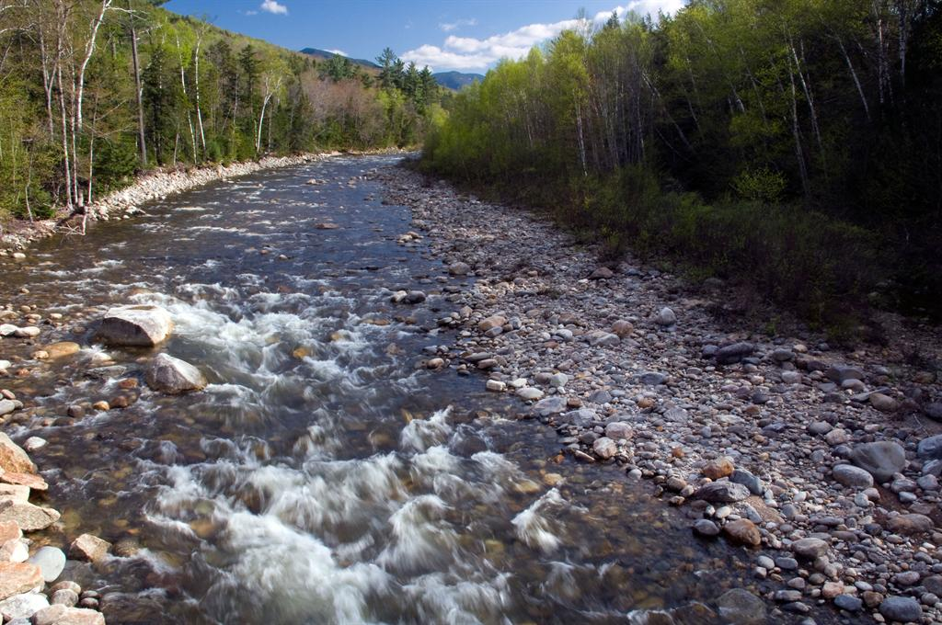
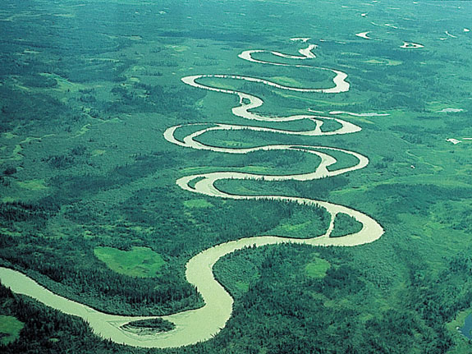
River channel
The route that the river follows

Slide 12
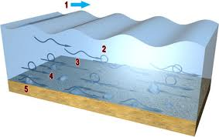
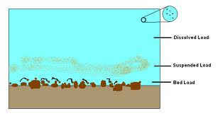
River load
Material that the river carries as it moves – rock, boulders, sand

Slide 13
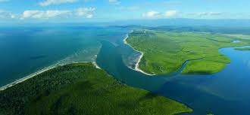
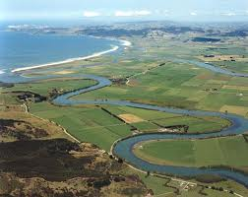
River mouth
Where the river ends and meets the sea

Slide 14
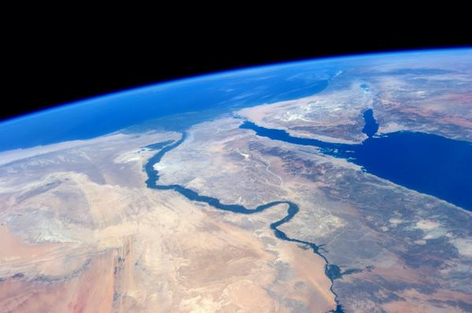
The Nile meeting the Mediterranean sea

Slide 15
Complete table…
Feature | Definition
Source | Start of a river
Drainage Basin | Area a river collects its water from
Watershed | Dividing line between drainage basins
Tributary River | Smaller River that joins a bigger one
Confluence | Where smaller river joins a bigger one
Channel | Route the river takes
Load | Material River Carries (rocks, gravel, sand etc.)
Mouth | End of a river (normally at sea).

Slide 16
Complete table…
Feature | Definition
Source | Start of river (normally high in hills)
Drainage Basin | Area a river collects its water from
Watershed | Dividing line between drainage basins
Tributary River | Smaller river joins onto larger river
Confluence | Where smaller river joins a bigger one
Channel | The route river takes to sea
Load | Material River Carries (rocks, gravel, sand etc.)
Mouth | End of river

Slide 17
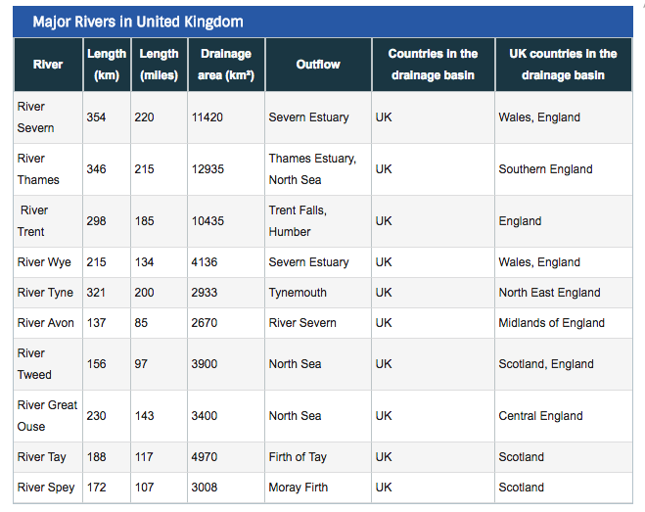
WHICH RIVER HAS THE LARGEST DRAINAGE BASIN IN THE UK?

Slide 18
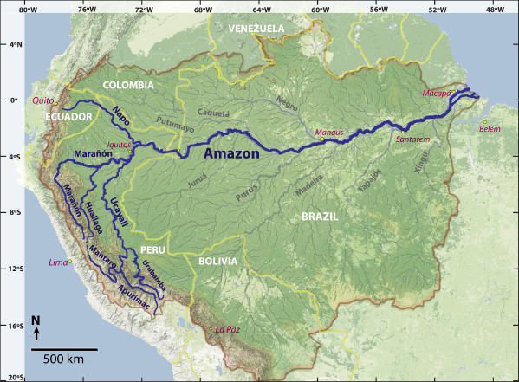
SOURCE
MOUTH
DRAINAGE BASIN
RIVER
CHANNEL
TRIBUTARY
CONFLUENCE

Slide 19
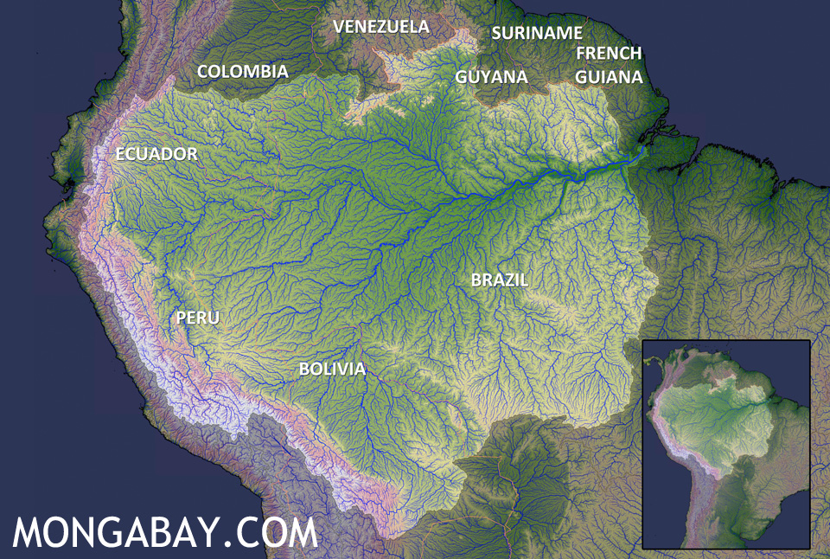

Slide 20

https://www.bbc.co.uk/iplayer/episode/b0bx73pk/earths-great-rivers-series-1-1-amazon

Slide 21
SOURCE
WHERE A RIVER STARTS (IN THE HILLS/MOUNTAINS)

Slide 22
DRAINAGE BASIN
AREA A RIVER COLLECTS IT WATER FROM

Slide 23
TRIBUTARY
A SMALLER RIVER THAT JOINS ONTO A LARGER RIVER

Slide 24
MOUTH
WHERE THE RIVER ENDS AND MEETS THE SEA

Slide 25
CONFLUENCE
WHERE A TRIBUTARY JOINS THE MAIN RIVER

Slide 26
RIVER CHANNEL
THE ROUTE THAT THE RIVER FOLLOWS.

Slide 27
LOAD
THE MATERIAL RIVERS CARRY (ROCKS, STONES ETC).

