Slide 1
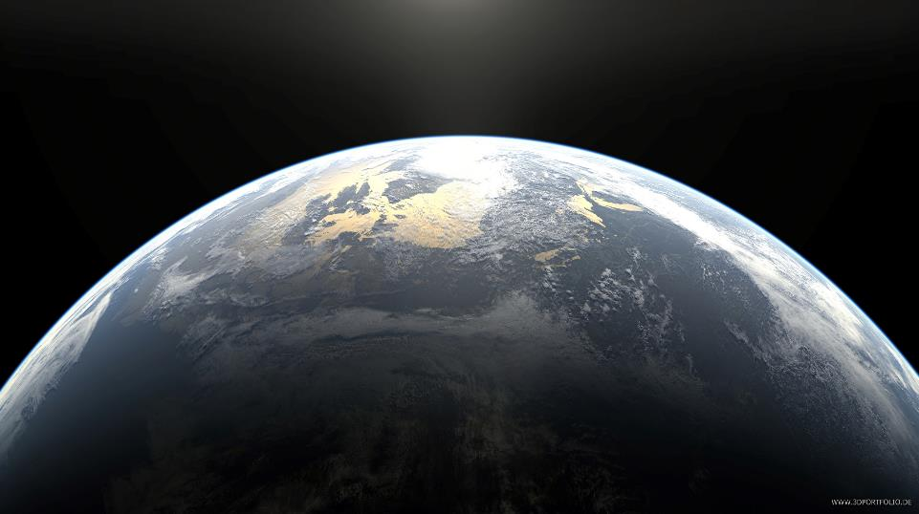
3. Earth’s surface is heated and radiates the heat back out to space.
2. Some energy is reflected back out to space – ice and snow
LAYER OF GREENHOUSE GASES (CO2, METHANE, NITRIOUS OXIDE ETC)
4. Greenhouse gases in the atmosphere trap some of the heat which causes the Earth’s temperature to stay at an even level (not too hot or too cold)
1. Solar energy from the sun passes through the atmosphere and is absorbed by the surface – trees, seas and oceans.
Increased greenhouse gases being let out means that the blanket of greenhouse gases is getting bigger so more heat is kept in = earth gets hotter. This is called the greenhouse gas effect.

Slide 2
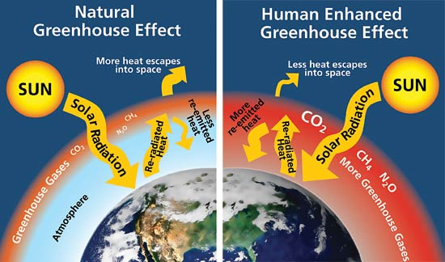

Slide 3
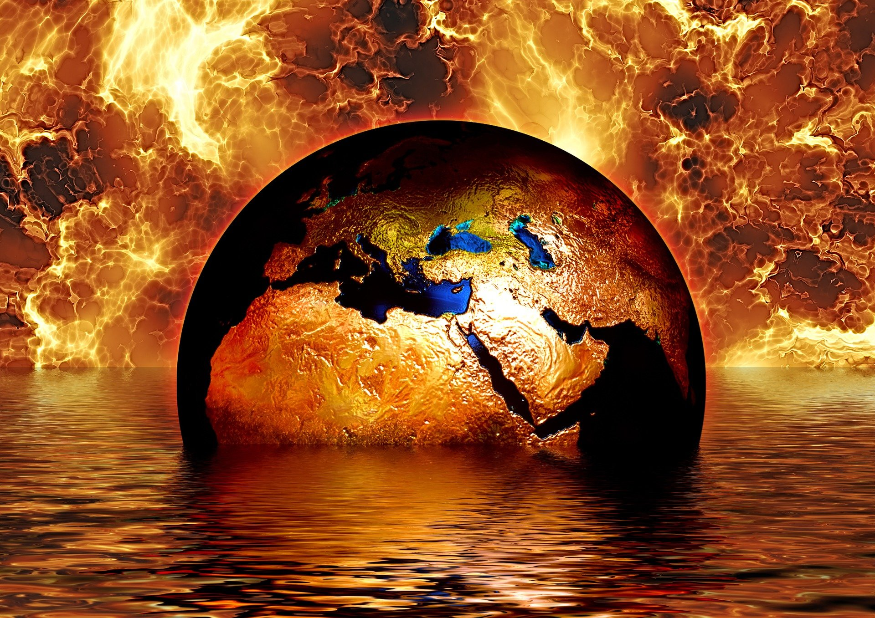
Climate Change Causes – Physical

Slide 4

Physical Causes = things that we (as humans) cannot control happening to the world.

Slide 5
Change in Solar Radiation
Our climate can change because we don’t always receive the same level of heat energy from the sun.
The number of sun spots on the sun changes all the time and peaks every 11 years. More sun spots = more heat from the sun.
During the 1600s, there was 70 years of there being very few sun spots and the climate became colder = Little Ice Age.

Slide 6
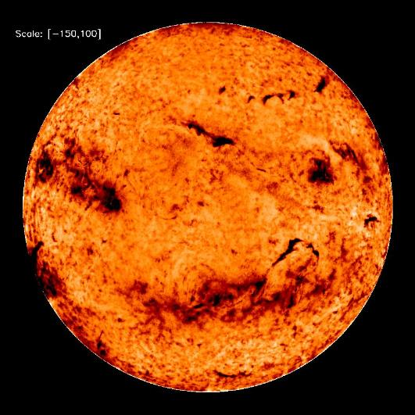

Slide 7
Milankovitch Theory - Earth’s Tilt, Stretch and Wobble
Tilt - Earth spins on an axis tilted approx 23°.Over 1000s of years, the Earth’s tilt and orbit changes and it wobbles on its axis – this affects our climate. These changes can take us closer to the sun, making the climate warmer.
Orbit (Stretch) – over a 97,000 year cycle the Earths orbit stretches, affecting the amount of energy received.

Slide 8
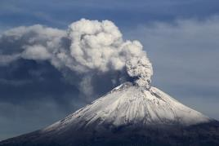
Volcanic Eruptions
When a volcanoe erupts, it sends gases and ash up into the atmosphere.
These particles absorb some of the heat from the sun, preventing it from reaching the Earth’s surface – therefore lowering temperatures.
Mt St Helen’s, Mt Hekla and Mt Pinatubo have all lowered global temperatures.

Slide 9
Ocean Circulation
The ocean helps to transfer heat energy around the World.
Some currents flow towards the tropics (warm water) and some towards the poles (cold water).
Ocean currents can change their direction and strength from time to time – this affects the climate of places they flow past.
El Nino – periodic warming of oceans.

Slide 10
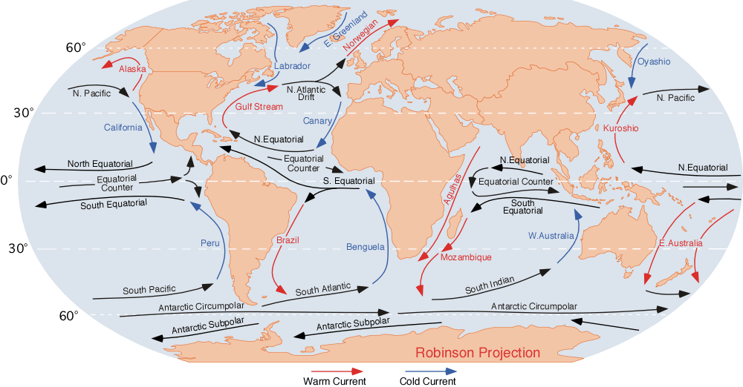

Slide 11
Continental Drift
The further you are from equator the cooler the summer and winter temperatures will be.
However, tectonic plates move slowly over time and this had an impact on countries climate. At one point, Scotland has a desert climate, a warm Mediterranean climate to our now present cooler wetter climate.
When many continents near poles – ice sheets form quickly and world cools down. When more near equator, opposite happens.

Slide 12
Natural Release of Greenhouse Gases
Methane is naturally released from the peaty soils in the arctic tundra and wetlands. This traps the heat in the earth’s atmosphere causing temperatures to rise.

Slide 13

Human Causes of Climate Change

Slide 14
The Greenhouse Gases
Carbon Dioxide = 55%
Methane = 30%
CFCs = 5%
Nitrous Oxide = 7%
Other Gases = 3%

Slide 15
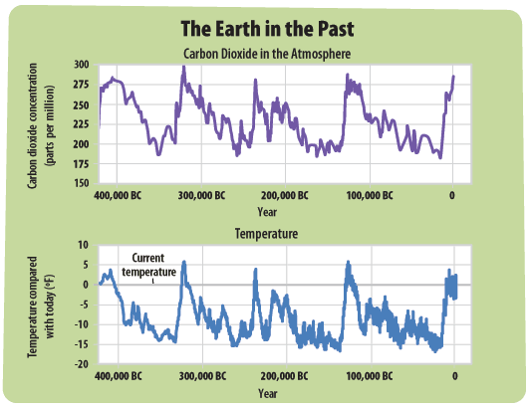

Slide 16
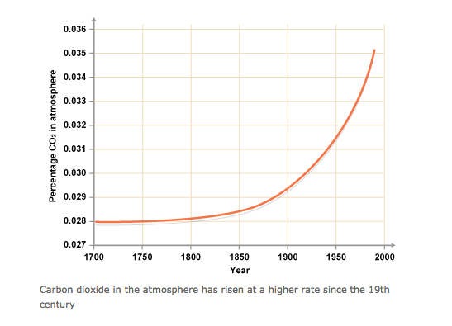

Slide 18
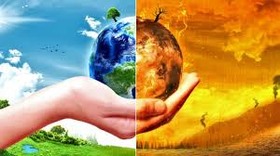
Human Causes = what are we doing that increases the layer of greenhouse gases?

Slide 19
Summary
The human causes of climate change can be summed up as: how are humans creating more greenhouse gases?
Increased CO2 – how?
Increased methane – how?
Increased nitrous oxide – how?
Increased CFCs – how?

Slide 20
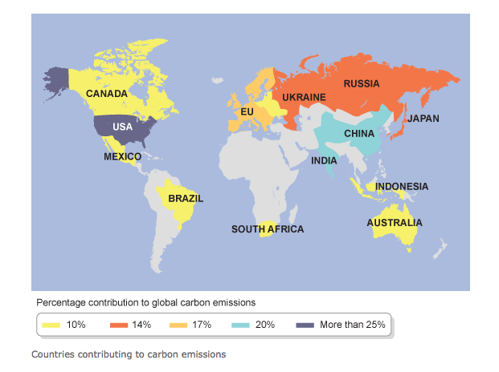
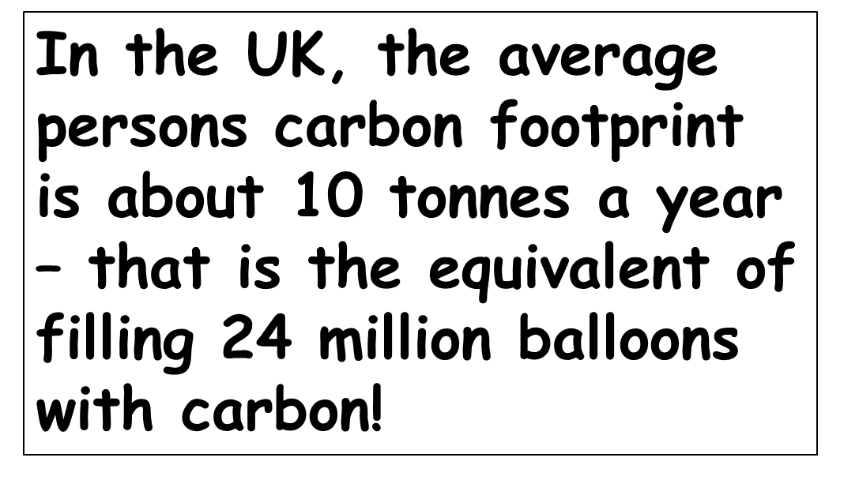

Slide 21

How do you contribute towards climate change?

Slide 22
Your Own Diary
Write your own diary for yesterday to see how much you contribute towards climate change.
Make it as detailed as possible – just bullet point all the things you did in that day (even what you ate!)
Now pass it on to person next to you so they can highlight when they think you are contributing towards climate change. We will come back to these later!

Slide 23
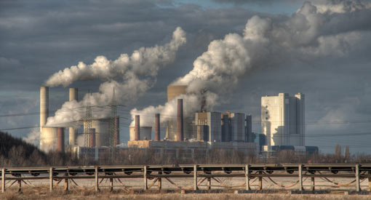
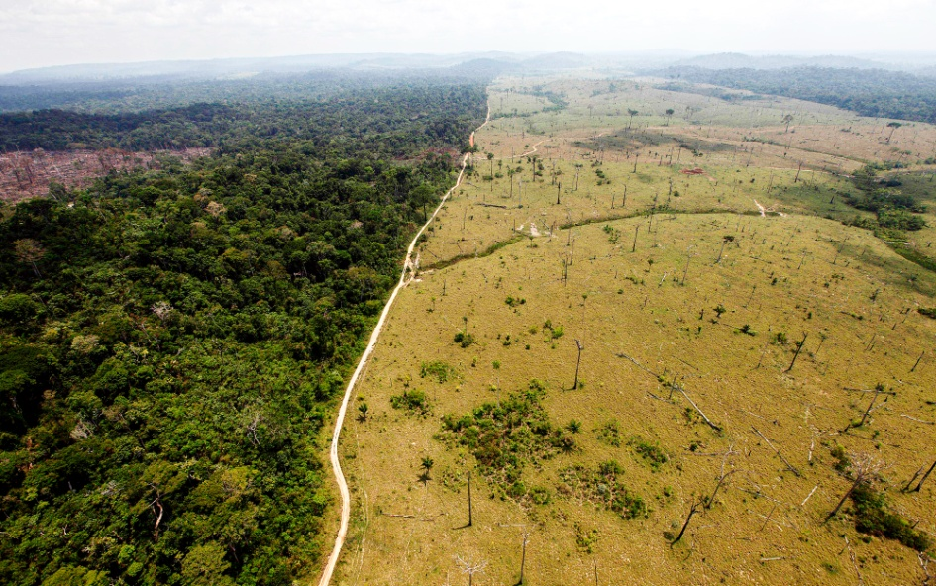
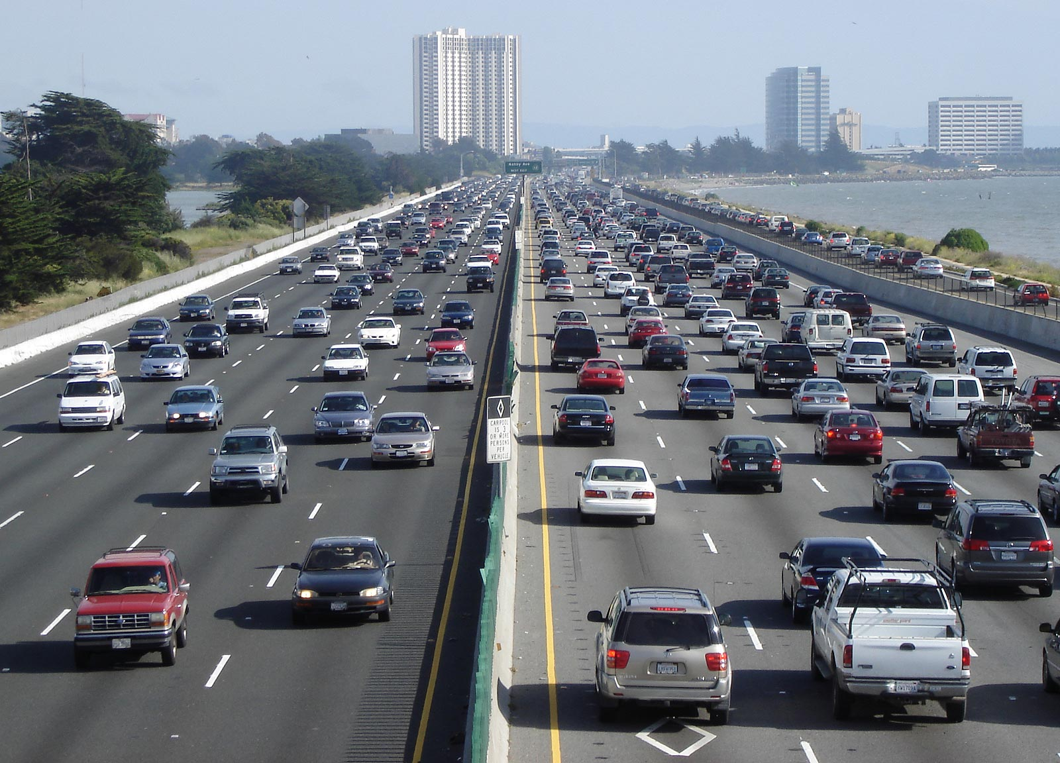
Increased CO2

Slide 24

Lets go back in time…..

Slide 25

Fossil Fuel History Lesson - The Industrial Revolution!
Since the Industrial Revolution (from about 1760 to 1840) humans have been burning more and more fossil fuels in our power stations, our homes and to run our transport system. Whenever a fossil fuel burns it gives off carbon dioxide.

Slide 26
Fossil Fuel History Lesson - The Industrial Revolution!
Globally, as the world becomes more industrialized and populated we have also started to burn more fossil fuels as part of improving our standards of living around the world (e.g. refrigerated food, travel by car rather than walking, air conditioning in the home etc)

Slide 27

Lets go back in time…
300 years of fossil fuels in 300 seconds
https://www.youtube.com/watch?v=cJ-J91SwP8w

Slide 28
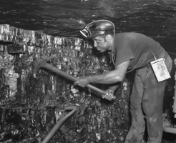
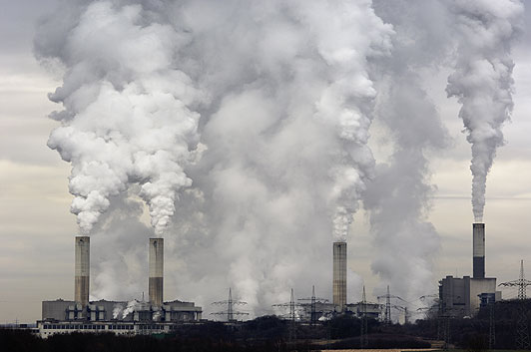
Industry

Slide 29
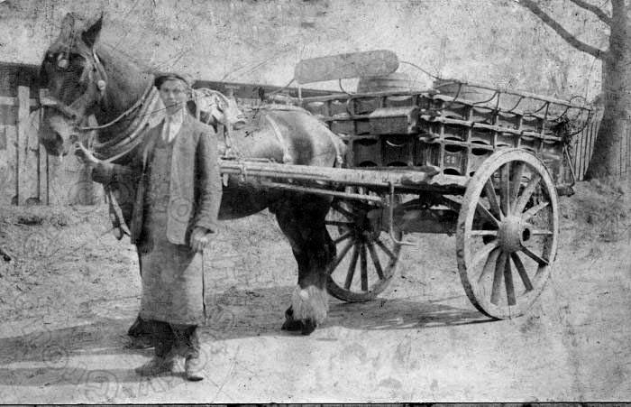
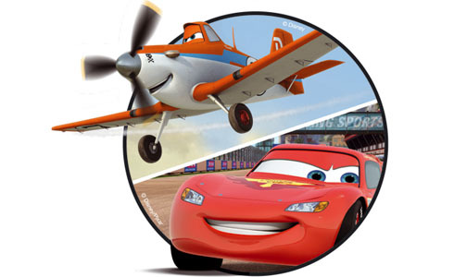
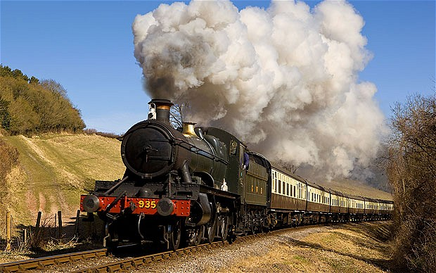
Transport

Slide 30
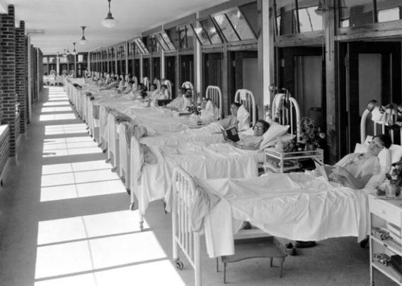

Healthcare

Slide 31
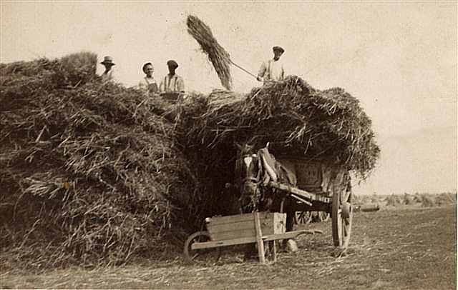
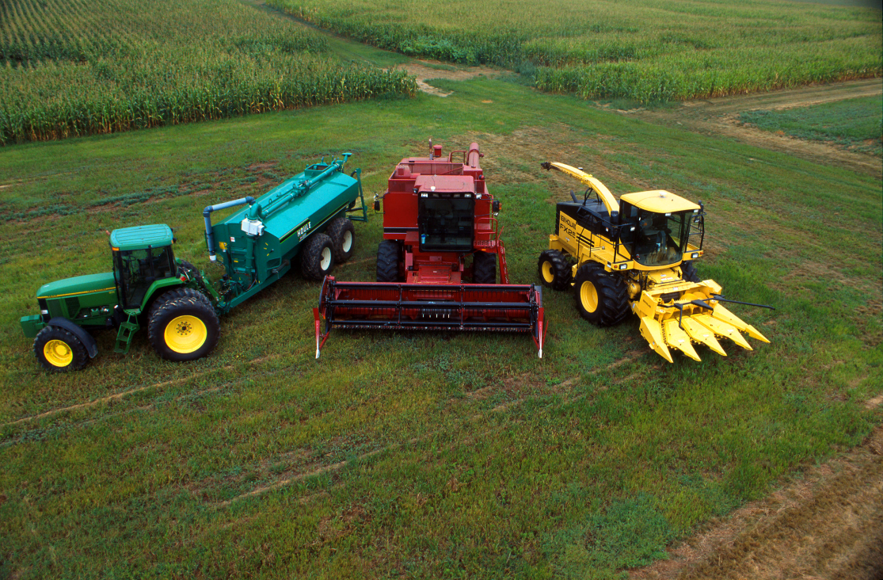
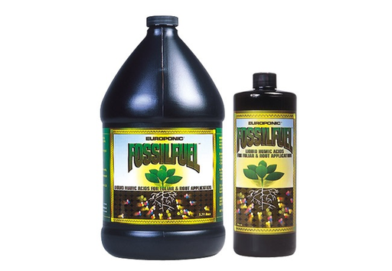
Farming

Slide 32
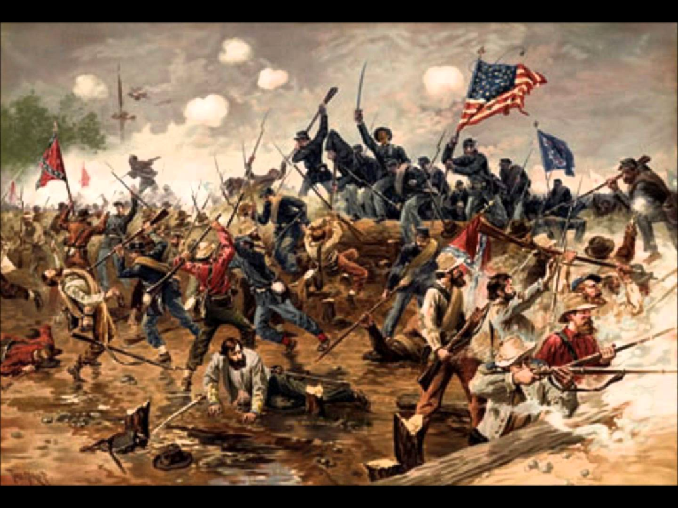
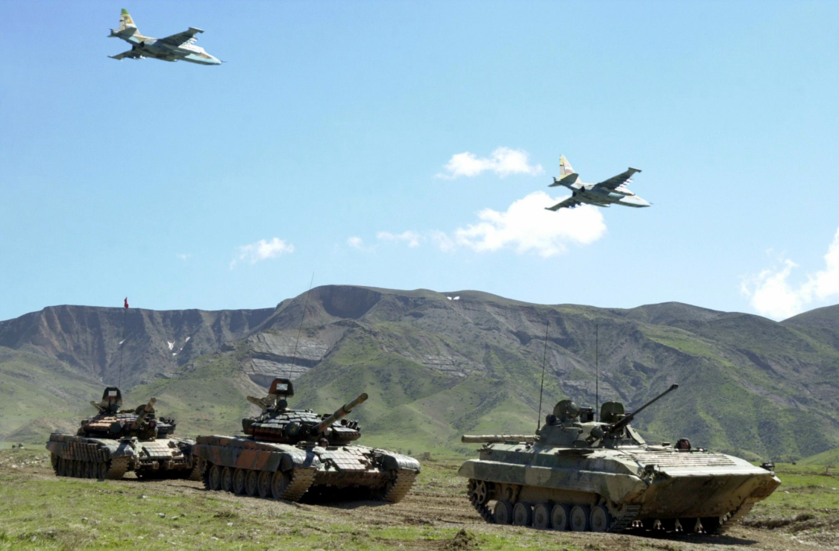
Conflict

Slide 33
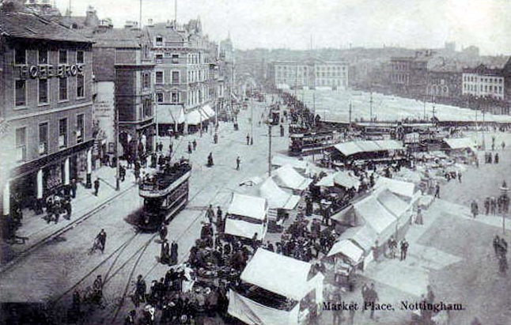
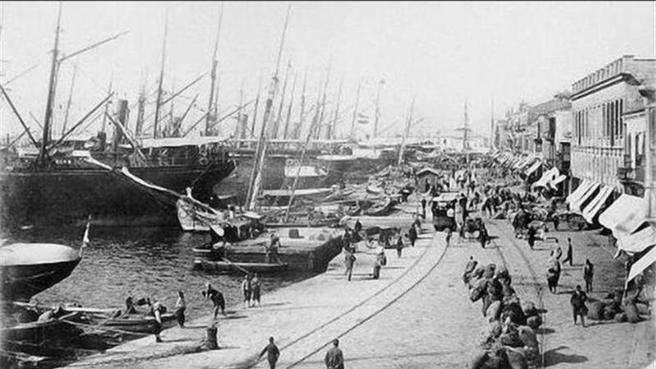
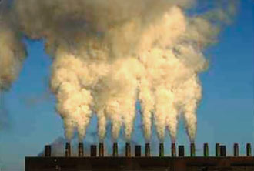
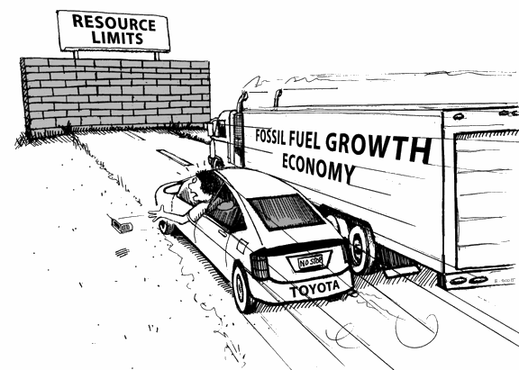
Economy
Notes:
http://www.theguardian.com/news/2015/apr/08/can-world-economy-survive-without-fossil-fuels

Slide 34
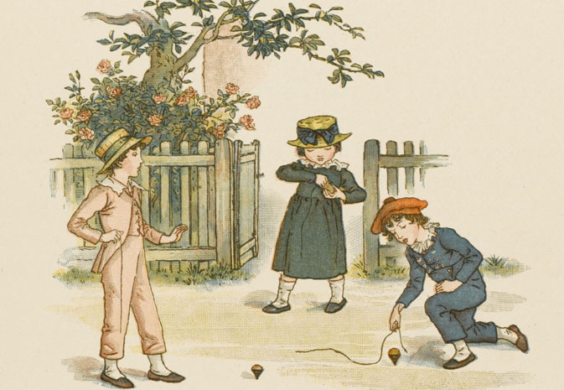
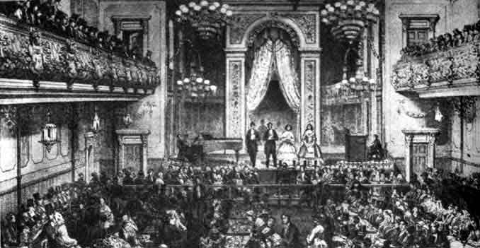


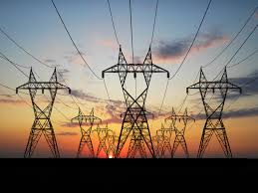
Entertainment

Slide 35
Increased CO2
Since the industrial revolution, the amount of CO2 released into the atmosphere has rose sharply – this is because of greater burning of fossil fuels such as coal (in factories, to power trains, warm houses).
More vehicles on road than ever – run on petrol which is a fossil fuel, when burned it releases CO2.
Deforestation – trees take in carbon dioxide but destroying large areas of forest mean nothing to take in carbon dioxide so it remains in atmosphere.

Slide 36
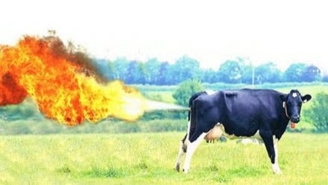
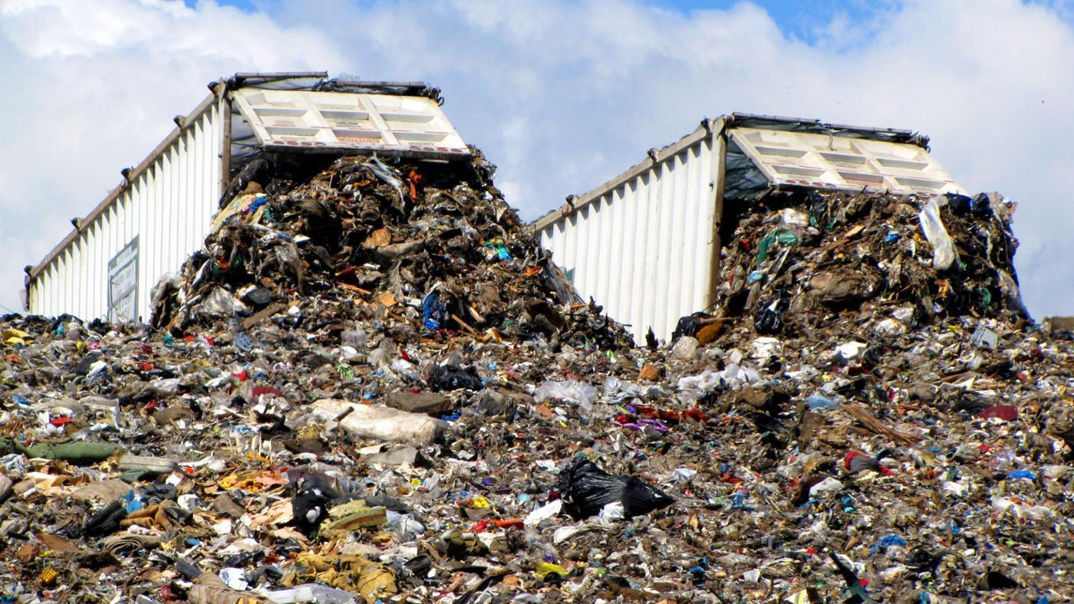
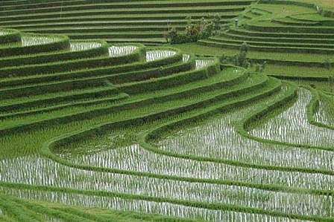
Increased methane
https://www.facebook.com/watch/?v=502327603633763

Slide 37
Increased methane
Padi fields = 10% of greenhouse gas emissions, rice absorbs carbon from atmosphere. However, if plant can’t use carbon it is dispersed into soil where converts to methane before being released into atmosphere.
Animal dung and farting cows = one cow releases about 100kg of methane each year – 1.5 billion cows on planet. Deforestation has led to land being used for cattle ranches so more methane.

Slide 38
Landfill sites – as waste begins to decompose it produces methane, which then goes into our atmosphere.

Slide 39
Increased Nitrous Oxide (N2O)
Since industrial revolution, level of nitrous oxide in atmosphere increased by 16%.
Fertilisers added to soil releases nitrous oxide – soils release two to four million tonnes per year.

Slide 40
Increased CFCs
Used in refigeration, aerosols, air-conditioning systems and polystyrene packaging.
When you use these (such as spraying aerosols) CFCs are released into the atmosphere – make up the smallest proportion of greenhouse gases.

Slide 41
Now back to your diaries….
Is there anything else you would highlight after what you have learnt?
Is there anything else you would add to your day that you maybe didn’t think was important?

Slide 42
Human Causes Task
Colour code your table to link the explanations to the correct gases: C02, Nitrous Oxide, CFCs, Methane.

Slide 43

Human Causes Pictionary
Notes:
http://www.geogonline.org.uk/Y8_globalwarming.htm

