Slide 1
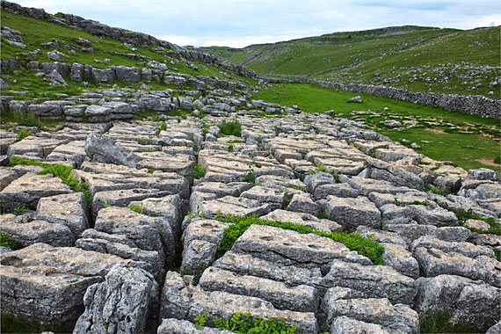
Limestone Landscapes

Slide 2
What do you need to know?
Formations: limestone pavement, potholes/swallow holes, caverns, stalactites and stalagmites, intermittent drainage.
Case Study of Yorkshire Dales
Land use in a limestone landscape.
Conflicts and solutions within this landscape – forestry, industry etc.

Slide 3
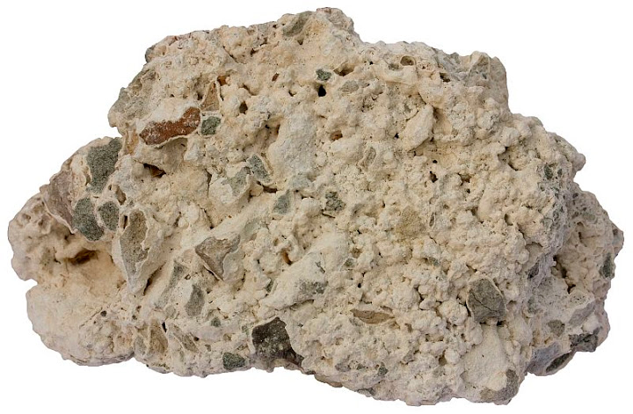
How was this actually made?

Slide 4
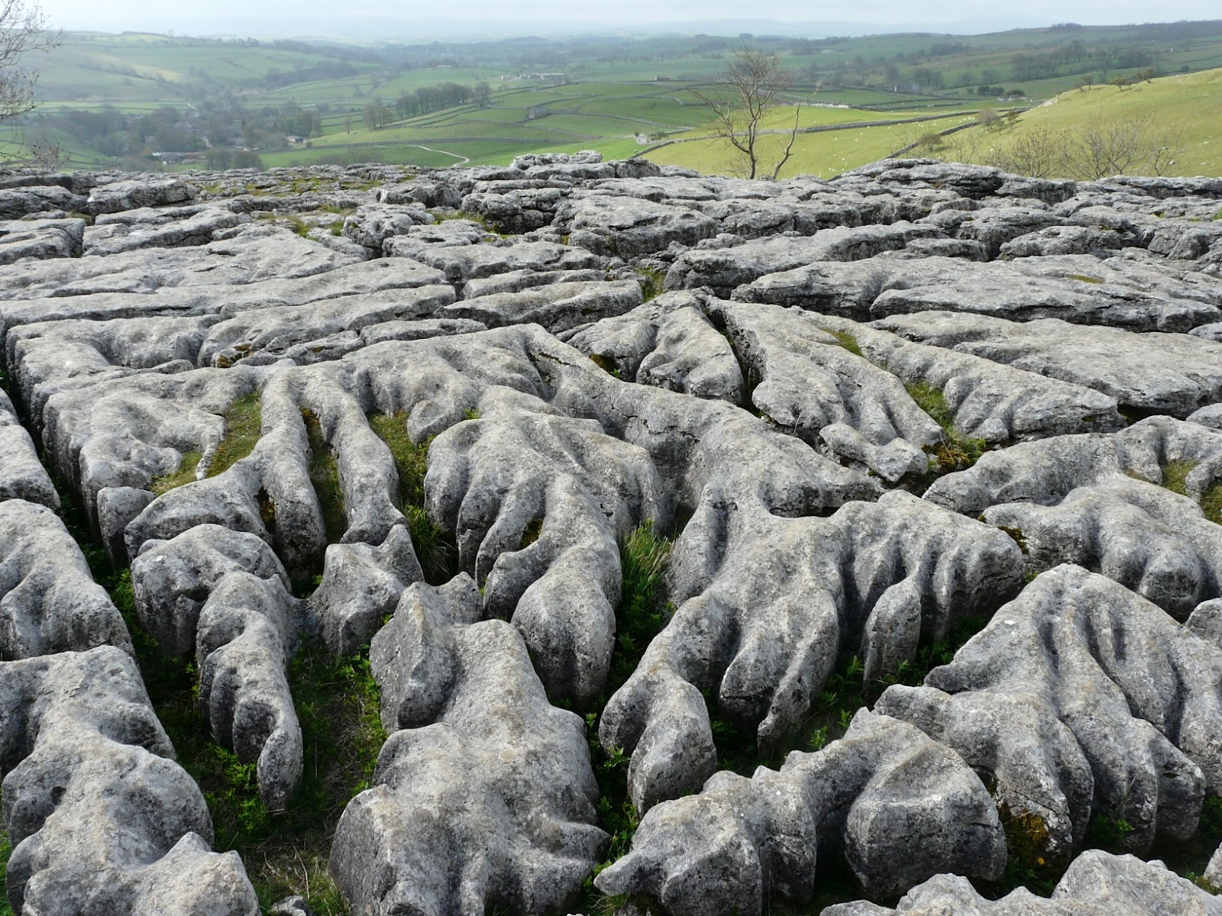
How did it get from under the sea to upland areas?

Slide 5
Time to find out...
https://www.youtube.com/watch?v=Yf4YtDlA1oQ&list=PLhYbQB65vJ9Zd8kPvfko_fjrRv7uSYg5r

Slide 6
Key Points
Limestone is a sedimentary rock (types of rock formed by deposition and cementation of organic material – plants, dead animals, sand etc).
Formed under water over 300 million years ago by dead animals, shells etc.
Different layers begin forming on top – sand etc.
Plate movements push areas out of the sea.
Ice scrapes away the layers to expose the limestone.

Slide 7
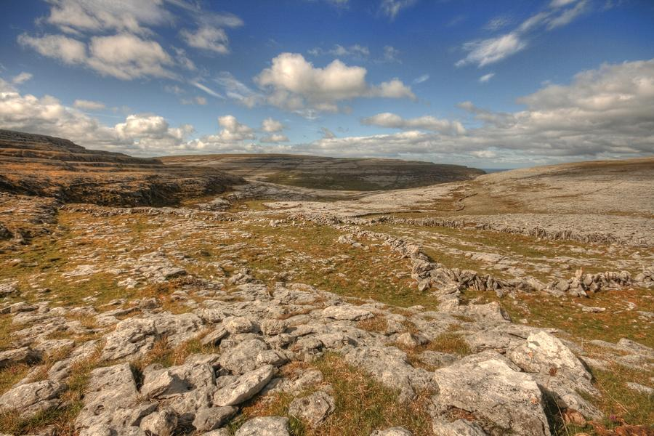
This is what a typical limestone landscape looks like today
A key part of this landscapes formation is down to the work of ice.

Slide 8
Lets go back 10,000 years…

Slide 9
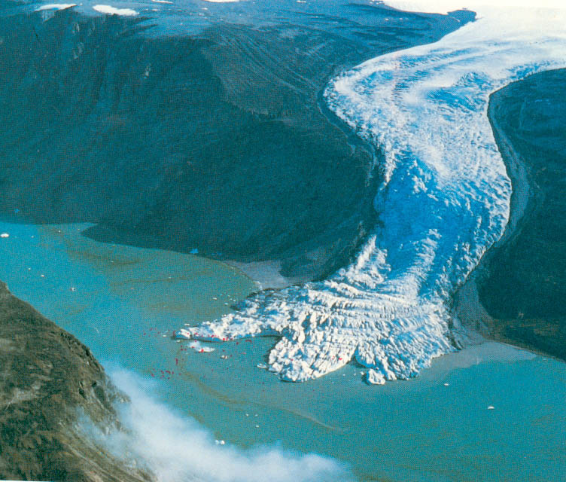
What is this?

Slide 10
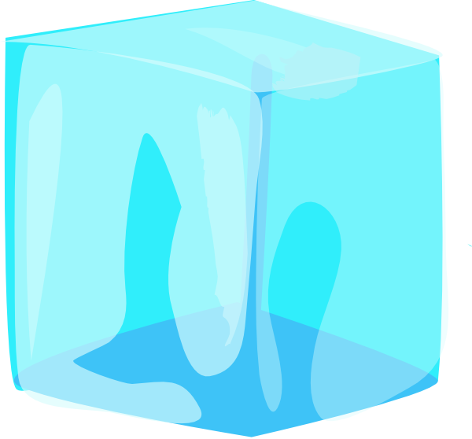

Glacier
Soil
Limestone

Slide 11
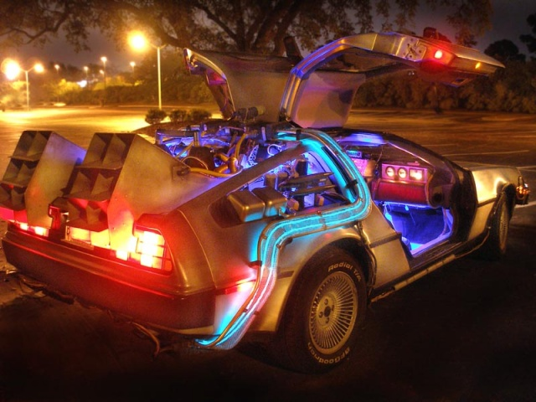
Fast forward to today…

Slide 12
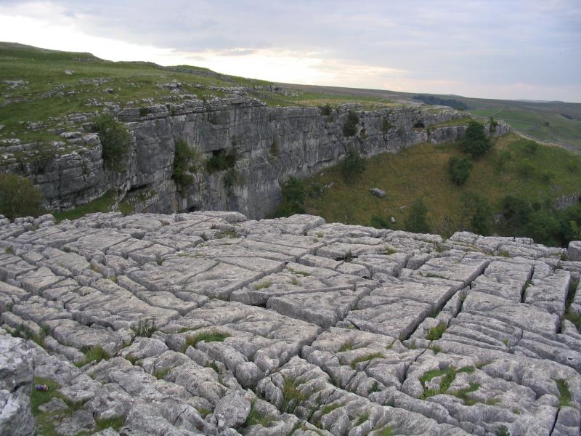
Karst Landscape

Slide 13
Structure of limestone
Limestone deposited in thick horizontal layers called strata.
Each layer represents a different period of deposition – bedding planes separate each layer (lines across the way).
Within each layer there are vertical cracks in the rock called joints.

Slide 14
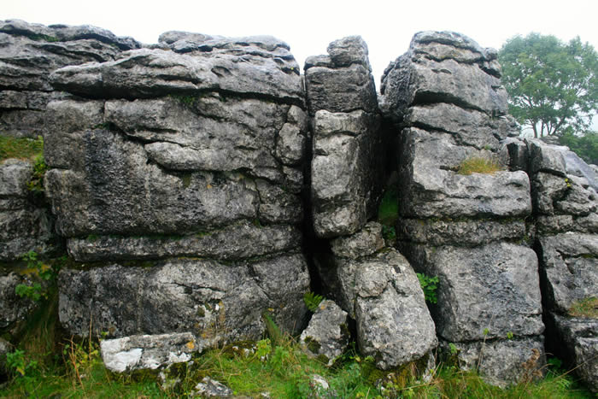
Limestone
These bedding planes and joints make the rock permeable i.e. water can pass through it.

Slide 15

Weathering
Rainwater is naturally slightly acidic because it absorbs carbon dioxide from the air.
Minerals in rocks may react with the rainwater, causing the rock to be chemically weathered.
Very slow process – wears down 1cm in 250 years.
Co2
Co2
Co2
Co2
Co2
Co2
Co2

Slide 16
Carbonation
Limestone = Calcium Carbonate (alkaline)
Rainwater = Carbonic Acid
Carbonic Acid dissolves Calcium Carbonate
This is called CARBONATION, a type of solution weathering (solution = dissolves limestone and removes as a solution).

Slide 17
Glacier
Co2
Co2
Co2
Co2
Soil
Limestone

Slide 18
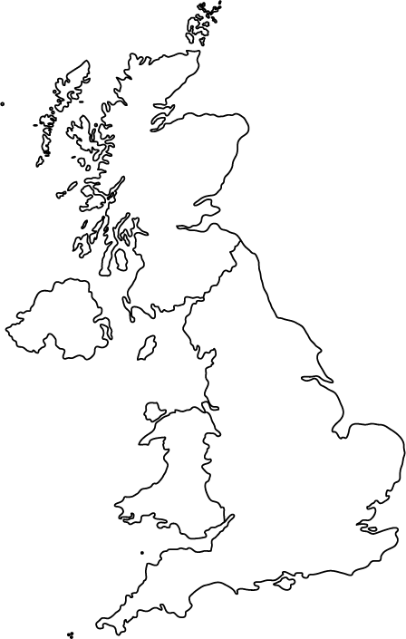
Where are these areas?

Slide 19
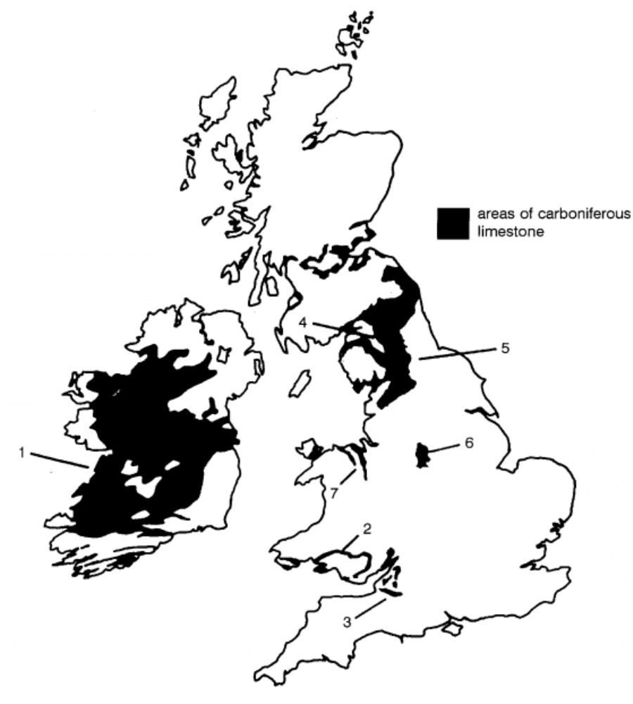

Slide 20
Tasks
Questions 1 – 7 (ANSWERS IN SENTENCES!).
For question 7, stick the wee map I have given you in your jotter.

