Slide 1

Formations – Wheel of Fortune!!

Slide 2
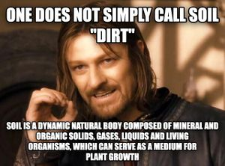
Homework Feedback

Slide 3
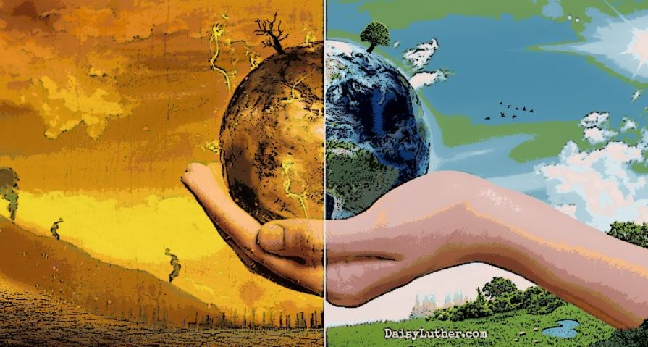
Climate Change Unit

Slide 4
What do you need to know?
Global Issues Section (Paper 2)– will always come up.
Causes of Climate Change – human and physical.
Effects of Climate Change.
Managing Climate Change – local, national, international + how effective (evaluate).

Slide 5
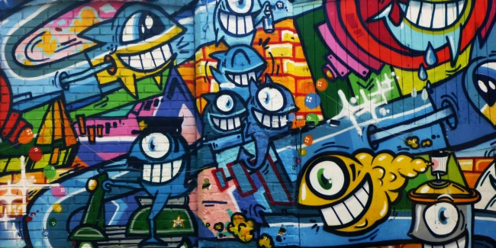
Climate change is something all kids should know something about! What do you know – graffiti board?

Slide 6
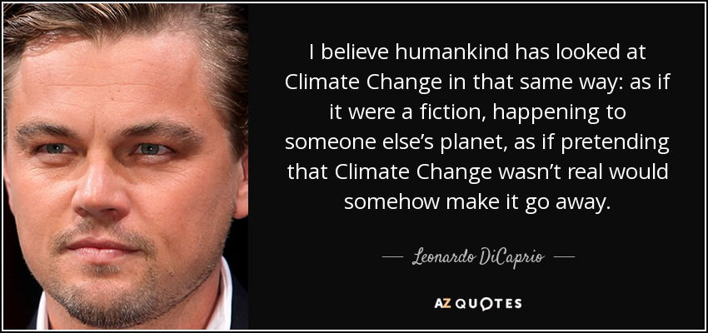
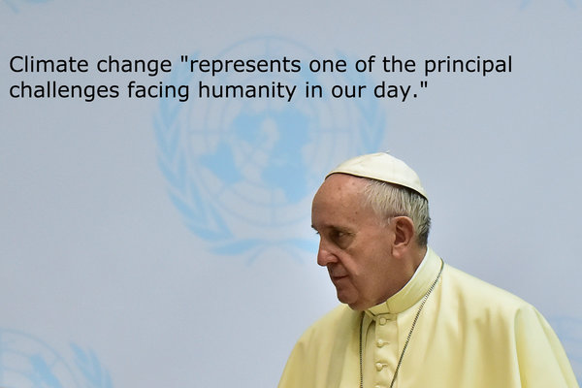
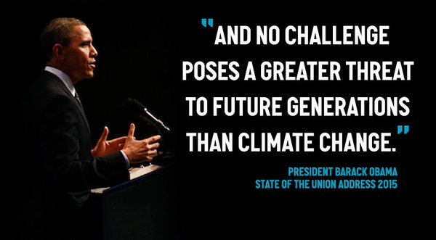
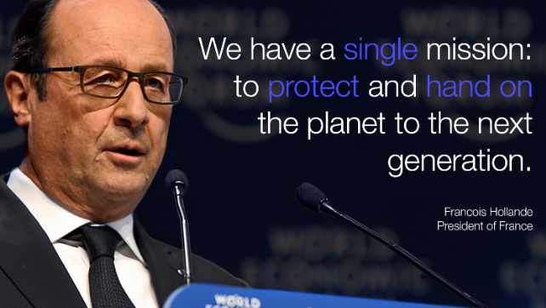

Slide 7

In the news…

Slide 8
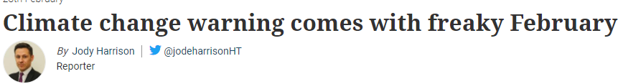
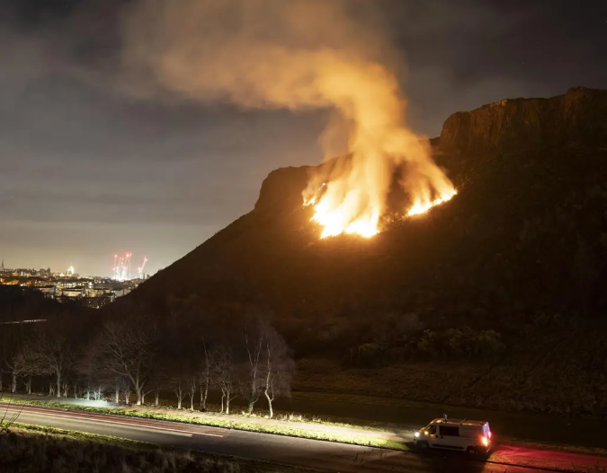
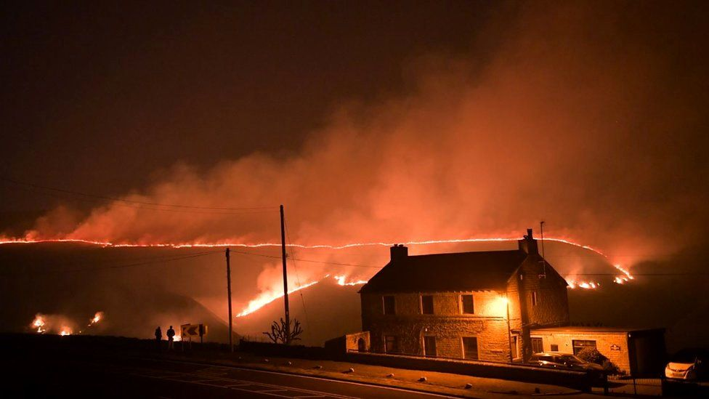

Slide 9
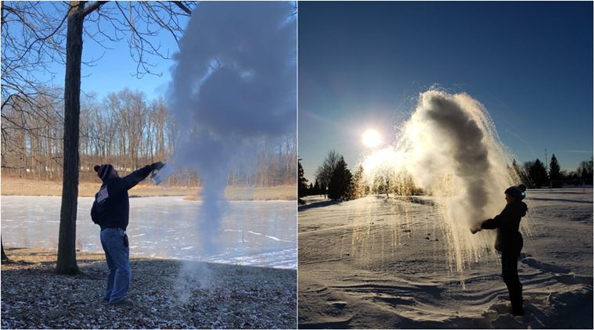
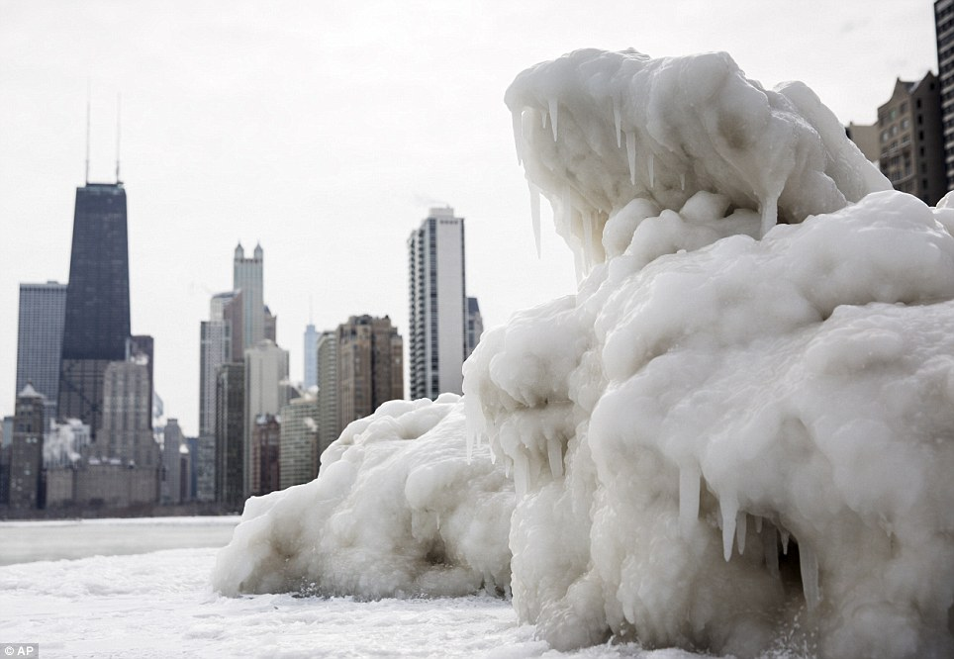

Slide 10
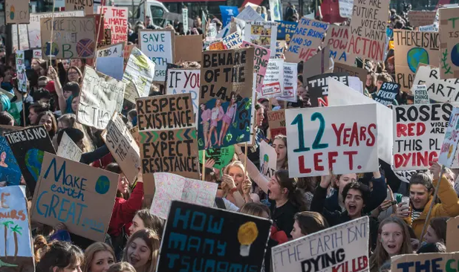
Climate Change School Strikes!

Slide 11
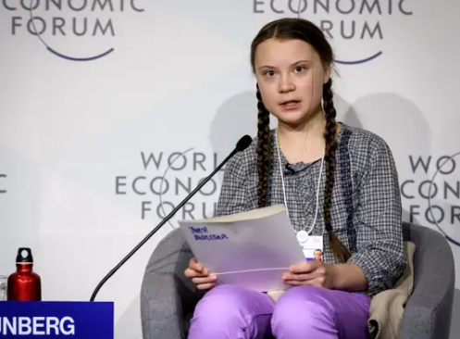
What is happening?
Greta Thunberg – 16 year schoolgirl from Sweden – decided not to go to school on Fridays but instead picket outside Swedish parliament to raise awareness of global warming.

Slide 12
What is happening?
Over 270 cities and towns throughout world now have kids protesting.
Demonstrations set up in over 60 places throughout UK – led by YouthStrike4Climate (UK Youth Climate Coalition).
https://www.youtube.com/watch?v=EAmmUIEsN9A
https://www.youtube.com/watch?v=8N196CwLVTI

Slide 13
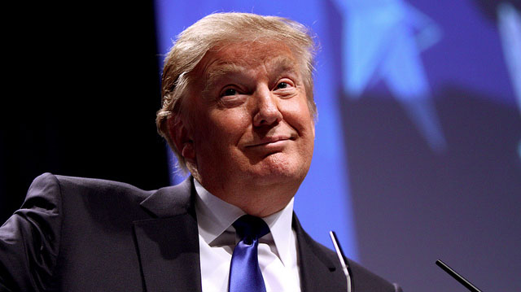
Climate change is a myth
https://www.google.com/search?safe=strict&rlz=1C1GCEB_enGB837GB837&biw=1366&bih=657&tbm=isch&sa=1&ei=thF9XPf8B4yJ1fAP7bKuyAE&q=trump+climate+change+tweet&oq=trump+climate+chan&gs_l=img.3.1.0l10.412267.415006..417284...1.0..1.108.1203.17j2......0....1..gws-wiz-img.......0i67j0i10.9lMEjJj7CnY
https://www.youtube.com/watch?v=yqgMECkW3Ak&t=85s

Slide 14
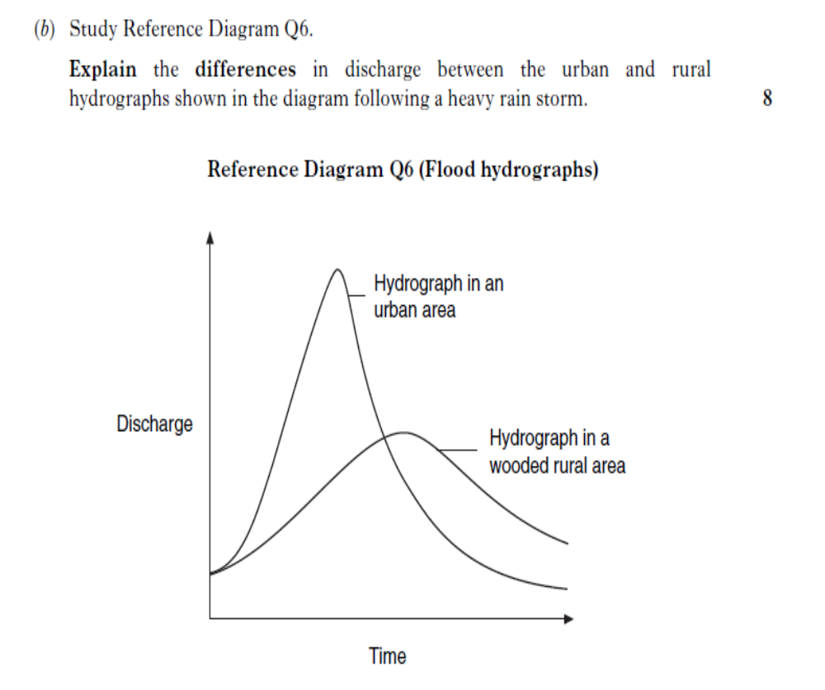
6

Slide 15
Model Answer
In the urban area, it has high peak discharge whereas the wooded rural area has a low peak discharge. This may be because in a urban area there is tarmac this means that water cannot penetrate it as it is impermeable meaning it flow over it quickly as surface run off to the river (1 mark). In an urban area they may have storm drains which means the water is allowed to flow quickly through these into the river (1 mark).
In the wooded rural area, there is a low peak discharge because there is a lot of vegetation meaning that precipitation may be intercepted by vegetation and then lose it through transpiration and evaporation (1 mark). The soils may be fine so the water will infiltrate and be stored underground (hence why urban has more water present that rural) (1 mark) by going underground the water will also take longer to get to the river giving a lower peak discharge at a later time(1 mark).
The urban area has a much steeper falling limb. This could mean there is more rivers or drains in this area, this could mean that there is a higher drainage density to allow water to drain out quicker – this is also much faster than soils and trees which absorb water (1 mark).

Slide 16
What is climate change?
Climate change can be seen as a large scale, long term shift in the planet’s weather patterns or average temperatures.
Since the last ice age, which ended about 11,000 years ago. The Earths climate has been relatively stable at about 14 degrees (celsius). However in the last 100 years, our climate has started to increase

Slide 17
Is Global Warming the same?
Global Warming is the term used to describe the current increase in the Earths average temperature due to rising levels of greenhouse gases.

Slide 18
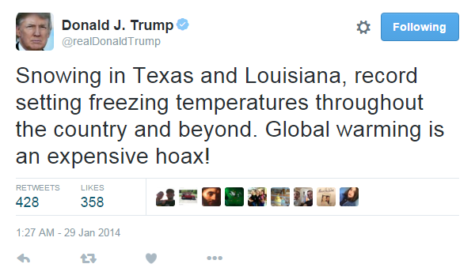
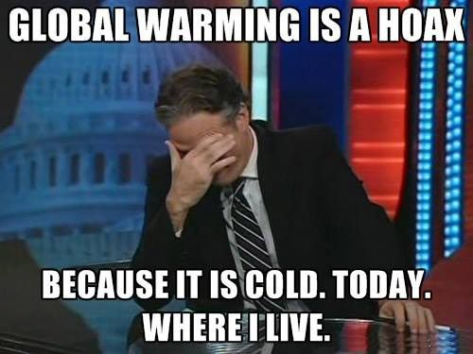

Slide 19
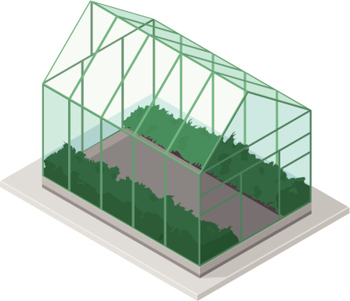
How is this linked to the global average temperatures going up?

Slide 20
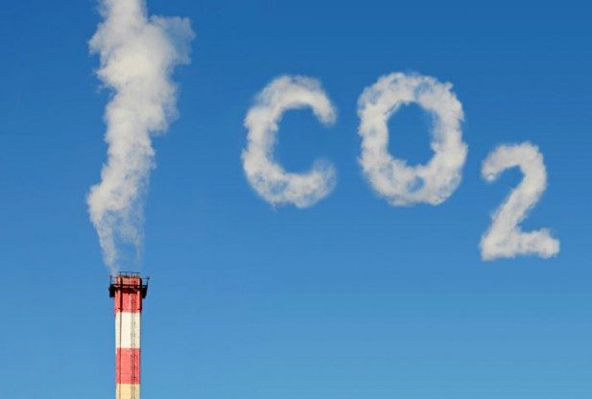
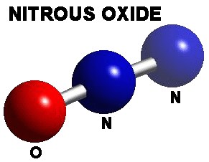
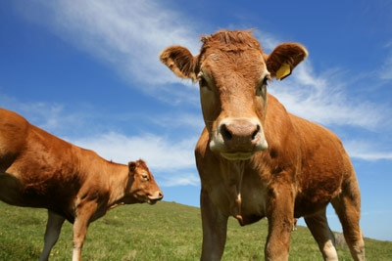
Greenhouse Gases Examples

Slide 21
The Greenhouse Gases
Carbon Dioxide = 55%
Methane = 30%
CFCs = 5%
Nitrous Oxide = 7%
Other Gases = 3%

Slide 22
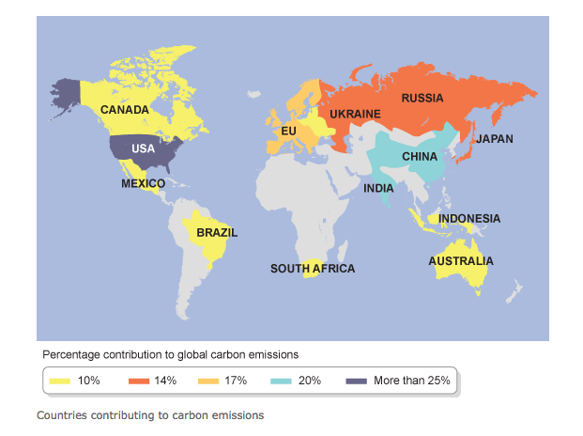

Slide 23
But how do these gases contribute towards climate change?

Slide 24
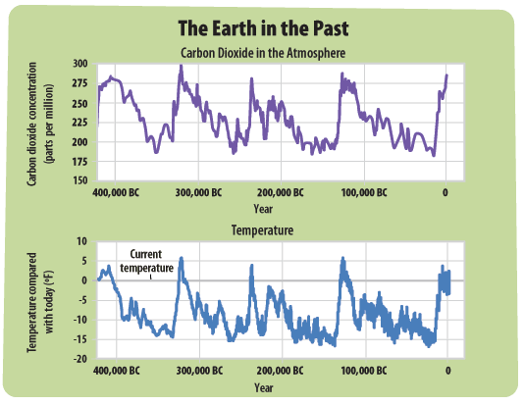

Slide 25
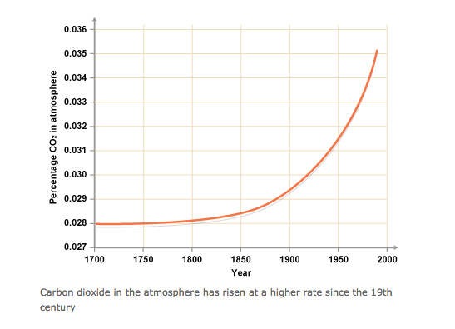

Slide 26
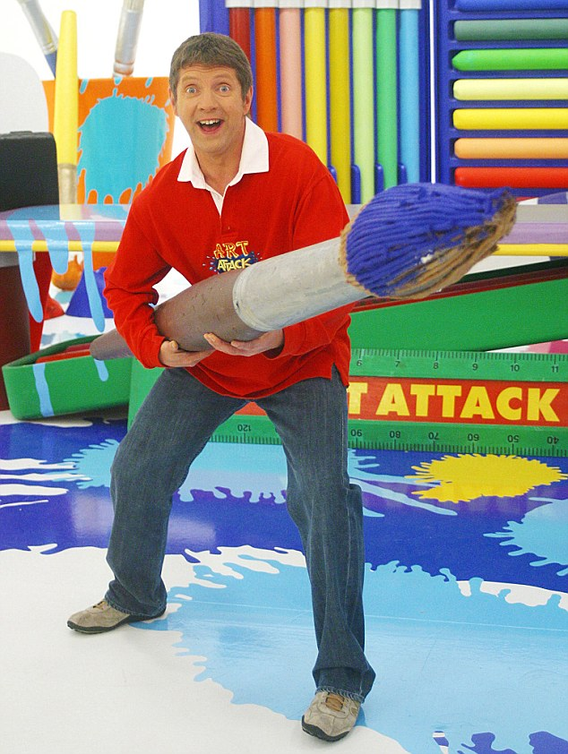
The Greenhouse Gas Effect

Slide 27
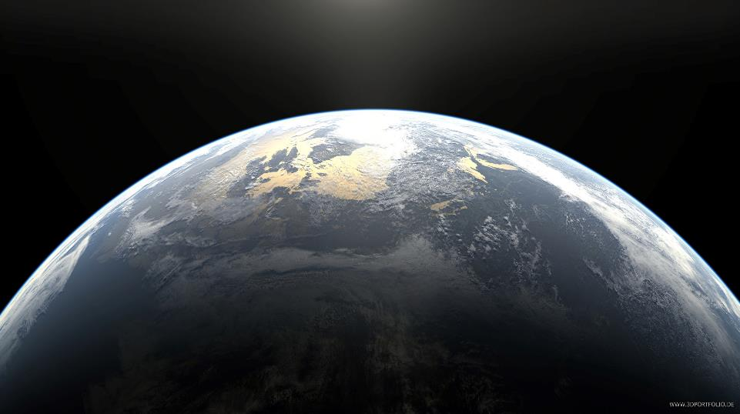
3. Earth’s surface is heated and radiates the heat back out to space.
2. Some energy is reflected back out to space – ice and snow
LAYER OF GREENHOUSE GASES (CO2, METHANE, NITRIOUS OXIDE ETC)
4. Greenhouse gases in the atmosphere trap some of the heat which causes the Earth’s temperature to stay at an even level (not too hot or too cold)
1. Solar energy from the sun passes through the atmosphere and is absorbed by the surface – trees, seas and oceans.
Increased greenhouse gases being let out means that the blanket of greenhouse gases is getting bigger so more heat is kept in = earth gets hotter. This is called the greenhouse gas effect.

Slide 28
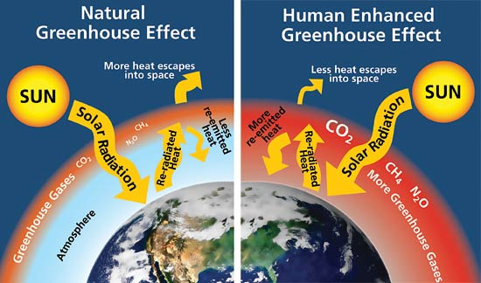

Slide 29
Greenhouse Gas Effect Memory Game

