Slide 1
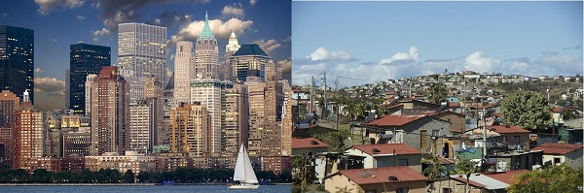
Development – Single Indicators

Slide 2
Learning Intentions
To describe how development can be shown (indicators)
To explain reasons for differences in levels of development.

Slide 3
How could we measure if Scotland was developed or not? What could we look at?

Slide 4
What is development?
Development is a process of change over time.
Traditionally = viewed as economic growth (rich = developed, poor = developing).
Modern = not just about money, but about improvements to people’s lives too (living standards, diet, health care, education etc).

Slide 5
How can development be measured?
Development Indicators (IODs) are used to compare countries.
Can be social or economic.

Slide 6
Development Indicators
 | UK | Brazil | Kenya
GDP Per Capita | 39,899 | 8649.95 | 1455.36
Adult Literacy % | 99 | 92.4 | 78.5
Life Expectancy | 81.6 | 74 | 60.62
Doctors per 1000 | 2.7 | 2.06 | 0.1
Calories per day | 3450 | 3120 | 2060
Tasks
Copy and complete table.
Choose two more countries of your own to add on.
List the top 5 countries for each indicator.

Slide 7
GDP V GNP
GDP = total value of all finished goods and services produced by a country in a year.
GNP = Same + all net income earned by that country and its population including overseas investments (TRADE).
PER CAPITA = PER PERSON.

Slide 8
Single Indicators – Describe and Explain (how do they show development)
GNP
GDP
Energy use per person (k watts)
Employment
Adult Literacy %
Life Expectancy
Doctors per 1000
Calories per day

Slide 9
Construct the table

Slide 10
Hans Rosling Video
https://www.youtube.com/watch?v=jbkSRLYSojo

Slide 11
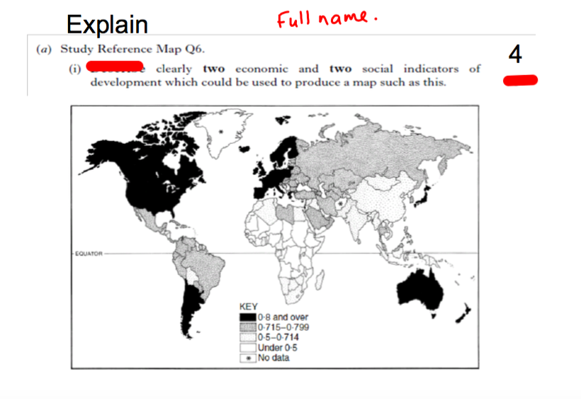
EXAM QUESTION

Slide 12
Developing counties are less developed because –
In some countries people cannot read and write so they cannot get a good job (1). In some countries they don’t have money to spend on healthcare so people suffer from ill health (1) when they are ill they cannot work limiting development (1). Some countries have a low GNP and don’t have the wealth to invest in the living standards of their citizens (1). Some countries make very little money from their exports which means less money to spend (1). Some have huge trade deficits and suffer from debt (1). Some countries are not industrialised meaning lack of jobs (1). This also means a lack of opportunities for further development (1). Some countries are over populated this makes it hard to provide food for everyone (1). It also makes its hard to provide services to the population (1).

Slide 13
End of Population
Describe and Explain factors behind Population Density and Distribution
Growth of Megacities/Rural →Urban Migration.
Describe and Explain Pop Pyramids (why do birth, death rates etc change/why are countries different).
DTM – describe and explain changes in birth/death rates.
Impacts and controlling under/overpopulation.
Why Mexicans migrate to USA?
Describe + explain how single indicators show development.

Slide 14

Class Snowball Fight

Slide 15
Write down a four mark explain question from the unit – make sure you know the answer as you will mark and give feedback!
Write name on the sheet.
Scrunch it up and throw it.

Slide 16
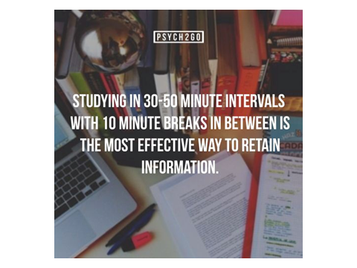
Revision Techniques

Slide 17

Flashcards
Question on one side.
Exam answer on the back.

Slide 18

Quizlet – Electronic Flashcards
Create flashcards that you can look at on your phone.
We could create a class set of flashcards.

Slide 19
Revision Clock
A revision clock is used to help break up your revision.
Try making one for limestone unit.

Slide 20
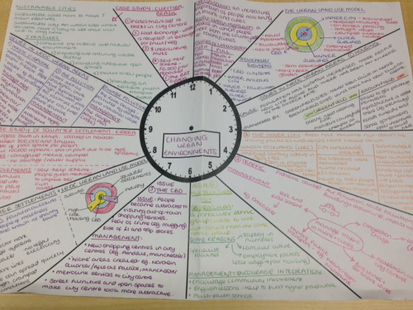

Slide 21
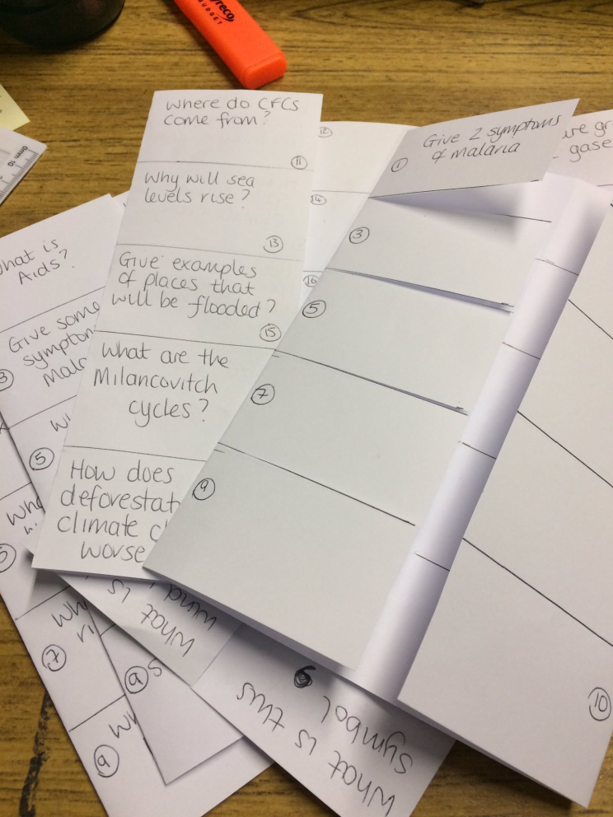
Foldables
Write question on one side of foldable and answer underneath the fold.

