Slide 1
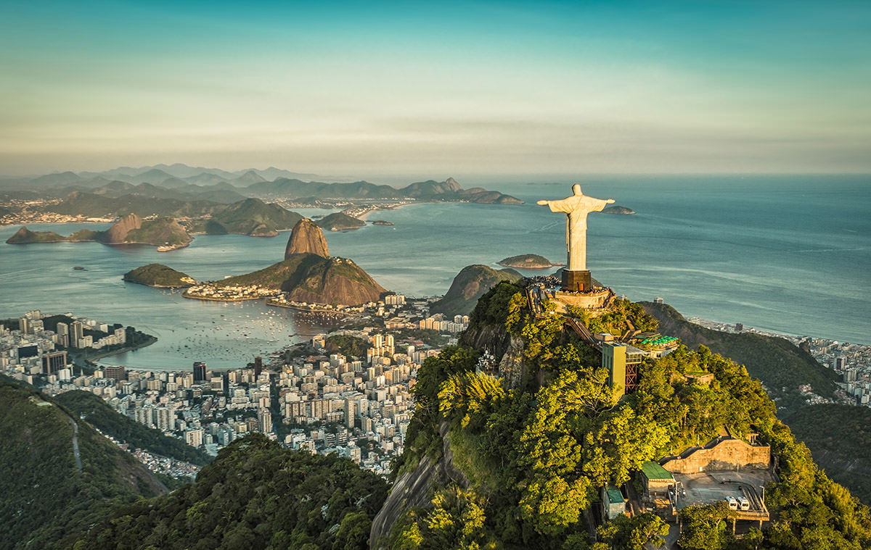
Urban Change and Management in Rio

Slide 2


What are we learning?
Housing and transport issues.
Management strategies employment
Impact of these management strategies.

Slide 3
Starter Question
Explain and evaluate methods used to control traffic congestion in a developed world city (6).

Slide 4
Park and ride was set up. This has been successful as buses are used instead of cars.
Park and ride was set up which means people don’t drive cars into CBD and instead of more than twenty cars, you have one bus. This has been very successful as Hermiston has a 95% average occupancy rate and facilities have been extended to deal with popularity.

Slide 5
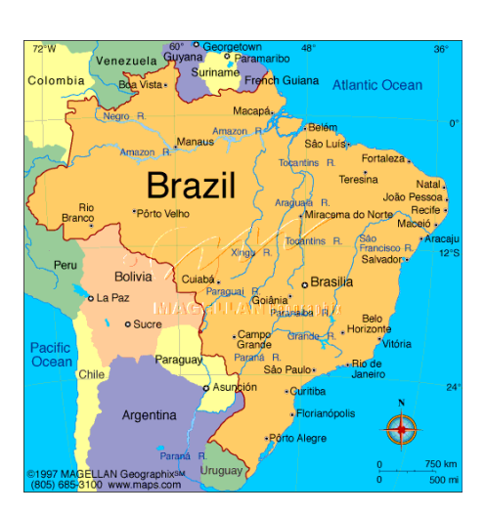
Brazil’s Golden Triangle

Slide 6
What is it?
South East of Brazil is where most people live.
It has always been the most industrial region – this caused the term “Golden Triangle” to be made.
The Golden Triangle is made up of three Brazilian cities: Rio De Janeiro, Sao Paulo and Belo Horizonte.

Slide 7

About Rio
Brazil’s second largest city = population of approximately 6 million.
It was the capital of Brazil from 1763 until 1960.

Slide 8
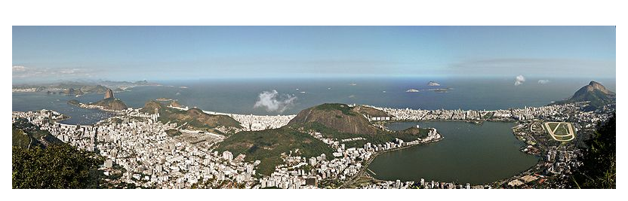
Location
SE Brazil on the Atlantic coast
Next to a large natural harbour -Guanabara Bay
Strip of flat land between the coast and steep inland mountains

Slide 9
https://www.youtube.com/watch?v=ieWNzZPfZzk
Show smartboard images.

Slide 10
Rio’s different zones – Smartboard File

Slide 11
Why do people move to Rio from the countryside?

Slide 12
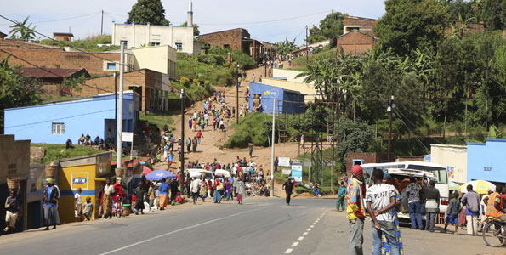
Rural → Urban Migration

Slide 13
Urbanisation
Urbanisation means an increase in the number of people living in cities.
In Brazil, people are migrating from the rural areas to live in the cities in the South East.
Why????

Slide 14

Push Factors
Reasons why they are leaving the countryside (pushing them away).

Slide 15

Pull Factors
Reasons attracting them to the city (pulling them in).

Slide 16
Places Textbook
Look at Diagram C (Page 23) and Diagram A (Page 26) to explore why people are moving from sparsely populated areas of Brazil to the South East.
Write down as many push (leaving countryside) and pull (attract to SE/cities) as you can.

Slide 17

Pull Factors
Jobs – more available, pay more.
Better services – schools, healthcare, shops, entertainment etc.
Fertile land to grow crops.
Good food suppliers.
Greater wealth or affluence – make more money.
Political Security – may be in danger in your country due to religion, gender etc.
More attractive environment/way of life.
Existing migrant communities.
Speak same language.
Welcoming environment – media favour immigrants, policies that allow migration (EU).

Slide 18
What is the reality when they get there?

Slide 19
Housing Issues in Rio
Due to rapid urbanisation (metropolitan area is over 11 million people) – there is a sever shortage of housing.
Housing prices in Rio have sky rocketed (most expensive in Brazil) after Olympics and World Cup – property prices have risen by 250% in past 6 years.
https://www.bbc.co.uk/news/business-27218510

Slide 20
The reality…
Many people who arrive in search of a better life can’t afford housing.
Millions have to construct their own houses from scrap materials such as wood, corrugated iron and metals.
These areas of temp accommodation are known as shanty towns or favelas in Brazil.

Slide 21
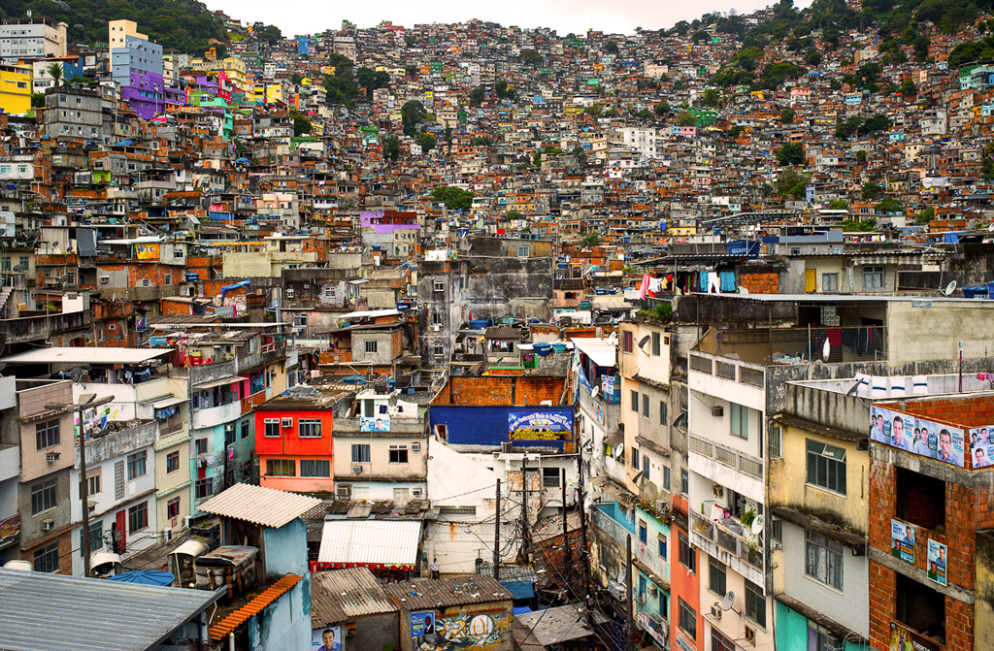
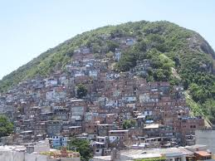
The Rio Favelas (slums)

Slide 22
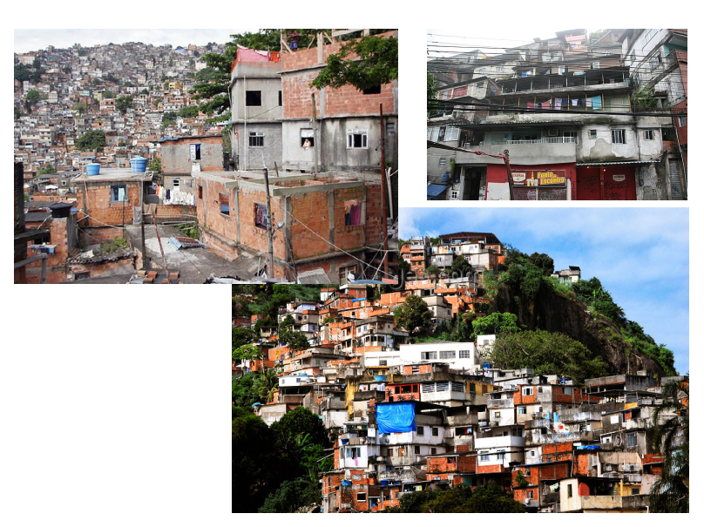

Slide 23
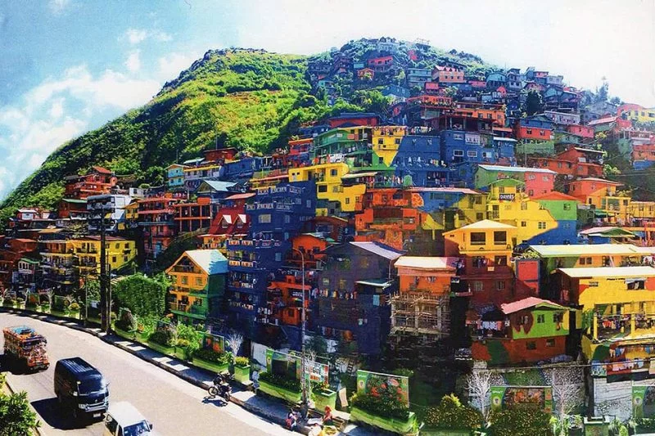

Slide 24
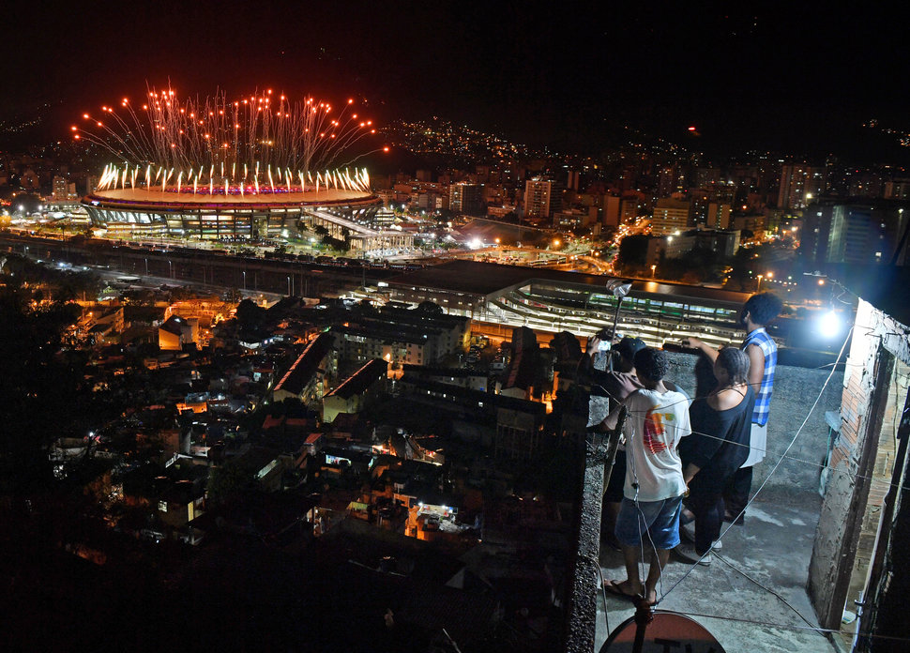
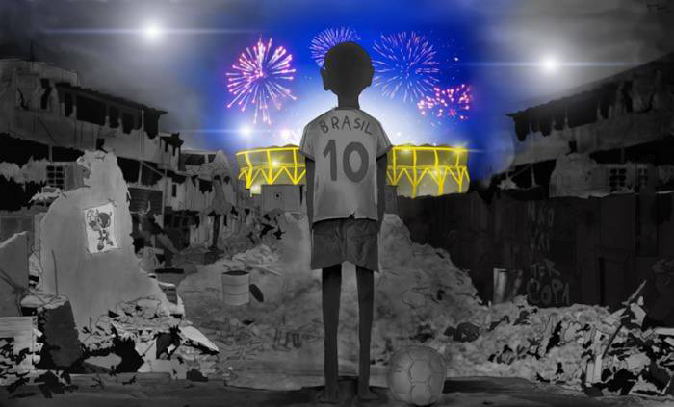

Slide 25
The Rio Favelas (slums)
Much like many large cities, many people move to Rio in search of a better life but end living in favelas (slums) – with overcrowding a big problem.
Close to 1.5 million people – about 25% of Rio’s population live in Favelas
There about 1,000 different favelas in Rio – Rochina being the biggest.

Slide 26
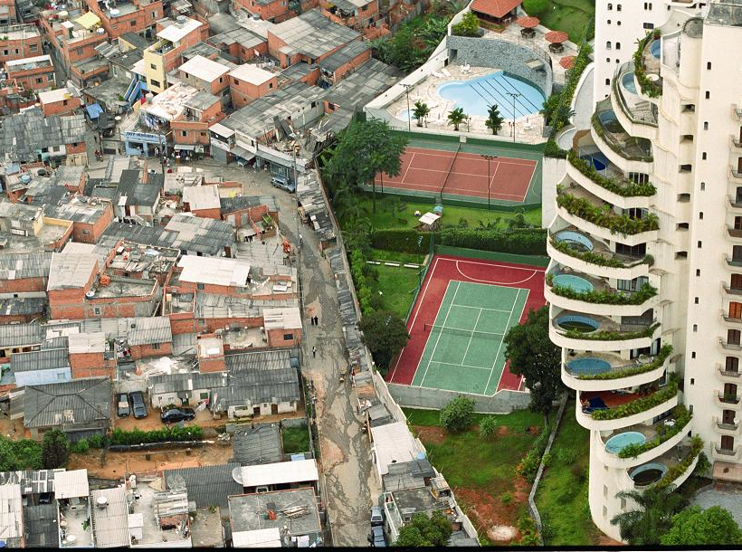

Slide 27
Crime in Rio’s Favelas
Rio’s favela’s are known as crime hotspots
Police and drug gangs fight for control of favelas – with gang warfare very much present.
Favela’s would not be safe for tourists although safer ones are open for tours etc.
On average, Rio has 37 times more murders than London. With many favelas being much higher than this.

Slide 28
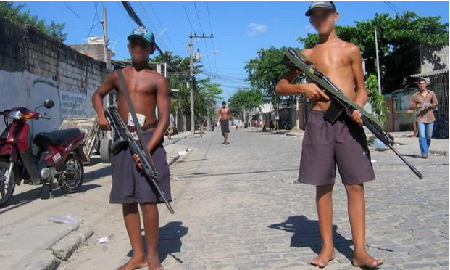
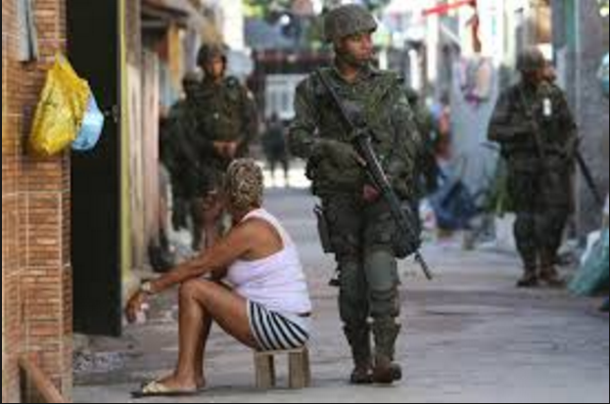
https://www.telegraph.co.uk/news/worldnews/southamerica/brazil/6360717/Rio-de-Janeiro-drug-traffickers-shoot-down-police-helicopter.html

Slide 29
LOOK AT SMARTBOARD FILE

Slide 30
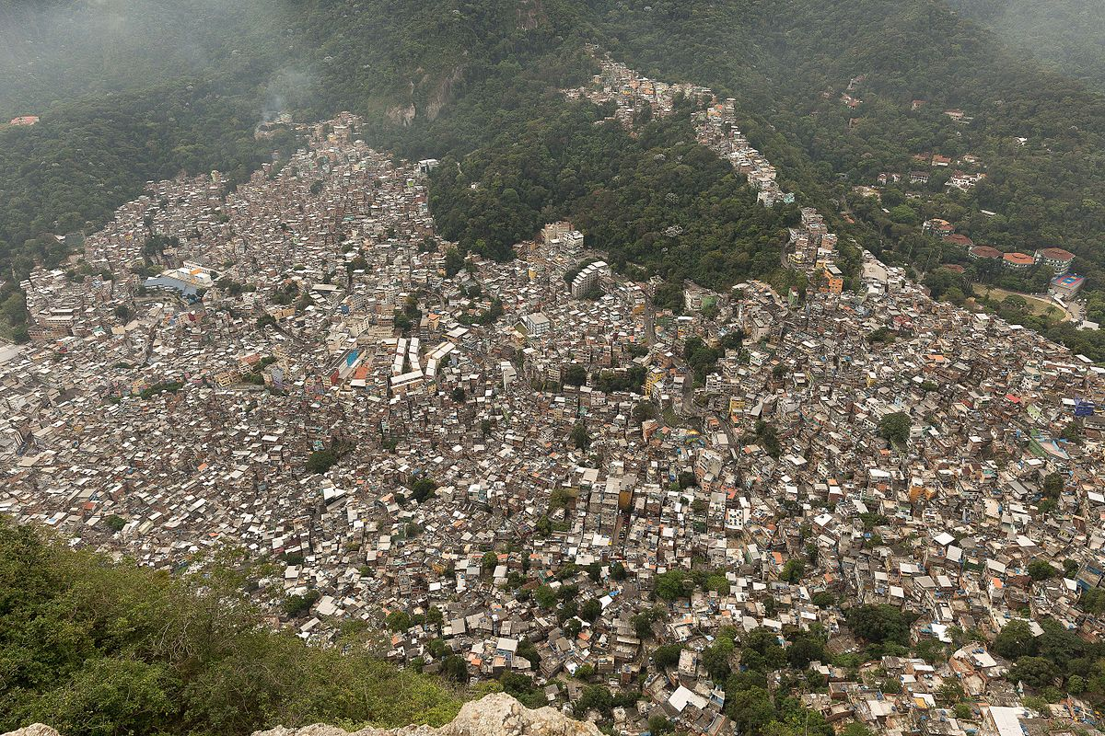
Issues within Rocinha

Slide 31
Rocinha
Rocinha is the largest favela in Brazil. It is located in the southern zone of the city.
It is built on a steep hillside overlooking the city, just one kilometre from the beach.
It is home to between 60,000 to 150,000 people (though this could be more) – less than a square mile of land.
https://borgenproject.org/10-facts-about-rocinha-brazil/

Slide 32
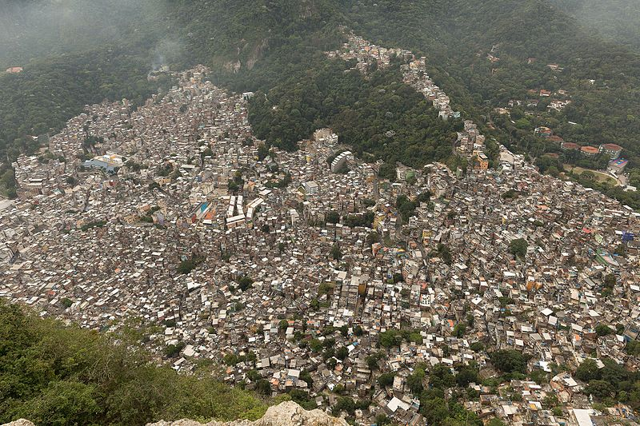

Slide 33
Life in Favelas
Draw a spider diagram – “Life in Favelas”
Take notes as you watch this short video.
Categories to think about:
Housing – what they like?
Health/Sanitation
Jobs
Education
Crime
https://www.youtube.com/watch?v=c3BRTlHFpBU

Slide 34
History of the Favelas
https://www.theguardian.com/world/video/2010/may/17/five-days-favela-complexo-mare
Favela 360
https://www.youtube.com/watch?v=GsUa1i5QQ0g

Slide 35
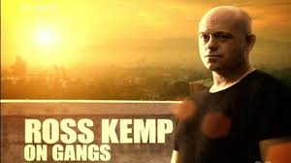
Ross Kemp on Gangs

Slide 36
Main Issues of Life in the Favela
From watching the videos, what do you think are the biggest issues of Life in the Favela? Explain why you picked your 1st place.
Rank them like this:
1
2
3
4
5
6

Slide 37
Rocinha’s Main Issues

Slide 38
Main Issue
Each group (6 groups) have been given a card with information on.
You will have 5 mins to read the card and write down the key points from it (facts and figures).
You will then go and learn about other groups areas.

Slide 39
Poor Housing and Services
Houses built illegally with basic materials (scrap metal, corrugated iron, broken brikes).
12% of houses = no running water
30% = no sewage connections
30% = no electricity
Illegal connections (gatos) to overhead pylons to get electricity = very dangerous (fires, electrocution).

Slide 40
Overcrowding
About 37,000 people crammed into each square kilometre.
Only one main road – everything must be carried in and out up narrow streets (including rubbish).

Slide 41
Poor Health
Poor sanitation = cholera and diarrhoea
Life expectancy = 13 years younger than wealthier area of Rio.
Infant mortality rate = 50 per 1000.

Slide 42
Lack of Jobs
Unemployment rate = about 20%
Informal sector = street vendors, drivers, labourers, maid = poorly paid (less than $100 a month), irregular.

Slide 43
Crime
Many favelas controlled by criminal gangs.
80 people killed each day in Rio.
Rochina = one of Rios most feared areas, until recently police hardly patrolled (used helicopters to shoot down if any problems).

Slide 44
Landslides
Heavy rainfall from tropical storms causes mudslides on steep hills.
1988 = 277 people killed, 13,000 homeless.
2010 = 95 people killed.

Slide 45
In a developing world city you have studied, Explain possible issues linked with urbanisation (3).

Slide 46
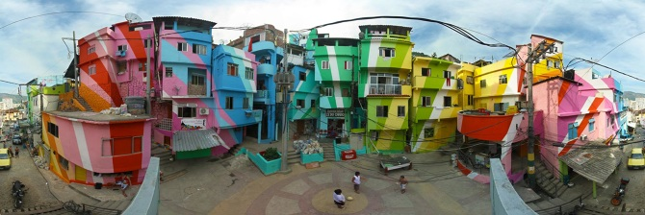
Improving the Favelas

Slide 47
Self Help Schemes
Local Authority provide residents with resources (bricks, tiles, wood, cement, glass) to improve house.
Residents use their skills to do work.
Almost all houses in Rocinha now concrete/brick.
75% houses have electricity.
Improvements restricted by steep hills and high density of housing.

Slide 48
Site and Service Schemes
Local authority in control of building projects.
Favela Bairro Project = started in 1994, targeted small favelas (500 to 2500 homes), £200 million set aside. Replace wood houses/ones on steep slopes, widen streets, pavements, water pipes, electricity, sanitation etc.
Installing water pipes and sewers has greatly improved health and reduced disease.
Generates income for council as families pay rent – however, not all can afford rent.

Slide 49
New Town (Barra da Tijuca)
Modern coastal suburb in west Rio.
Area made more accessible and built up.
Less crime, less crowded, better housing.
Luxurious apartment blocks = 130,000 residents.
Usually only wealthy can afford to live there (have maids, cooks, gardeners etc).
Favelas now growing here.

Slide 50
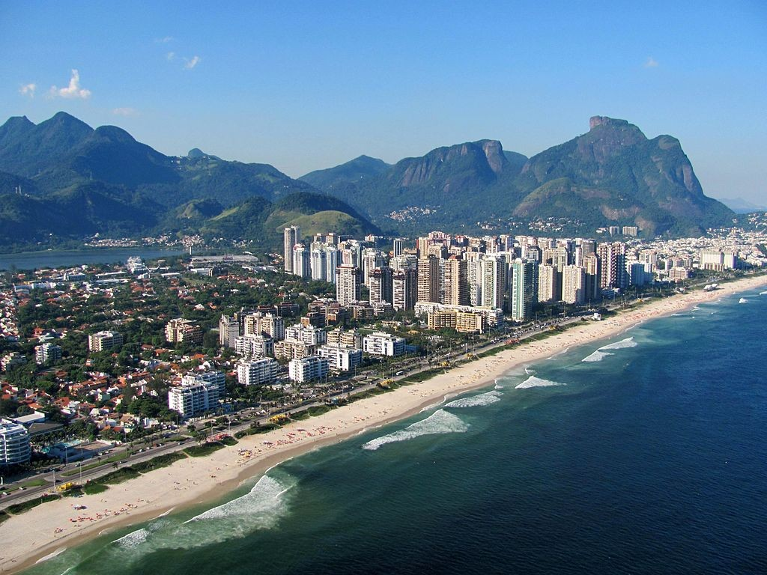

Slide 51


Morar Carioca
Programme of improvements to be finished by 2020 – happening due to 2014 World Cup and 2016 Olympics.
Urbanises all favelas in Rio.

Slide 52
a) Setting up Pacifying Police Units (UPP)
Permanent community presence within favelas – intensive policing and improvements in social services to meet local needs and reduce crime.
Increase in drug seizures and arrests. Lower homicide and robbery rates. Residents accept police presence.
Upgrade in quality of life – electricity supply in Chapeu Mangueira.
However, due to improved life and security – house prices near favelas have soared.

Slide 53
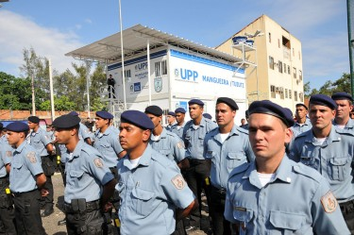

Slide 54
b) Improving Existing Infrastructure of Favelas
40 architecture practices have been tasked with redesigning 582 inner-city slums = 1.2 million Brazilians (health centres, cinemas, creches etc).
Fear that they are just beautifying the favelas for tourists – without investment in jobs and education then not much change can occur.

Slide 55
Favela Painting
Community project to turn favelas into artwork.
Thousands come to visit mural – first time news reports begin to focus on favelas without talking about crime.
Improved residents perceptions of their home, employed young artists, built community spirit.

Slide 56
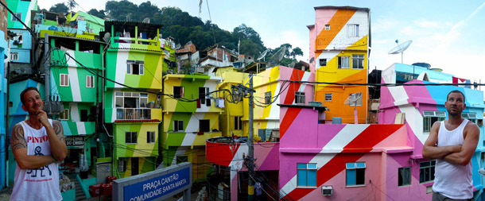

Slide 57
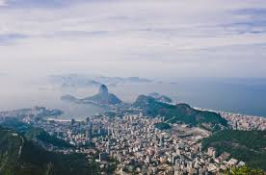

Reach Christ the Redeemer
1 Evaluation
2 improvements made
3 issues about Life in the Favelas

Slide 58
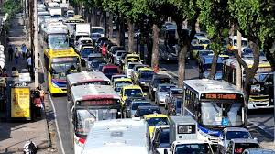
Transport Issues in Rio

Slide 59
Rio Transport Network
Rio's transport system consists of a metro system, suburban trains and a large bus fleet.
62% of the journeys in Rio are made by bus, 30% are by car and only a small percentage of journeys are via the metro system (5%) and rail network (3%).

Slide 60
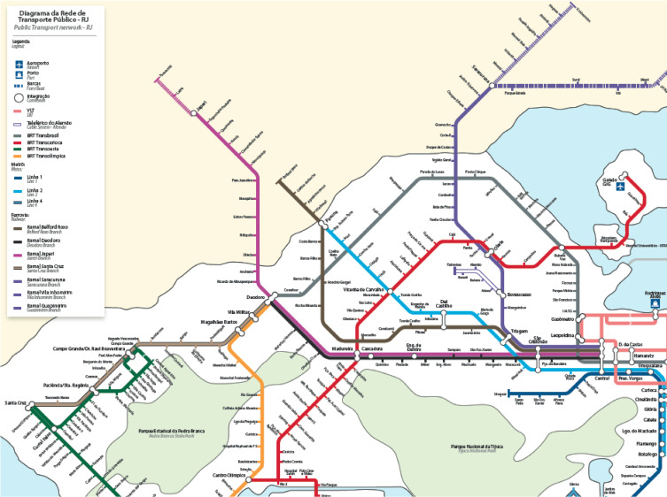

Slide 61
Why is it congested?

Slide 62

Reading Task
Read the short segments from “Rio Times” newspaper articles.
Read the traffic problems section and Guardian article at the back of your booklet.
What would you say are the reasons for traffic issues? Write down any good facts/figures you could use.

Slide 63
Reach Christ the Redeemer
1 Evaluation
2 improvements made
3 issues about Life in the Favelas

Slide 64

Physical landscape with mountainous terrain and proximity to sea makes it difficult to build and adapt transport systems

Slide 65
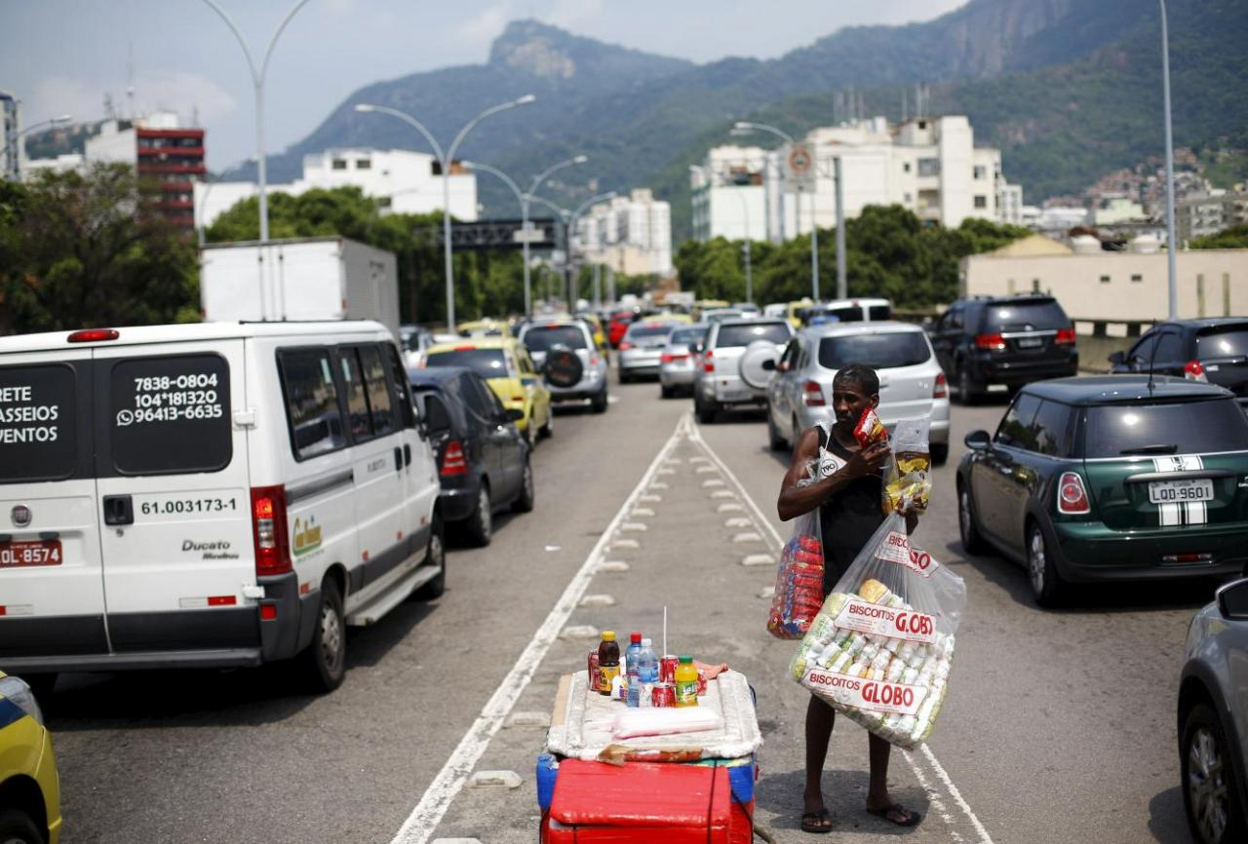
Government offered tax exemptions to boost car sales (900,000 (1992) – 2.5 million (2012)

Slide 66
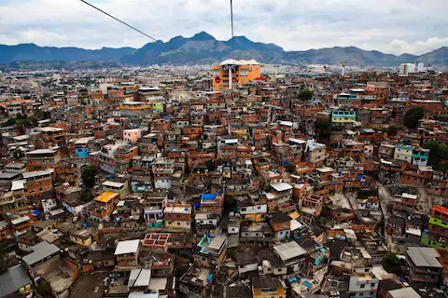
25% of Rio live in favelas – conventional forms of public transport not feasible due to steep hill sides.

Slide 67
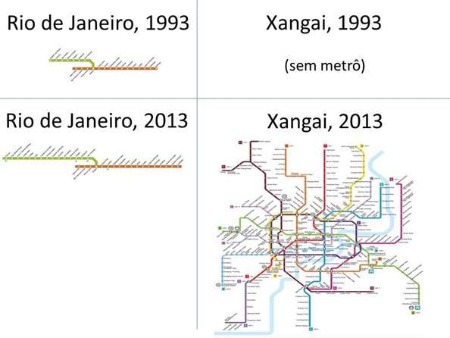
Lack of investment in public transport (crowded, poor quality) –service doesn’t meet demand - and poor city planning.

Slide 68
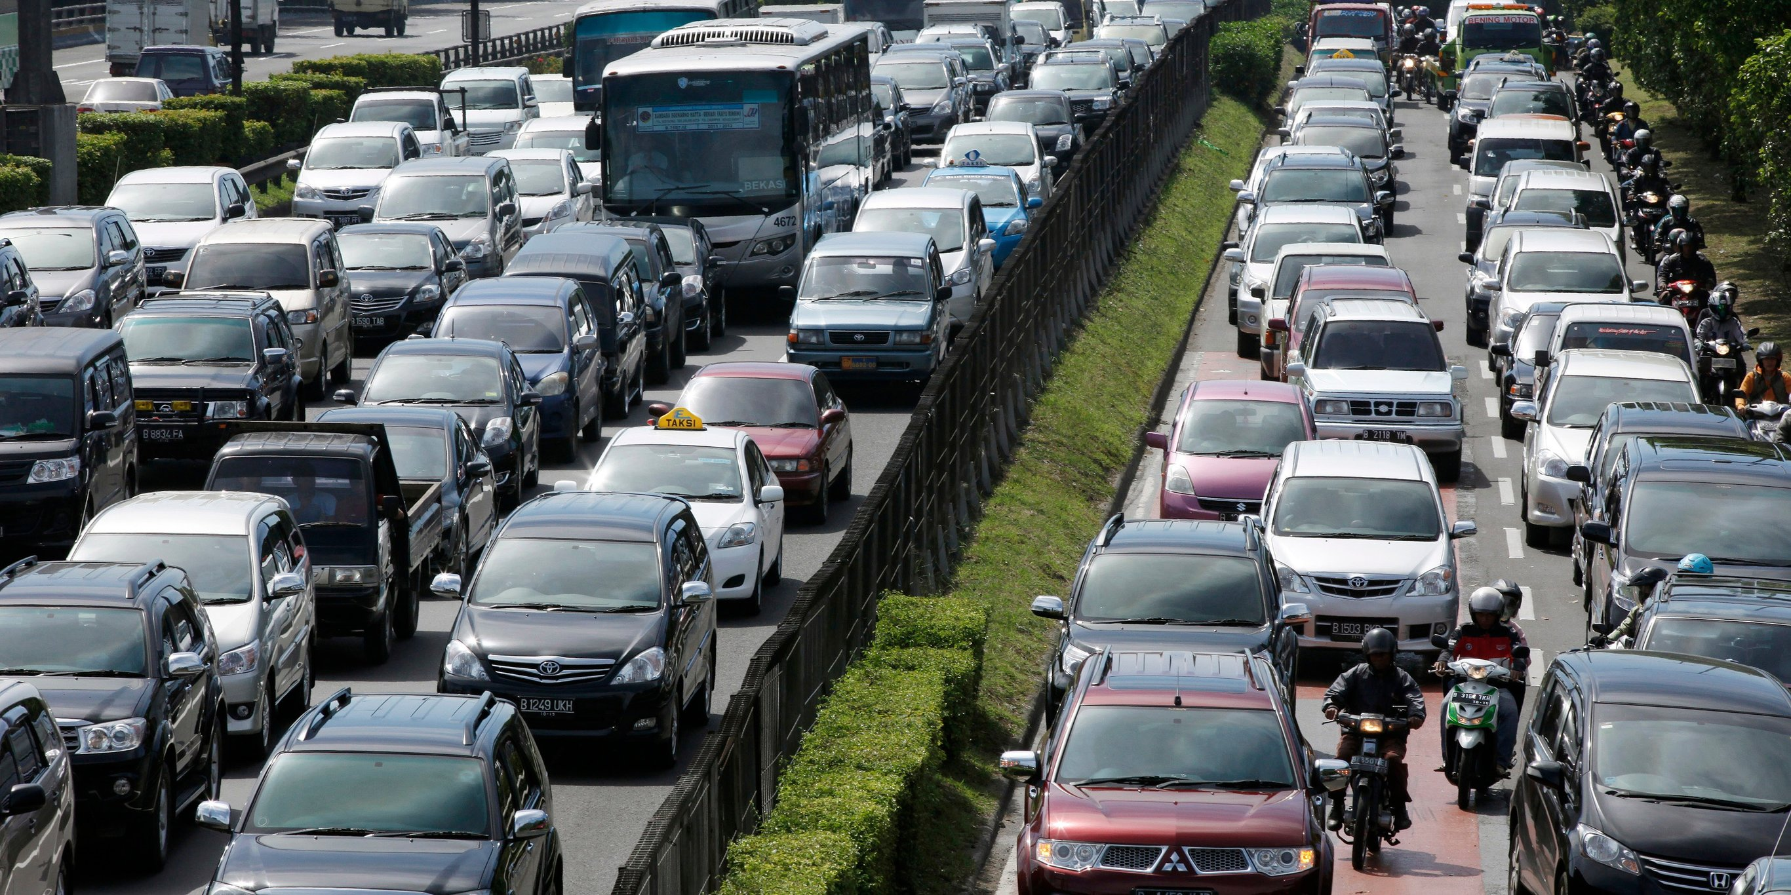
Long Commuting Times (highest in country). Many can’t afford to live near where they work.

Slide 69
Increased road accidents (causing roads to slow down), caused by:
Lack of money spent on upkeeping of road.
Old, neglected cars – likely to breakdown.
People not following traffic rules.
Drink driving

Slide 70
Bus Prices Increasing (raised by about 9% in 2014) – sparked protests.
https://www.bbc.co.uk/news/world-latin-america-26077374

Slide 71
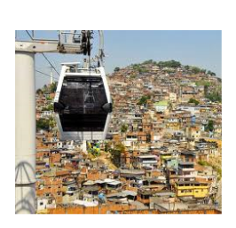
Solving Traffic Congestion

Slide 72

Different Strategies
Metro System
Rio Niteroi Bridge
Railway System
Ferries
Cable Cars
Bus Rapid Transit
Bike Rio
Olympic Plan 2016
Intercity Ticket

Slide 73
Pairs Task
6 groups.
For your strategy/ies answer the following the questions:
What is your strategy (bit of background)?
What does your strategy do to help traffic issues?
What is the impact of the strategy? (evaluate)
Try include important facts and figures!

Slide 74

A wee break – Bolivia's Death Road
https://www.youtube.com/watch?v=daQcxVqQJsI

Slide 75
Starter – Maths Problem
Trips per day using intercity ticket - (The length of the Rio Niteroi Bridge + percentage of residents using cable cars + how many bike rental stations).
727,000 - (24+17+600)
726,359

Slide 76
5A: Due 19/9/2018
For a developing city you have studied:
Explain housing issues present within shanty towns (6).
Explain strategies used to improve housing (6).
Evaluate the effectiveness of strategies used to improve housing (6).

Slide 77
Trip: A week on Wednesday – get forms in and money in.

Slide 78

Exam Technique

Slide 79
Practice Exam Questions
For a developing world city you have studied:
Explain reasons behind traffic congestion (6).
Explain strategies employed to manage these issues (6).
Evaluate the effectiveness of these strategies (6).

Slide 80
What does a good answer look like?
The roads are bad.
The roads are bad due to lack of money spent on upkeep which can cause traffic accidents to close roads/slow down traffic.
25% of people in Rio live in Favelas.
25% of people in Rio live in Favelas – the hills here are steep so infeasible for conventional forms of public transport.

Slide 81

Socrative Practice
SMITH1400

Slide 82

Mark Mr Smith’s answer

Slide 83
Mark Each Others
From what you have learnt, practice marking someone else's.
Remember to give constructive feedback.

Slide 84
A wee break – Bolivia's Death Road
https://www.youtube.com/watch?v=daQcxVqQJsI

Slide 85
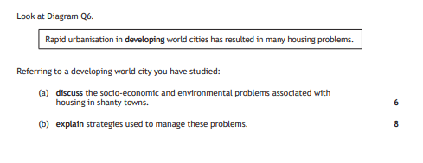

Slide 86
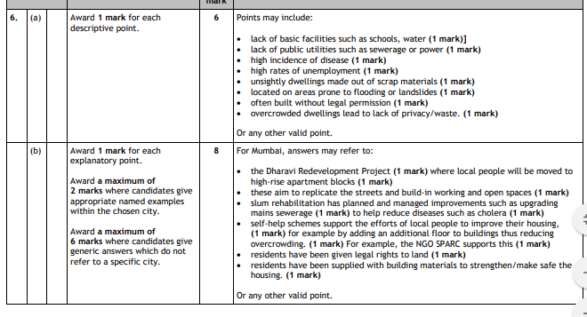

Slide 87
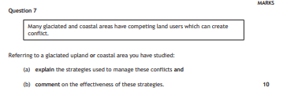

Slide 88
