Slide 1
Country Examples: Name a country
Where climate hinders development as its very dry.
Where climate helps development as its wet and warm.
Where the relief hinders development as its very steep.
Where lack of resources/minerals hinders development.
Where lots of resources/minerals helps development.
Where natural disasters hinders development.
Where trading links helps development due to ports.
Where lack of trading links hinder development due to being landlocked
Where being involved in a war hinders development.
Where a high amount of disease such as malaria hinders development.

Slide 2
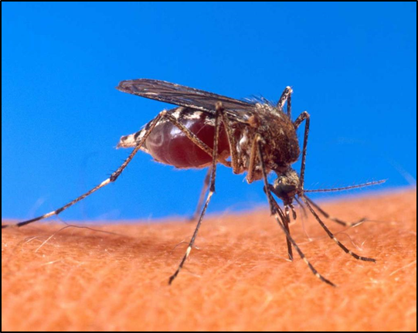
Malaria

Slide 3
What do you need to know about?
For a water-related disease (malaria):
Causes
Impacts
Management (including effectiveness)

Slide 4
Malaria Facts
Global population at risk - 2.3 billion people - about 40% of the world’s population
Number infected - 500 - 600 million people
Global annual mortality - 1.5 - 3 million deaths, or between 4000 and 8000 each day – One of worlds deadliest diseases.
Every 30 seconds, a child dies of malaria.

Slide 5
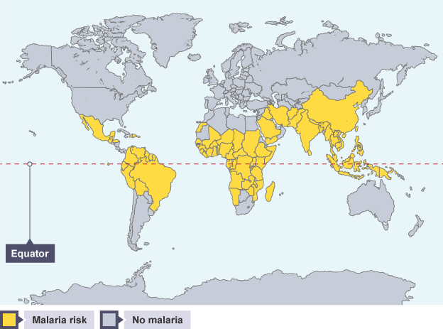
Malaria
Malaria is usually found between the Tropic of Cancer in the north and the Tropic of Capricorn in the south. There are a number of human and physical factors which contribute to the worldwide distribution of malaria.
Who can name the most countries at risk?

Slide 6
Infection
You can catch Malaria from blood transfusions,
…or infected needles,
…or intra placentally i.e from a mother to the baby in her womb.
But by far the most common way is by being bitten by the female Anopheles Mosquito.

Slide 7
Cause and Spread
The female Anopheles Mosquito carries and spreads the disease.
Malaria is a PROTOZOA parasite (plasmodium).
https://www.youtube.com/watch?v=qvlTOhCmxvY
The parasite attacks
the liver and destroys
the red blood cells
The female
mosquito
becomes infected
when it sucks a human’s blood
Bites another victim
And passes on the
Parasite (plasmodium)

Slide 8
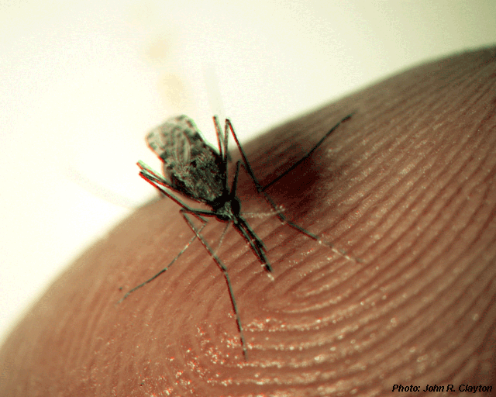
When the Anopheles Mosquito “bites”, it actually sinks a long, thin mouth part, the proboscis, into the skin.
The mosquito then pumps saliva under the skin, to stop the blood clotting – so that it can drink uninterrupted! In the saliva is the main culprit, the Plasmodium, a single-cell blood parasite.

Slide 9
Signs and Symptoms
Fever – up and down
Dehydration
Anaemia
Jaundice
NHS - http://www.nhs.uk/Conditions/Malaria/Pages/Introduction.aspx

Slide 10
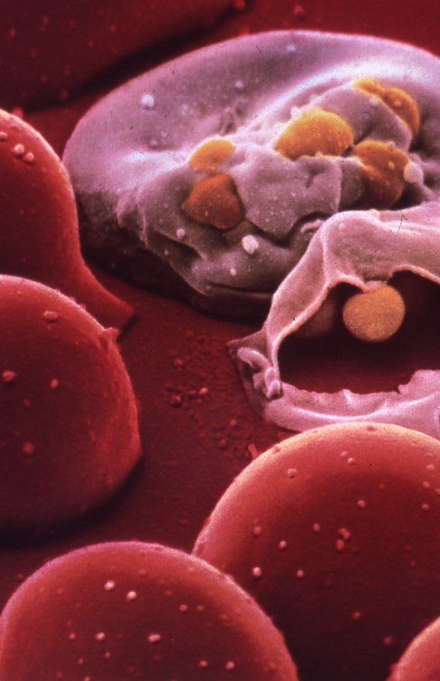
A remarkable close-up of destroyed red blood cells.

Slide 11
Risk Populations: Who are vulnerable to Malaria
Deaths from Malaria are mainly among the young in risk areas due to immunity built up in older population
Highest death rates are in children under 5 years of age
Older people are susceptible when they move from one area and return outside of 6 months

Slide 12
Distribution in UK
Distribution mainly among those visiting friends and relatives
20 deaths in UK each year
2000 cases are diagnosed

Slide 13
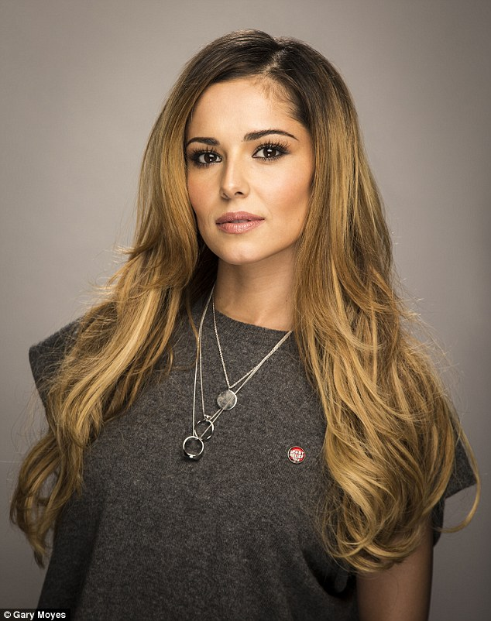
https://www.youtube.com/watch?v=WqjefnWJjeM

Slide 14
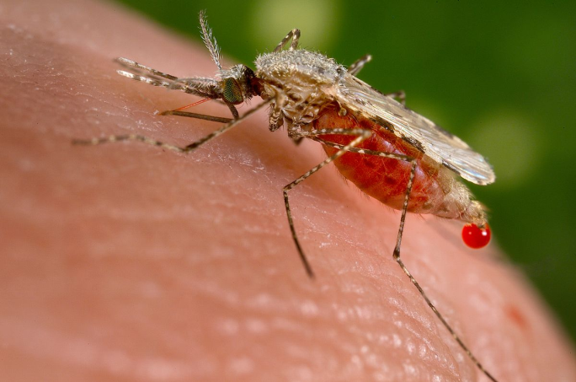
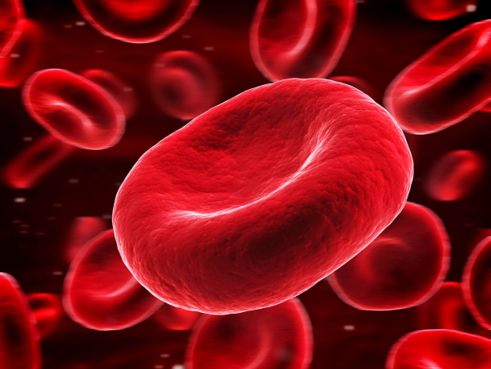
What is needed?
Mosquito – Female Anopheles.
Blood supply (people) – to affect with malaria.
Environment – certain temperature, still water to lay eggs.

Slide 15
Malaria
Malaria is usually found between the Tropic of Cancer in the north and the Tropic of Capricorn in the south. There are a number of human and physical factors which contribute to the worldwide distribution of malaria.
Name 10 countries which are at risk of Malaria.

Slide 16


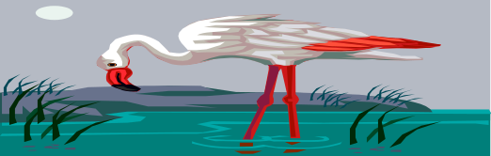

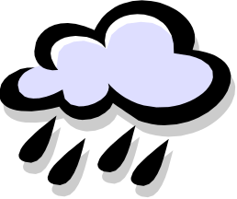
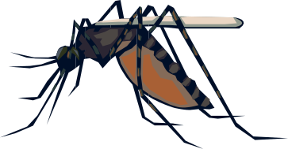
Environmental Conditions
Favouring Malaria
HIGH TEMPERATURES
15C-40C
STAGNANT WATER
PHYSICAL
FACTORS
HIGH RAINFALL
SHADE, BUILDINGS OR VEGETATION

Slide 17

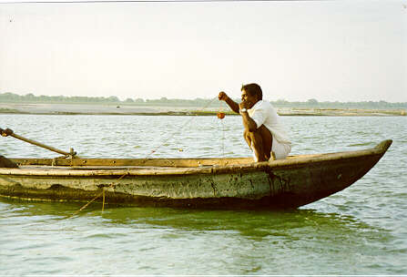
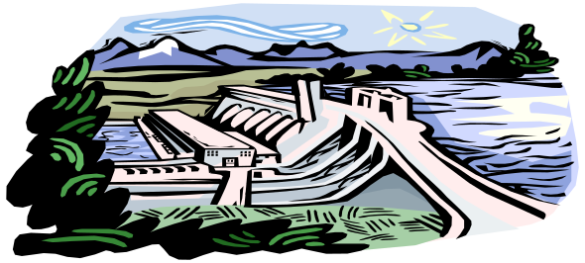

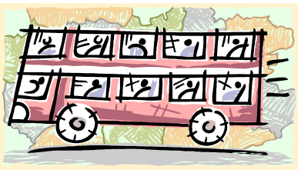
PEOPLE LIVING NEXT TO LAKES
GROWING RICE IN PADDY FIELDS
LACK OF
MONEY
HUMAN FACTORS
NEW DAMS
RESERVOIRS
INCREASED MIGRATION

Slide 18
Match Up Task
Use the explanation sheets to fill in your tables.
Match up the explanation with the reason.

Slide 19
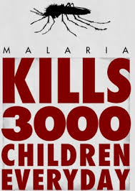
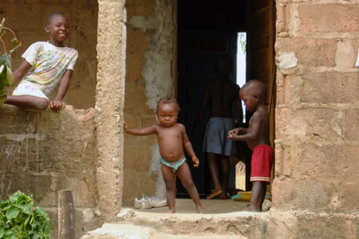
Malaria leads to large number of children aged under five dying. This increases child mortality rates and therefore birth rates
Adults with malaria are too weak to work which leads to a loss of productivity or to them not being able to produce enough food for their family.
People with Malaria who do not work remain poor and do not have a lot to eat which makes them more vulnerable to disease.
Effects of Malaria
Tourists may be less likely to visit a country with malaria so there is less revenue from tourism.
A country's limited resources are used up in health care rather than in education or improving services which hinders development. (Nearly half of hospital beds in Africa are malaria)

Slide 20
Vicious Cycle of Disease
Person becomes weak
Little food to eat
Illness
Poverty
Unable to work hard

Slide 21
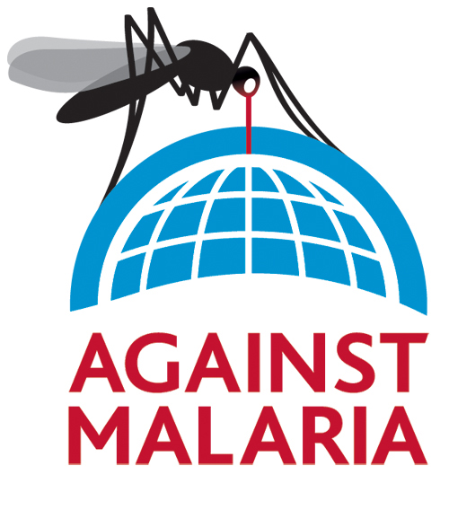
Preventing and Controlling Malaria
How do Developing countries control the spread of Malaria?

Slide 22
Using the causes….
What possible control mechanisms do you think might be used?

Slide 23
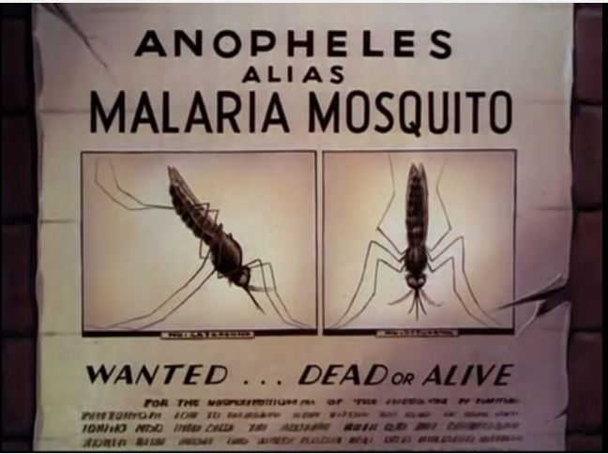
Disney Does Malaria
Causes + Solutions.
https://www.youtube.com/watch?v=y68F8YwLWdg

Slide 24
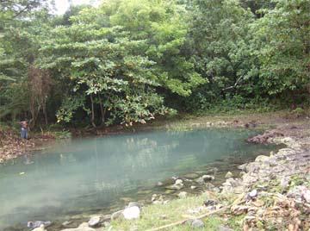
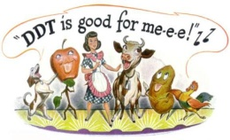
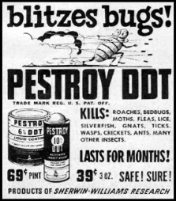
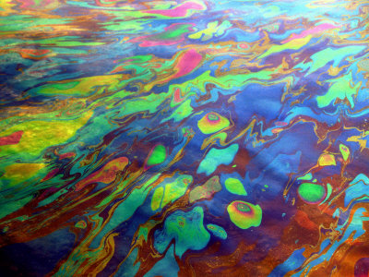
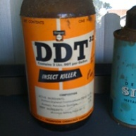
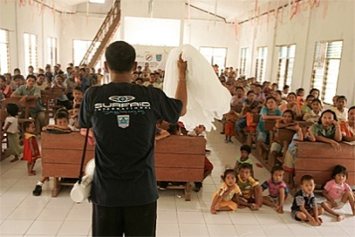
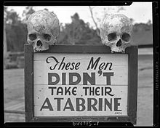
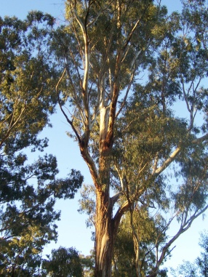
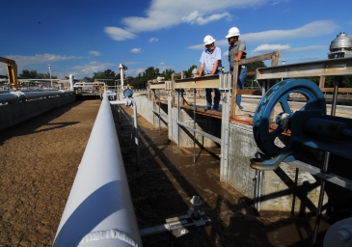
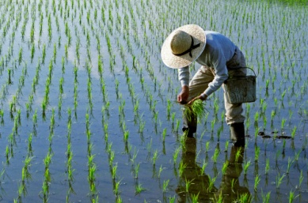
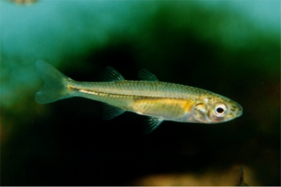
Drain breeding sites
Spray insecticides (DDT)
Spray a film of oil on water surfaces, this kills larvae
Public education
Medical treatment
Control Methods
Plant Eucalyptus trees
Modern water management
schemes
Plant mustard seeds in paddy fields
Small fish in irrigation sites

Slide 25
1. AGAINST ADULT MOSQUITOES
INSECTICIDE SPRAYS
(SUCCESSFUL…BUT)
INSECTICIDE TREATED BED NETS
(VERY SUCCESSFUL)
DDT
MALATHION

Slide 26
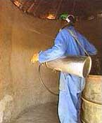
1
Insecticide sprays such as DDTare very efficient, but there are several drawbacks:
They are relatively expensive, often beyond the means of poor villages;
Sprays must be applied repeatedly for long-term effectiveness.;
They may contaminate water and crops.
4. Most importantly, mosquitoes can quickly develop immunity to the spray.

Slide 27
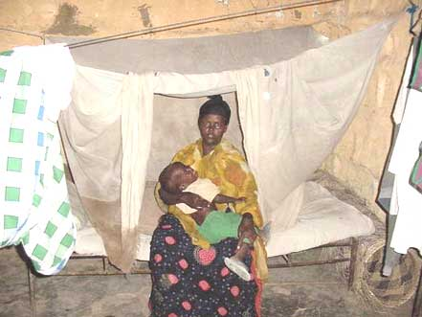
2
A simple mosquito net may mean the difference between life and death…

Slide 28
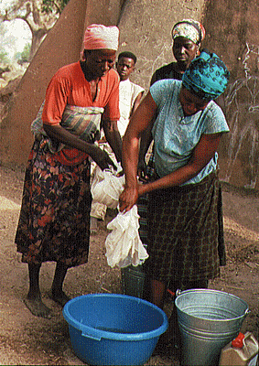
Only about 10 dollars a net but not affordable to everyone. Only work at night

Slide 29
2. AGAINST EGGS AND LARVAE
PHYSICAL
BIOLOGICAL
DRAINING BREEDING SITES
ADDING OIL, EGG WHITES OR MUSTARD SEEDS
FLUSHING BREEDING SITES
ADDING FISH TO PONDS AND PADI FIELDS
PLANTING EUCALYPTUS TREES

Slide 30
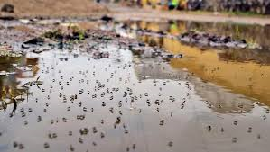
1
PHYSICAL CONTROL
Draining of Breeding Sites

Slide 31
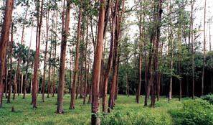
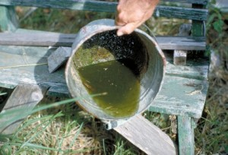
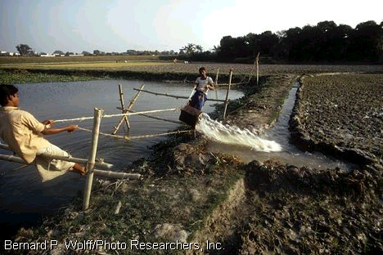
3
Draining breeding places: because mosquitoes need so little water in which to lay their eggs, it can be virtually impossible to find and drain them all.
Flushing out breeding sites by weekly release of water can drown the larvae, but can only be done in suitable areas and where there is surplus water.
Planting Eucalyptus trees to absorb excess water from the soil helps drain breeding sites.

Slide 32
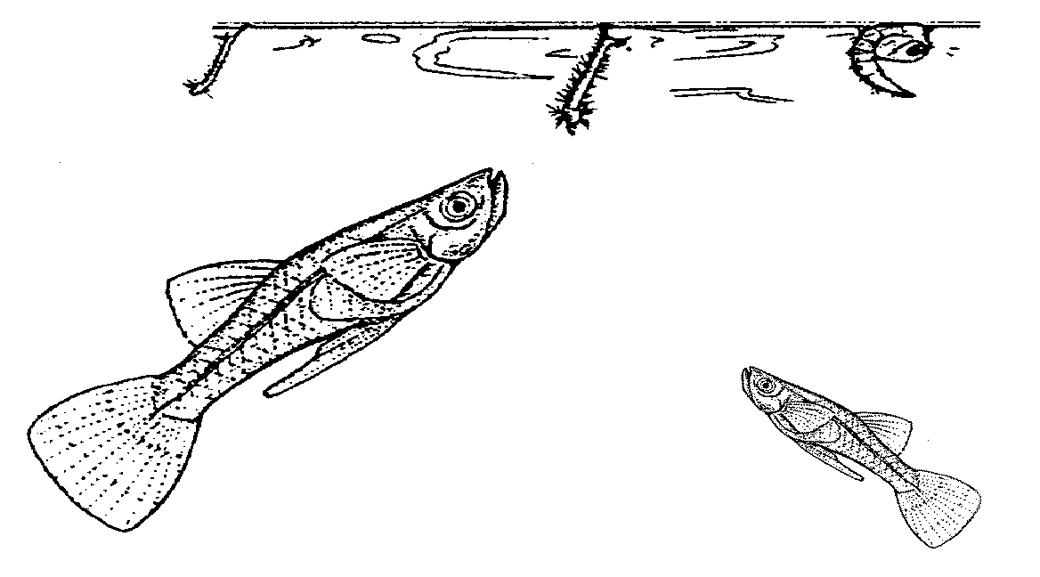
BIOLOGICAL CONTROL
4
Adding larvae-eating fish, such as the Muddy Loach, to padi fields and pools, can clear them of larvae within a day.

Slide 33
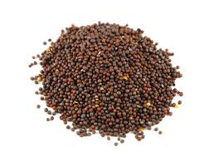
6
Adding egg whites or mustard seeds to breeding grounds – drown larvae

Slide 34
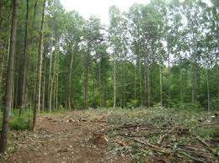
7
Clear trees and shrubs that provide shelter needed for reproduction

Slide 35
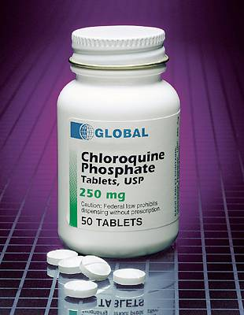
AGAINST THE PLASMODIUM…
1
1. Chloroquine: Now the most common anti malarial drug, but, like Quinine, becoming ineffective as the Plasmodium mutates and becomes immune to it.

Slide 36
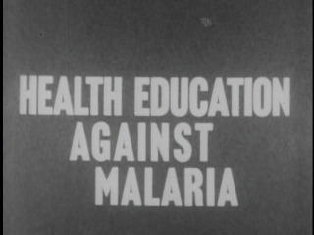
Public Education via local health campaigns – make people more aware of the risk factors

Slide 37
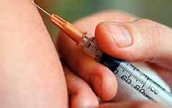
Vaccine
At the moment, there is no effective vaccine against malaria, although scientists all over the world are trying to develop one.

Slide 38
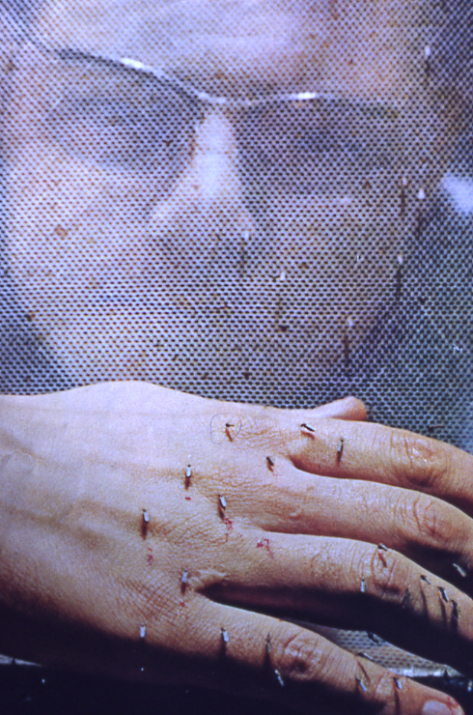
The search goes on to try to find a vaccine: the Bill Gates Foundation recently donated more than $168 million towards malaria research, most of that to find an effective vaccine available to all.

Slide 39

ROLL BACK MALARIA
Started in 1998, Roll Back Malaria is a global programme aimed at halving the world's malaria problem by 2010.
It is a coordinated attempt involving the WHO, UNICEF, the World Bank and many governments and scientific and medical experts across the world.

Slide 40
Ted Talk
https://www.ted.com/talks/bart_knols_cheese_dogs_and_pills_to_end_malaria

Slide 41
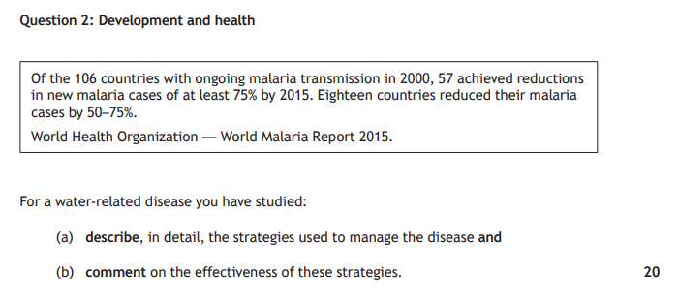
Practice Question
For a water

