Slide 1
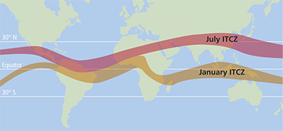
Intertropical Convergence Zone (ITCZ)

Slide 2
What is the Inter Tropical Convergence Zone?
A belt of low pressure produced by heating at the equator and the convergence of the trade winds (tropical continental (over land = dry) and tropical maritime (over sea = wet)).
This zone moves in response to the changing position of the thermal equator (the area receiving the most intense heat).

Slide 3
Diagrams Task
Can you give your blank Africa maps the following titles:
Thermal Equator Positions
ITCZ in January
ITCZ in July
Tropical Airmasses

Slide 4
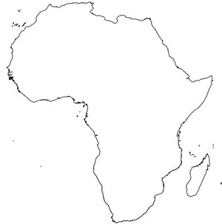

Slide 8
Thermal Equator
The thermal equator receives the most intense heat from the Sun. Around 20th June each year the Sun is overhead at 23½º North, the Tropic of Cancer. Around 20th December the Sun is overhead at 23½º South, the Tropic of Capricorn.

Slide 9
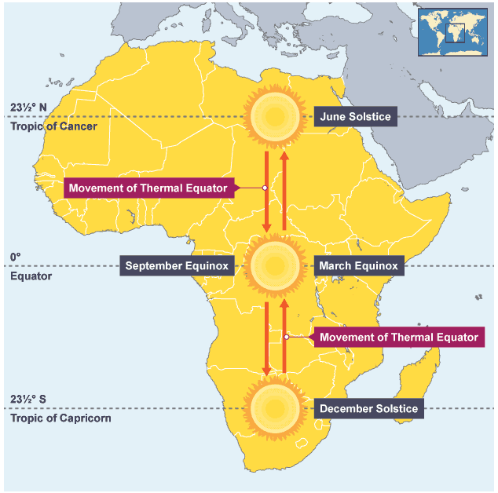

Slide 10
The ITCZ in Africa
The Seasonal change in the location of the ITCZ governs the supply of rainfall in locations throughout Africa.
The ITCZ in Africa moves with the Thermal Equator – you need to know key features for January and July.
Weather associated with ITCZ = heavy precipitation/high intensity rainfall.
Copy Figure 2.22 from Textbook Page 21 – remember the key and make lines nice and clear.

Slide 11
Copy Figure 2.22 and 2.23 from Textbook Page 21 – remember the key and make lines nice and clear.
Copy Figure 2.23 – Page 22.

Slide 12
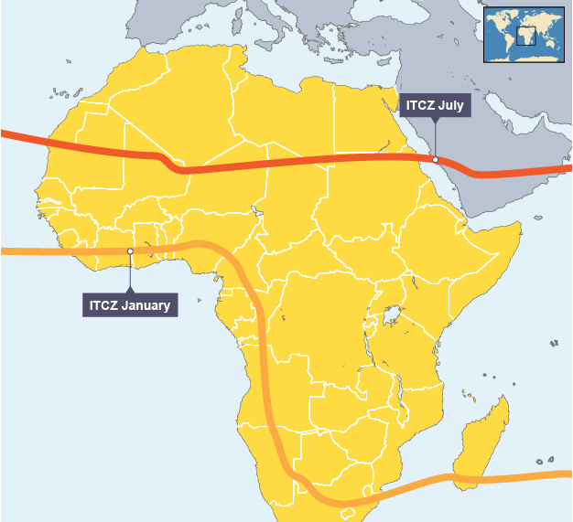

Slide 13
ITCZ in Africa
Weather associated with ITCZ = heavy precipitation/high intensity rainfall.
Key Rules
ITCZ = band of low pressure where trade winds meet.
Directly underneath ITCZ = thunderstorms, heavy rain (two air masses are meeting – pushing maritime air up, cools and condenses to form clouds.)
South of ITCZ = wet weather due to Tropical Maritime air mass.
North of ITCZ = dry weather due to Tropical Continental air mass.

Slide 14
ITCZ in July
Northern Hemisphere Summer Time.
ITCZ moves to Tropic of Cancer.
Sahara receiving maximum insolation.
Low air pressure of ITCZ pulls in hot, moist, tropical maritime winds (such as south westerlies from Atlantic source close to West and Central Africa).
Moisture from Tropical maritime winds therefore brings wet season to West Africa.

Slide 15
ITCZ in January
Thermal equator changes – ITCZ moves with it to the Tropic of Capricorn (southern hemisphere summer). Some still found about 8oN along coastal belt of West Africa.
Most of Africa north of equator experiences dry season (bar East Africa and coastal belt of West Africa).
Due to influence of Tropical Continental air = hot, dry air.
Hot, dry north-east wind which brings large amounts of dust is called the Harmattan.

Slide 16
The Two Air Masses
Tropical Continental (travelled over land (continent)) = dry.
Tropical Maritime (travelled over sea (maritime)) = wet
Copy Figure 2.23 (page 22)

Slide 17
Now put it all together – How does the ITCZ and its associated air masses influence the climate of Africa?

Slide 18
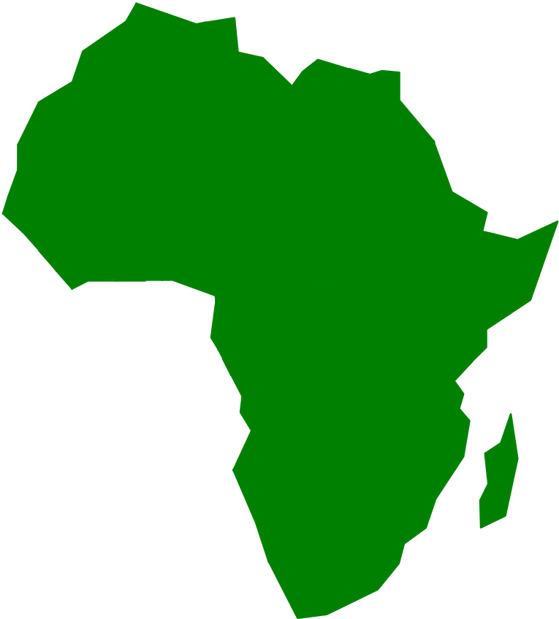

How does the ITCZ and its associated air masses influence the climate of Africa?
The ITCZ shifts position throughout the year in relation to
the apparent movement of the sun because of the way the
earth sits on its axis.
In July
The sun is directly overhead the Tropic of Cancer due to the
tilt of the earth. The ITCZ migrates northwards and is
positioned over the Tropic of Cancer.
ITCZ is positioned at the Tropic of Cancer
23 ½ºN
0º
23½ºS
ITCZ
Tropic of Cancer
Equator
Tropic of Capricorn

Slide 19
This means that Africa is dominated by the Tropical
Maritime air mass, bringing with it warm, wet and generally
unstable conditions. This explains why July is Africa’s wet
season.
cT
ITCZ positioned at Tropic of Cancer
ITCZ
Warm moist unstable Tropical Maritime Air dominates most of Africa.
mT

Slide 20
In January
The sun is directly overhead the Tropic of Capricorn due to
the tilt of the earth. Therefore the ITCZ migrates south and is
positioned over the Tropic of Capricorn.
Tropic of Cancer
23 ½ºN
0º
23½ºS
Equator
Tropic of Capricorn
ITCZ
ITCZ is positioned at the Tropic of Capricorn

Slide 21
This means that much of Africa is influenced by Tropical Continental air,
bringing with it warm, dry stable conditions and the warm, drying
Harmattan wind. This explains why most of Africa experiences its dry
season at this time of year.
Warm, dry stable Tropical Continental Air dominates most of Africa.
cT
ITCZ
ITCZ positioned at Tropic of Capricon
mT
Some western and southern parts of Africa remain under the influence of Tropical Maritime air
because the Tropical Continental air mass (above the ITCZ) is not strong enough to push against
the dense Tropical Maritime air mass which is moving into the land from the sea.

Slide 22

Lets do it on a larger scale!

Slide 23


Check your Understanding!
Use your notes on the ITCZ to answer the following
questions:
Write a definition for the ITCZ.
What type of air pressure occurs at the ITCZ?
What weather does the tropical continental air mass bring?
What weather doe the tropical maritime air mass bring?
What will the weather be like at the ITCZ?
Why does the ITCZ appear to migrate to different positions throughout the year?
Where is the ITCZ positioned in a) July b) January
Explain why most of Africa experiences warm, wet weather in July.
Explain why most of Africa experiences its dry season in January.
Why do some parts of western and southern Africa always experience Tropical Maritime air?

Slide 24
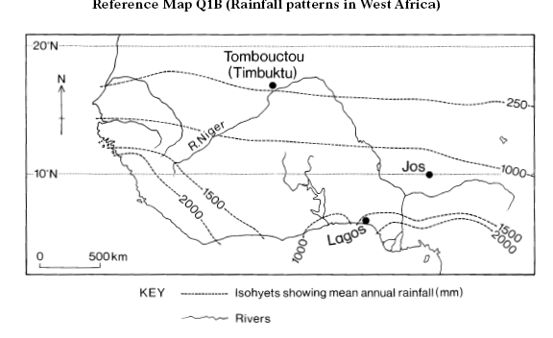
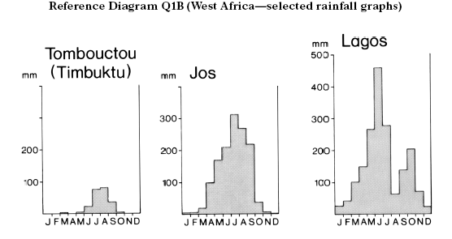
Example exam question (2)
Explain the varying rainfall patterns shown in Reference
Diagram Q1B. (8)
Take each climate graph and explain the patterns of rainfall.
Look at the average rainfall data. What patterns can you see? Which area has most / least rainfall on average?

Slide 25
Example exam question (2)
Explain the varying rainfall patterns shown in Reference
Diagram Q1B. (8)
Take each climate graph and explain the patterns of rainfall.
Look at the average rainfall data. What patterns can you see? Which area has most / least rainfall on average?

Slide 26
Example exam question (2)
Explain the varying rainfall patterns shown in Reference
Diagram Q1B. (8)
Take each climate graph and explain the patterns of rainfall.
Look at the average rainfall data. What patterns can you see? Which area has most / least rainfall on average?

Slide 27
Example exam question (2)
Explain the varying rainfall patterns shown in Reference
Diagram Q1B. (8)
Take each climate graph and explain the patterns of rainfall.
Look at the average rainfall data. What patterns can you see? Which area has most / least rainfall on average?

Slide 28

What do the graphs show?
Timbukto has on average very little rainfall (only 250mm per annum). It has no rainfall at all in January, February November and December. Jos too has distinct wet and dry seasons, experiencing 1000mm of rainfall per annum, a peak of 300mm in July and minimal rainfall in November, December, January and February. In contrast, Lagos has markedly more rainfall throughout the year, with up to 2000mm per annum, and rainfall peaking twice in the year. (June at 475mm and October at 200mm). It also has no dry months at all.
Now for the explanations!
Questions to ask yourself:
1) why do Timbukto and Jos experience rainfall in July?
2) Why do Timbukto and Jos experience no rainfall at all in November, December, January and February?
3) Why does Lagos experience more rainfall on average, and gets rainfall throughout the year?
4) What is responsible for the twin rainfall peaks in Lagos in June and October?

Slide 29

Check your explanations
These patterns can be attributed to the movement of the ITCZ and its associated air masses. Lagos is under the influence of warm moist Tropical Maritime air for most of the year, which explains its higher annual rainfall amounts and lack of dry season. Its twin rainfall peaks are caused by the ITCZ migrating northwards and southwards in relation to the position of the sun.
Timbukto and Jos in contrast are much further North than the ITCZ in January, which is positioned at the Tropic of Capricorn. This will result in Timbukto and Jos being influenced by warm, dry Tropical Continental air, which explains why they have either no or very little rainfall during these months.
In June and July Timbukto experiences its highest rainfall amounts
because the ITCZ has migrated northwards due to the position of the sun
overhead the Tropic of Cancer. This results in Timbukto experiencing
Tropical Maritime air at these times, hence this is when it gets
the majority of rainfall. Similarly, this is why Jos experiences
its highest rainfall totals (300mm and 275mm respectively) in
July and August.

Slide 30
Attempt on your own…
2016 Past Paper
New Higher Specimen Paper

