Slide 1
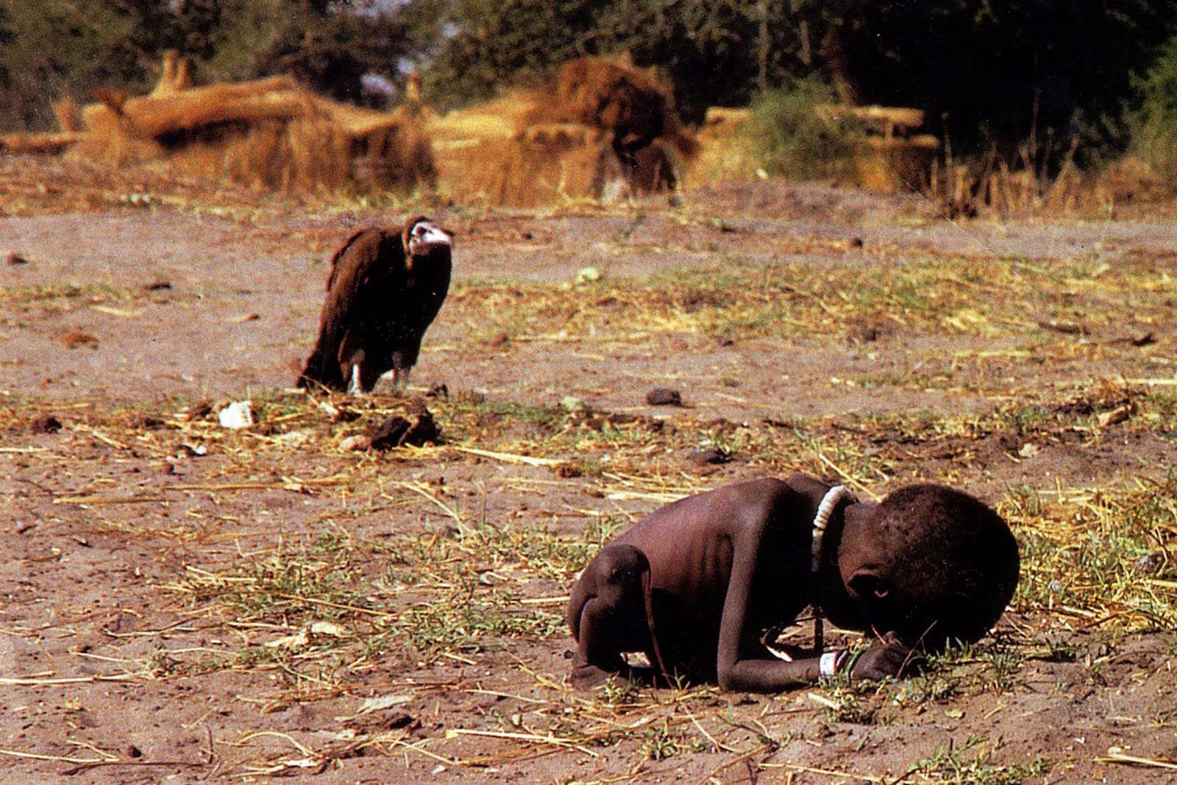
Uneven Development Between Countries

Slide 2
Learning Intentions
To be explain why some countries are more developed than others.

Slide 3
What factors may influence development within a country?
https://www.youtube.com/watch?v=9-4V3HR696k

Slide 4
Why can’t some countries become developed? What is stopping them?
https://www.youtube.com/watch?v=9-4V3HR696k

Slide 5
 | Factor | Examples
 | Physical | Access to water Agricultural potential Relief of land Mineral resources Natural soil quality Natural disasters Climate Remoteness and Isolation
Human | Economic | Trading links Infrastructure (roads, internet, power) Stage of industrial development Key industrial sector Transnational development
 | Social | Population structure Health of population Skill of workforce Education levels
 | Political | Colonial links Status of women Conflict or war High dependency groups Corruption Debt levels Ethnic and religious tensions

Slide 6
Give me a country....
Where climate affects development as its very dry.
Where the relief affects development as its very steep.
Where lack of minerals affects development.
Where lots of minerals helps development.
Where natural disasters affects development.

Slide 7

Graffiti Boards!

Slide 8
Task: Explain differences in Development
Pair up.
For your factor, try provide the following: case study examples, explain how it could help/hinder development.
Physical
Natural Disasters
Agricultural Potential
Natural Resources (such as coal/oil)
Natural Soil Quality
Remoteness
Climate
Human
Trade Links
Status of Women
Infrastructure
Health of Population
Conflict/War
Education Levels

Slide 9
CHAD | CENTRAL AFRICAN REPUBLIC
HAITI | NEPAL
UNITED ARAB EMIRATES | SAHEL
SAUDI ARABIA

Slide 10
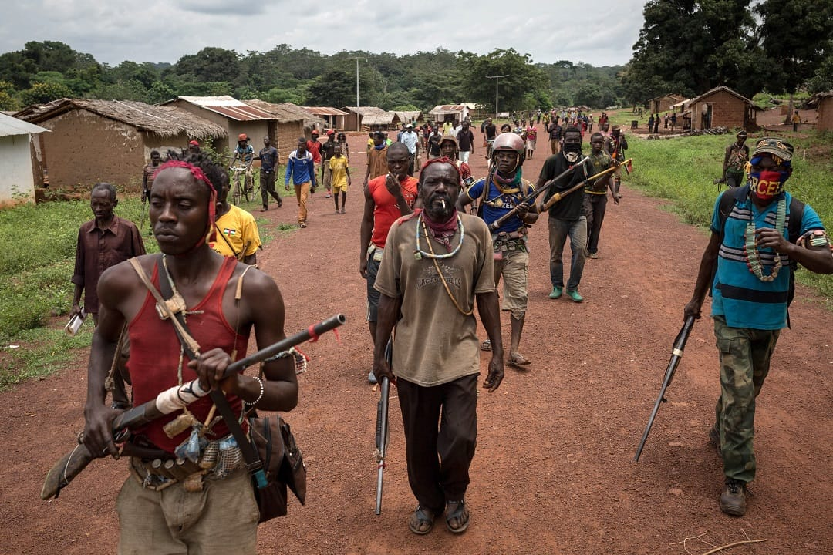
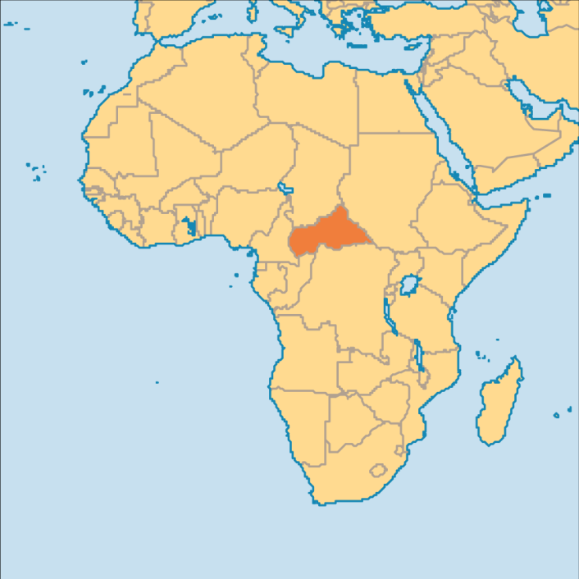
Central African Republic – Last on the HDI!
https://www.bbc.co.uk/news/world-africa-13150040

Slide 11


Summary Question
Explain 4 reasons why the UK may be more developed than countries such as Central African Republic (4).

Slide 12
Example Questions (up to 12)
Explain the physical factors that influence the development gap.
Referring to case studies, explain both physical and human factors that can influence development in developing countries (12 marks = 3 case study marks).
Referring to human factors explain why development is uneven between developing countries.

