Slide 1
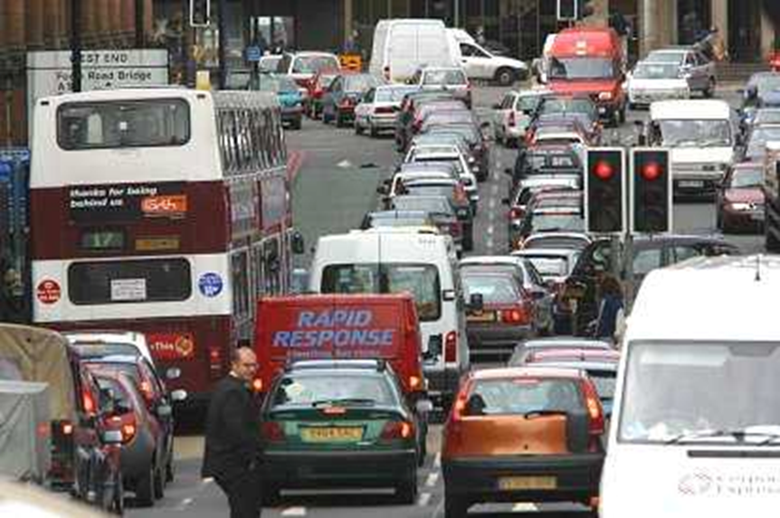
Traffic Congestion in Edinburgh's CBD

Slide 2
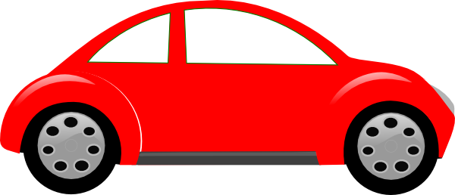
What are we learning?
Explain the causes of traffic congestion
Explain the ways in which it is being controlled
Evaluate how successful these control mechanisms have been.

Slide 3
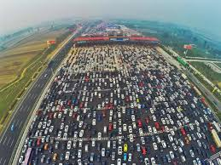
Insane Traffic Jams!
https://www.youtube.com/watch?v=oaQP9S8ScRc

Slide 4
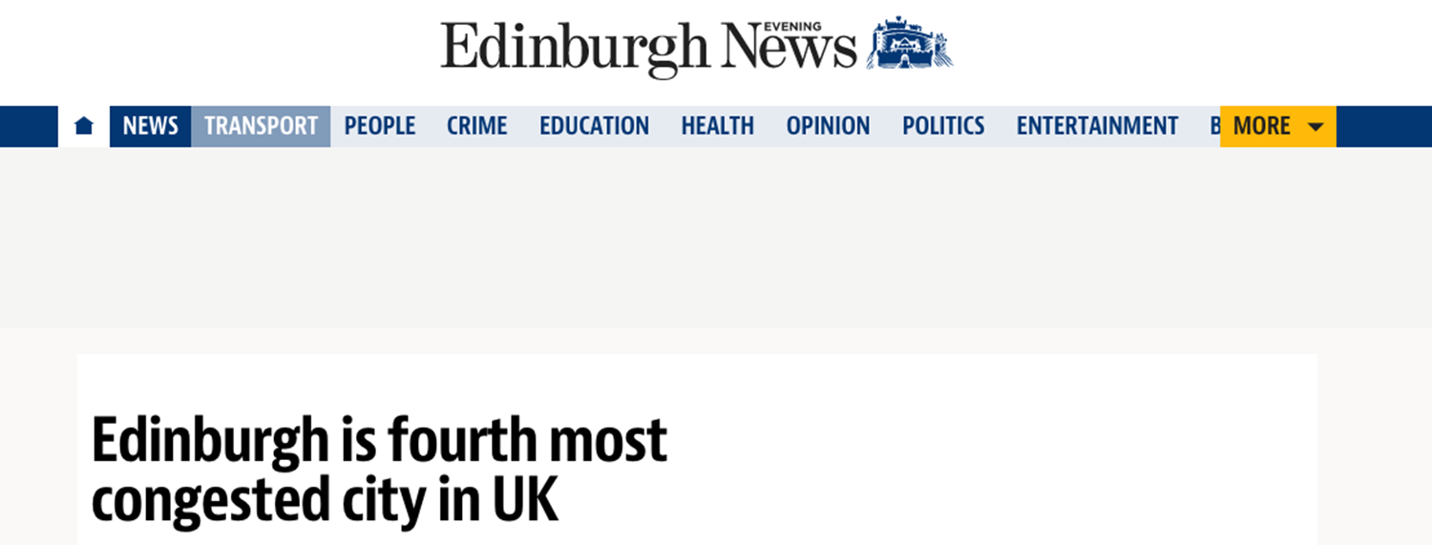
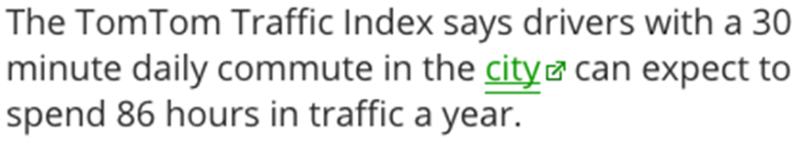
But why???

Slide 5
Thinking Skills
In your pairs, you have been give a picture that links to one of the causes of traffic congestion within Edinburgh.
Write down what you think your picture shows and how it causes traffic congestion.

Slide 6
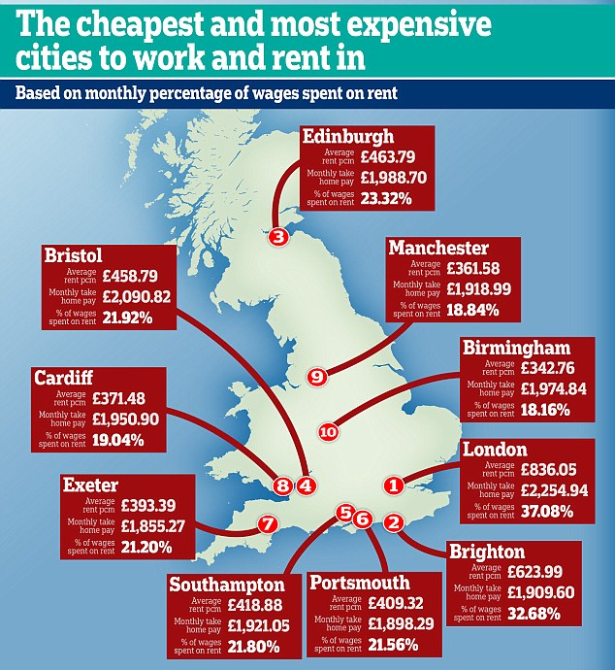

Slide 7
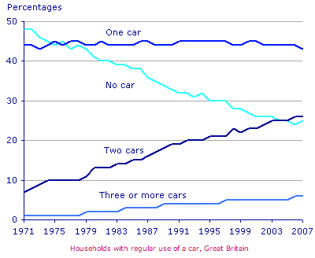

Slide 8
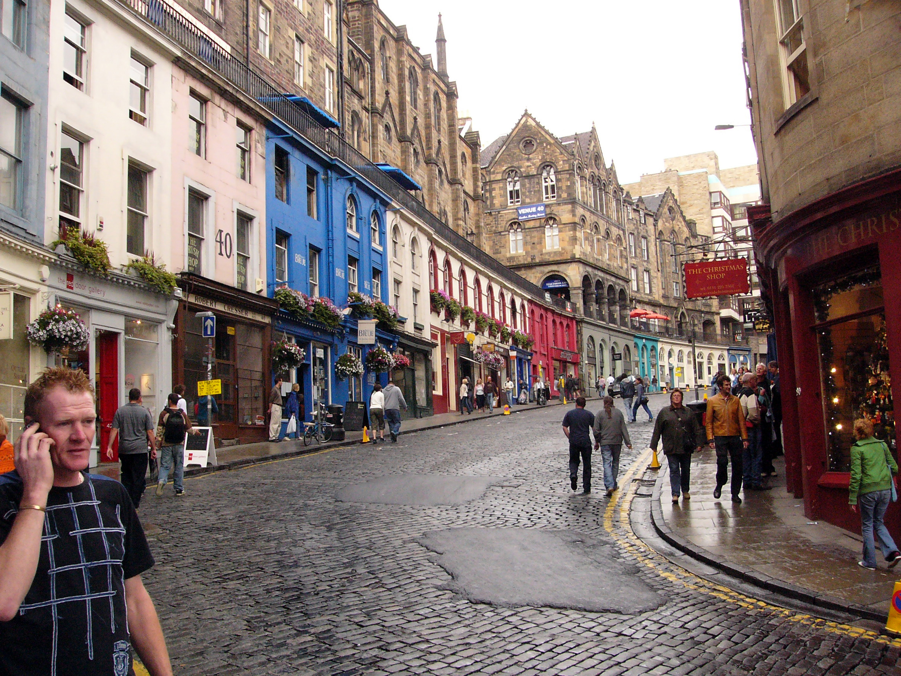

Slide 9
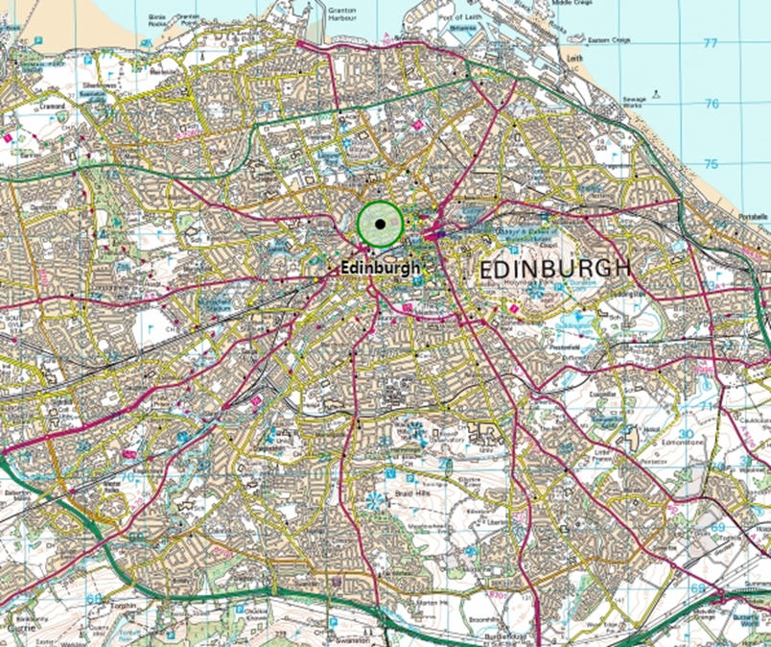

Slide 10

????

Slide 11
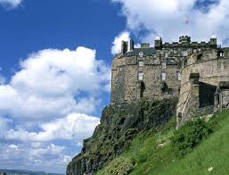

Slide 12
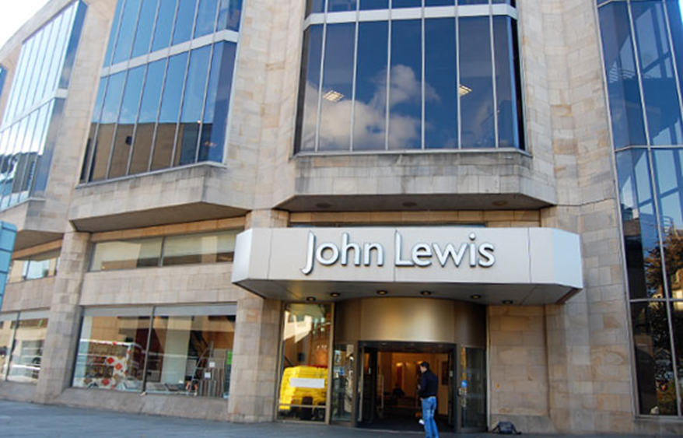

Slide 13
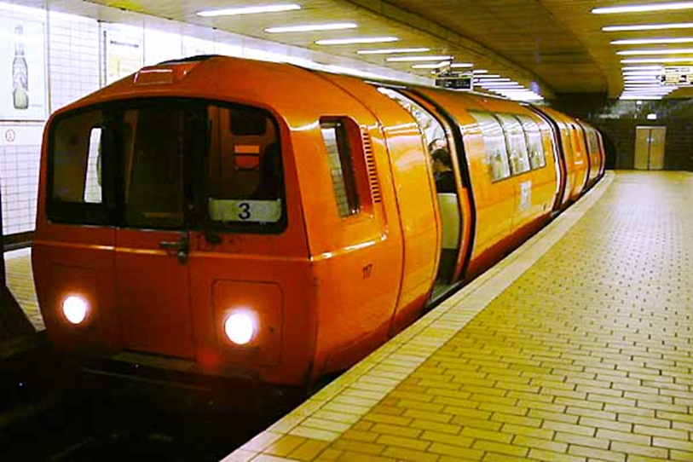
Glasgow

Slide 14
Traffic Congestion Causes

Slide 15
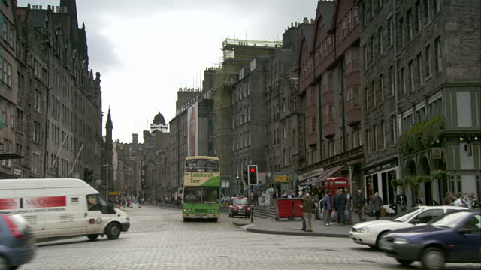
The Streets
Streets (such as Charlotte Square) are narrow, cobbled and winding. They were built before lots of cars were on the road so are not use to the large amount of traffic.

Slide 16
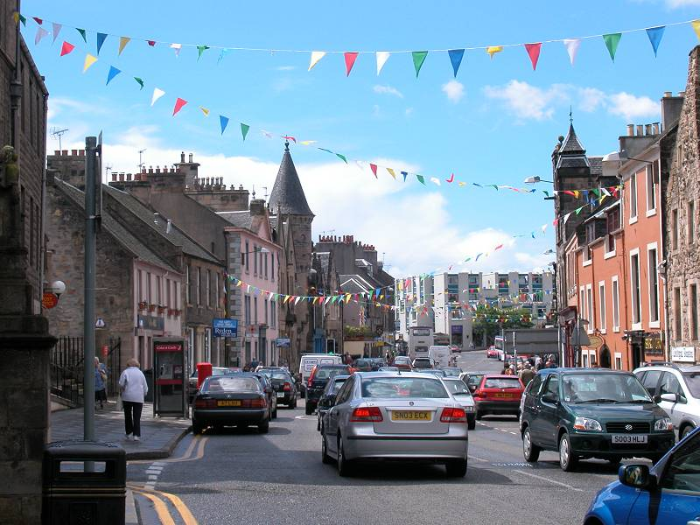
Commuters
Property is expensive in the CBD so people live outside Edinburgh (Linlithgow) and commute in – so more cars on the roads.

Slide 17
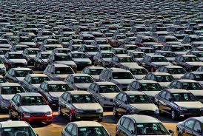
Car Ownership is Rising
In the modern world, car ownership is rising so more cars are on the roads.

Slide 18

Rush Hour
Many people try to go the same places at the same time (to work for 9) (after work at about half 5) – so lots of transport is on the road at the same time.

Slide 19

Route Centre
The CBD of Edinburgh is a route centre so many roads are coming together – bringing lots of traffic together.

Slide 20
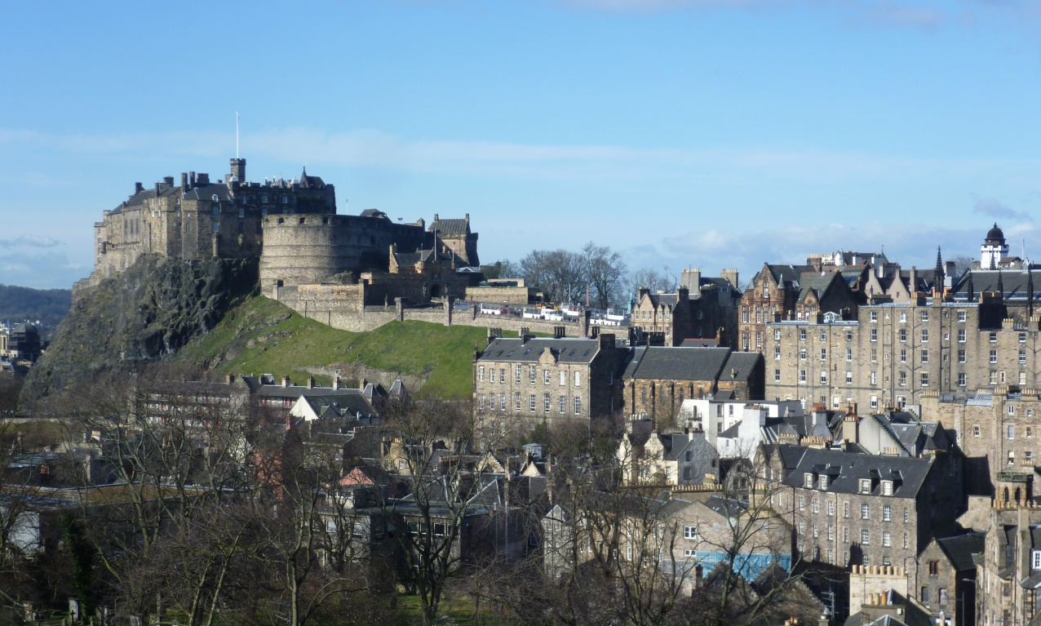
Lots of tourist attractions in CBD.
The CBD of Edinburgh has lots of tourist attractions (such as the Scott monument) which means lot of people travelling within the CBD to visit these.

Slide 21

Lots of high order shops in CBD.
The CBD of Edinburgh has lots of high order shops (such as John Lewis) which causes lots of people from outside of the CBD travel in to make use of these.

Slide 22

Few suburban train links.
Unlike Glasgow, Edinburgh does not have a lot of different train stations within the city or an underground system. This causes all traffic to be on the streets of Edinburgh.

Slide 23
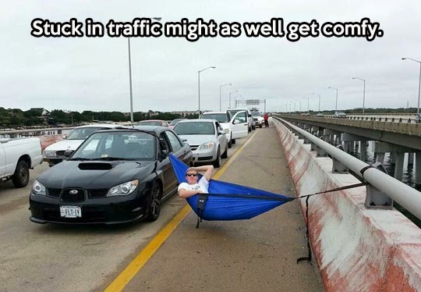
What are the solutions to this traffic congestion in Edinburgh?

Slide 24
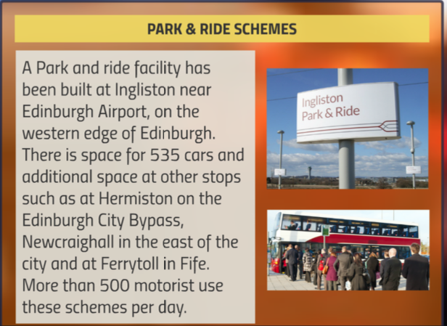

Slide 25
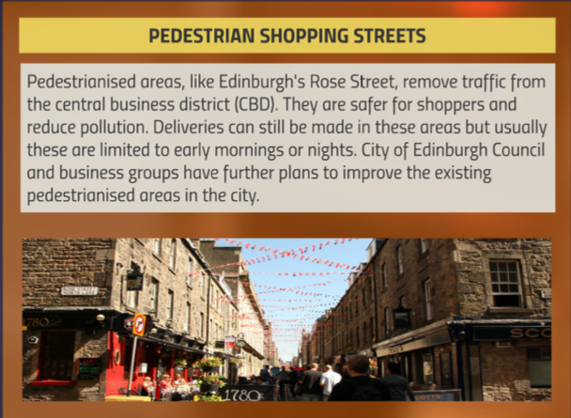

Slide 26
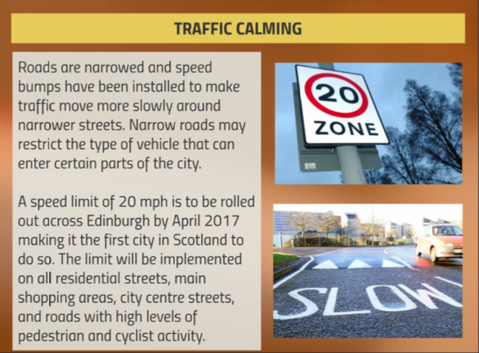

Slide 27
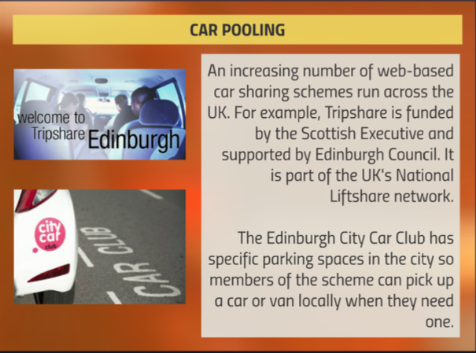

Slide 28
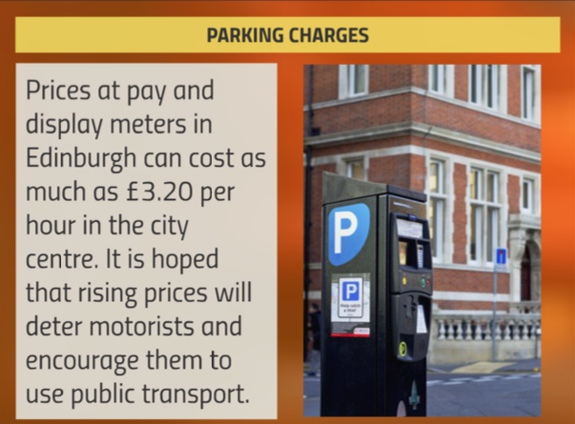

Slide 29
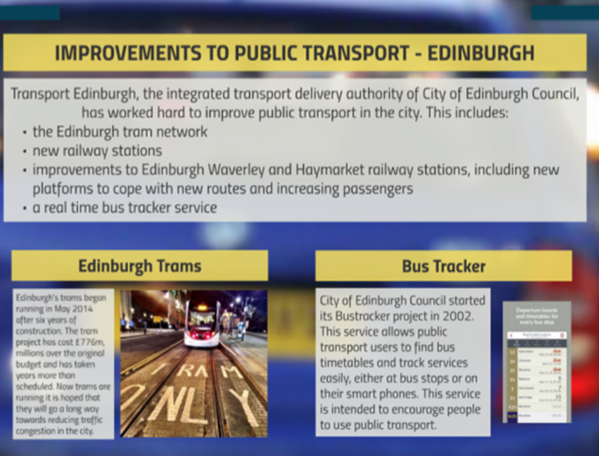

Slide 30

More Suburban Train Stations Opened – Newcraighall and Wester Hailes + Borders railway opening = less cars on the road.

Slide 31
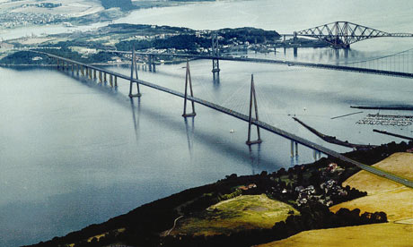
Queensferry Crossing = linking Fife, give greater capacity at Firth of Forth crossing = less congestion.

Slide 32
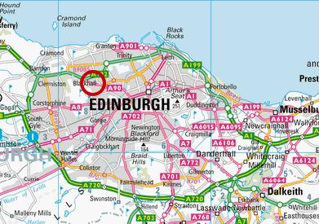
City Bypass (A720) opened in 2000 to take traffic away from the CBD.

Slide 33
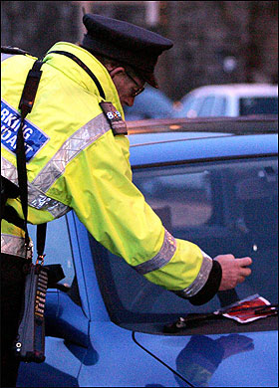
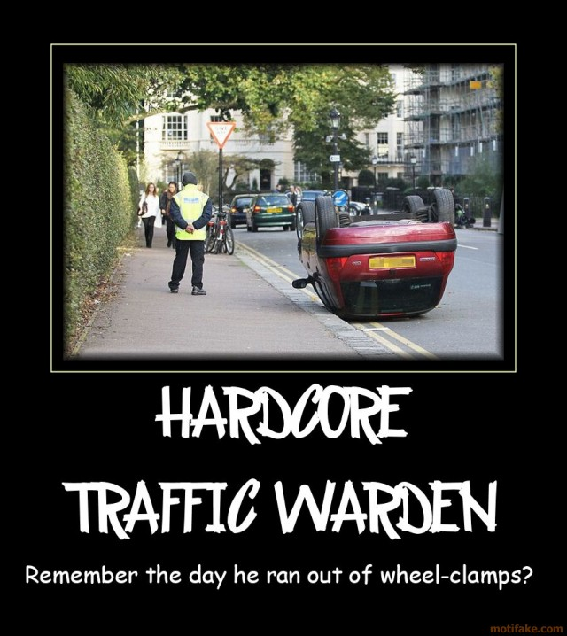
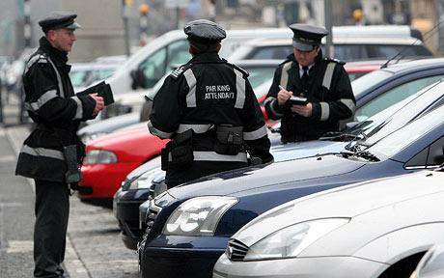

Slide 34
Task: Causes and Solutions
Colour code the table to show the different causes and solutions.

Slide 35
Booklets
Read the booklets and explain any other solutions.
Evaluate the success of any of the other solutions you wrote down as well as the following schemes:
City Bypass
20 mph Speed Limits
The Trams
Park and Ride
Public Transport
Cycling

Slide 36
City Bypass
Traffic increased so much (especially at rush hour) that bypass actually causing congestion.

Slide 37
20mph Speed Limit
Reduces casualities
Self enforcing
Plans to extend
Already in 2000 streets.

Slide 38
Trams
Dangerous – deaths from cyclists getting wheels caught in tracks.
Expensive to build and only managed to get 1 line out of 3 planned

Slide 39
Park and Ride
Hermiston average occupancy rate of 95%
More spaces added at park and rides due to popularity

Slide 40
Public Transport
More people using public transport than any city outside London
1st in Bus Travel in UK.
Co2 emissions down by 70,000 tonnes between 2008 and 2010.

Slide 41
Cycling
4.8% of all journeys to work.
100% of primary school kids to have cycle training to bikeability level 2 by 2016.

Slide 42
Exam Style Questions
For a named city in the developed world,
Explain causes of traffic congestion (6).
Explain solutions to traffic congestion (6).
Evaluate the successfulness of theses solutions (6).

