Slide 1
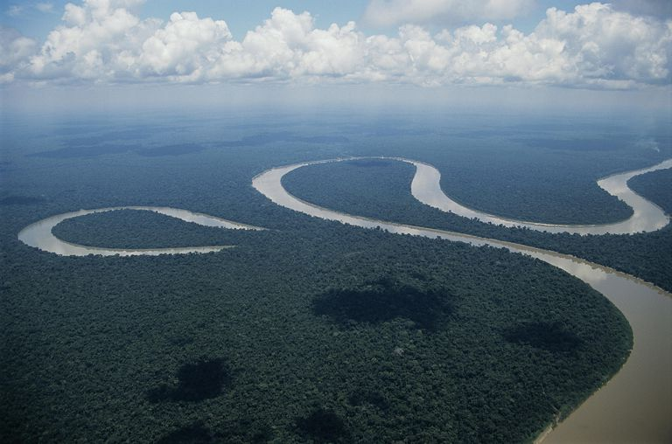
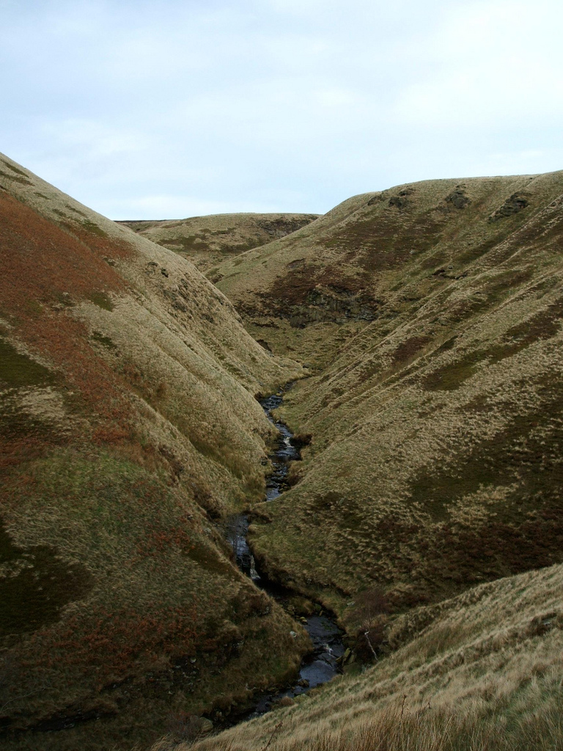
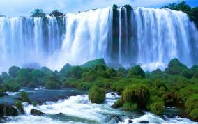
River Formations

Slide 2
What you need to know?
Explain the formation of:
V Shape Valley
Waterfall
Meander
Oxbow Lake
Just been brought into New Higher (won’t be in past papers).

Slide 3

Formations - what can you remember from way back?

Slide 4

Time Travel Back to S3….

Slide 5

River Profile and Characteristics!!

Slide 6

Key Processes
Abrasion
Hydraulic Action
Solution
Freeze Thaw Weathering

Slide 7
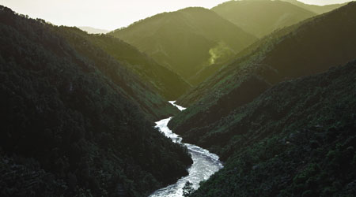
Upper Course – V Shape Valley

Slide 8

What do you notice?

Slide 9
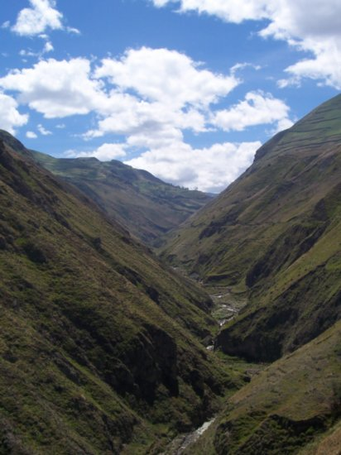
V-shaped valley
Steep valley sides
Interlocking spurs
http://www.cleo.net.uk/resources/displayframe.php?src=308/consultants_resources%2f_files%2fintespur2.swf

Slide 10
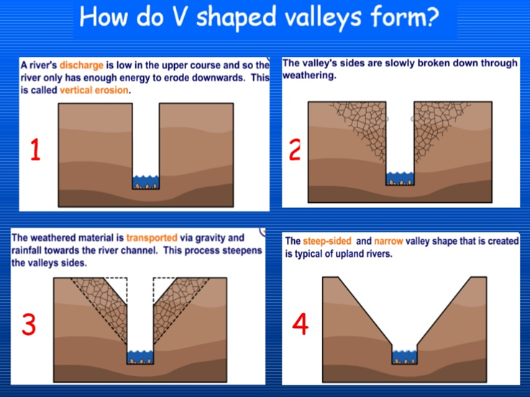
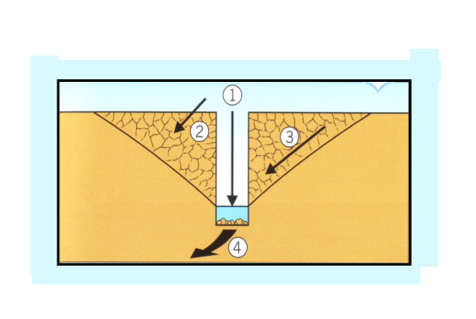

Slide 11
Explanation
Rivers begin high up in the mountains so they flow quickly downhill eroding the landscape vertically. The river cuts a deep notch down into the landscape using hydraulic action, when the sheer force of the water gets into small cracks and breaks down the sides of the river valley. Abrasion also occurs which is when the river bed and banks are eroded by the load hitting against them. Another type of erosion that happens is solution, when the river water dissolves minerals from the rocks and washes them away.
As the river erodes downwards the sides of the valley are exposed to freeze-thaw weathering (water goes into cracks, freezes and expands –breaking the rock).
Freeze thaw loosens the rocks (some of which will fall into the river by gravity) and steepens the valley sides. The rocks which have fallen into the river assist the process of abrasion and this leads to further erosion.
The river transports the rocks downstream and the channel becomes wider and deeper creating a V-shaped valley. The river flows around rock outcrops called interlocking spurs.

Slide 12
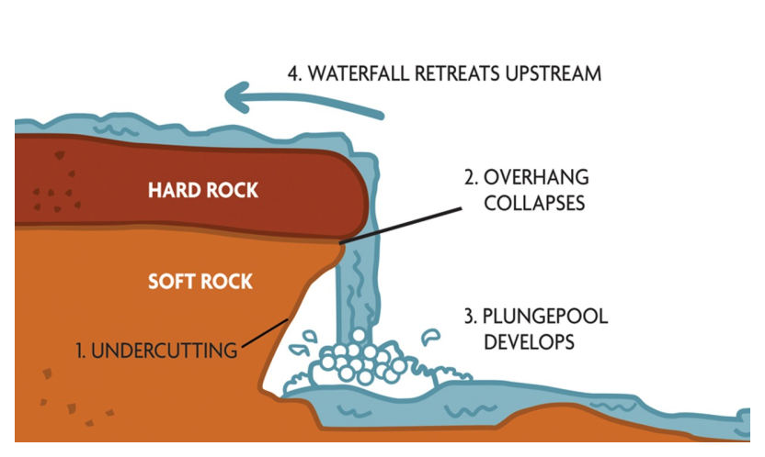

Slide 13

How are formations marked?
Specimen Paper Marking Guidelines.

Slide 14
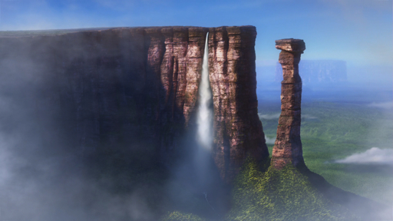
Upper Course – Waterfall Formation

Slide 15
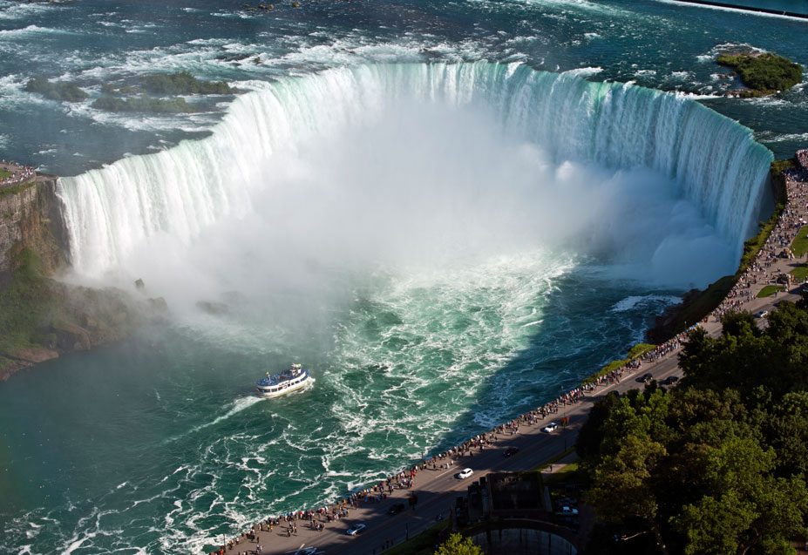
Niagara Falls

Slide 16
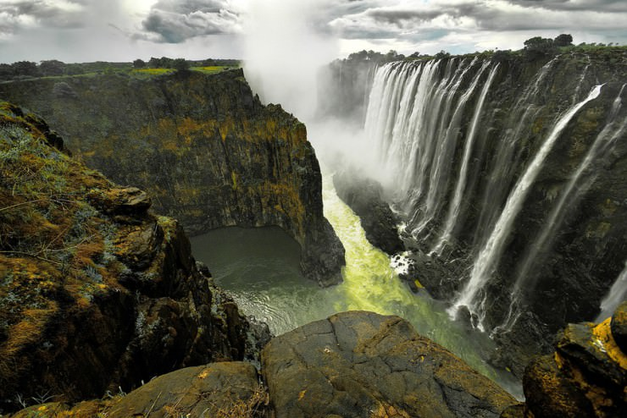
Victoria Falls, Zimbabwe

Slide 17
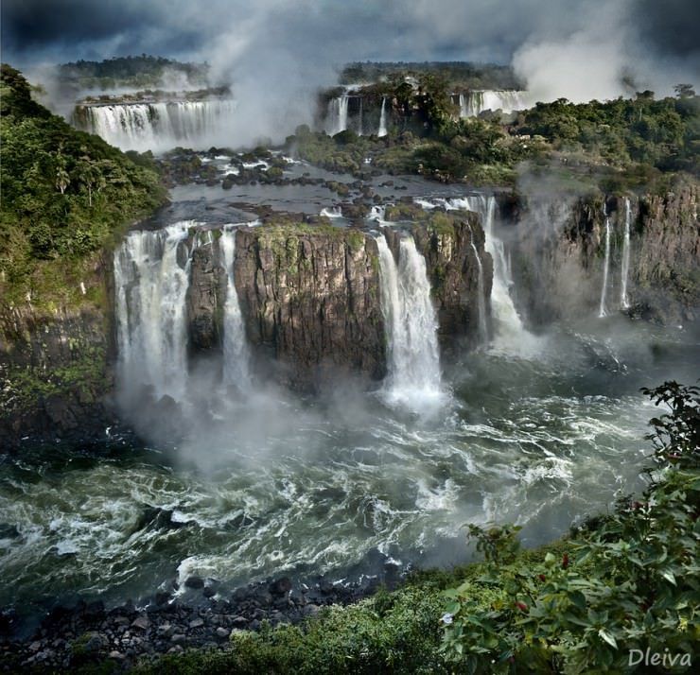
Iguazu Falls, Argentina

Slide 18
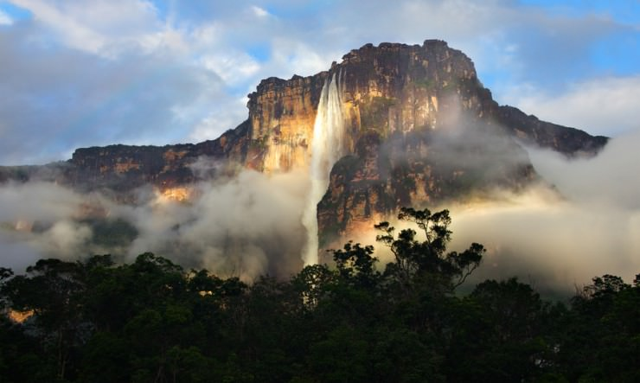
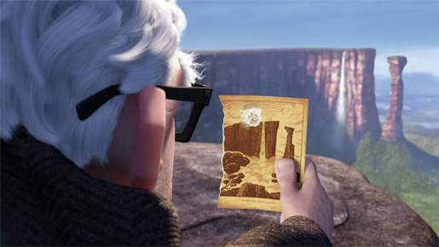
Angel Falls, Venezuela

Slide 19
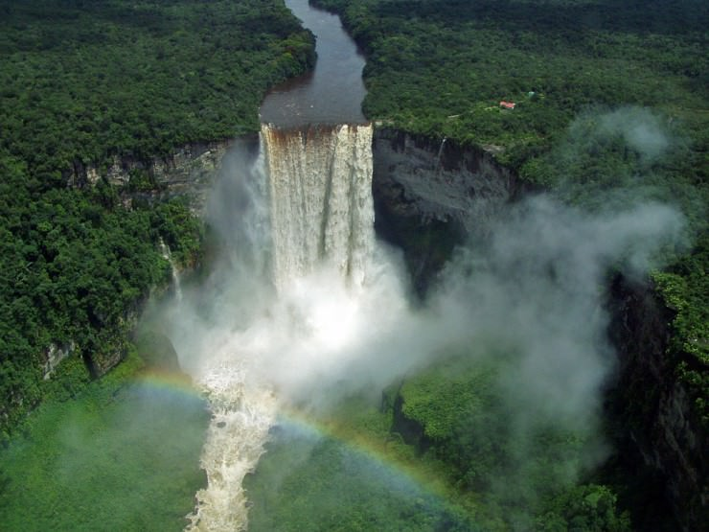
Kaieteur Falls, Guyana

Slide 20
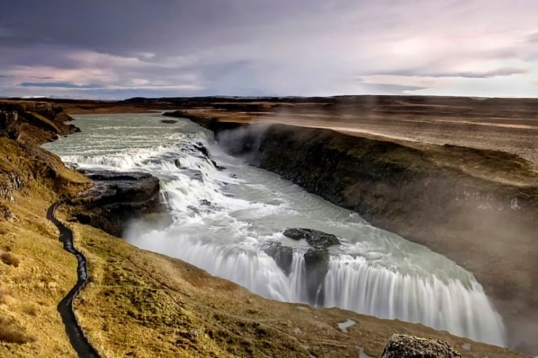
Gullfoss, Iceland

Slide 21
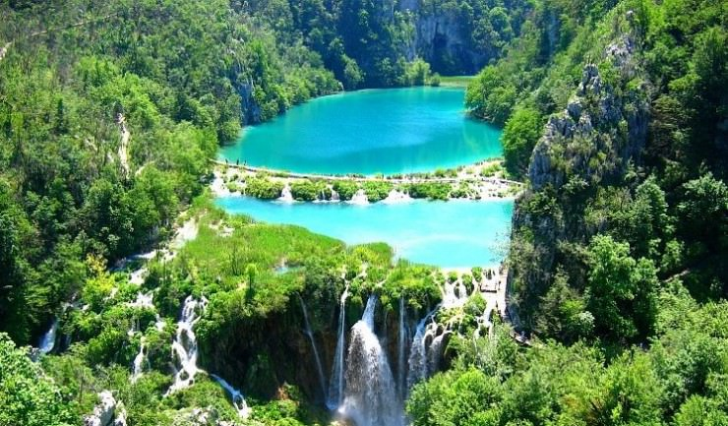
Plitvice Falls, Croatia

Slide 22
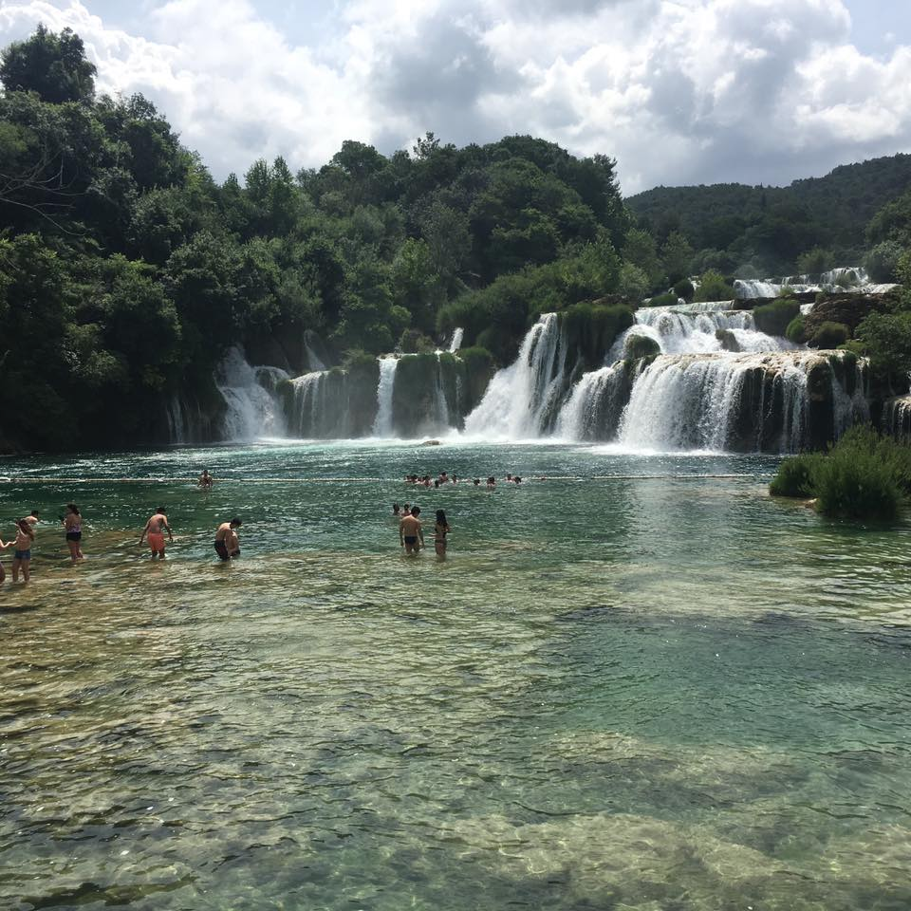
Krka Falls, Croatia

Slide 23
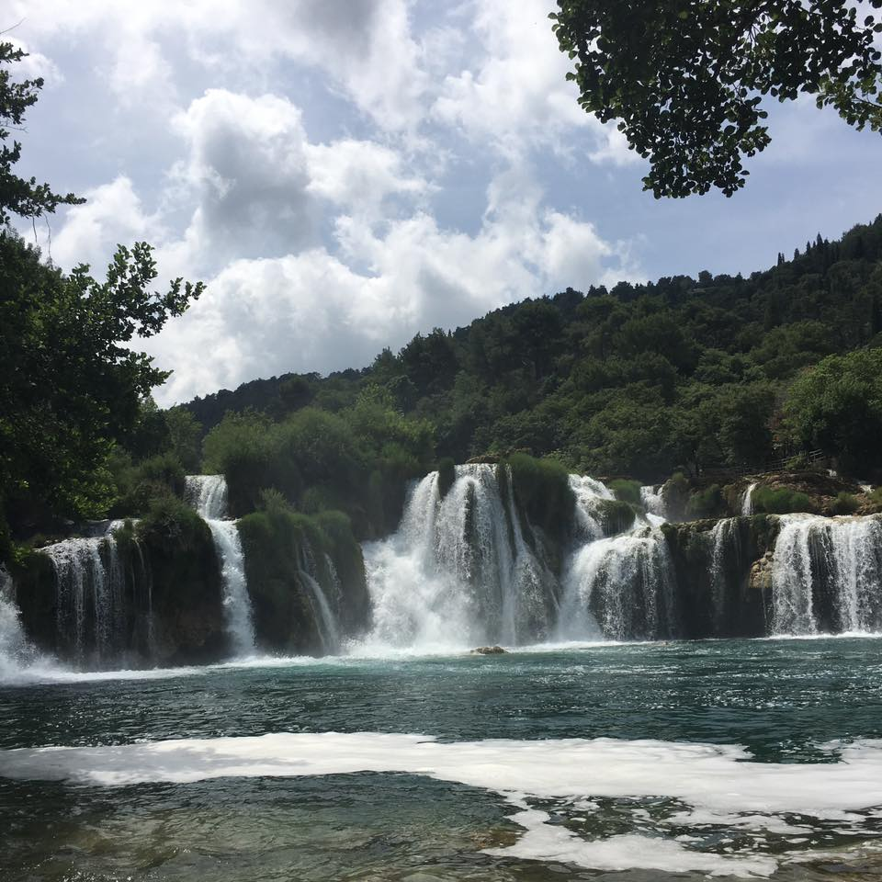

Slide 24
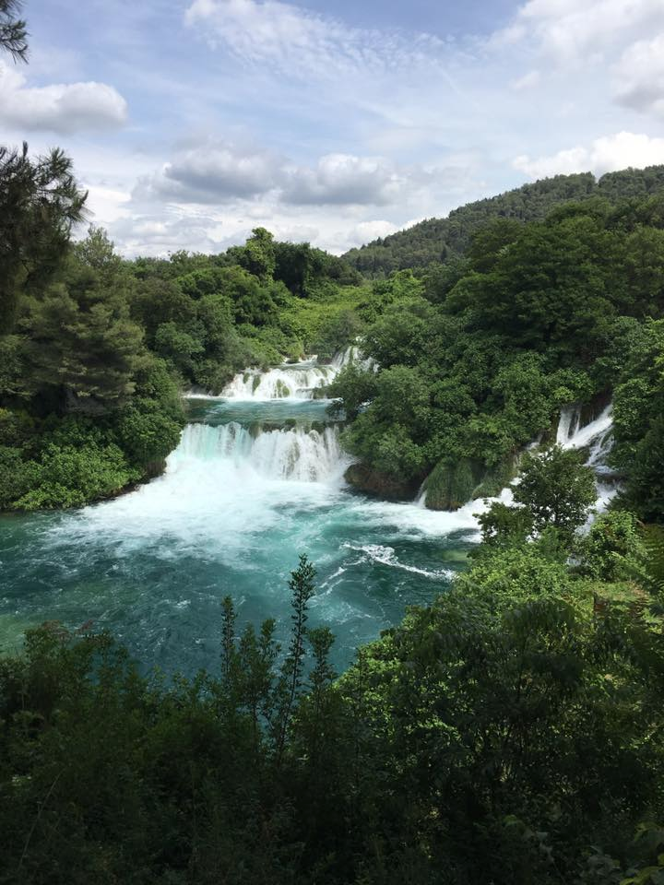

Slide 25
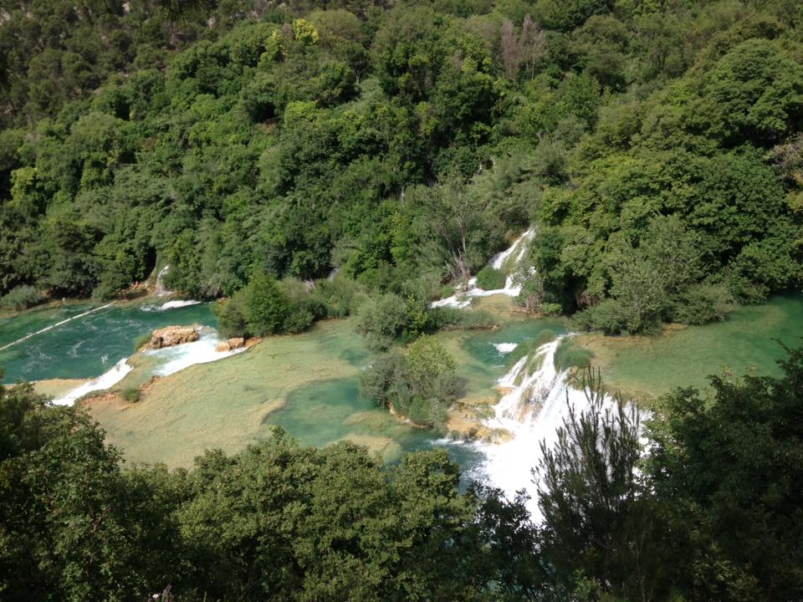

Slide 26
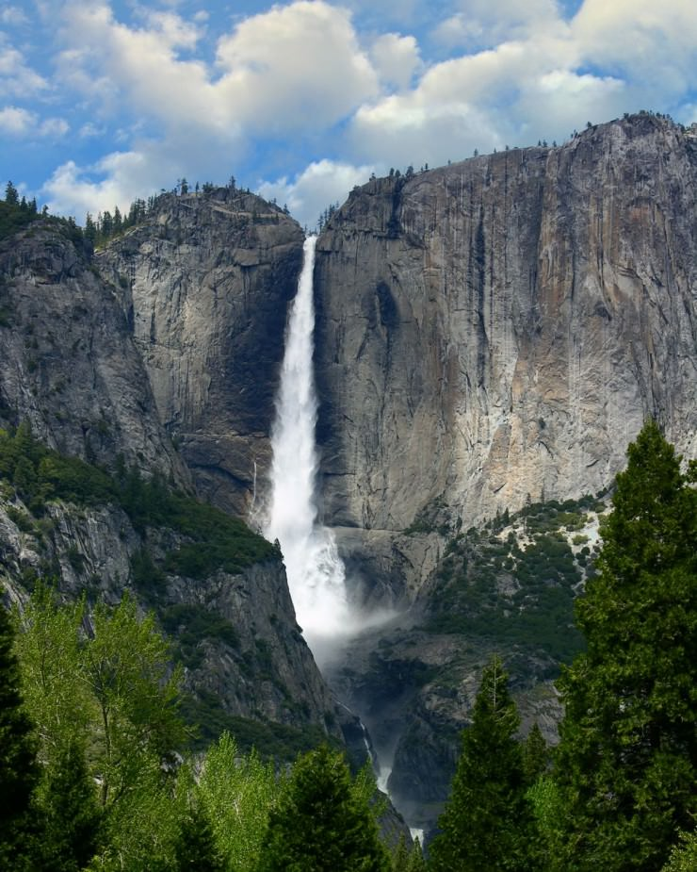
Yosemite Falls, USA

Slide 27
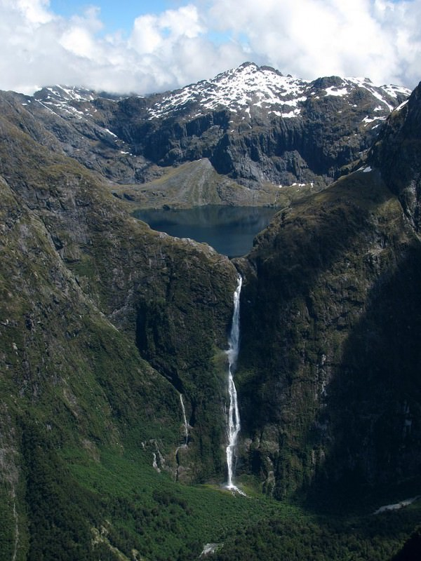
Sutherland Falls, New Zealand

Slide 28
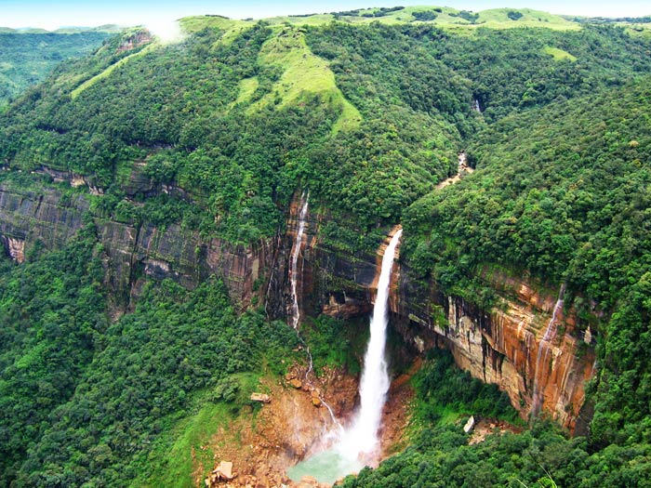
Nohkalikai Falls, India

Slide 29
What are waterfalls?
Waterfalls are perhaps the most spectacular erosional feature of a river.
Occur in upper course of the river.
A waterfall is an area of a river or stream where the water flows over a steep vertical drop, often landing in a plunge pool below. They occur in the upper course of a river/stream.

Slide 30
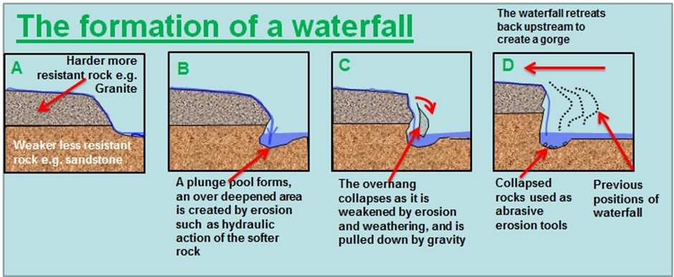

Slide 32
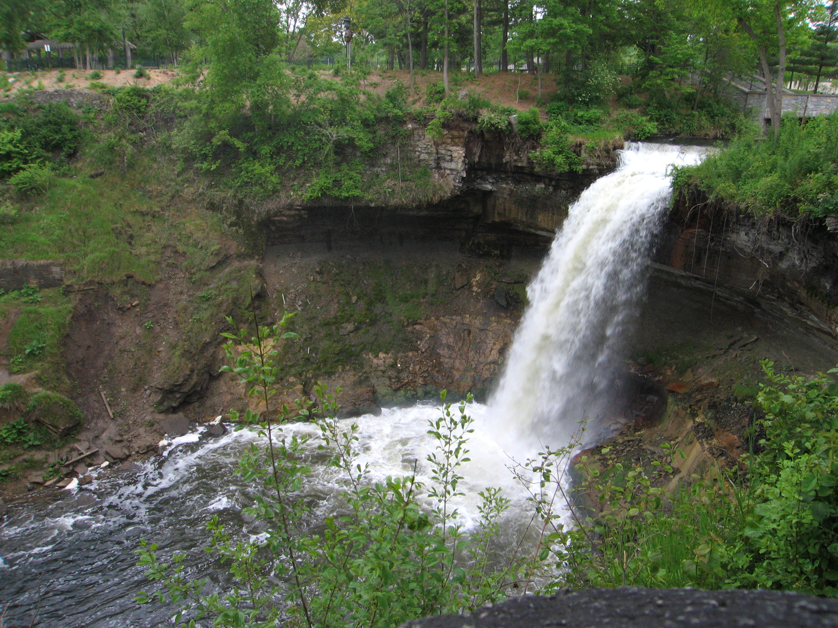
Steep sided gorge
Hard Rock
Undercutting
Soft rock
Plunge pool

Slide 33
The river flows over bands of less resistant (softer) and resistant (harder) rocks. The river erodes the less resistant rock quicker by hydraulic action (explain), abrasion (explain) and solution (explain). Due to the differential erosion, the hard rock is undercut.
This undercutting of the harder rock leaves an overhang which becomes unsupported and collapses into the plunge pool below.
After the overhang falls, some of the rocks are swirled around by the river and this helps to form a deep plunge pool below the waterfall. The plunge pool is also deepened during times of high discharge when hydraulic action is most powerful.
The waterfall is moved upstream, the process continues and a steep-sided gorge is cut back into the hillside.

Slide 34
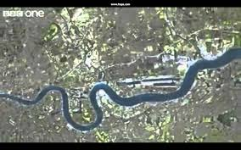
Middle Course – Meander and Oxbow Lake

Slide 35
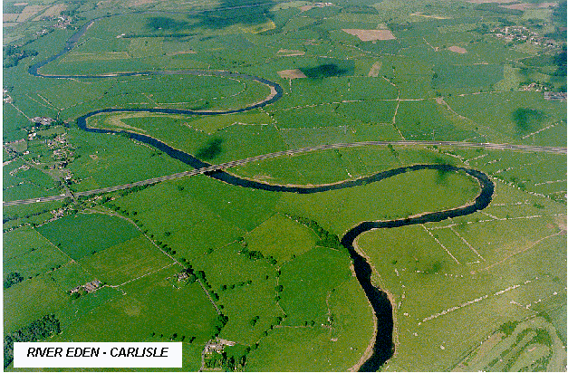
A meander is a bend in the river found in flatter areas of the
river. It is caused by the speed of the river slowing down and
therefore the river starts to wander across the landscape
Meander

Slide 36
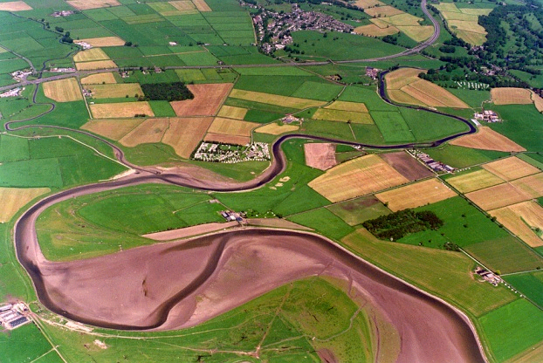
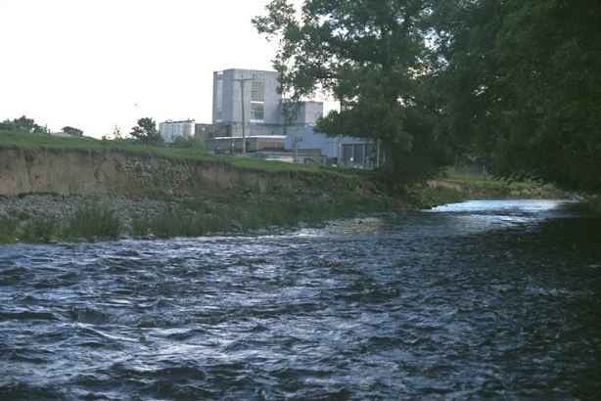
On a meander, the two sides of the river are different, one side is
Shallow and is called a river beach.
The other side is deep and has a steep river cliff next to it.

Slide 37
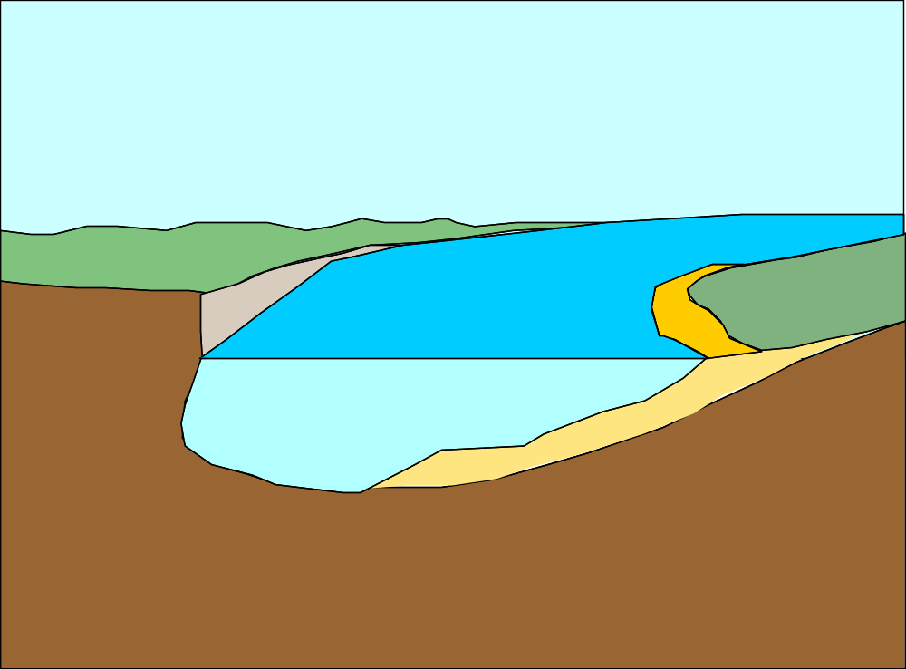
River bend
Fastest current
slowest current
Bank will
collapse
Small
river
cliff
Outer bank
Is eroded by hydraulic action and abrasion
Slip off slope
( river beach )
Deposition of
Sand and shingle = shallow
Deepest part
of the river due to erosion

Slide 38
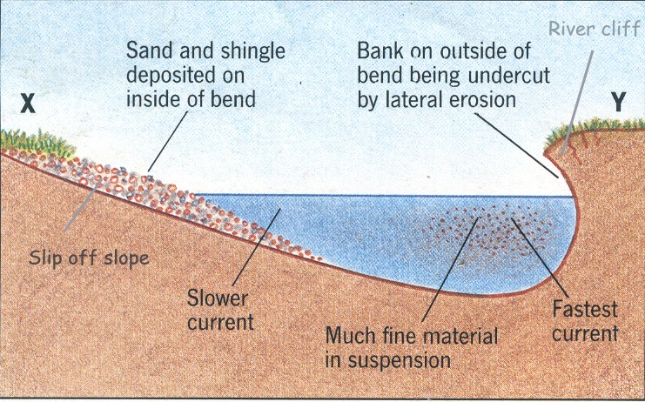

Slide 39
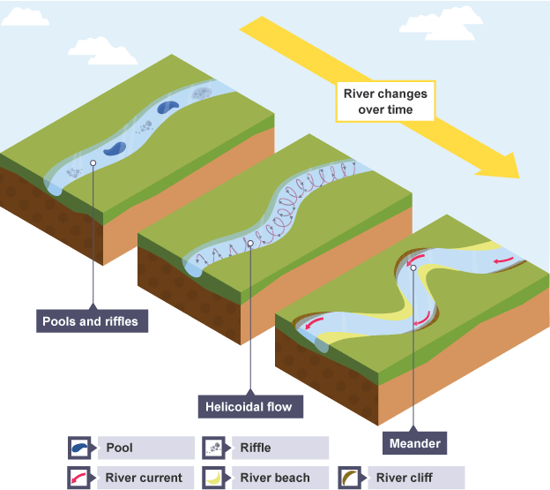

Slide 40
In a straight river channel pools and riffles will develop as water twists and turns around obstructions such as large boulders. This results in areas of slower and faster water movement.Pools are areas of deep water and greater erosion (energy build-up due to less friction). Riffles are areas of shallow water created by deposition of coarse sediment.
A corkscrew-like flow of water called Helicoidal Flow moves material from the outside of one meander bend and deposits it on the inside of the next bend.
Water moving faster has more energy to erode. The river erodes the outside bends through hydraulic action (explain), abrasion (explain) and solution (explain).This occurs on the outside of the bend and forms a river cliff.
Water moves slowly on the inside of the bend and the river deposits some load, forming a gently sloping river beach (also called a slip-off slope).
Continuous erosion on the outer bank and deposition on the inner bank forms a meander in the river, which will migrate downstream and change shape over time.

Slide 41
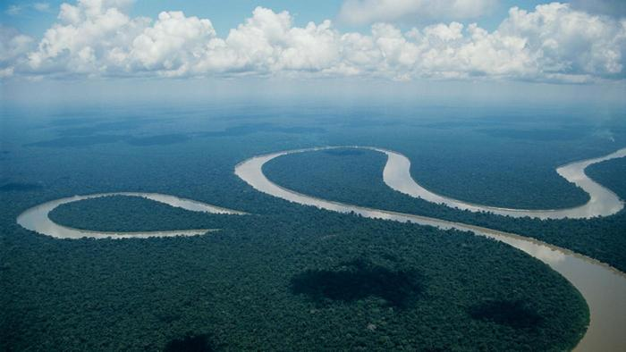
http://www.bbc.co.uk/learningzone/clips/oxbow-lakes/405.html
Using what you learned about meanders, how do you think an oxbow lake is formed?

Slide 42
https://twitter.com/geogabout/status/931996572434526208

Slide 43
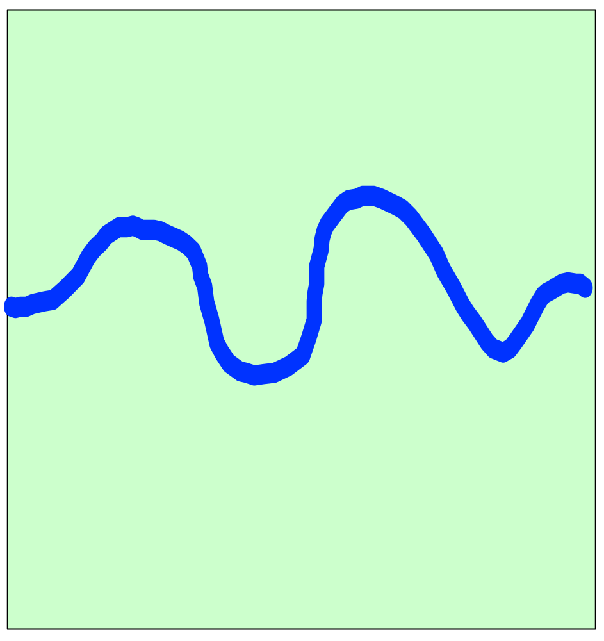
Lets start with a meander...
Notes:
43

Slide 44
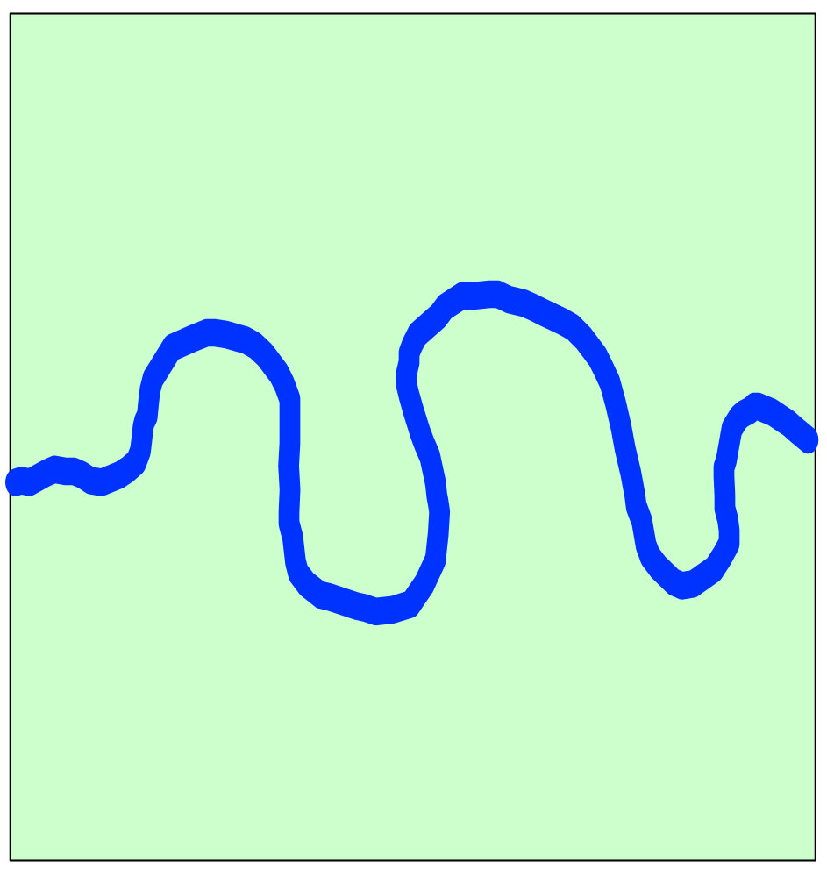
Notes:
44

Slide 45
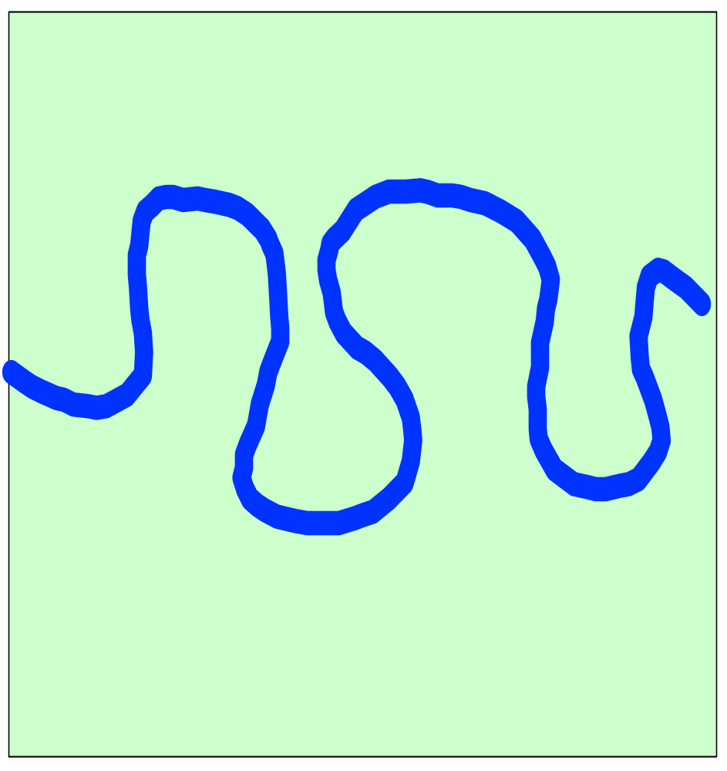
Notes:
45

Slide 46
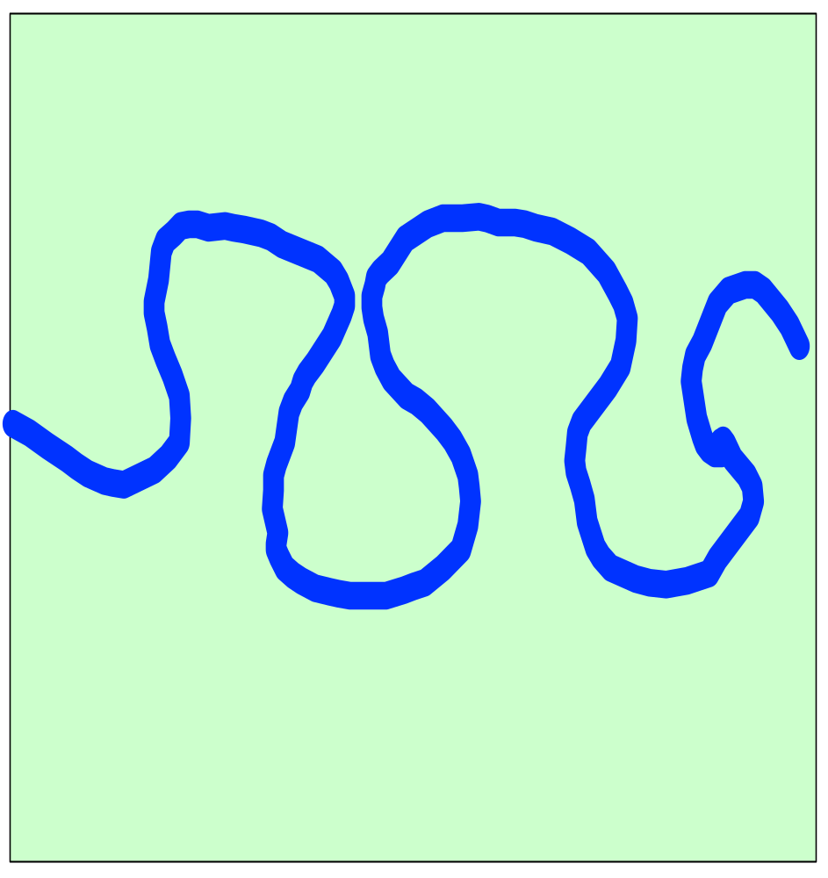
Shortest Route
When the river is in flood or is powerful enough it will take the shortest route through the neck of the meander, leaving an ox-bow lake.
Notes:
46

Slide 47
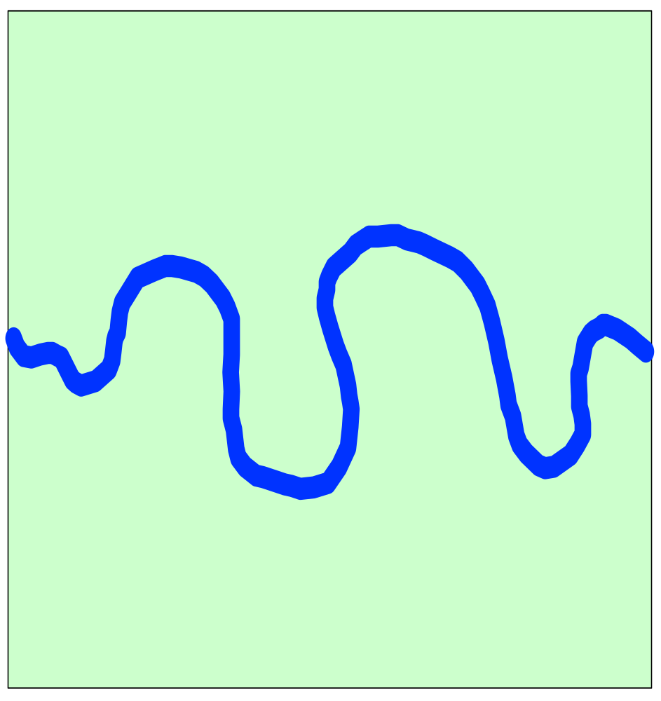
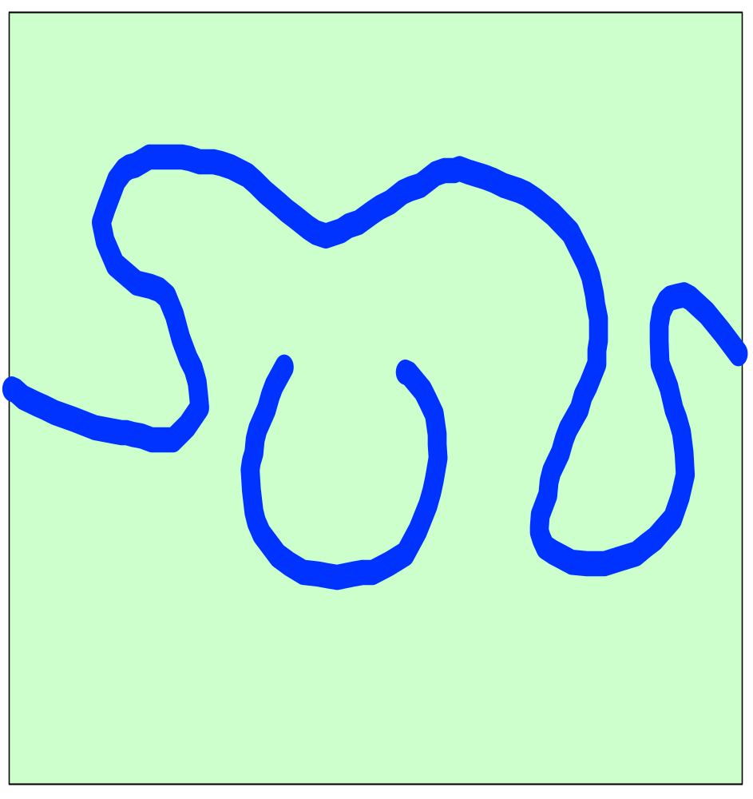
Most erosion
The river now follows the new route
Eventually during a period of
heavy river flow it cuts through
Some bends get closer
and closer
The meanders change shape
through time
Most deposition
(Slip off slope)
Small river
cliff is formed
At the bends the river flows faster
at the outside
The bends migrate
Sideways leaving deposits on the inside
Of the bend
The neck gets narrower
and narrower
The old meander
Is left as a small lake
(OX - BOW lake)
The erosion makes the
Meanders more pronounced
Notes:
47

Slide 48
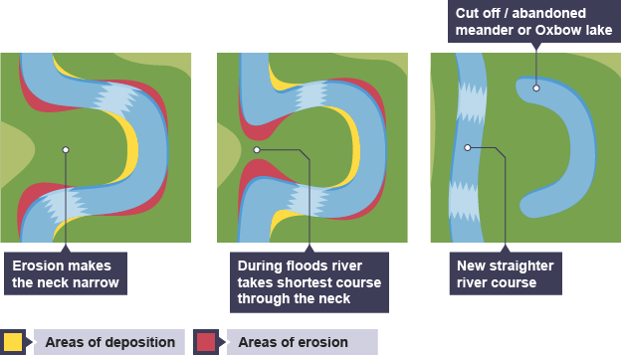
Oxbow Lake Formation

Slide 49
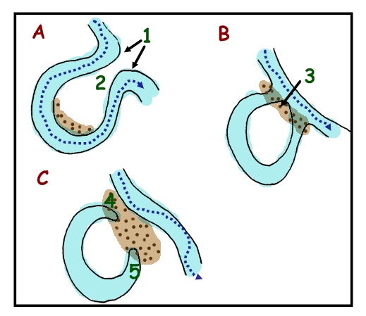

Slide 50
The water flows faster on the outside bend of a river meander so erodes the banks by the processes of hydraulic action (the sheer force of the water hitting the banks) and by abrasion (where fine materials rubbing against the banks act like sandpaper) causing the banks to become steeper.
Deposition takes place on the inside bend of the meander where the water is shallower and moving more slowly. It has less energy here.
Over time continual erosion and deposition narrows the neck of the meander - leaving a very narrow piece of land.
During a storm or a time of flooding, when the river is more powerful, it cuts through the narrow neck and takes a new, straighter route
Deposition takes place, leaving the old meander cut off, and an oxbow lake is formed. This feature can fill up with sediment and dry out, only filling up after heavy rain.

Slide 51
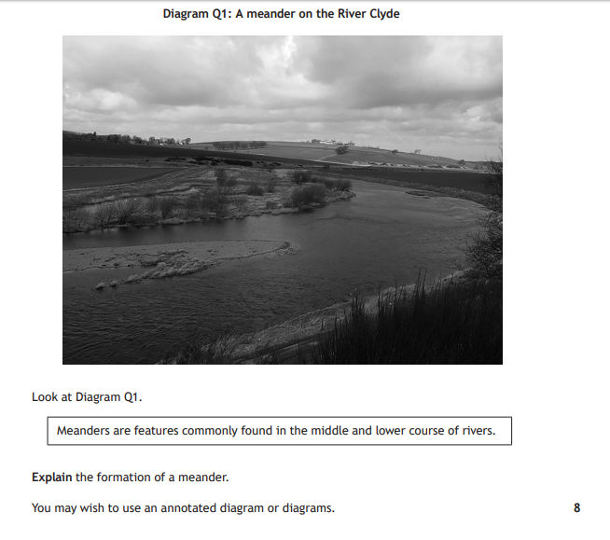
Specimen Paper

Slide 52
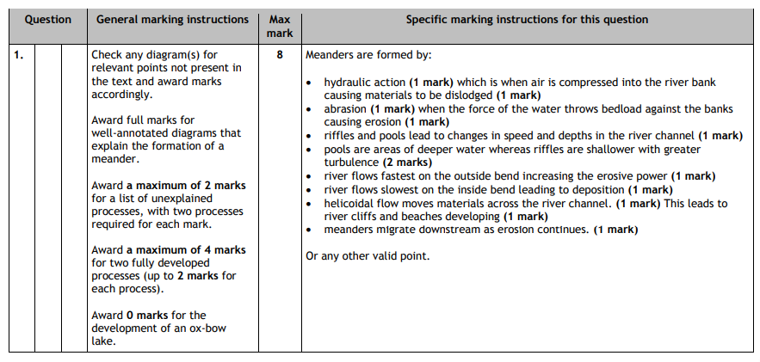

Slide 53

What are the key points from each one?

Slide 54
A3 Revision Sheets
Split your A3 Sheet into 4 (a quarter for each formation).
Make a revision sheet to sum up how each formation is formed.
REMEMBER THE KEY WORDS/THINGS FOR EACH FORMATION – MAKE THIS CLEAR! THINK ABOUT HOW YOU LEARN!

Slide 55

Formations Quiz Race

