Slide 1
Global Heat Budget Revision
Figure | What does it relate to?
17%
8%
6%
23%
46%
100%

Slide 2
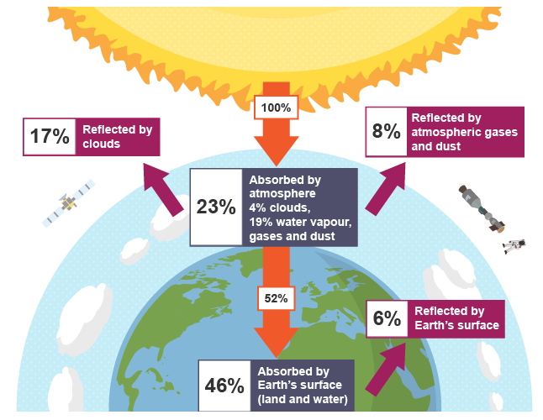
SCATTERED

Slide 3
Albedo Effect = reflection
Surface | Albedo
Thin clouds (cirrus) | 30-40%
Thicker stratus clouds | 50-70%
Cumulonimbus clouds | 90%
Dark soil | 10%
Coniferous forest (equator) and urban areas | 15%
Grasslands and deciduous | 40%
Fresh snow (polar) | 85%
WHITE = MORE REFLECTIVE. DARK = ABSORBS MORE.

Slide 4
Help to Remember
RAS
R = Reflection (17% clouds, 6% by surface – albedo effect)
A = Absorption (4% clouds, 19% water vapour, gas and dust)
S = Scattered (8% by atmospheric gases and dust)

Slide 5
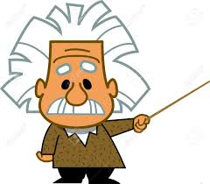
That leaves how much being absorbed by Earth.....
100 (insolation from sun) – 31% (albedo effect) – 23% (absorbtion) =
46%

Slide 6
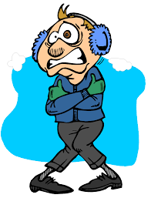
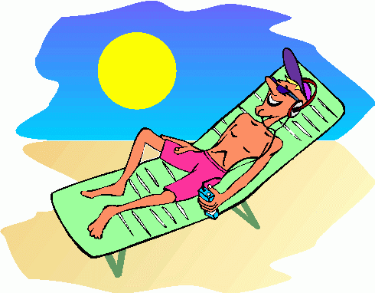
Variations in Insolation

Slide 7
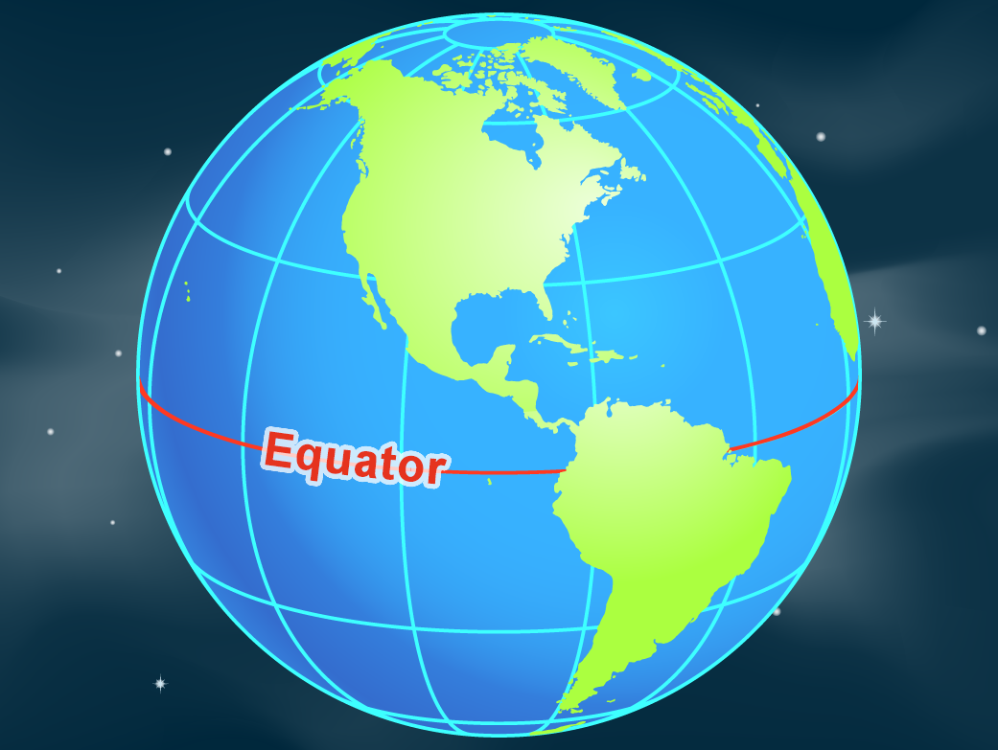
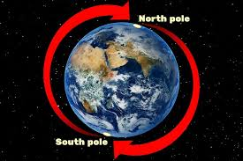
What have we learnt so far?
Lack of Insolation = Energy Deficit
Most Insolation = Energy Surplus

Slide 8
Incoming Insolation v Outgoing Radiation
Between 35oN and 35oS there is a surplus of energy because incoming insolation is more than outgoing radiation (terrestrial radiation).
Polewards from about 35oN and 35oS there is a deficit of energy because there is more outgoing radiation (terrestrial radiation) than incoming insolation.

Slide 9
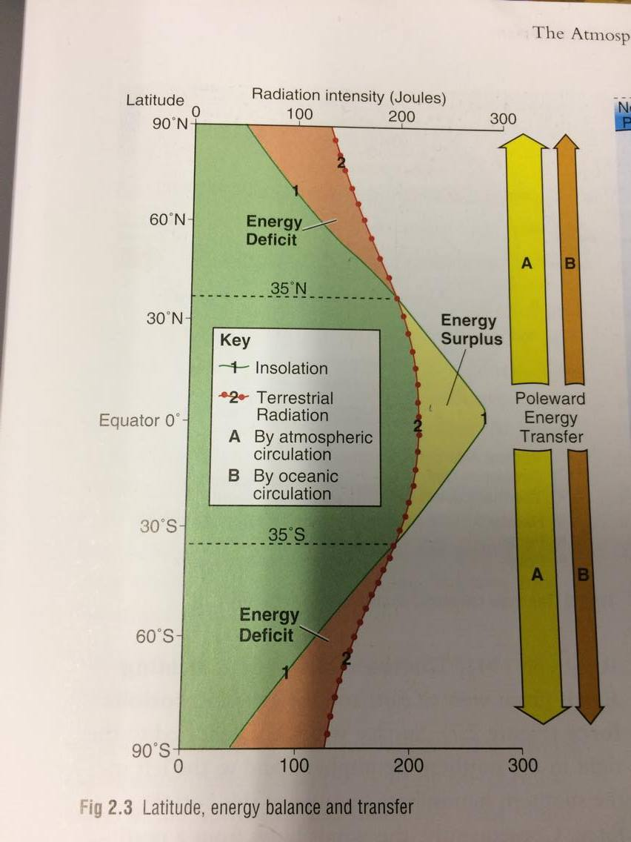

Slide 10
But why does insolation (energy received) vary?

Slide 11
Key Reasons
Curvature of the Earth (Latitude)
Thickness of Atmosphere
Albedo Effect
Earth’s Tilt

Slide 12
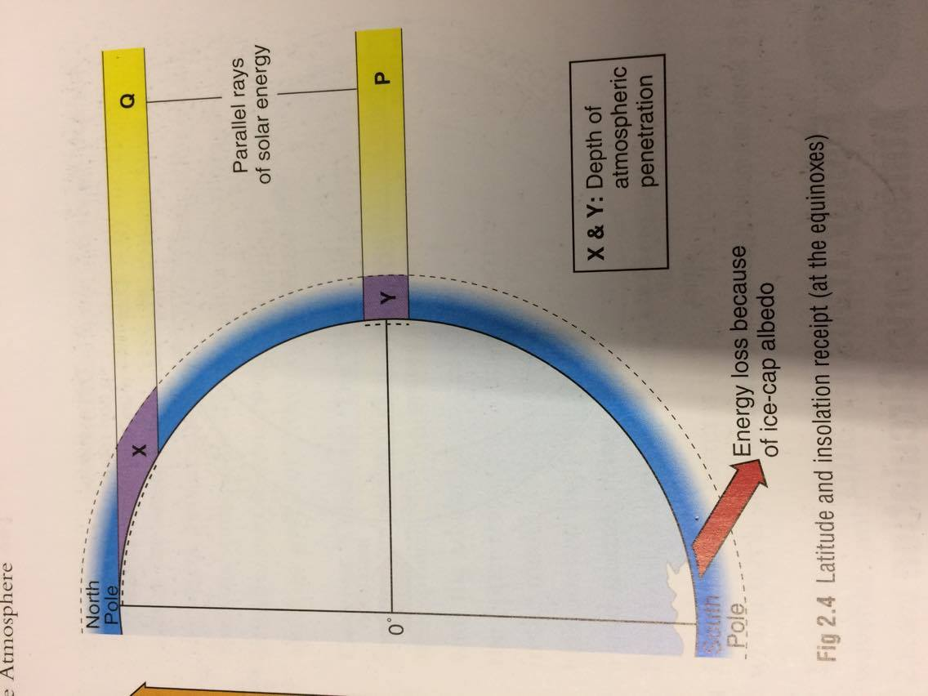

Slide 13
Curvature of the Earth (Latitude)
As the Earth is a sphere, this means variations in amount of insolation received.
Band of insolation near North Pole has to heat a larger area, while band at equator heats a smaller area.
Therefore insolation at arctic circle is strethced and there weaker. Insolation at equator is concentrated and therefore warmer.

Slide 14
Thickness of Atmosphere
Further away from the equator, the more atmopshere the radiation has to penetrate – therefore more lost due to scattering, absorbtion and reflection. This changes in thickness is due to the Earth being spherical.

Slide 15
Albedo
Poles have a high albedo due to ice caps being light in colour which means heat is lost as reflected back as terrestrial radiation.
Equatorial have low albedo due to dark colours of forests which absorb heat.

Slide 16
Earth’s Tilt
When Earth tilts, angle of the sun’s rays changes throughout the year.
Winter Solstice (21st December) = North Pole is tilted away from sun (no insolation), overhead sun is at Tropic of Capricorn (maximum insolation).
21st March = Maximum overhead sun at Equator – Northern hemisphere is in spring while Southern in autumn.
June 21st = Earth continues to move so maximum overhead sun now at Tropic of Cancer – Northern Hemisphere get maximum insolation. South pole is receiving none at all due to curve of Earth.
Tropical areas always receive insolation no matter what time of year.

Slide 17
June 21st = Earth continues to move so maximum overhead sun now at Tropic of Cancer – Northern Hemisphere get maximum insolation. South pole is receiving none at all due to curve of Earth.
Tropical areas always receive insolation no matter what time of year.

Slide 18
