Slide 1
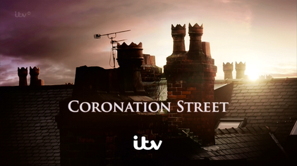
Write down at least three ways the Coronation Street set could reflect the inner city.
https://www.youtube.com/watch?v=JaYR7TLkii8
https://www.youtube.com/watch?v=HNI7A9PkD5M

Slide 2
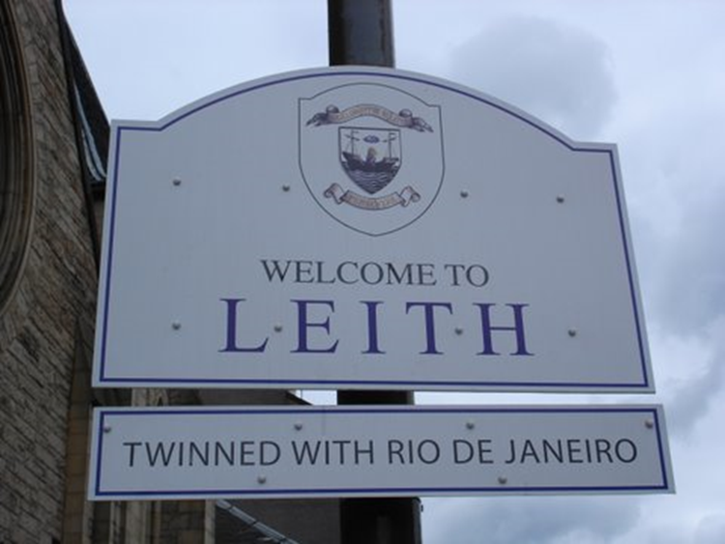
Changes in the Inner City (Leith)

Slide 3
What are we learning?
Problems associated with Inner City Leith
Explain the solutions to these problems
Evaluate the success of these solutions in dealing with the problems.

Slide 4
Inner City Features Recap
Next to the CBD.
Developed during the Industrial revolution (1850 -1914).
Narrow roads due to lack of transport at time.
Tennement housing – often owned by factories.
Few controls on building standards.

Slide 5
Split paper into three…
Issues
Solutions
Evaluate – success??

Slide 6
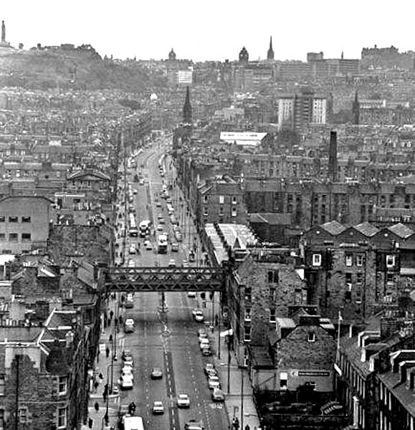
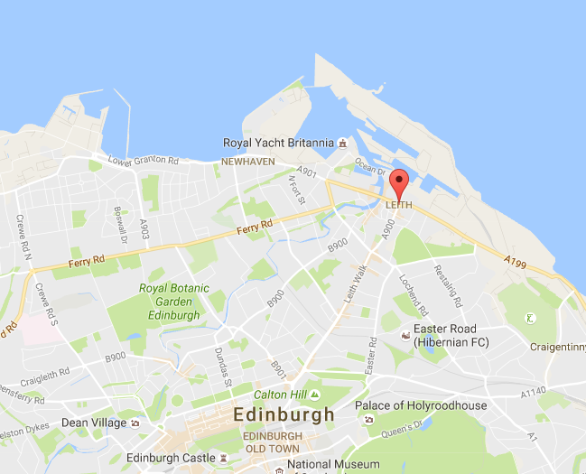

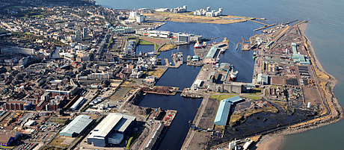
Leith
https://www.youtube.com/watch?v=kWpYxvjzgQw

Slide 7
The History of Leith
Leith used to be a very busy port due to links with the UK and the rest of Europe. It was an industrial area with many people employed in it (whisky, sugar, shipbuilding).
Goods transported by rail and canal to Leith.
The houses in Leith were poor quality tenements with many 1960s tower blocks common.
A high density of buildings with little open space.

Slide 8
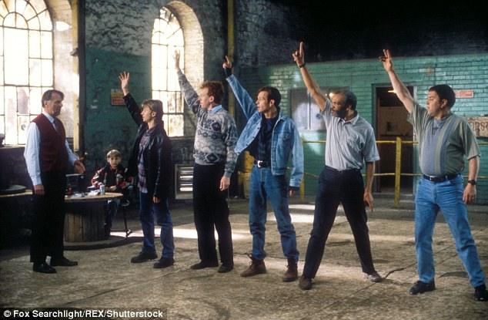
The Full Monty – Inner City Sheffield
https://www.youtube.com/watch?v=iwFenK3ME8I

Slide 9

Starter – Give me 5….issues that Leith was facing.

Slide 10
Then….The Decline!
Industry left the inner city due to resources running out, modernisation, competition from countries like India and China, better locations on edge of town.
This has a number of knock on effects and the inner city areas begins to become more and more run down, with increasing issues such as unemployment and crime.

Slide 11
Issues for Leith
Port and trade declined = shipbuilding and distilling closed down = derelict building/land.
People move away = population shrinks = shops began to close down.
Above national average unemployment levels = high poverty rate = cycle of poverty.
Housing was put up quickly to accommodate all the workers = poor quality buildings, empty buildings.
Can’t afford to have children/not somewhere you want to bring them up = ageing population.

Slide 12
Industry shuts down
Loss of jobs = high unemployment
Lack of money
Turn to crime/drugs/alcohol
Lose house = derelict buildings
Shops shut as lack of money, going in.

Slide 13
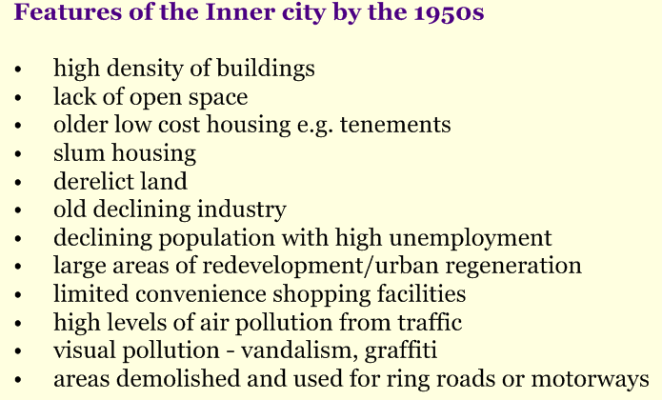

Slide 14
Overall….. An image of decay and depression – by the 1980s Leith was a byword for a run down area.

Slide 15
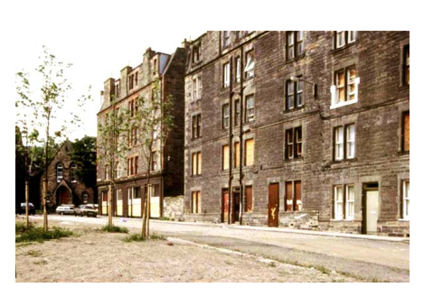

Slide 16

Trainspotting

Slide 17
“Set in the late Thatcher era, the book didn’t attempt to paper over the cracks or shy away from the high levels of unemployment, urban decay, and heroin addiction which plagued the city throughout the Eighties. Welsh helped shine a light on aspects of Auld Reekie which people seldom spoke about.”

Slide 18
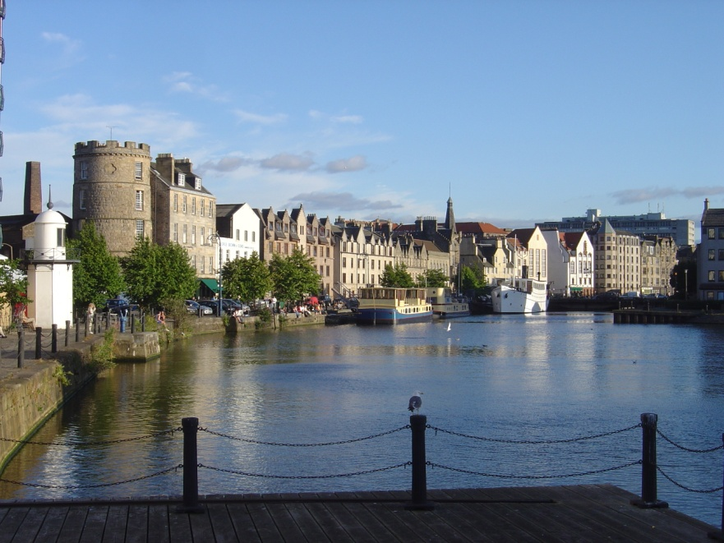
So...What did they do?

Slide 19
Thinking Skills!
Think about the issues that Leith is currently facing.
Come up with one idea about how you would improve it – could be a scheme, you could build something etc.
Explain what your idea is and how it would improve the issues within Leith.

Slide 20
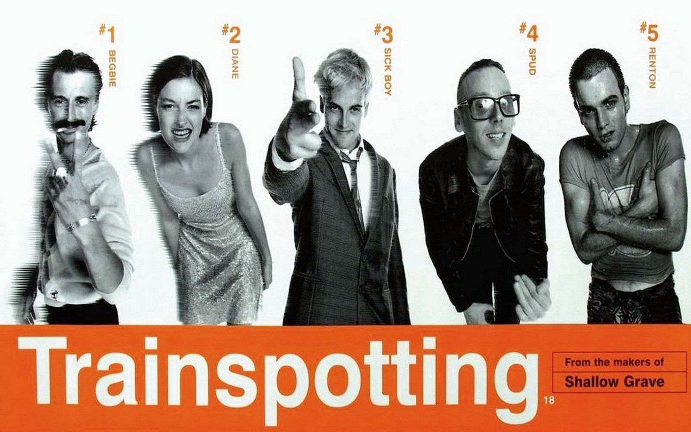
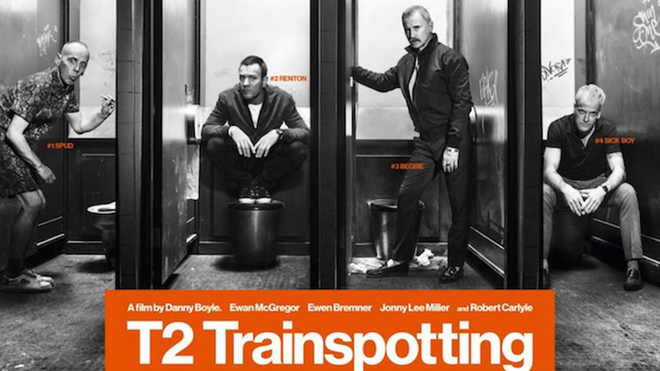

Slide 21
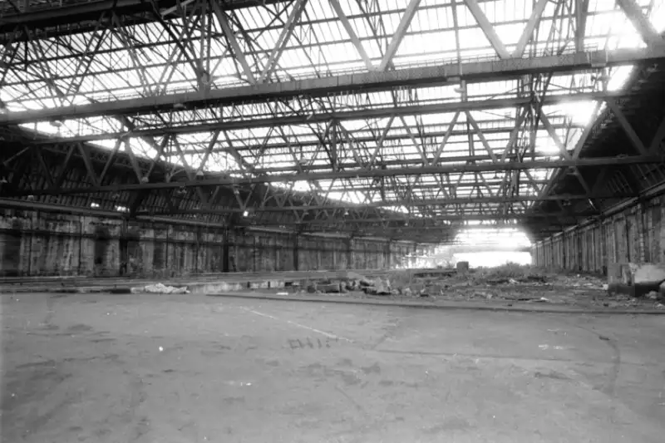
Towards the end of the chapter, two of the book’s main characters take a detour at the foot of Leith Walk to ‘relieve’ themselves at the disused Central Station, which Welsh, through the voice of Renton, describes as a “barren, desolate hangar, soon tae be demolished”.

Slide 22
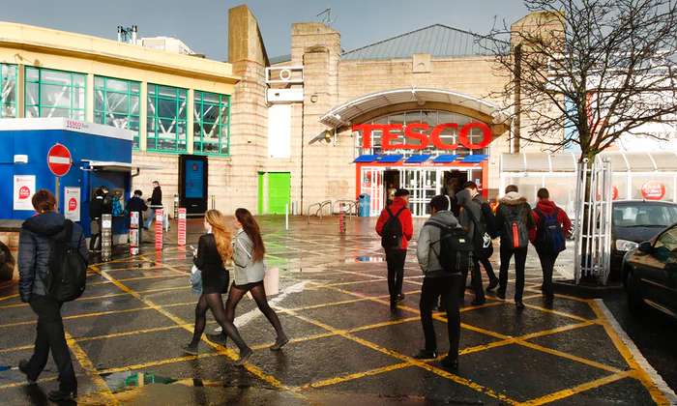
The old station was demolished soon after Renton and Begbie’s visit and later replaced by a supermarket and Leith Waterworld swim centre (now a soft play centre).

Slide 23
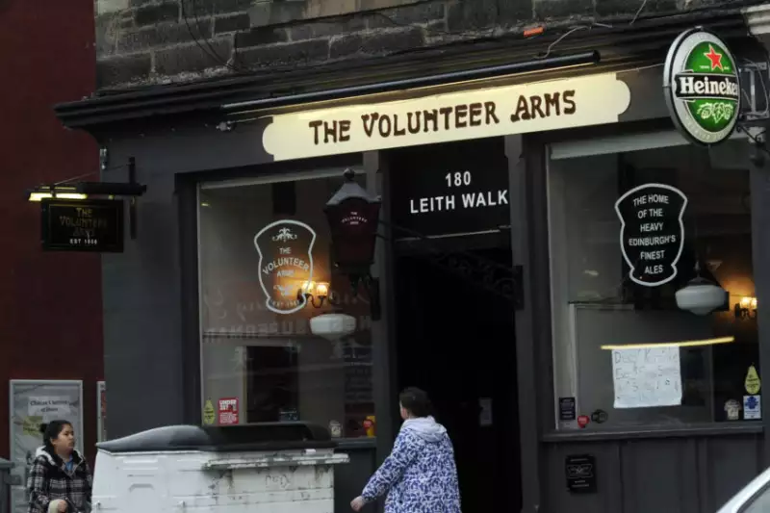
One of the pubs featured prominently in Trainspotting is the Volunteer Arms, a proper working man’s boozer with a rough reputation, situated towards the foot of Leith Walk.

Slide 24
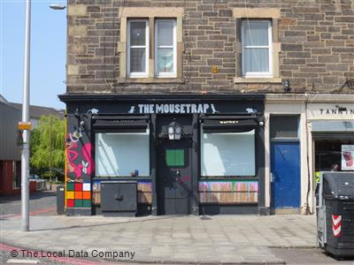
The Volly underwent a £70,000 transformation in 2014 to reopen as the Cask & Still, a trendy whisky bar intent on capturing a whole new clientele.
Last year the pub was renamed again as The Mouse Trap.

Slide 25
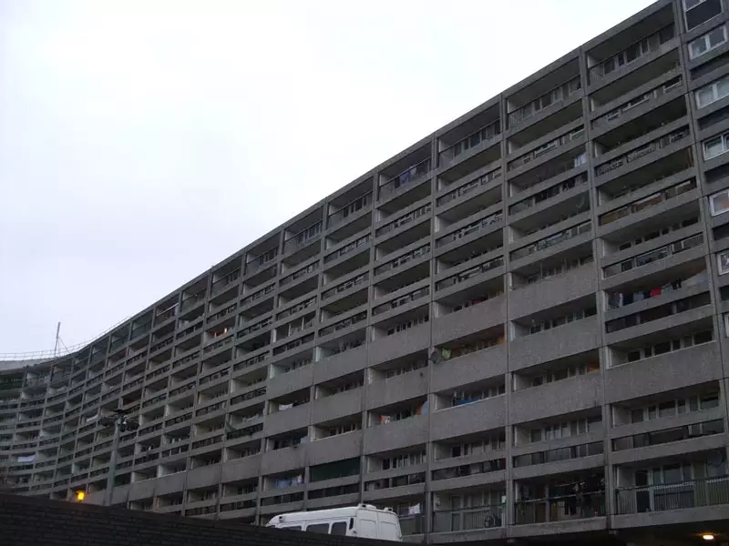
Leith’s Banana Flats - home to Simon ‘Sick Boy’ Williamson in Welsh’s novels

Slide 26
Still there! In 2017 they were awarded Category A Heritage Status. Put simply, this status means the flats (actually named Cables Wynd) are now considered ‘of national and international importance.

Slide 27
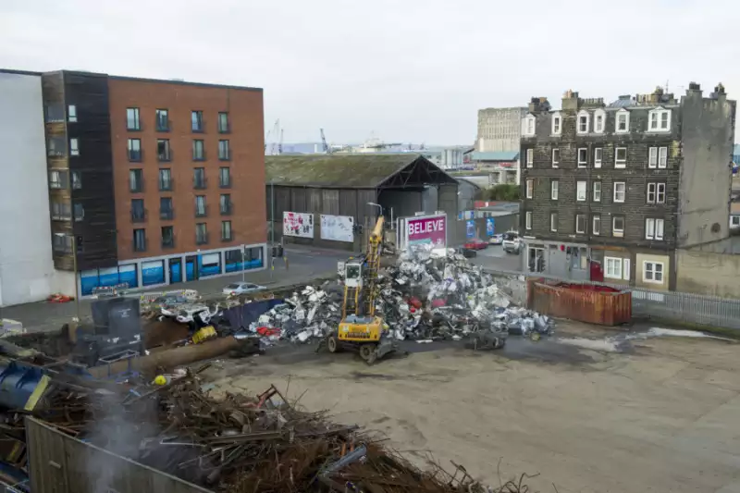
Yet like our dear old Spud, there are still pockets of Leith left in the past, with a perfectly placed scrap heap opposite a nice block of flats, that just so happen to be the location where Sick Boy lives. A fitting juxtaposition, and one that reminds us that though the sequel thrives in its modern landscape, there’s still a touch of industrialism that the films would be so lost without.

Slide 28
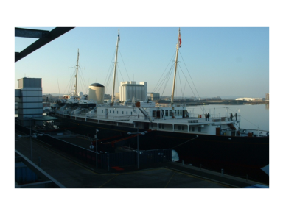
Royal Yacht Britannia is now docked there as a permanent tourist attraction

Slide 29
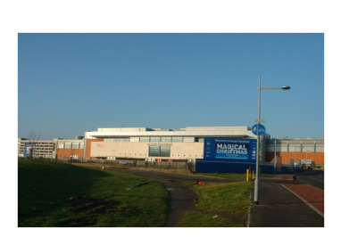
Ocean Terminal provides a shopping environment for locals and tourists

Slide 30
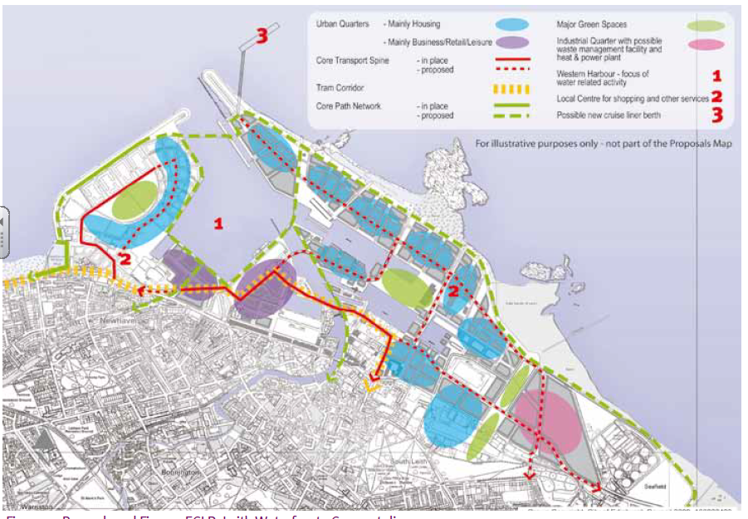
Waterfront and Leith Area Redevelopment Plan
In 2011, plans were approved for redevelopment of the waterfront and the Leith area.

Slide 31
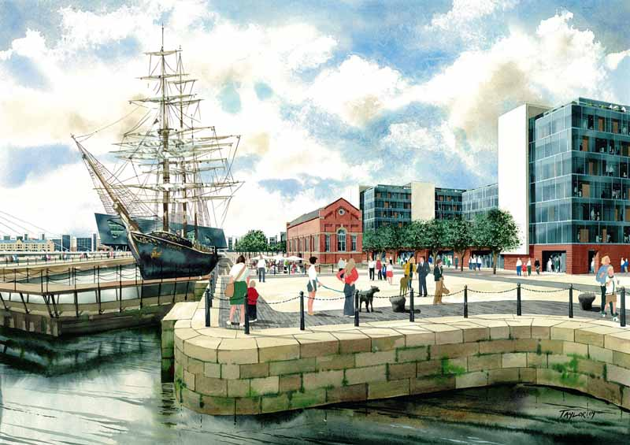
Environmental improvements – landscaping of Leith docks to make it a more “21ST century” port (recobbled pathways, trees planted)

Slide 32
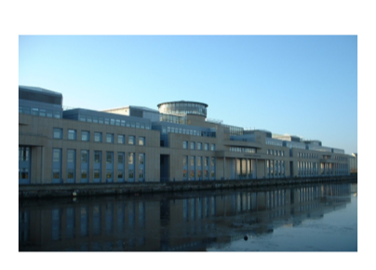
New office space has opened to bring jobs back to the areas eg - Scottish Executive, Visit Scotland and radio stations

Slide 33
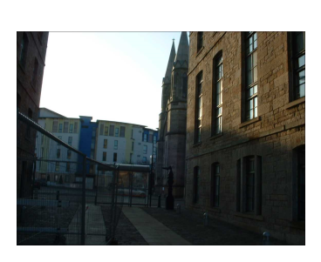
Warehouses and empty whisky factories have been converted into flats/shops. Tenements brought up to modern standards.

Slide 34
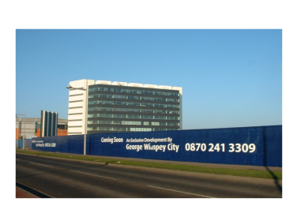
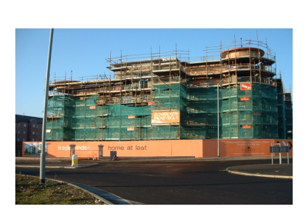
Housing is a mix of social and private accommodation - with many luxurious ones built.

Slide 35
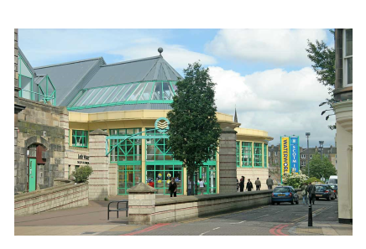
New leisure facilities – Ocean Terminal, Leith Water world (closed in 2012)

Slide 36
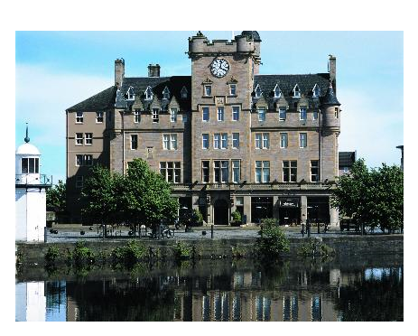
New hotels built – Holiday Inn Express, Malmaison

Slide 38
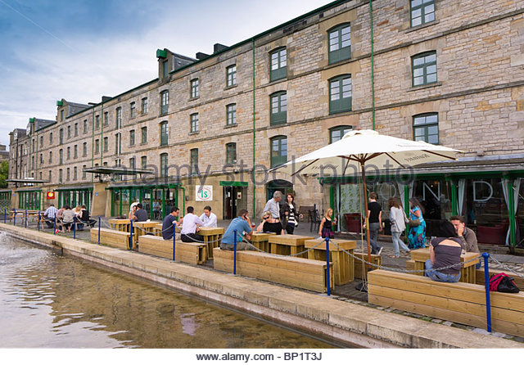
The area has benefited from gentrification with new services being opened such as shops and bars
Gentrification = the process of renovating and improving a house or district so that it conforms to middle-class taste.

Slide 39
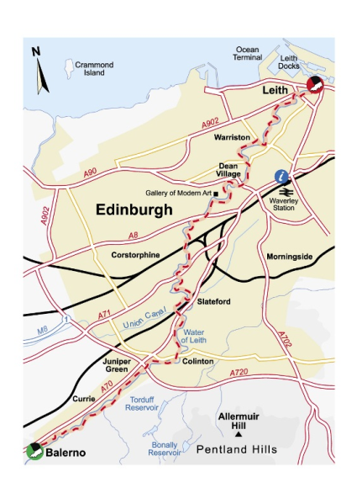
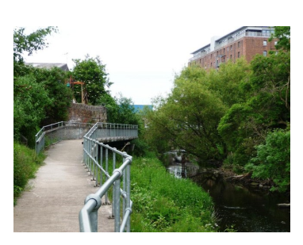
Water of Leith walkway cleaned up and public walkway opened

Slide 40
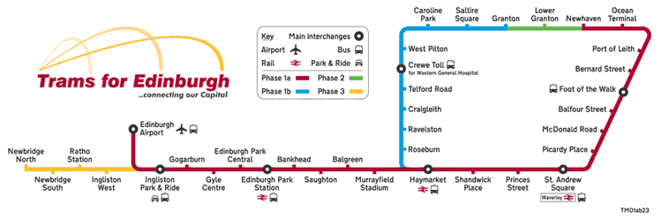
Transportation links have also improved access to the CBD - Bus and Tram (easy for commuting/tourists)

Slide 41
Was redevelopment a success?
A younger, more affluent population has been attracted to Leith
Increase in daytime population
Commericial development/gentrification may get harm the famous Leith community spirit. However, things like community spaces and art projects (Biscuit Factory) are trying to prevent this and provide jobs and community spirit.
People are attracted from all over Scotland to spend their leisure time there.
Environmentally looks better – landscaped docks.
Affluent dock and riverside area – bars, shops, offices etcs = more employemnet opportunities BUT well paid jobs tend to go to commuters not locals.
Better shopping areas and transport links for both locals and tourists – brought more money into area.
Leith becomes more sought after → house prices up → locals priced out of area.
Regeneration did slow down due to recession of 08/09 = Edinburgh trams project.

Slide 42
Was redevelopment a success?
A younger, more affluent population has been attracted to Leith
Increase in daytime population
Commericial development/gentrification may get harm the famous Leith community spirit. However, things like community spaces and art projects (Biscuit Factory) are trying to prevent this and provide jobs and community spirit.
People are attracted from all over Scotland to spend their leisure time there.
Environmentally looks better – landscaped docks.
Affluent dock and riverside area – bars, shops, offices etcs = more employemnet opportunities BUT well paid jobs tend to go to commuters not locals.
Better shopping areas and transport links for both locals and tourists – brought more money into area.
Leith becomes more sought after → house prices up → locals priced out of area.
Regeneration did slow down due to recession of 08/09 = Edinburgh trams project.

Slide 43
Was redevelopment a success?
A younger, more affluent population has been attracted to Leith
Increase in daytime population
Commericial development/gentrification may get harm the famous Leith community spirit. However, things like community spaces and art projects (Biscuit Factory) are trying to prevent this and provide jobs and community spirit.
People are attracted from all over Scotland to spend their leisure time there.
Environmentally looks better – landscaped docks.
Affluent dock and riverside area – bars, shops, offices etcs = more employemnet opportunities BUT well paid jobs tend to go to commuters not locals.
Better shopping areas and transport links for both locals and tourists – brought more money into area.
Leith becomes more sought after → house prices up → locals priced out of area.
Regeneration did slow down due to recession of 08/09 = Edinburgh trams project.

Slide 44
Was redevelopment a success?
A younger, more affluent population has been attracted to Leith
Increase in daytime population
Commericial development/gentrification may get harm the famous Leith community spirit. However, things like community spaces and art projects (Biscuit Factory) are trying to prevent this and provide jobs and community spirit.
People are attracted from all over Scotland to spend their leisure time there.
Environmentally looks better – landscaped docks.
Affluent dock and riverside area – bars, shops, offices etcs = more employemnet opportunities BUT well paid jobs tend to go to commuters not locals.
Better shopping areas and transport links for both locals and tourists – brought more money into area.
Leith becomes more sought after → house prices up → locals priced out of area.
Regeneration did slow down due to recession of 08/09 = Edinburgh trams project.

Slide 45
CN Traveller Magazine Quote
“Once a formidable center of shipbuilding, Edinburgh’s port area, Leith, later experienced considerable decline—an era memorably depicted in the movie Trainspotting. Thankfully, today’s Leith has transformed into a hip area with a great food and arts scene.”
http://www.cntraveler.com/galleries/2015-05-11/what-to-do-in-leith-edinburgh-next-cool-neighborhood-leith

Slide 46
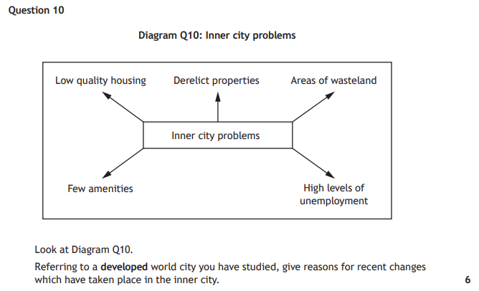

Slide 47
Practice Questions
For a developed world city you have studied,
Explain recent changes which have occurred (3).
Evaluate the success of recent changes (3).

Slide 48
A recent change has been the building of Ocean terminal to provide jobs within the area. This will also encourage people to come to the area to spend money.
The new shopping areas have been successful as more money is now being spent in Leith from people outside the area. Unemployment levels have also went down.

Slide 49
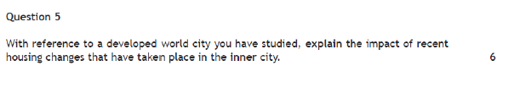
Exam Style Question

Slide 50
How would you answer it?
Many inner city areas have now been improved through urban regeneration schemes. Improvements in Leith include:
New housing, such as high rise flats. Warehouses are converted into housing.
Renovation of older housing, often tenements to bring up to modern standards.
Environmental improvements by landscaping and improving Leith docks to make it more of a “21ST century port”.
Attracting a mix of inhabitants, for example introducing luxury flats.
Gentrification brings more employment opportunities in the area so encourages people to live there. Employment opportunities such as restaurants, bars, Ocean Terminal, Scottish Executive.
Increased services such as restaurants, bars, Ocean Terminal and the gentrified idea of Leith as trendy, make it a more appealing place to live (even if they are commuting out of the area.)
Improving transport links, with more bus routes and the new tram route, make it easier to live in Leith and commute elsewhere, with better and quick access to the CBD.

