Slide 1
Homework Questions: Due 21/2/19
Explain how different factors have contributed to the formation and characteristics of a brown earth soil (10).
Explain how different factors have contributed to the formation and characteristics of a gley soil (10).
Draw a fully annotated soil profile of a podzol soil to show its main characteristics (8).

Slide 2
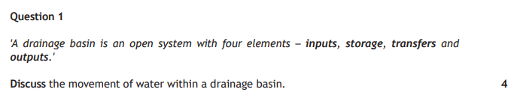

Practice Question (2018 past paper)
6

Slide 3


Slide 4
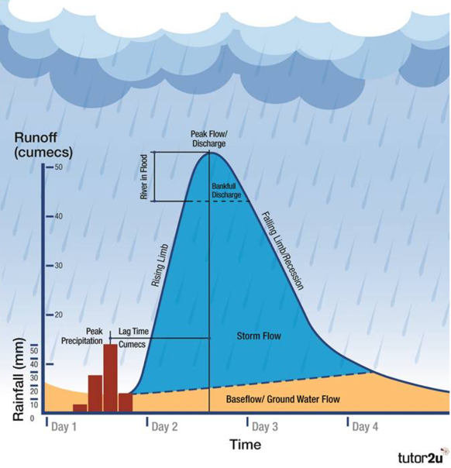
Hydrographs

Slide 5
What are hydrographs?
RIVERS ARE CONSTANTLY CHANGING!
Discharge = amount of water in a channel at a given time (measured in cumecs – cubic metres per second).
When rainfall increases, so will the level and discharge of the river.
The relationship between precipitation and the level of a river is illustrated by a flood (storm) hydrograph – shows whether river has high or low flood risk.

Slide 6
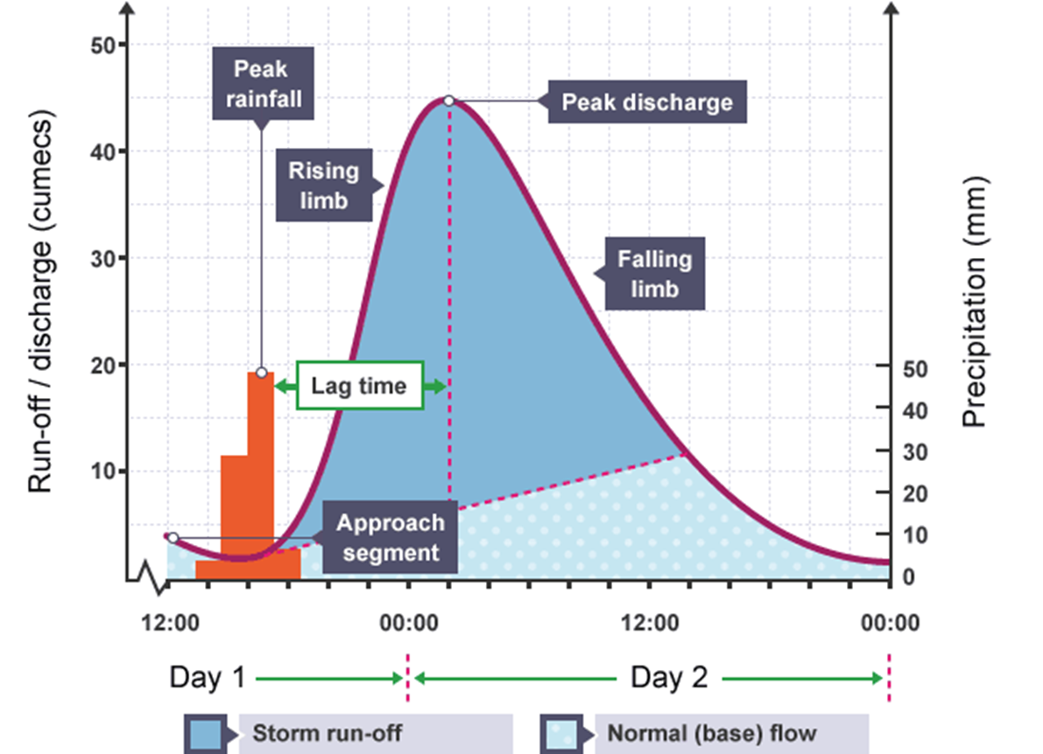

Slide 7
3
2
Discharge (m³/s)
1
0 12 24 36 48 30 72
Hours from start of rain storm

Slide 8
Rainfall shown in mm, as a bar graph
3
2
Discharge (m³/s)
mm
4
1
3
2
0 12 24 36 48 30 72
Hours from start of rain storm

Slide 9
Discharge in m³/s, as a line graph
3
2
Discharge (m³/s)
mm
4
1
3
2
0 12 24 36 48 30 72
Hours from start of rain storm

Slide 10
Rising limb
The steepness of the line graph indicates the speed at which the rainfall reaches the river. A very steep limb is caused by rapid surface runoff reaching the river all at once
3
Rising limb
2
Discharge (m³/s)
mm
4
1
3
2
0 12 24 36 48 30 72
Hours from start of rain storm

Slide 11
Peak flow
Peak flow
Occurs when the river reaches its highest level
3
Rising limb
2
Discharge (m³/s)
mm
4
1
3
2
0 12 24 36 48 30 72
Hours from start of rain storm

Slide 12
Recession limb
Peak flow
The line graph as the river returns to normal. River discharge falls more gradually than it rises. Slower through flow and groundwater flow feed the river more gradually and continuously than surface runoff
3
Rising limb
Recession limb
2
Discharge (m³/s)
mm
4
1
3
2
0 12 24 36 48 30 72
Hours from start of rain storm

Slide 13
Basin lag time
Basin lag time
Peak flow
Time difference between the peak of the rain storm and the peak flow of the river
3
Rising limb
Recession limb
2
Discharge (m³/s)
mm
4
1
3
2
0 12 24 36 48 30 72
Hours from start of rain storm

Slide 14
Base flow
Basin lag time
Peak flow
Normal discharge of the river
3
Rising limb
Recession limb
2
Discharge (m³/s)
mm
4
1
3
2
Base flow
0 12 24 36 48 30 72
Hours from start of rain storm

Slide 15
Basin lag time
Peak flow
3
Rising limb
Recession limb
Overland flow
2
Discharge (m³/s)
mm
4
Through flow
1
3
2
Base flow
0 12 24 36 48 30 72
Hours from start of rain storm

Slide 16
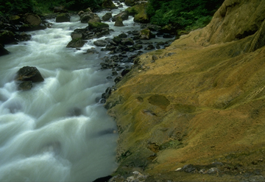
Overland flow
Through flow
Volume of water reaching the river from surface run off
Volume of water reaching the river through the soil and underlying rock layers

Slide 17
Vocab
Approach segment – discharge of the river before it rains.
Falling limb – rain water is still reaching the river but in decreasing amounts.

Slide 18

Whiteboard Understanding Check

Slide 19
Admin
Late homework.
Processed Information Sheets.
2nd Prelim

Slide 20
Starter: Draw the hydrograph...
It was 6am in the morning and it started raining – only a wee bit – about 2mm. This carried on like this until 8am where it got heavier and shot up to 8mm at 9am. It just kept going and going and got to 9mm at 10am before reaching 12mm on 11am. Luckily after this is calmed down and went down to 5mm at 12pm and then 2mm at 1pm – by 2pm it had stopped.
This amount of rain in a short period of time had an effect on the local river. The local river normally flows at about 10 cumecs but after the peak rainfall it shot up very steeply and hit its peak discharge at 6pm with 55 cumecs. It only returned to its normal flow level at 2am the next morning.

Slide 21
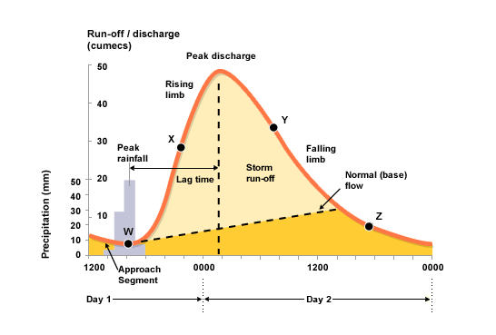

Slide 22
Describing a hydrograph
You need to refer to:
Basin lag time
Peak discharge
Time and amount of peak rainfall
Time and amount of peak discharge
The basin lag time - difference between peak rainfall and peak discharge
Steepness of the rising and recession/ falling limbs
Time it takes for the river to return to normal base flow
3
Rising limb
2
Overland flow
Recession limb
mm
Discharge (m³/s)
4
Through flow
1
3
2
Base flow
0 12 24 36 48 30 72
Hours from start of rain storm
You should make sure that you refer to the hours at the bottom of the graph during your answer.

Slide 23
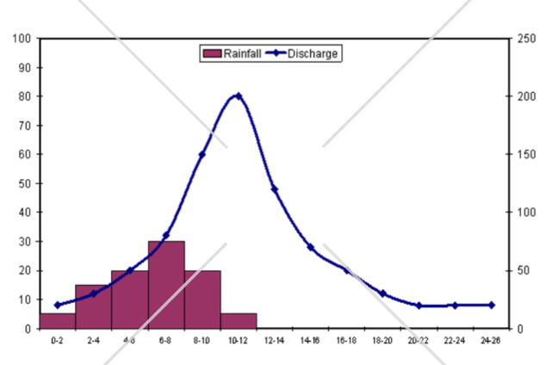
For this river, describe the changes in discharge levels. (5)
Rainfall (mm)
Discharge (cumecs)

Slide 24
For this river, describe the changes in discharge levels. (5)
Rainfall (mm)
Discharge (cumecs)

Slide 25
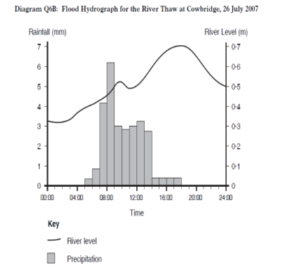
For this river, describe the changes in discharge levels. (5)

Slide 26
Slight increase in discharge until 09.00 hours in response to rain which started to fall at 07.00 hours (1 mark). At first, this rain would have been intercepted by vegetation and have infiltrated the soil (1 mark). There is a steep rising limb up to a peak discharge of 100 cumecs at 18.00 hours (1 mark). This water would have filled up storages in the soil due to throughflow and groundwater (1 mark) – as the soil became saturated, surface run-off increased causing a peak (1 mark). The rising limb becomes less steep briefly between 13.00 and 15.00 hours, caused by a marked reduction in rain to 4mm around 10.00 hours (1 mark). There is a short lag time of 5 hours which could be due to deforestation/steep slopes/impermeable rock (1 mark). A high number of tributaries may lead to the short lag time as water is transported more rapidly by surface run-off (1 mark).The river discharge quickly decreases, shown by a steep falling/recession limb down to because of no more rainfall after 15.00 hours (1 mark).

Slide 27
Explain – Why is the hydrograph the way it is?

Slide 28
What sort of things are trying to explain?
Peak Discharge – High/Low
Lag Time – High/Low
Steep Falling Limb.

Slide 29
Thinking Skills
Sort the answers into the correct sections:
High Peak Discharge
Low Peak Discharge
High Lag Time
Low Lag Time
Steep Falling Limb

Slide 30
Answers – How did you get on?

Slide 31
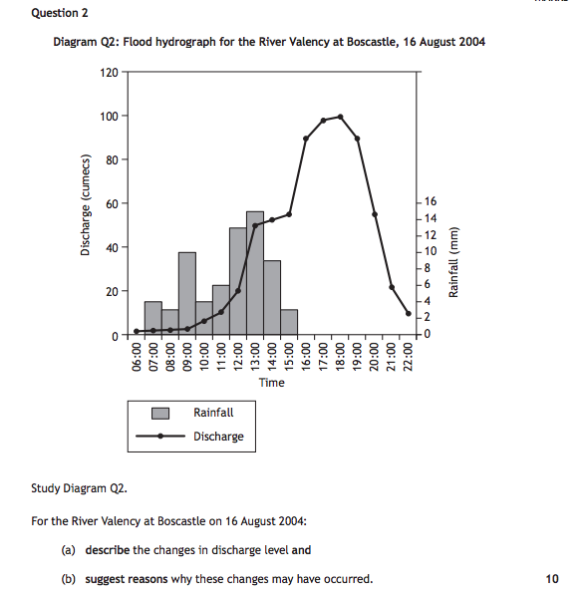
Specimen Paper

Slide 32
There is a relatively short lag time of about 6 hours (1 describe mark). This may be because there is impermeable rock which means water will stay on ground and get to river quicker (1 explain). There may be steep land which allows water to travel quicker to river (1 explain). There may a lack of vegetation to intercept and absorb water (1 explain)There is a slow rise in discharge until about 9am (1 describe mark). There is a steep rising limb (1 describe mark) with a high peak discharge of about 100 cumecs at 6pm (1 describe mark). This may be because it’s a large drainage basin so lots of water to get into the river (1 explain). It may be an urban area with storm drains to allow lots of water to enter river (1 explain).There is a steep falling limb between 18:00 and 22:00 (1 describe mark). This may be because there is lots of rivers and streams nearby to help with drainage (1 explain mark).

Slide 33
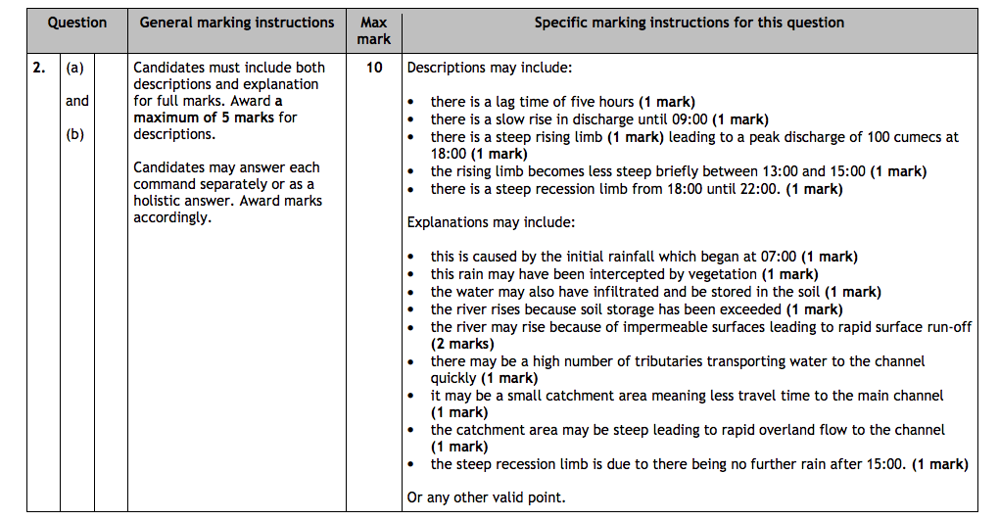

Slide 34
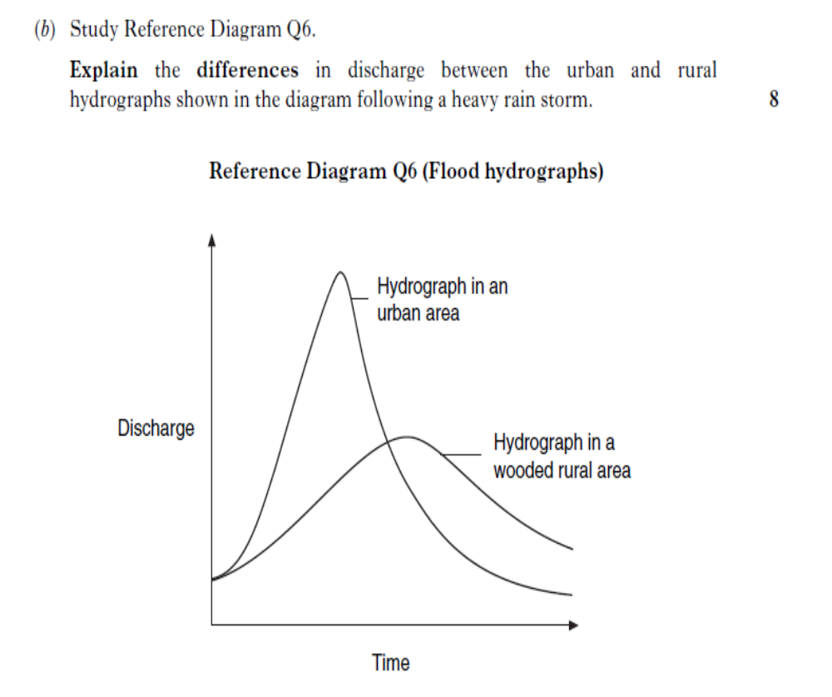
6

Slide 35
Model Answer
In the urban area, it has high peak discharge whereas the wooded rural area has a low peak discharge. This may be because in a urban area there is tarmac this means that water cannot penetrate it as it is impermeable meaning it flow over it quickly as surface run off to the river (1 mark). In an urban area they may have storm drains which means the water is allowed to flow quickly through these into the river (1 mark).
In the wooded rural area, there is a low peak discharge because there is a lot of vegetation meaning that precipitation may be intercepted by vegetation and then lose it through transpiration and evaporation (1 mark). The soils may be fine so the water will infiltrate and be stored underground (hence why urban has more water present that rural) (1 mark) by going underground the water will also take longer to get to the river giving a lower peak discharge at a later time(1 mark).
The urban area has a much steeper falling limb. This could mean there is more rivers or drains in this area, this could mean that there is a higher drainage density to allow water to drain out quicker – this is also much faster than soils and trees which absorb water (1 mark).

Slide 36

Test Each Other!
Pair Up.
On your whiteboard (using a whiteboard pen!), make up a storm hydrograph.
Now you answer it on a bit of paper (10 marks – describe and explain).
Move to another table and describe and explain their graph underneath it.

