Slide 1
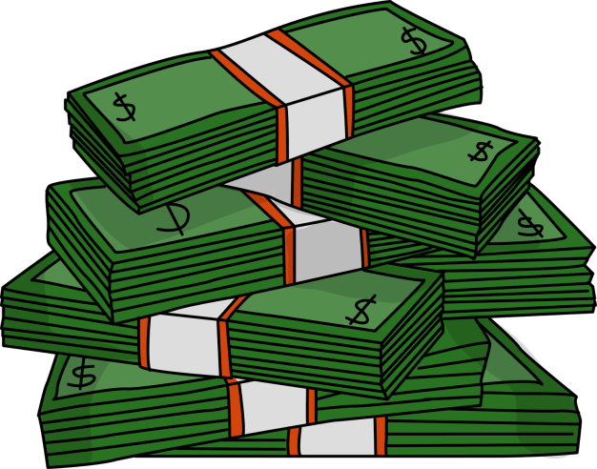
DEVELOPMENT IS MORE THAN JUST MONEY!

Slide 2








Slide 3
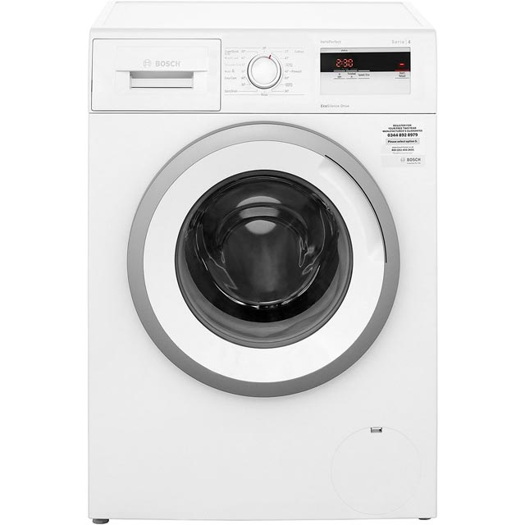
Washing Machine and Development?
https://www.youtube.com/watch?v=6sqnptxlCcw

Slide 4

Welcome Back!

Slide 5
Reminder – Assignment!
27% of final grade – must be taken seriously!
Final write up = 23rd January 2018 = under exam conditions, only allowed PI sheet.
Make sure we have seen all PI sheets within next week.

Slide 6
Learning Scale
4 = I fully understand and I am confident enough to help others.
3 = I understand and I could apply it on my own.
2 = I am starting to understand but do still have questions.
1 = I do not understand. HELP!!!!

Slide 7
Development – After Christmas Recap!
1 mark for each | 2 marks for each | 3 marks for each
Give a social indicator of development. | Explain how this indicator of development can demonstrate the development levels between countries. | Explain the issues with using single indicators of development.
Give a economic indicator of development. | Explain how this indicator of development can demonstrate the development levels between countries. | Explain 3 case study examples of where single indicators can hide inequalities.
What does HDI stand for? | Explain what the HDI is. | Name the top 3 countries of on the HDI….
Total Score = 18!!

Slide 8
Teenage Affluenza
https://www.youtube.com/watch?v=_y8KOpJignk

Slide 9
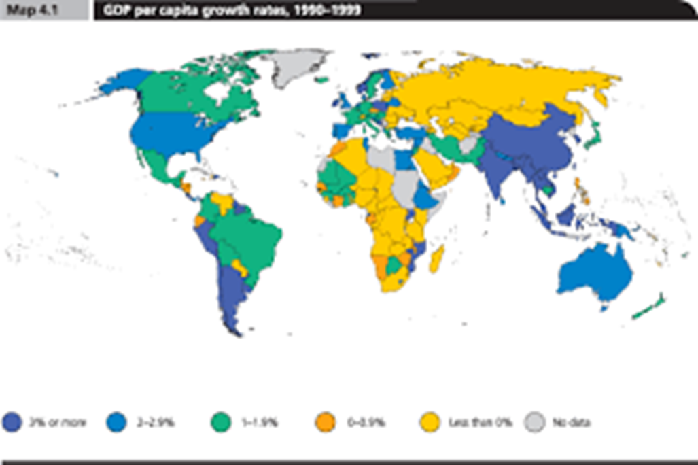
Measuring Development

Slide 10
Learning Intentions
To be able to describe and explain single indicators of development

Slide 11
Development Indicators
Development Indicators (IODs) are used to compare countries – not one single one is used.
Can be social or economic.
What do you think a good development indicator should look like?
Linked to development.
Allows for comparison (all measured same way).
Easily measurable.

Slide 12
Health. Does the population have access to medical care? A developing country has less money to spend on training doctors and nurses.
Jobs. What type of job dominates? Developing countries focus on primary jobs, such as farming, fishing and mining. Developed countries focus on secondary and service jobs such as banking, retail and information technology.
Education. Do the population have access to education? What level of education is available (primary, secondary or further/higher education)? Literacy rate?

Slide 13
Trade. Developed country lots of trade between developed countries. Developing countries sell raw materials such as oil or precious metals and buy manufactured goods (e.g. cars) from developed countries.
Population. Developing country has a higher birth and death rate, more children dying (high infant mortality) and adults dying at a younger age (short life expectancy).

Slide 14
Gross Domestic Product (GDP)
The total amount of money made by a country from its raw materials, its manufactured goods and its services.
The GDP is always measured in US dollars ($).
The total amount is then divided by the total number of people living in the country. This gives an average GDP per person (capita).

Slide 15
Gross National Product (GNP)
Same as GDP + all net income earned by that country and its population including overseas investments (TRADE).
Always in $.

Slide 16
Why are most measured as an average/per capita?
USA GDP = 18.57 trillion US Dollars
Monaco GDP = 6.075 billion US Dollars
USA = 325.7 million
Monaco = 38,499.
USA GDP per capita = 57,466 US Dollars
Monaco GDP per capita = 162,009 US Dollars.

Slide 17
Wealth | Education | Living Standards | Healthcare

Slide 18
Indicators to sort…
calories per day
GNP per capita.
life expectancy
school completion rate.
doctors per 1000
GDP per capita
access to safe water.
literacy rates
poverty rate
teachers per 1000
infant mortality rate
energy use per person

Slide 19
Indicator Examples
Wealth – GDP per capita, GNP per capita.
Healthcare – life expectancy, doctors per 1000, infant mortality rate.
Education – literacy rates, teachers per 1000, school completion rate.
Living standards – energy use per person, calories per day, poverty rate, access to safe water.
THERE ARE LOADS - https://data.worldbank.org/indicator

Slide 20
FILL IN TABLE TOGETHER – SOCIAL AND ECONOMIC
Indicator | DESCRIBE (WHAT DOES IT SHOW) | EXPLAIN (HOW IT WORKS)
GDP per capita
GNP per capita
Energy Use per Person (kwatt)
%Adult Literacy
Doctors per 1000
Life Expectancy
Calories per day (cals)

Slide 21
How do indicators explain development?
Economic
GDP per capita = Total value of all goods and services produced by a country (per capita = per person) = Shows how much a country has invested in their industry and the ability (education) of people to work in this industry. Shows how attractive a country is for industry to go to (good roads, good rights etc.)

Slide 22
Number of Fortnite Players per country
Percentage of people who wear make up
Number of textbooks per classroom
Number of paracetamols per capita

Slide 23

Number of mobile phones per capita…
https://en.wikipedia.org/wiki/List_of_countries_by_number_of_mobile_phones_in_use

Slide 24
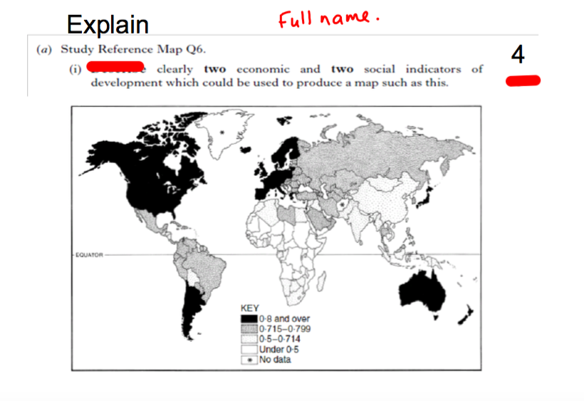
EXAM QUESTION
8

Slide 25
One economic indicator is GDP. This shows how developed a country is as it can show how much industry there is within a country which can help develop it – countries with 0.8 or over on the map (1). If that country is industrialised then this shows that it must be appealing for industry to go to so invested in roads, education etc (1). Another economic indicator is energy use per person. If this is high then it means that people must have the money to afford to use electricity (1). If energy use is high then a country must have invested in industry to produce electricity such as power stations (1).
One social indicator is adult literacy rate. If a country has a high literacy rate then a country must have invested in education and have the ability to train teachers (1). A high literacy rate would mean that people can get qualified to work in jobs which will help develop a country further (1). Calories per day can also help show development. If it is high then there was must be a wide range of food available for the population to have access to (1). It could also show that a country has good farmland to grow food and is not dealing with issues such as drought which can hinder development (1).

Slide 26
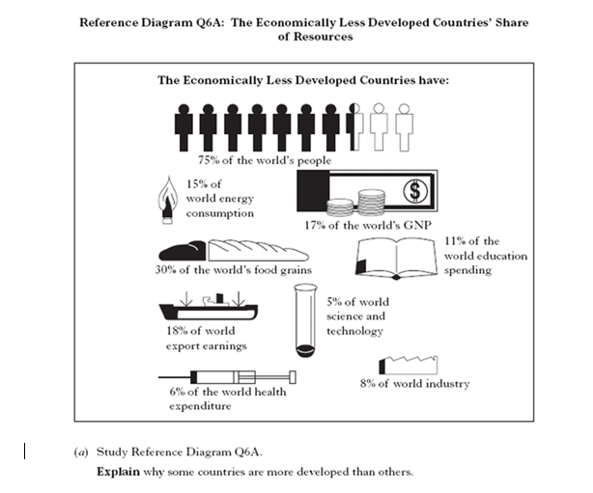

Slide 27

Hans Rosling Video
https://www.youtube.com/watch?v=jbkSRLYSojo

Slide 28
What are the issues with single indicators of development?

Slide 29
Rank the countries in your jotter from most to least developed…

Slide 30
Ranking Task
For each indicator, rank the country from top (1) to bottom (17). Now rank them in your jotter from overall most developed to overall least developed (in your opinion!).
From doing this, can you see anything that could be wrong with using single indicators to measure development? How could it be fairer?
Who is top of rankings:
Add all their rankings together/3 – lowest number wins!

Slide 31
The Issues with Single Indicators
Single indicators of development are averages and therefore disguise inequalities in living standards throughout the country.
Only shows one aspect of a countries development - Using single ones may make country rank high in a specific area (education) but don’t rank high in other areas.
Measured in US dollars = unfair currency exchange rates (not accurate comparison of wealth between countries)

Slide 32
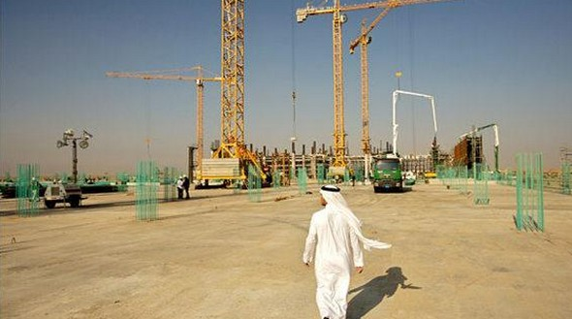
Saudi Arabia = 12th in GDP per capita!!

Slide 33
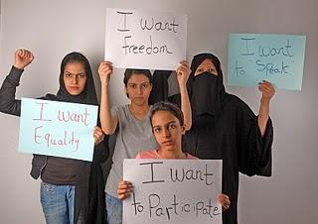

Slide 34
Women in Saudi Arabia are not allowed to....
Drive – until this year!!!
Vote to the same extent as men
Walk outside uncovered
Meet men who are not family in public
Open a bank account
http://timesofindia.indiatimes.com/world/middle-east/Five-things-that-Saudi-Arabian-women-still-cannot-do/articleshow/50101298.cms

Slide 35
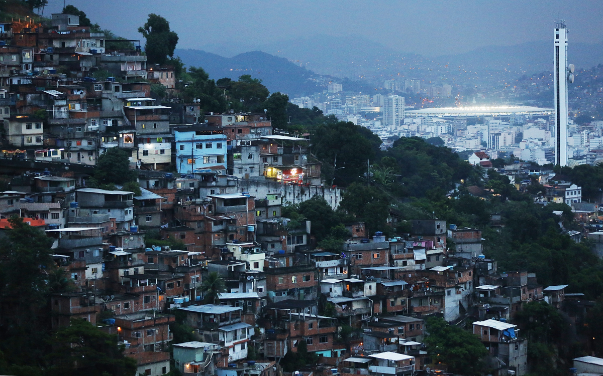
Brazil

Slide 36
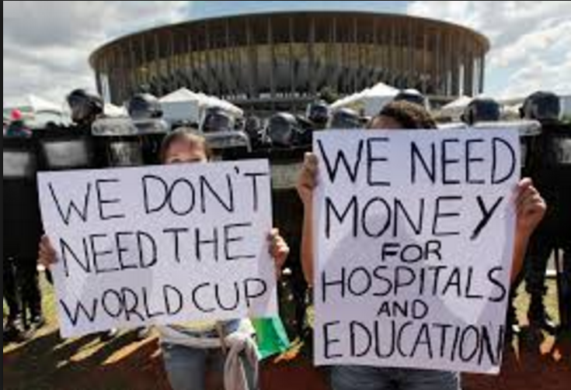

Slide 37
Kibera
Life expectancy in Kibera slums is 30 years of age, compared to 50 years of age in the remainder of Kenya.

Slide 38
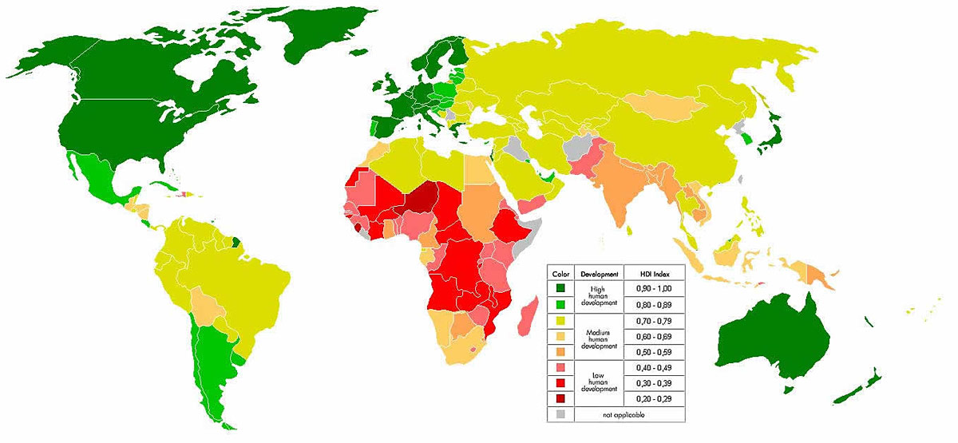
Combined/Composite Indicators

Slide 39
What are they?
They combine a number of different single indicators of development together to give a more valid picture of a countries development.
Should prevent the problems we discussed regarding single indicators.

Slide 40
Physical Quality of Life Index
Created in 1977.
3 social indicators = adult literacy (education), life expectancy (health) and infant mortality (health) .
Rank between 1 – 100.
If you are 80+ you are developed.

Slide 41
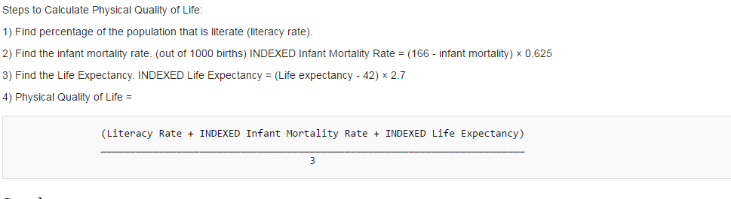

Slide 42
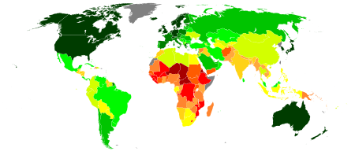
The HDI (Human Development Index)

Slide 43
Human Development Index (HDI)
Developed in 1990s by the UN and updated in 2010.
5 components (social and economic):
Health and longevity – life expectancy
Knowledge and education – adult literacy, school enrolment.
Standard of living – GNP, cost of living.
Ranking between 0 and 1 – 0.8+ = developed.

Slide 44
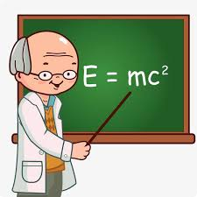
Health
Life Expectancy
Between 0 and 1.
0.8 or above = DEVELOPED!!
Knowledge
Literacy Rate
School Enrolment
Standard of Living
GNP
Cost of Living

Slide 45
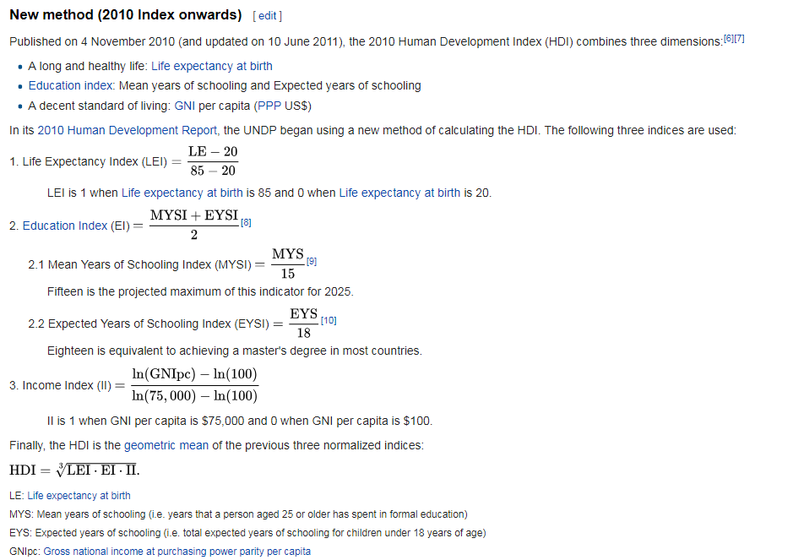

Slide 46
Kenya
149
146

Slide 47
Brazil
81
79

Slide 48
UK
25
16

Slide 49
UAE
42
8

Slide 50
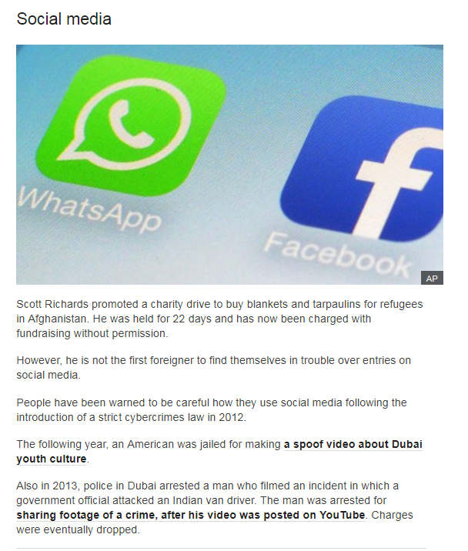

Slide 51
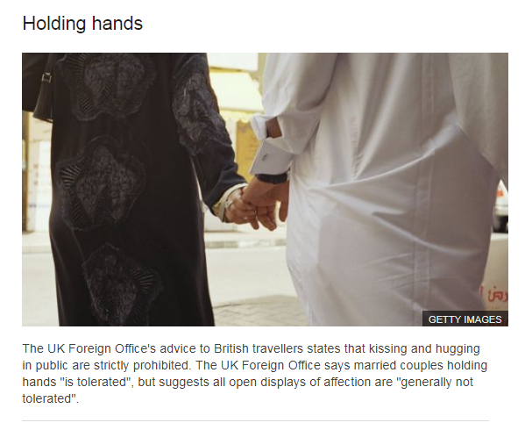

Slide 52
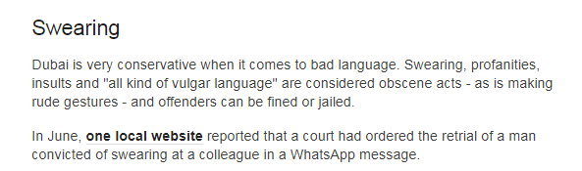
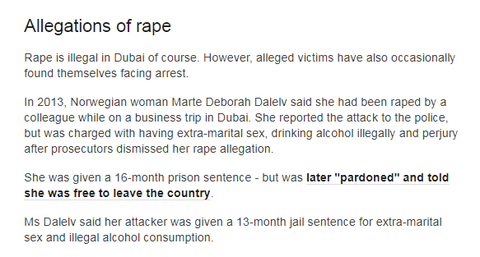

Slide 53
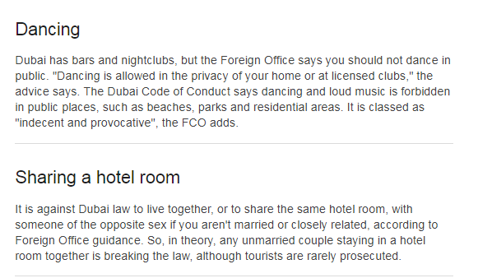

Slide 54
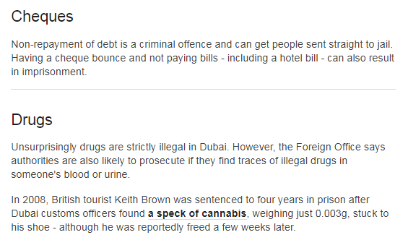

Slide 55
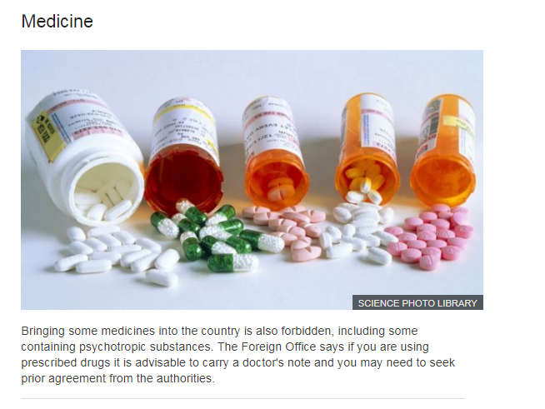

Slide 56
Some facts…
Foreign laborers in Dubai often live in conditions described by Human Rights Watch as being "less than humane“
https://thecoverage.my/opinion/list/24-shocking-photos-of-dubais-horrible-labour-camps/
https://www.youtube.com/watch?v=ijnrMYFxcQw

Slide 57
Womens Rights
In 2006, less than 20% of Emirati women were part of the national labor force.
80% of women in UAE are classified as household workers (maids).

Slide 58
LGBT Rights
In keeping with traditional Islamic morality, both Federal and Emirate law prohibit homosexuality and cross-dressing with punishment ranging from long prison sentences, deportation, for foreigners, and the death penalty

Slide 59
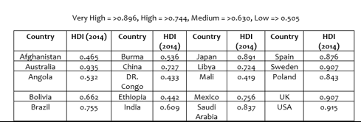
Tasks
Rank the countries in order from most developed to least developed.
Collect a blank map and plot them on your map (make sure to have a key for Very High, High, Medium and Low.
Research 15 more countries to add onto the map.

Slide 60
Why are combined indicators better than single indicators of development?
Don’t just rely on one indicator – doesn’t hide inequalities.
HDI – range of social and economic.
Gives a score – easy to understand who is developed/who isn’t and to compare countries.
Modern and up to date – takes into account what is important in modern world in terms of development.

Slide 61
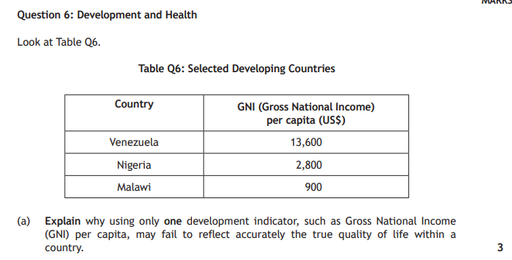
5

Slide 62
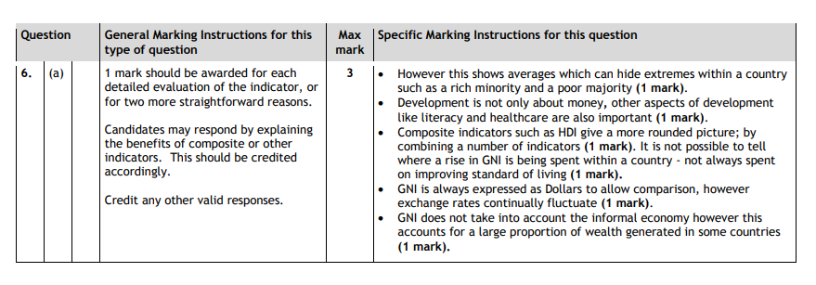
5

