Slide 1
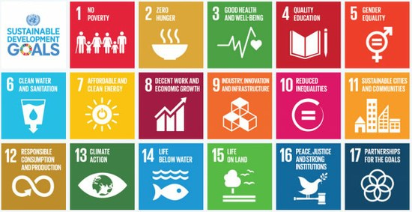
Development and Health Unit

Slide 2
Overview
Global Issues Section (Paper 2 – always comes up).
/20 marks.
What you need to know?
Development Indicators – single, combined, validity of these.
Uneven development between developing countries.
Health – Malaria (causes, impacts, controlling (evaluate)), primary healthcare.

Slide 3
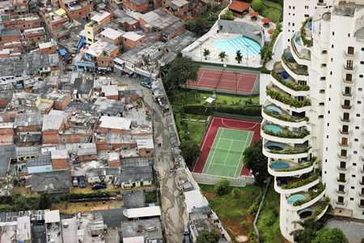
What is Development?

Slide 4
Pyramid Task – What are the 6 most important things for a country to be ‘developed?’

Slide 5
“Development is a process of change over time; it leads to a better quality of life due to economic, social, political and environmental change.”

Slide 6
What is development?
Development is a process of change over time.
Traditionally = viewed as about money (rich = developed, poor = developing).
Modern = not just about money, but about improvements to people’s lives too (living standards, diet, health care, education etc).

Slide 7
Key Terms
MEDC = More economically developed country
Developed country = countries with a high standard of living.
LEDC = Less economically developed country
Developing country = countries with a low standard of living.

Slide 8
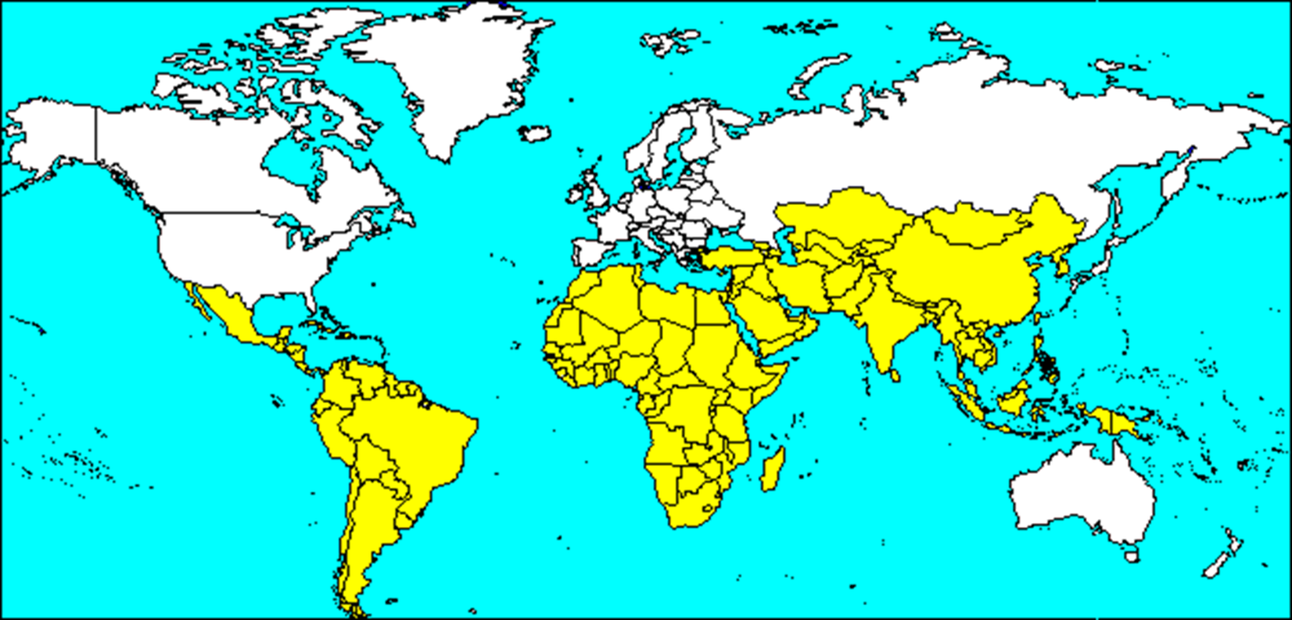
A World of Two Halves?

Slide 9
Carousel Task
A selection of pictures have been placed around the room.
Go around and any words you associate with the picture.
Try to think how it could be the linked to the idea of “development”.

Slide 10
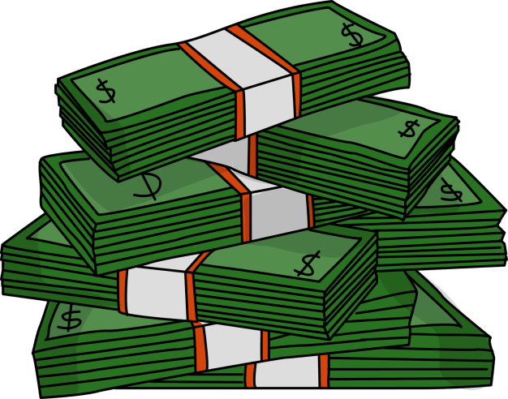
DEVELOPMENT IS MORE THAN JUST MONEY!

Slide 11
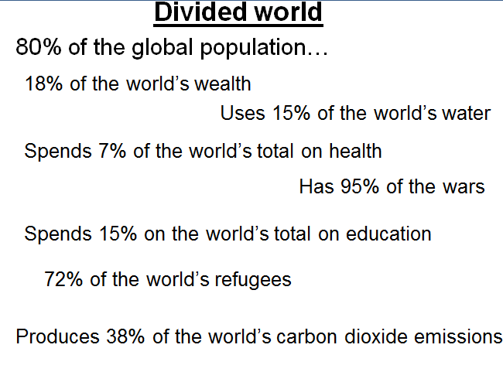

Slide 12
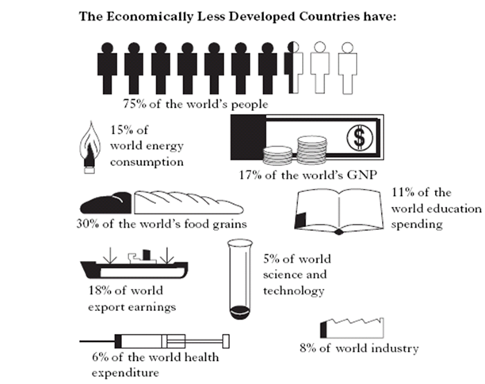

Slide 13
Write down in your jotter at least 10 things you feel is essential to have (couldn’t live without it!).

Slide 14
1 in 5 people in the UK (14 million) live in poverty.

Slide 15
The difference between “wants” and “needs” - UK
https://www.youtube.com/watch?v=T4YcHhqqfCg
https://www.youtube.com/watch?v=40cVFwQ5zwg
https://www.youtube.com/watch?v=VqG1tD5B3MI
https://www.youtube.com/watch?v=fJDhnvuNgEg - Dispactches

Slide 16

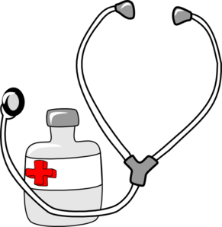






Slide 17

Washing Machine and Development?
https://www.youtube.com/watch?v=6sqnptxlCcw

