Slide 1
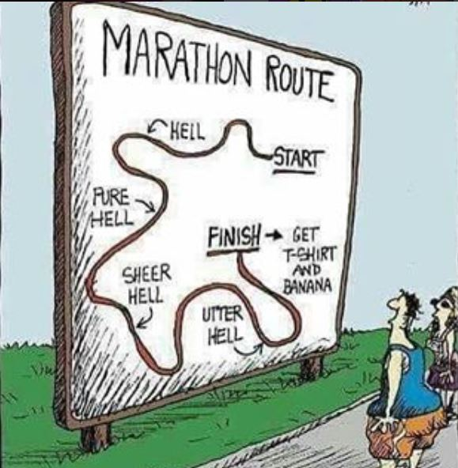
Welcome Back – The Final Push!
Higher Geography
Exam

Slide 2
Soil Recap!! Woooo!!
Three Colors – one for each soil.
Match boxes with correct soil.
NO LOOKING AT JOTTERS – MISTAKES ARE OK!
Once you have done this, use it to help construct an annotated soil profile for each one.

Slide 3
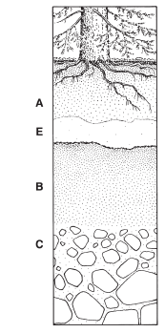
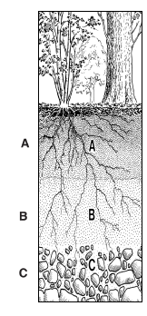
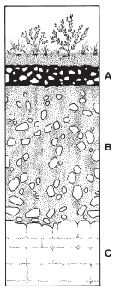
Brown Earth
Podsol
Gley

Slide 4
Ten Minute of Teaching!
One thing I really want to go over again in the next few weeks is....

Slide 5
Homework Questions: Due 21/2/19
Explain how different factors have contributed to the formation and characteristics of a brown earth soil (10).
Explain how different factors have contributed to the formation and characteristics of a gley soil (10).
Draw a fully annotated soil profile of a podzol soil to show its main characteristics (8).

Slide 6


Hydrosphere

Slide 7
What do you need to know?
Hydrological Cycle within a drainage Basin.
Interpretations of hydrographs.
River formations: V Shape Valley, Waterfall, Meander, Oxbow Lake.

Slide 8

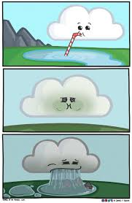
Hydrological Cycle

Slide 9

The earths surface is full of water but where is it all found/stored?
SEAS AND OCEANS
LAKES
RIVERS
71% of the Earth’s surface is water
95.5% of the water is held in the oceans

Slide 10
The Hydrological Cycle
The constant movement (transfer) of water between the sea, land and atmosphere is called the hydrological cycle or water cycle
This involves stages such as precipitation, surface runoff, evaporation, transpiration and condensation.

Slide 11
Tasks
Copy Figure 3.2 (Page 39).
Write a definition for:
Evaporation
Precipitation
Condensation
Surface Run Off
Transpiration
Infiltration
Percolation
Through Flow
Ground Water

Slide 12
Hydrological Cycle from Memory
On your scrap paper, you have five minutes to draw the hydrological cycle from memory. You must label the following:
Evaporation
Precipitation
Condensation
Surface Run Off
Transpiration
Infiltration
Percolation
Through Flow
Ground Water

Slide 13
Tasks
Evaporation = water is heated, water vapour is transferred from land (sea, rivers etc) into atmosphere.
Precipitation = rain/snow that falls from sky.
Condensation = water vapour cools down and condenses (joins together) to form clouds.
Transpiration = water vapour is transferred from leaves of plants into atmosphere.
Surface Run Off = all the water that flows over the surface into water supplies.
Infiltration = movement of water into the ground through soil.
Percolation = “like filtering” = movement of water down through cracks in rocks.
Through Flow = the downward movement of water through the soil towards water supplies (rivers, sea etc).
Ground Water = water which is stored underground (water table, in rocks etc) – eventually reaches surface.

Slide 14
Homework Questions: Due 21/2/19
Explain how different factors have contributed to the formation and characteristics of a brown earth soil (10).
Explain how different factors have contributed to the formation and characteristics of a gley soil (10).
Draw a fully annotated soil profile of a podzol soil to show its main characteristics (8).

Slide 15
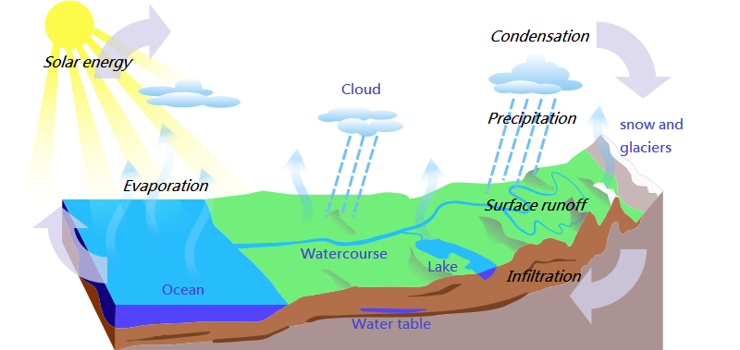

Slide 16
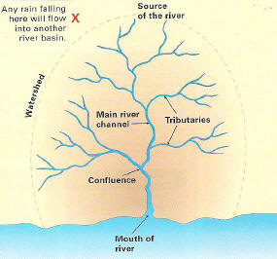
Drainage Basins

Slide 17
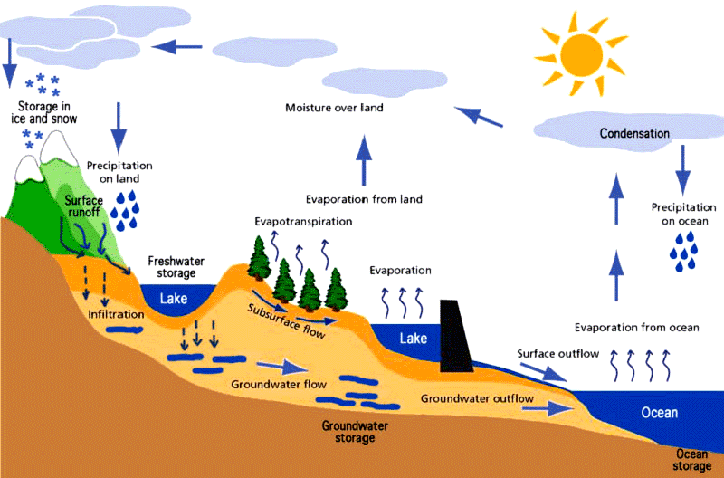
River basins
Rivers start in upland areas and flow downhill across the land, ending in lakes or at the sea.
.
A drainage basin forms part of the hydrological cycle as water is transferred in a continuous cycle from the land to the sea to the atmosphere

Slide 18
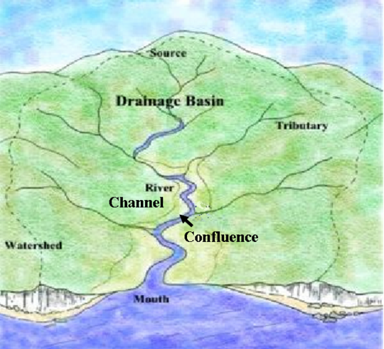
Drainage basin
A drainage basin is the area into which water will flow.
Each river system will have its own drainage basin.
Drainage basins are separated by watersheds.

Slide 19
Source – where the river starts
Tributary – is a small stream that flows into a bigger one
Watershed – the boundary of the drainage basin
Confluence – where a small rivers joins a larger one
Mouth – where the river ends

Slide 20
Inputs
Storage
Transfers
Outputs

Slide 21
Drainage basin - inputs
A drainage basin has inputs, storage, transfers and outputs.
The main input is precipitation
mainly in the form of rain and snow.
The type, strength and rate of occurrence all have an impact on the amount of water in the system – open system.

Slide 22
Drainage basin - storage
Storage is the moisture kept in the system. This can be found in the soil, in lochs, ice caps, glaciers and on the leaves and roots of vegetation.
Water seeps into the ground by the processes of percolation and infiltration, and is stored in the soil or in the water table.

Slide 23
Drainage basin - transfers
Transfers is the movement of the water through the system – air, clouds and water.
Movement of clouds bearing moisture by process of advection.
Overland flow is the movement above land in rivers. Surface Run off causes water to flow into these rivers.
Through flow (infiltration and percolation) is the movement through soil which will lead to rivers/seas/oceans.
Groundwater flow is the very slow movement of the water along the water table which leads to rivers/seas/oceans.

Slide 24
Drainage basin - outputs
Outputs is the moisture which leaves the system by processes such as evaporation, evapotranspiration and through water flowing into the seas and oceans

Slide 25
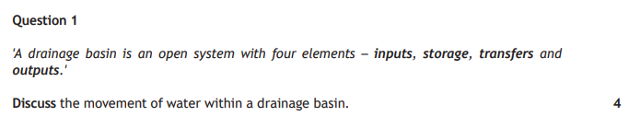
Practice Question (2018 past paper)
6

Slide 26
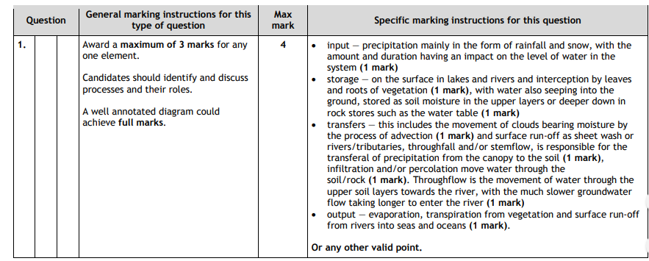

Slide 27
Hydrological Cycle from Memory
On your scrap paper, you have five minutes to draw the hydrological cycle from memory. You must label the following:
Evaporation
Precipitation
Condensation
Surface Run Off
Transpiration
Infiltration
Percolation
Through Flow
Ground Water

Slide 28
Mr Smith’s Water Cycle Game!!
Rules
Everyone starts with 100 water droplets, keep a tally of how many you are losing or gaining in the game.
Two winners: one who reaches ocean first and ocean has most water droplets left.
If you end up with 0 water droplets left then you need to roll a 6 – this will make precipitation occur and reward you with 20 water droplets.
Think about why you are losing water droplets?
What do letters mean?
S = Storage = lose 50 water droplets as they are stored in nearby lakes.
I = Infiltration = some of your water droplets have decided to go underground – lose 10 water droplets (stored in soil and rocks) and miss a turn as it is slower to get to the ocean.
SR = Surface Run Off = Overland flow is quick! Move forward 2 spaces!
ET = Evapotransipiration = 5 of your water droplets are heated and begin to rise – lose these 5. HOWEVER, roll the dice, if it is a even number then it rains and you gain 10.
Pr = Precipitation = More of this falls – add 5 water droplets.
P = Pick up a physical factor card.
H = Pick up a human factor card.

Slide 29

I see what you are saying – but is there anything that can affect this hydrological cycle?

Slide 30
Physical factors affecting the
hydrological cycle

Slide 31
Relief
Vegetation
Drainage basin
Physical factors affecting the hydrological cycle
Rock type
Climate
Drainage density
Soil type

Slide 32

WHY DO YOU THINK????

Slide 33
Vegetation
The amount and type of vegetation is very important.
The less vegetation, the less interception that will take place and more surface/ground water there will be.

Slide 34
Drainage basin
The size of the drainage basin is another factor.
The smaller the drainage basin, the faster the water will be able to pass through it.

Slide 35
Climate – level of precipitation
Prolonged rainfall – the ground becomes saturated and infiltration becomes replaced by surface runoff
Intense storms – heavy rainfall in areas of hard surfaces, can lead to surface runoff
Snowfall – water held in storage. Rise in temperatures leads to rapid melting and it the ground is frozen, infiltration is impeded.
Rate of evapotranspiration determines the amount of water lost from the system

Slide 36
Soil type
This controls the speed of infiltration, the amount of storage and the rate of through flow.
Sandy soils = less flooding as they absorb water
Clay soils = more flooding as they can’t store the water

Slide 37
Rock type
Permeable rocks – water will pass through it
Porous rocks – contain pores that fill with and store water e.g. sandstone and chalk
Pervious rocks – water passes through it flowing along joint and cracks. Less surface runoff as a result e.g. limestone
Impermeable rocks – water can’t percolate through it therefore surface runoff happens e.g. granite

Slide 38
Relief
The steeper the land, the faster the water will reach the river channel and become a part of the surface runoff

Slide 39
Human Activities Impacting Hydrological Cycle

Slide 40
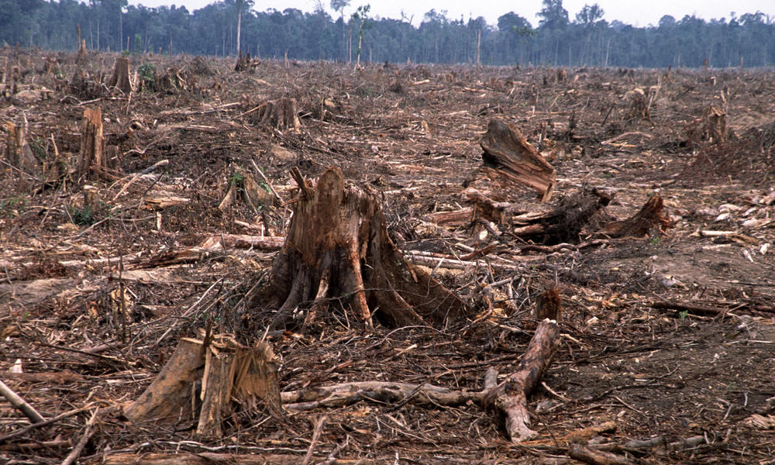
Deforestation

Slide 41
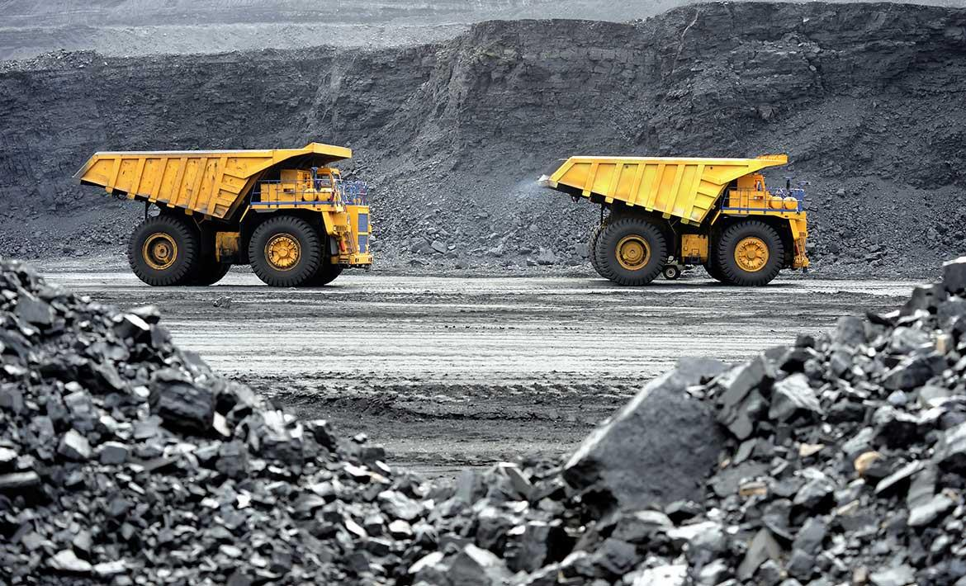
Mining

Slide 42
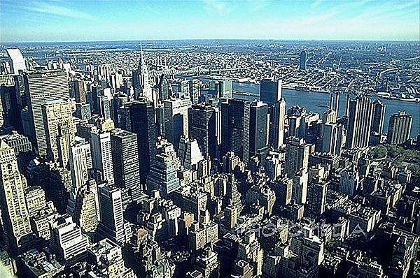
Urbanisation

Slide 43
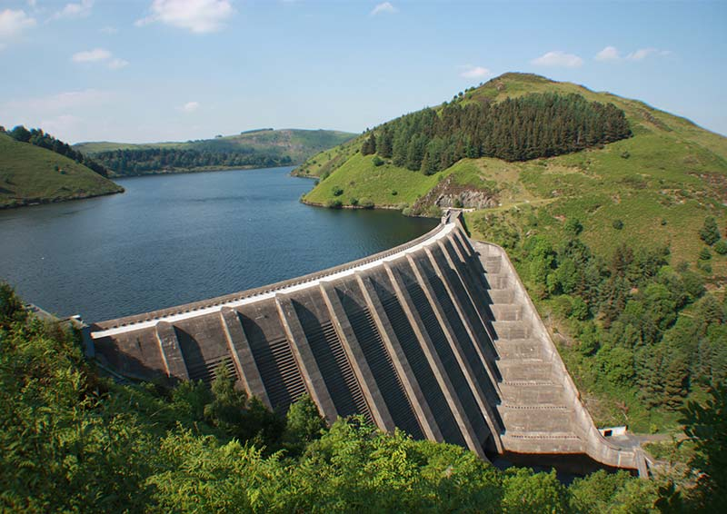
Reservoirs/Dams

Slide 44
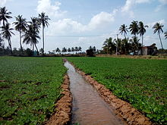
Irrigation

Slide 45
Human factors affecting the
hydrological cycle

Slide 46
Forestry
Increases interception therefore less surface water

Slide 47
Urbanisation
The removal of natural vegetation to be replaced with impermeable surfaces such as concrete and drains can speed up overland flow and can lead to higher river levels – less infiltration and more surface runoff.
It can also decrease the amount of water returning to ground water storage, possibly reducing the water table – again due to less infiltration.

Slide 48
Mining
This might lead to a reduction in vegetation cover leading to increased runoff. Lakes, rivers and reservoirs may become silted up, leading to reduced storage capacity in these areas.

Slide 49
Deforestation
The cutting down of trees increases runoff, decreases evaporation and leads to extreme river flows as water in not intercepted and stored by trees.

Slide 50
Reservoirs/dam building
Interring with the natural path of water can change the cycle quite dramatically. Building dams and reservoirs means less water is going underground and therefore stored underground. More surface water means increased evaporation and cloud forming, which may ultimately affect rainfall patterns.

Slide 51
Irrigation
Taking water from a river or underground store can reduce the rive flow, lower water tables and increase evaporation by placing water in surface stores or by crops removing water from the cycle as they grow.

Slide 52
Practice Question
Explain the human and physical factors that may affect the hydrological cycle. (10)

