Slide 1
Cover Work
New topic = Rural Land Degradation
Title for lesson = Desertification in Sahel.
Using booklets , write down what is meant by the term “desertification”.
Using atlas, stick in map and write down the different Sahel countries.
Create a climate graph for the Sahel region.
Using booklets, make two lists (physical and human) and explain the causes of desertification.

Slide 2
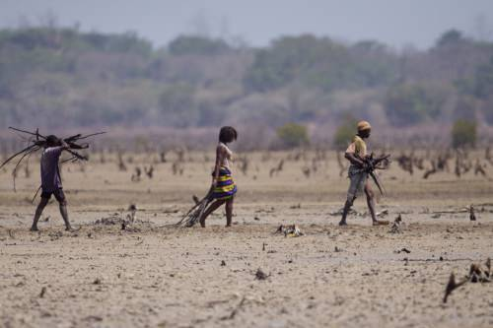

Slide 3
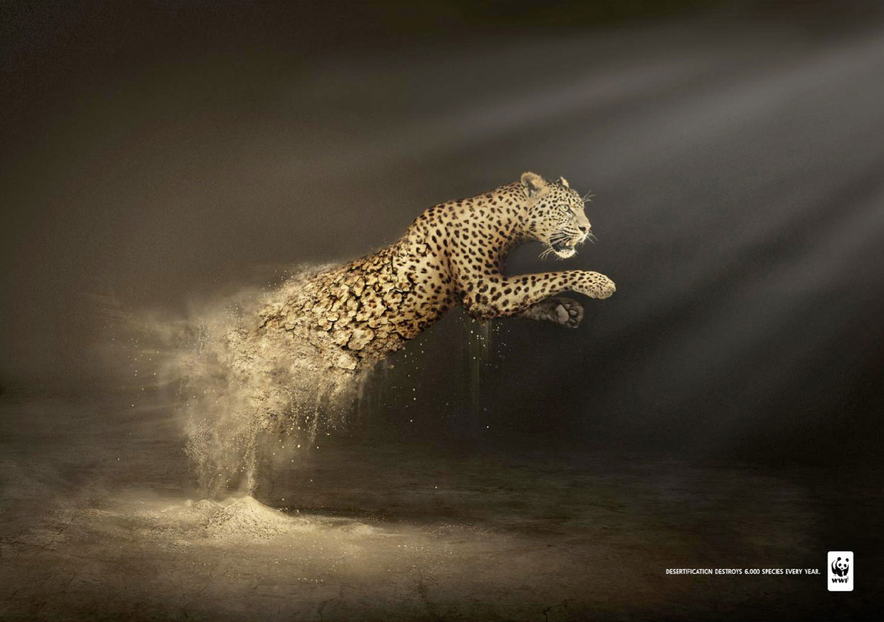

Slide 4
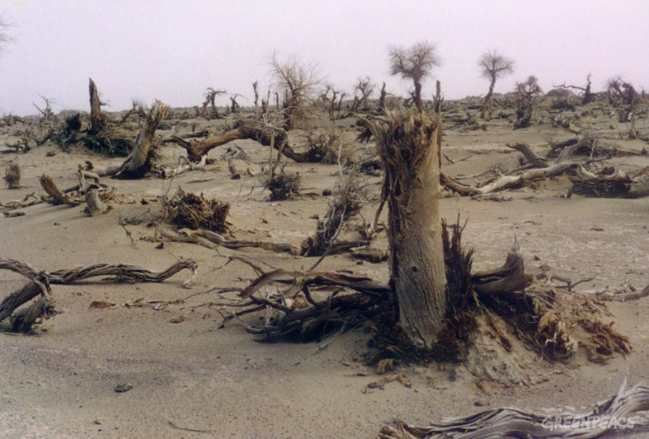

Slide 5
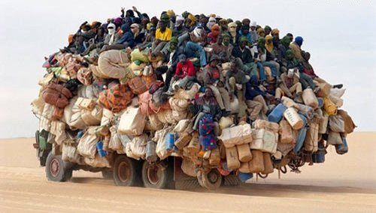

Slide 6
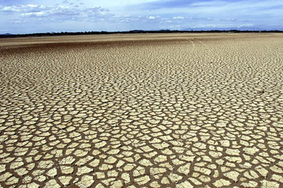

Slide 7
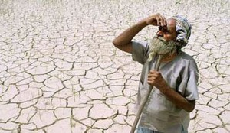

Slide 8
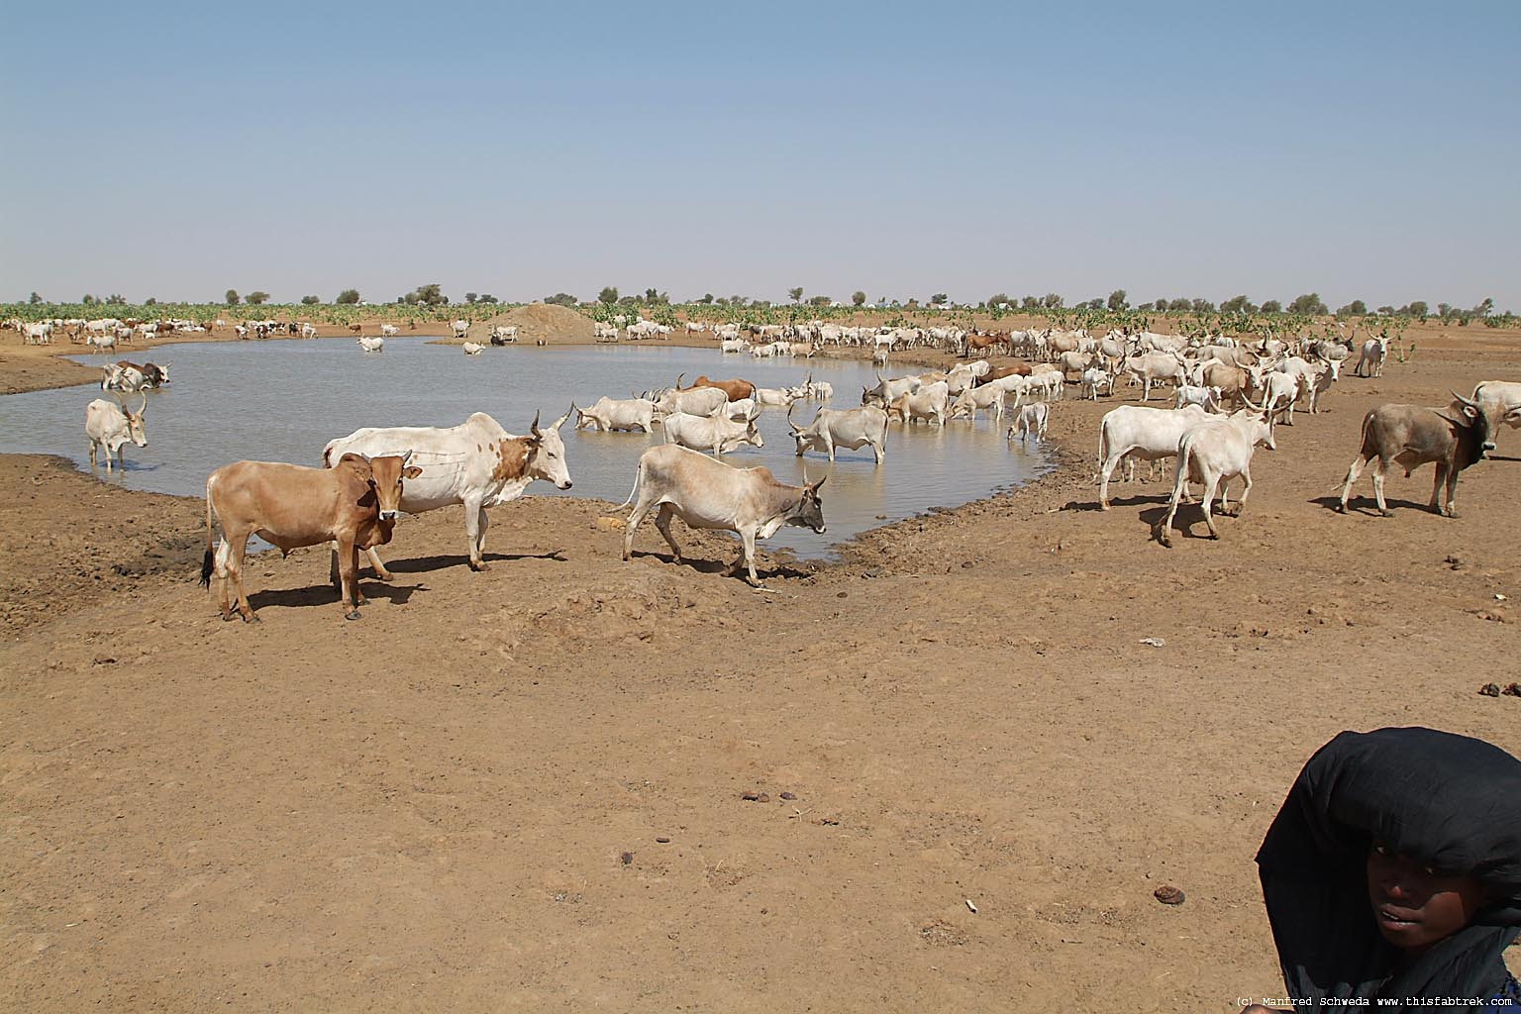

Slide 9
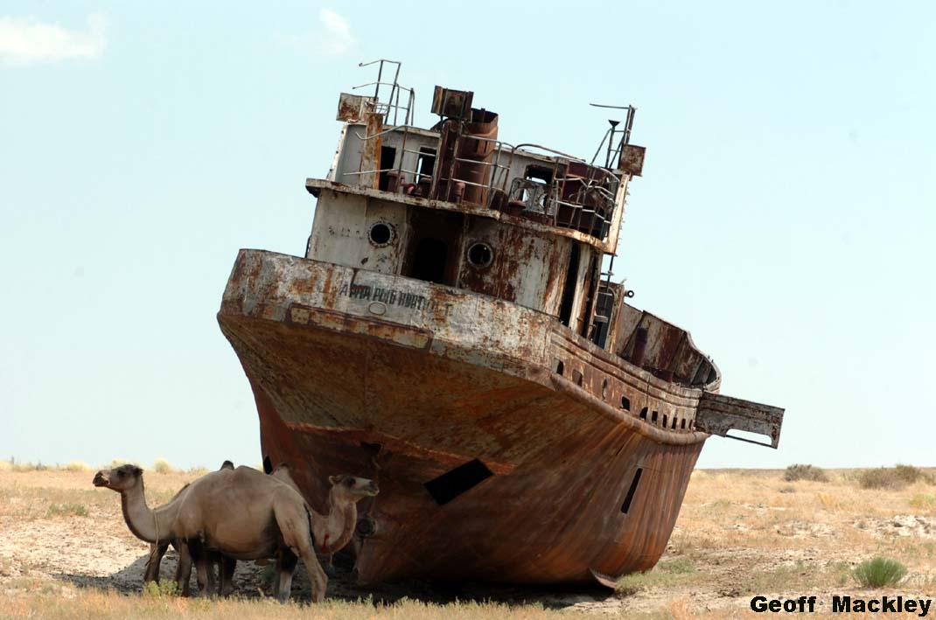

Slide 10
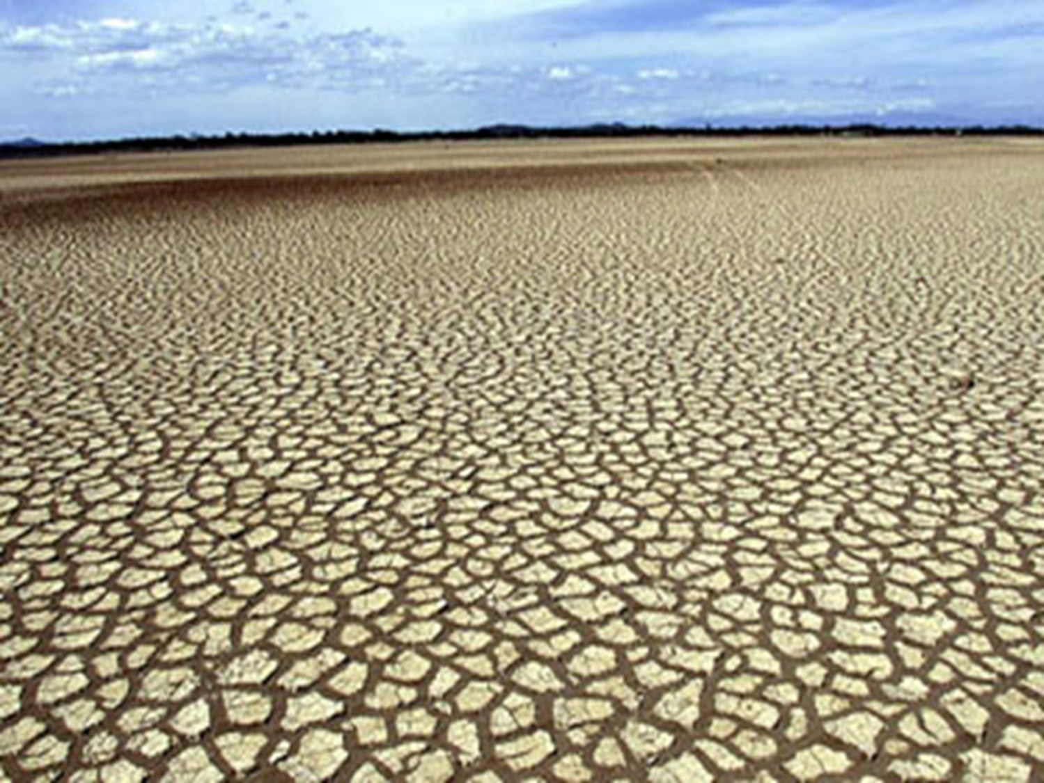
Desertification

Slide 11
What you need to know?
To understand what is meant by the term desertification.
To explain impacts of desertification in the Sahel.
To explain ways of managing desertification and evaluate their effectiveness.

Slide 12
What is desertification?
The process by which fertile land begins to turn into desert.
Nearly one fifth of worlds land is threatened by desertification.

Slide 13
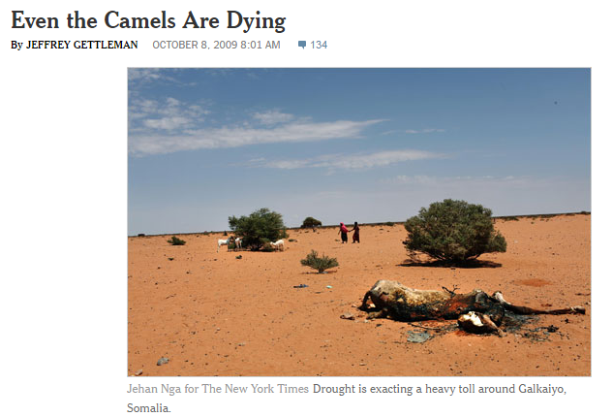
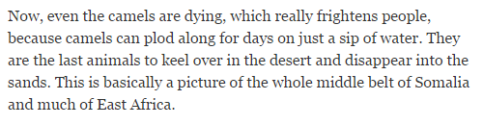

Slide 14
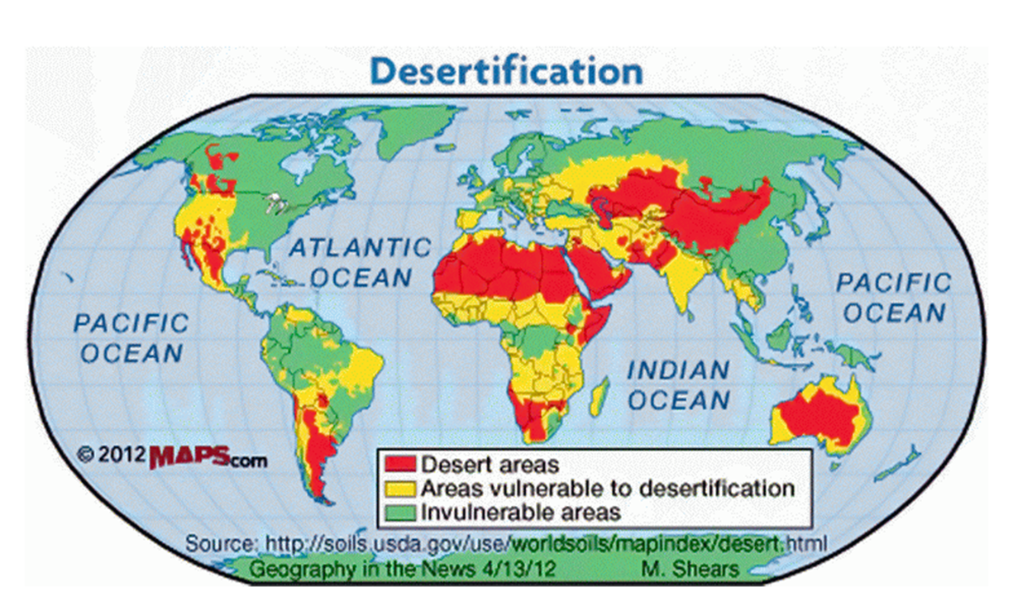

Slide 15
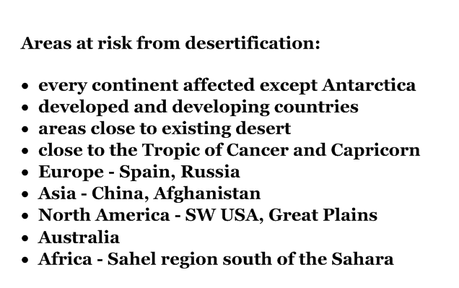

Slide 16
The Sahel
The Sahel is a region which runs across the north of Africa.
Due to a number of reasons such as droughts and overgrazing, desertification is happening majorly across this region.

Slide 17
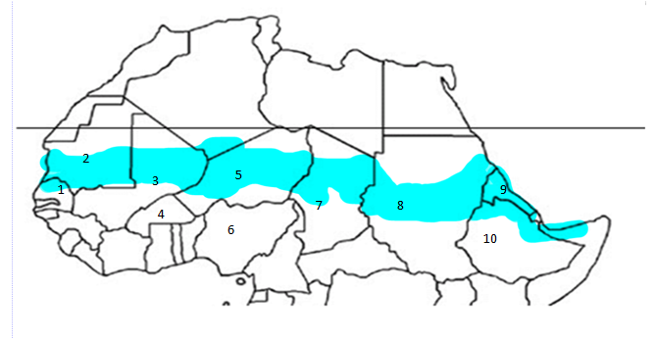
Senegal 5. Niger 9.Eritrea
Mauritania 6.Nigeria 10.Ethiopia
Mali 7. Chad
Burkina Faso 8. Sudan

Slide 18
Soil…..
Soil is very fragile and needs careful management. It takes about 200 to 1000 years for a 2.5 cm thick layer of fertile soil to be formed.
Desertification is causing the removal of the layer of top soil (the important bit!).

Slide 19
How can soil be eroded?
Water Erosion
Gully erosion
Sheet erosion
Rill erosion
Rain splash
Wind Erosion
Suspension
Saltation
Surface Creep

Slide 20
Knowledge Checker – Syria → Europe Migration

Slide 21
Syria → Europe Migration
2 reasons why they are leaving Syria for Europe.
2 Advantages to the Host
2 Disadvantages to the Host
2 Advantages to the Donor
2 Disadvantage to Donor

Slide 22

Causes of Desertificaiton

Slide 23
Main Causes of Desertification
4 main factors in desertification occurring:
Climate Change
Over grazing
Over cultivation
Trees used for fuel and shelter

Slide 24
Climate in the Sahel
The Sahel is characterised by strong climatic varitations and an irregular rainfall that ranges between 200 mm and 600 mm per year.
Temperatures in Sahel have changed faster than global trend – increasing from between 0.2oC to 0.8 degrees Celsius since late 1970s

Slide 25

Video Clip!

Slide 26
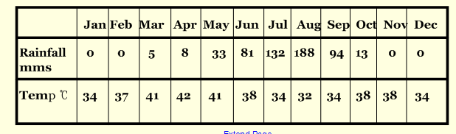
Climate Graph Sahel
Bar = Rain, Line = temperature.

Slide 27
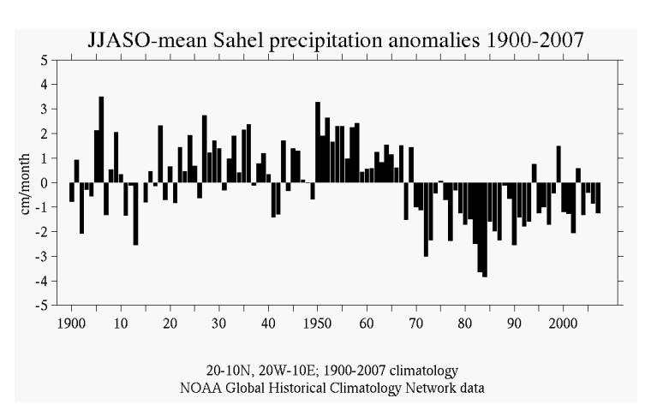
Above average rainfall
Below average rainfall

Slide 28
Climate Change Effects
climate change - temperatures in Sahel increasing faster than global trend (0.20 to 0.80 C per decade since the 1970s)
high temps in Sahel - over 30o throughout year
increased evaporation rates, soil dries out and can get blown away
heavy rain (distinct wet season) - washes away the dried out soil
reduction in mean annual rainfall in second half of 20th century
long periods of drought in the 1940s, 70s and 80s
heavy rains and floods in the first decade of 21st century

Slide 29
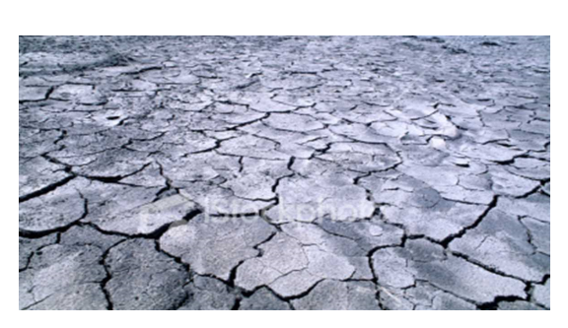
Drought
A long period without rainfall, causes crops/water holes to die/dry up, lack of food, may have to move to find food.

Slide 30
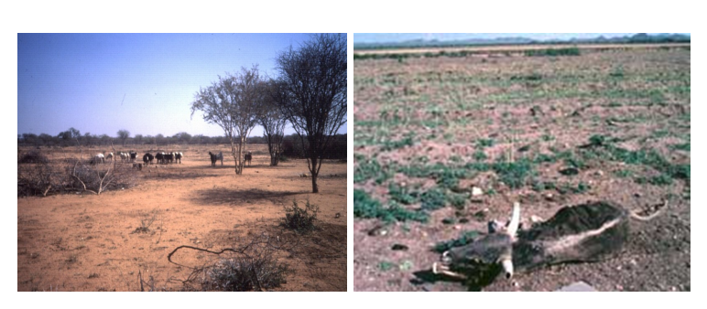
Overgrazing
Too many animals grazing on the land, animals eat all the vegetation, vegetation fails to grow, soil is exposed to rain and wind, soil is washed or blown away.

Slide 31
Overcultivation
Many crops being grown on the land year after year, no rotation of crops, crops take all the nutrients from the soil, the soil becomes infertile and nothing can grow. Because there are no crops to protect the soil the soil is again easily eroded by the wind and rain.

Slide 32
Removal of trees for fuel and shelter
There are few trees in the desert and their roots hold the soil together. When the trees are removed for firewood or to build shelter the roots die and the soil becomes loose. Yet again this means the soil can be easily blown or washed away.

Slide 33
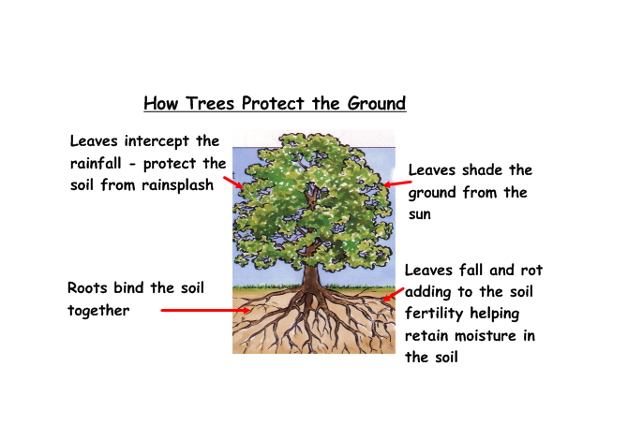

Slide 34
Causes Flow Chart

Slide 35
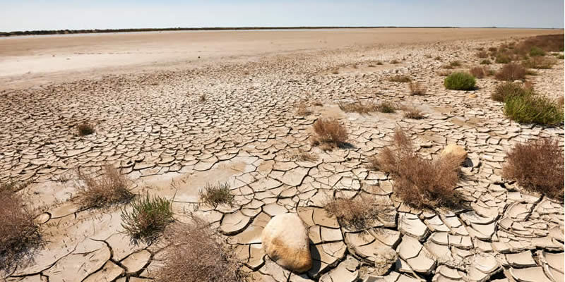
Effects of Desertification

Slide 36
What are we looking for?
We you are basically asking yourself is – when the land becomes unusable – what does this mean to the people and environment?
Write an effect on your post it note.
https://www.bbc.com/bitesize/guides/z9rbb9q/revision/4

Slide 37
Effects Task
Read the booklet and write down as many effects of desertification as you can.
Try and include examples/stats – highlight these.
You will need at least 8 reasons.

Slide 38
Effects of Desertification

Slide 39
Practice Question
For a semi-arid area you have studied, explain the effects of rural land degradation on the people and environment. (8)

Slide 40
